Slide 1
CENG315 PHARMACY DATABASE SYSTEM
Prepared by:
Rumeysa Coşkun
Eren Demirel
Gökay Gülsoy
Münir Tolga Ak
Berkan Gönülsever

Slide 2
Aim of the Project
The aim of this project is to keep all information in the database from the production of the drugs to the sale to the patient.
We designed this database to provide ease of use, keep detailed data about actors such as doctors, patients, employees of the pharmacy, manufacturers; and automate the process.
The users of the system are pharmacists.

Slide 3
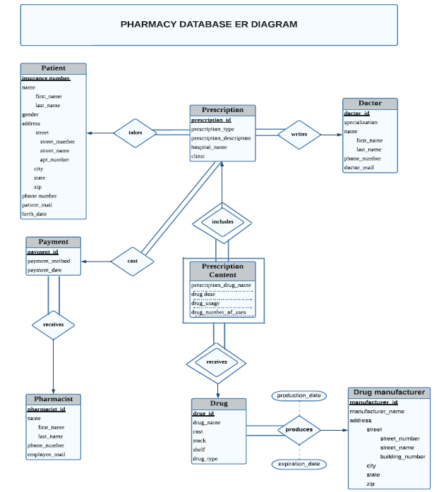

Slide 4
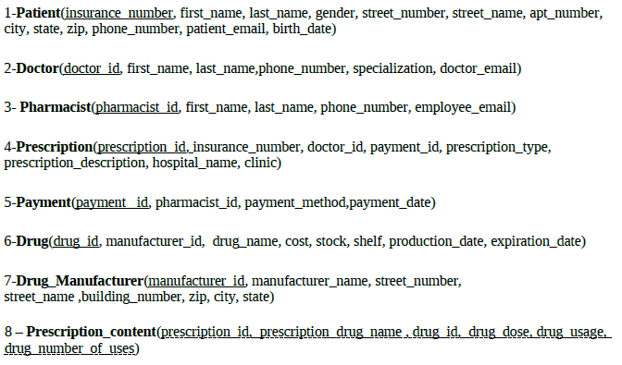
Relational Schema

Slide 5
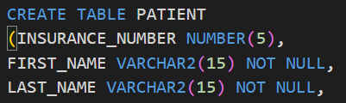
Constraints
NOT NULL constraints are added to all the necessary fields.
PRIMARY KEY and FOREIGN KEY constraints are also added to all primary and foreign key fields.

Slide 6

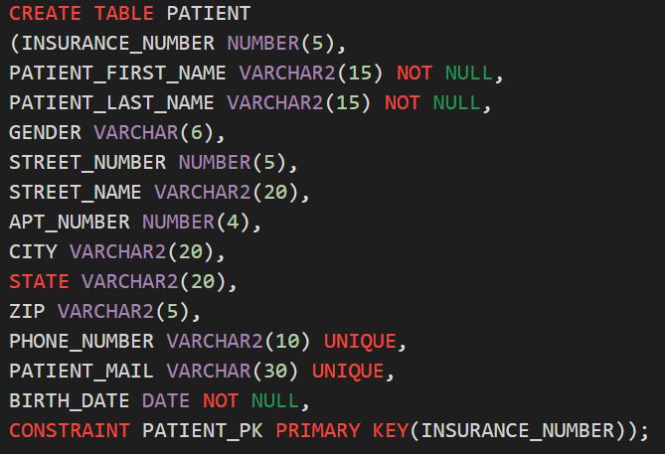

Slide 7
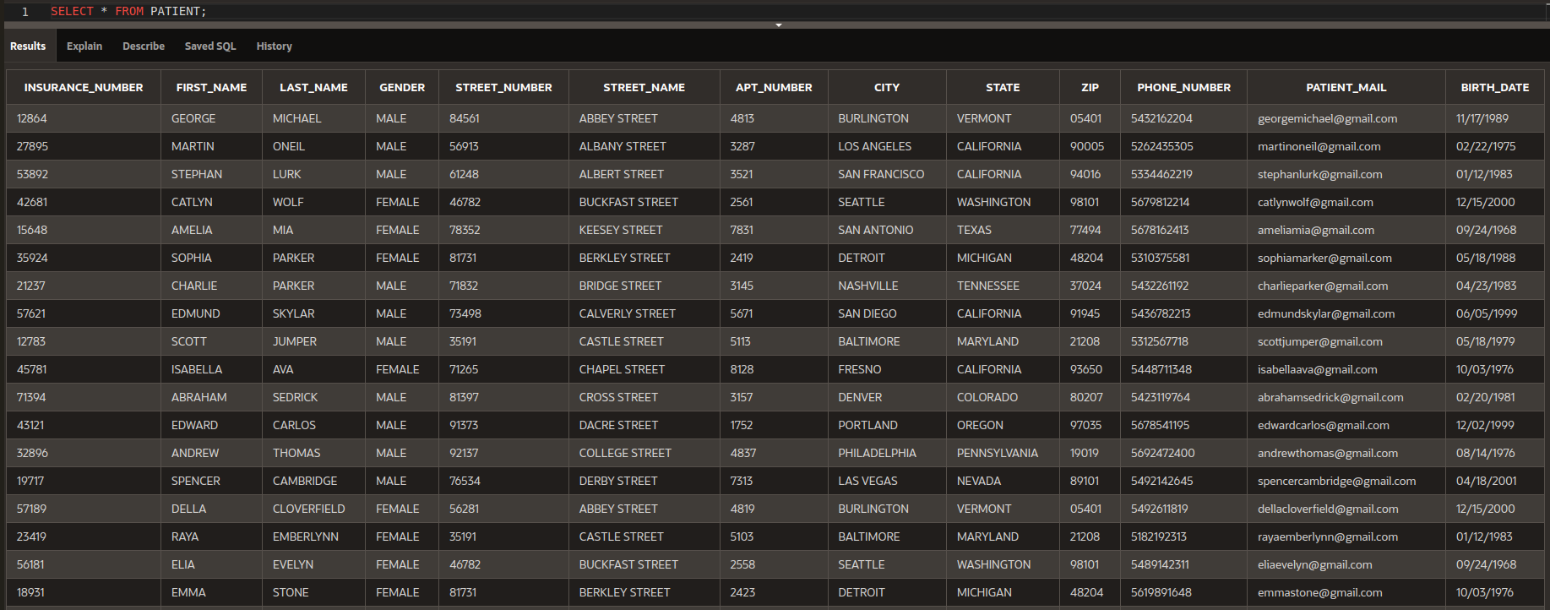
PATIENT

Slide 8
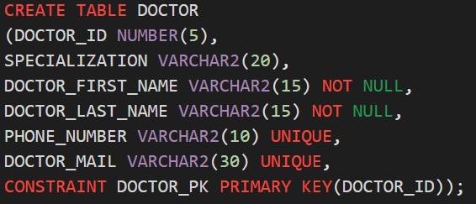

Slide 9
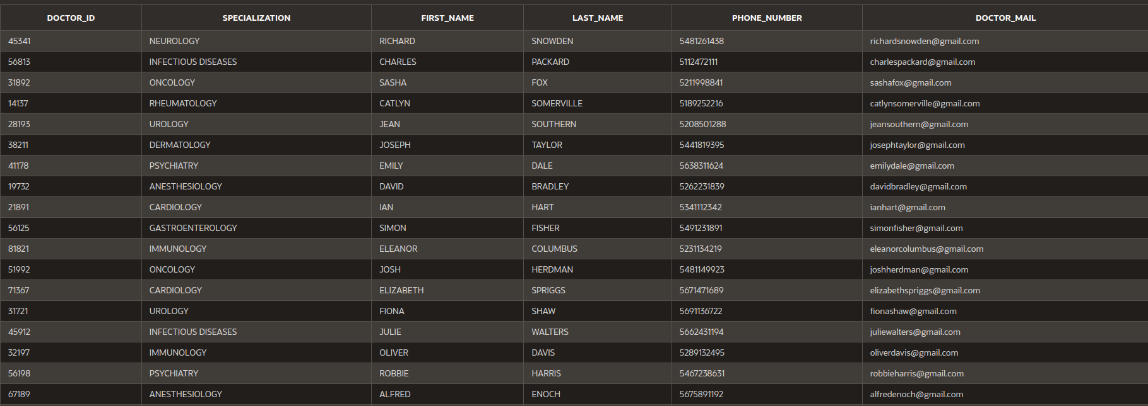
DOCTOR

Slide 10
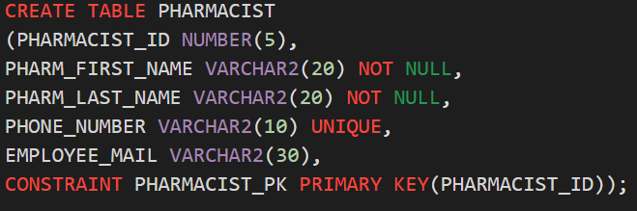
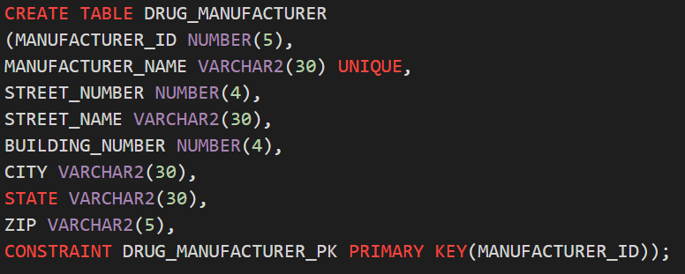

Slide 11
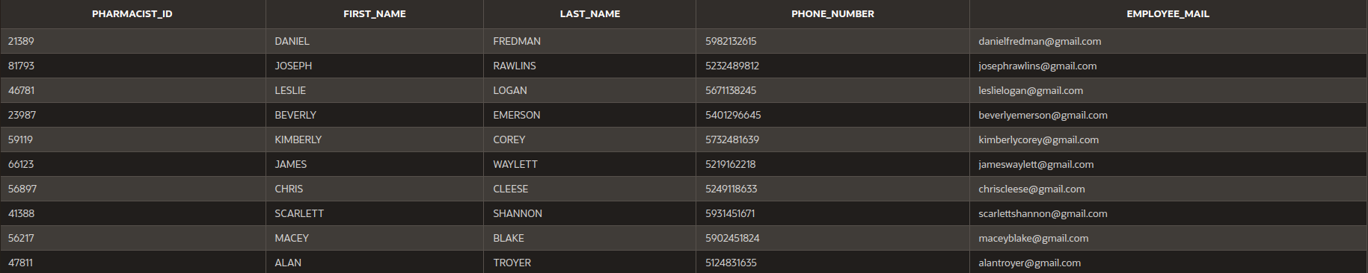
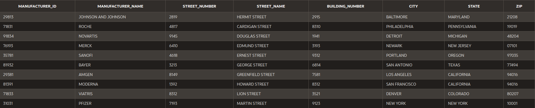
PHARMACIST
DRUG_MANUFACTURER

Slide 12
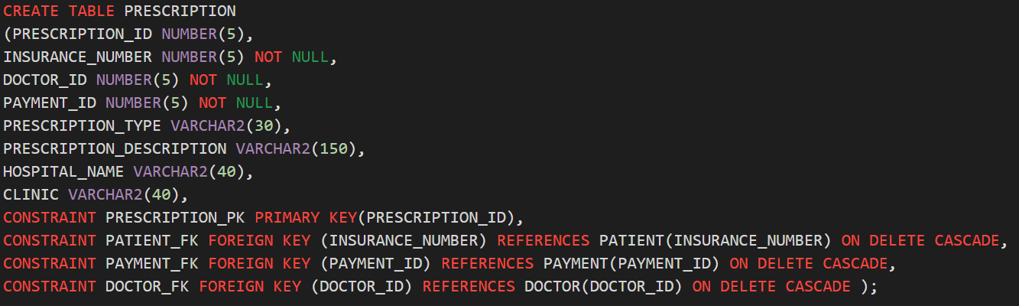

Slide 13
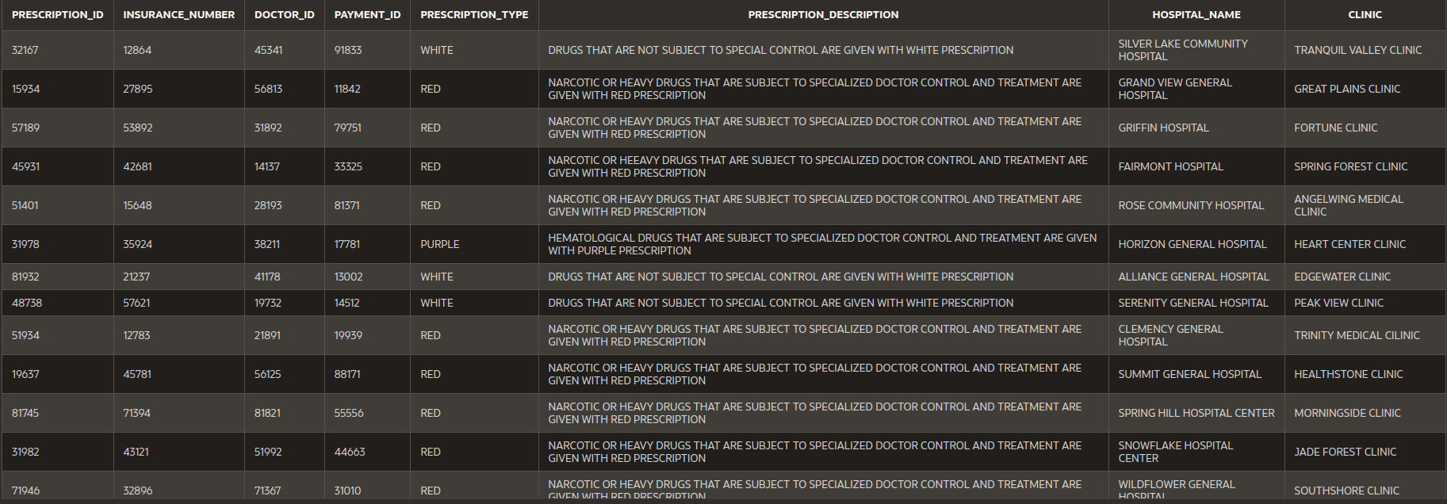
PRESCRIPTION

Slide 14
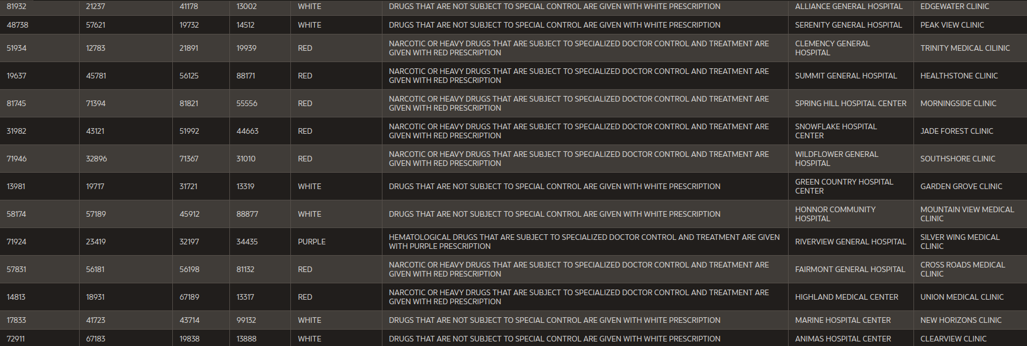
PRESCRIPTION (continued)

Slide 15
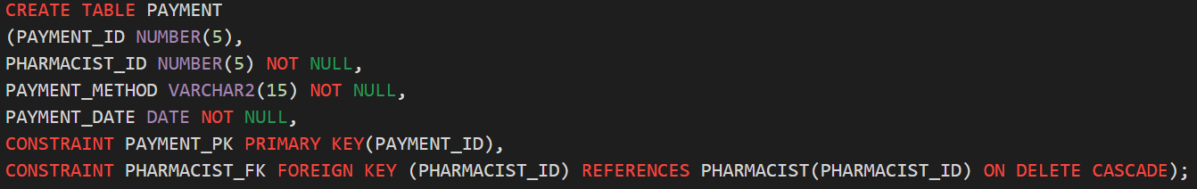

Slide 16
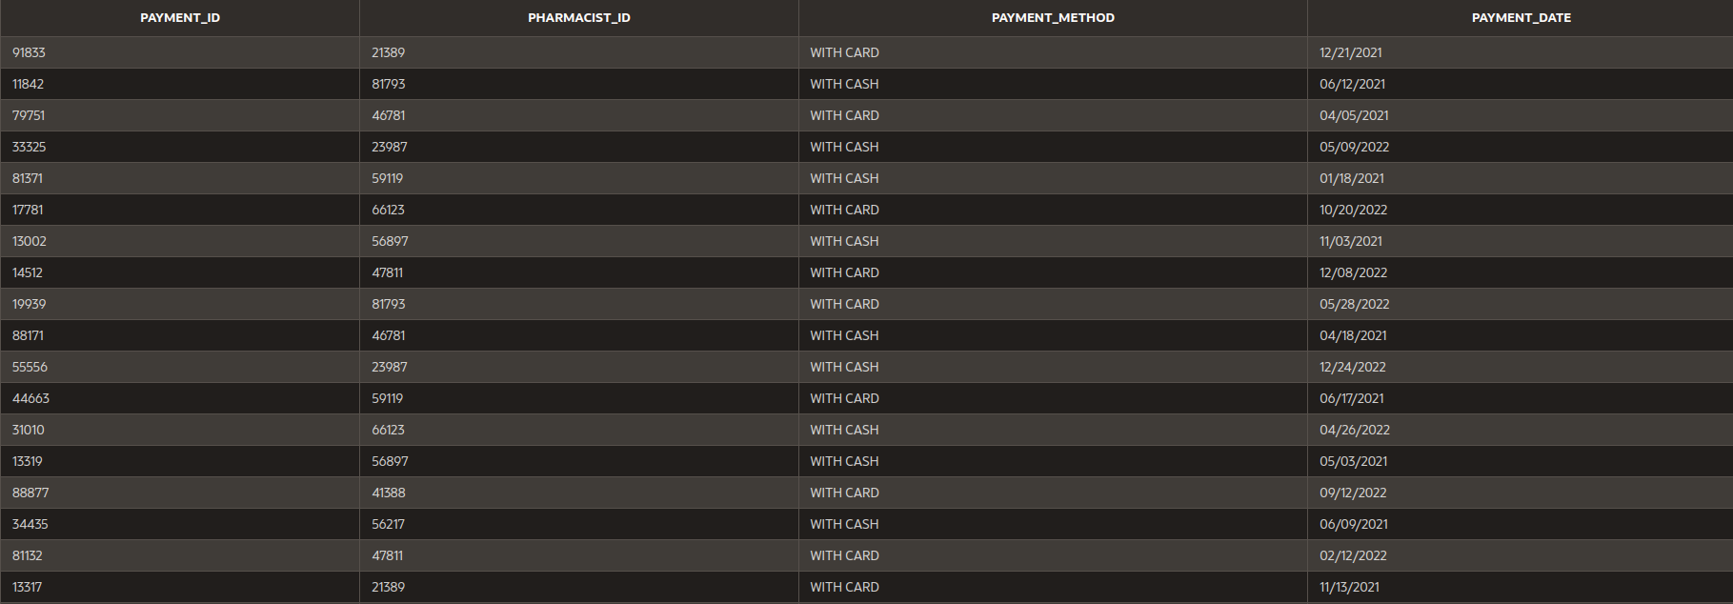
PAYMENT

Slide 17
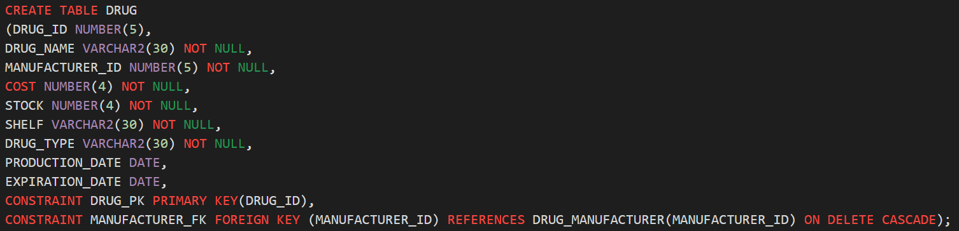

Slide 18
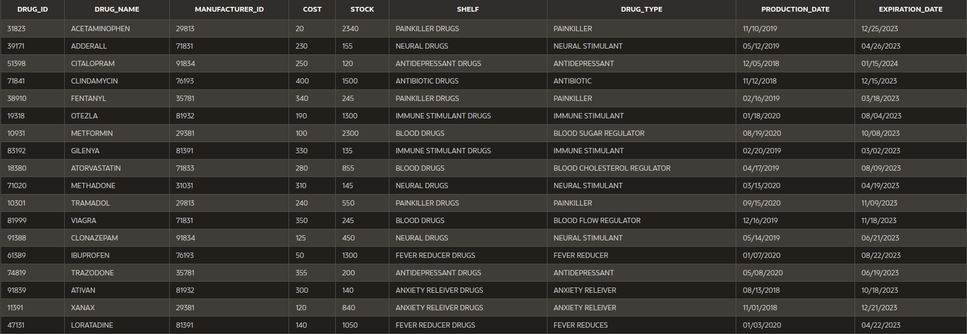
DRUG

Slide 19
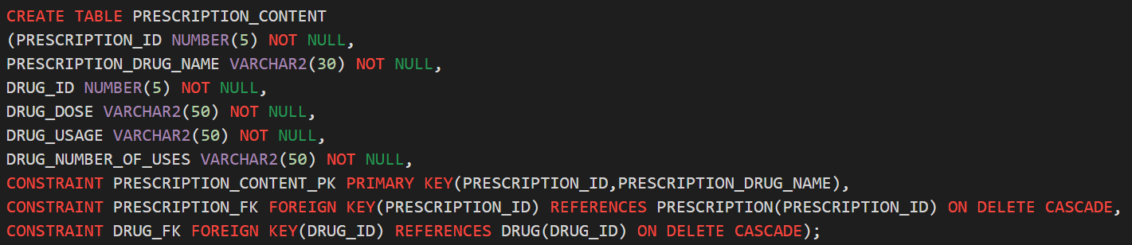

Slide 20
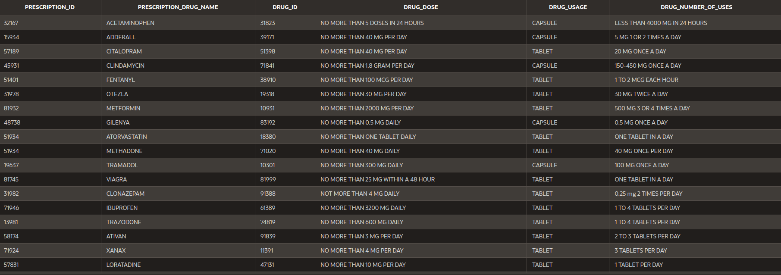
PRESCRIPTION_CONTENT

Slide 21
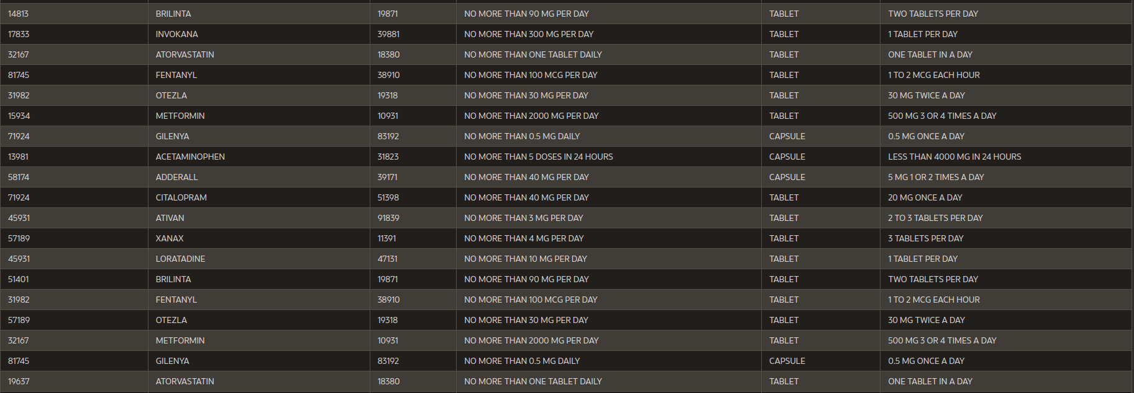
PRESCRIPTION_CONTENT (2)

Slide 22
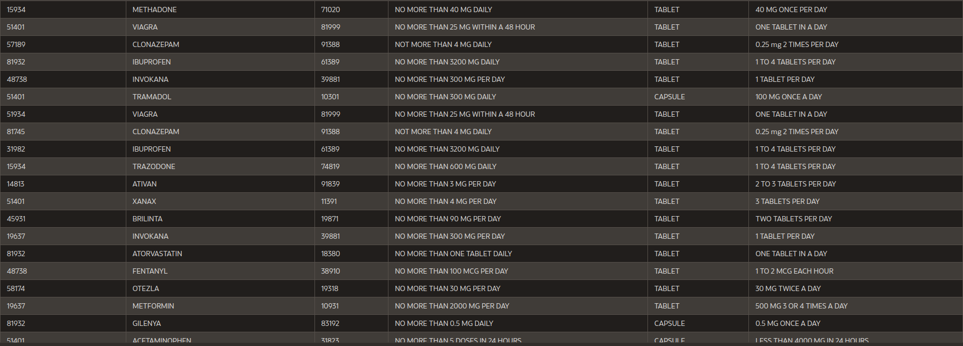
PRESCRIPTION_CONTENT (3)

Slide 23
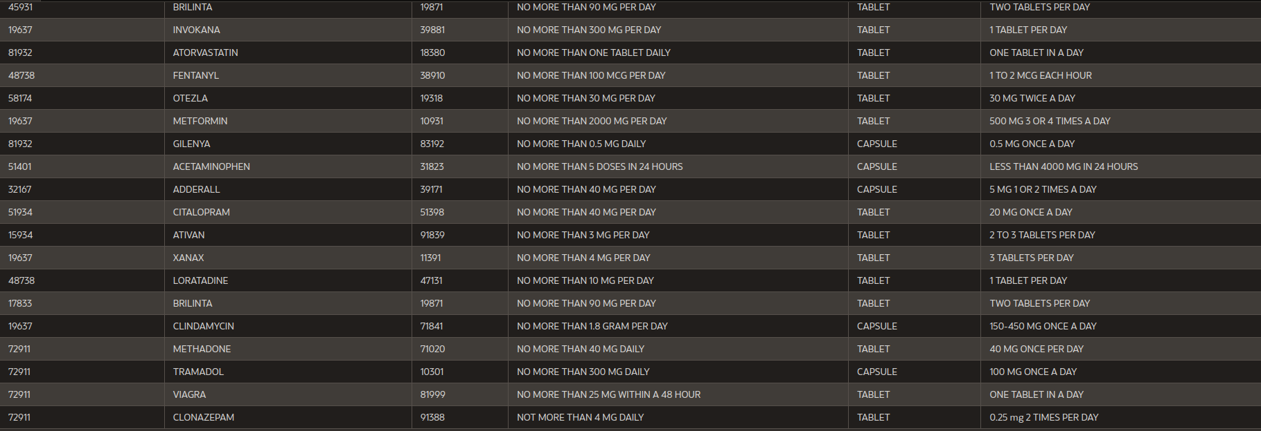
PRESCRIPTION_CONTENT (4)

Slide 24
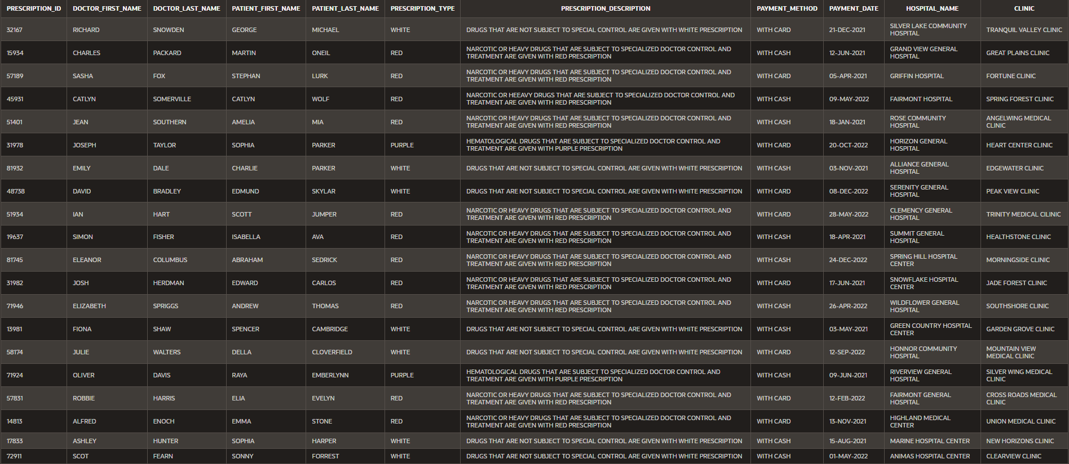
Some Fundamental Queries…

Slide 25
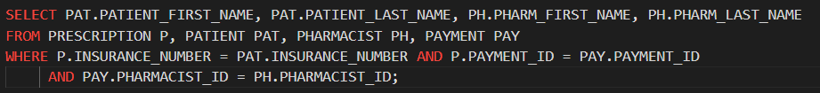
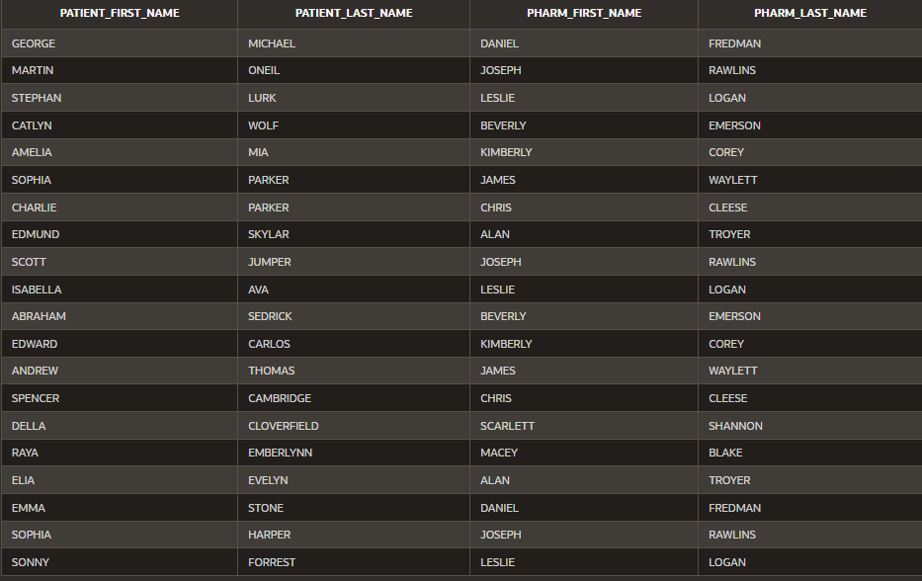
…

Slide 26
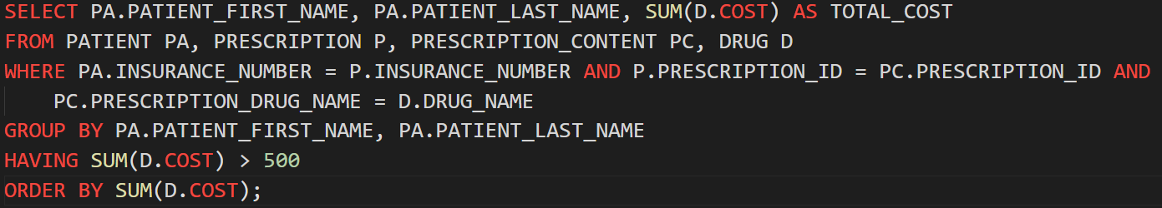
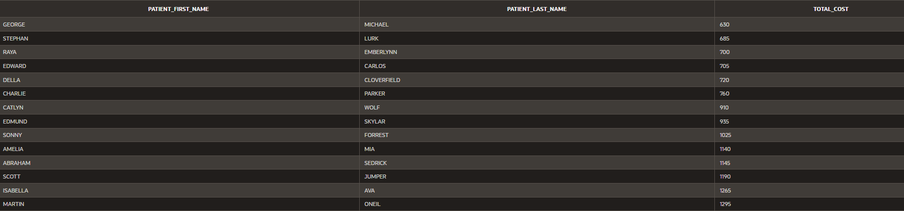

Slide 27
