Slide 1

Fantastically Ordered Prompts and Where to Find Them: Overcoming Few-Shot Prompt Order Sensitivity Ilaha Karimli - 300201111
Date: 30/11/2025

Slide 2
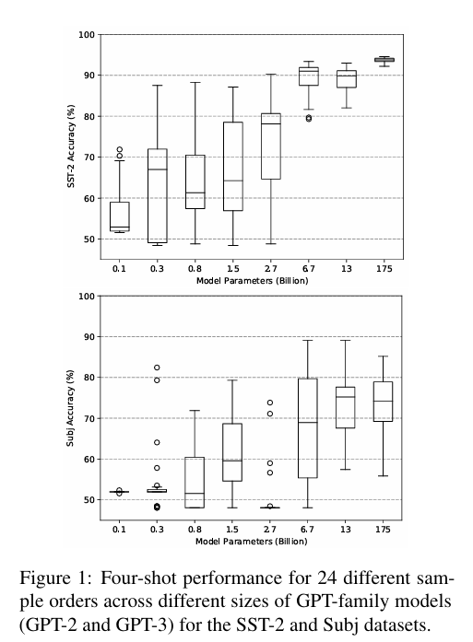
Introduction
In-Context Learning & Problem Definition
LLM s can perform well with only a few examples.
This approach is called In-Context Learning (ICL).
An ICL prompt is built from a template + ordering of examples.
Prior work shows that template design strongly affects performance.
New Findings (Core Contribution)
The order of examples affects performance as much as the template.
Order sensitivity is:
Present across all model sizes
Independent of task
Reduced but not removed by scaling
What We Already Know

Slide 3
Introduction
Depth of the Problem
No shared pattern among high-performing orders.
Use the generative ability of LMs to create an artificial, unlabeled dev set.
Outcome
Method yields ~13% relative improvement across GPT-family models.
Proposed Method
In true few-shot settings, no validation set exists → choosing permutations is difficult.
Works across model scales and 11 different classification tasks
Evaluate using entropy-based metrics.
Select the highest-scoring permutations automatically.

Slide 4
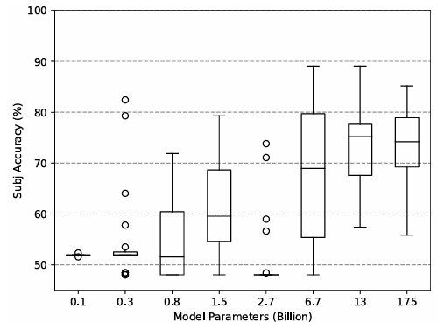
Order Sensitivity
Increasing model size does not guarantee low variance
Larger models don’t eliminate variance.
Order sensitivity persists across all sizes (GPT-2 → GPT-3).
Same examples, different orders → large accuracy shifts.
Bigger models improve accuracy but variance stays high.
Even near-perfect prompts can drop to random performance with reordering.

Slide 5
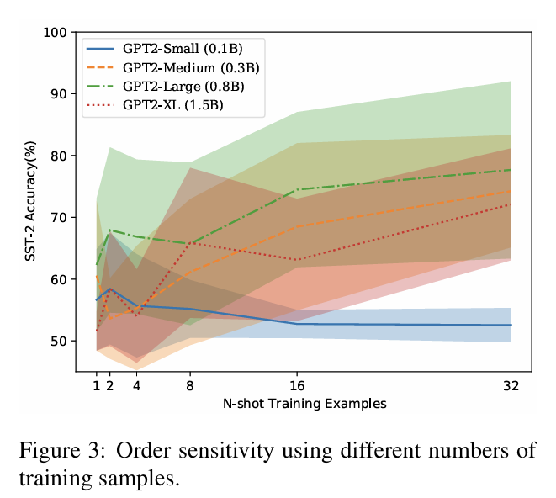
Order Sensitivity
Adding training samples does not significantly reduce variance
More examples → slightly better accuracy
But variance remains and sometimes increases
Increasing data alone does not stabilize model behavior

Slide 6
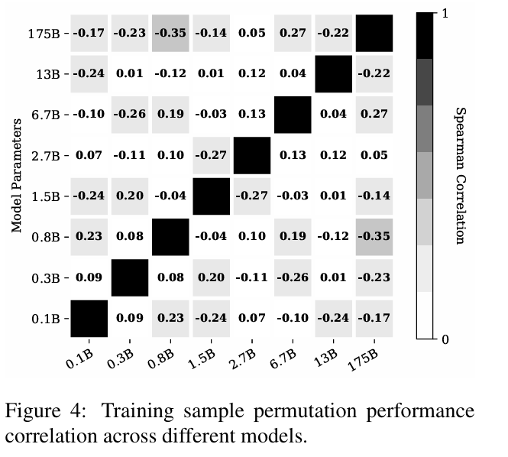
Order Sensitivity
Performant prompts are not transferable across models
Prompt effectiveness is model-specific
A good permutation in GPT2-XL can become poor in GPT2-Large
Cross-model Spearman correlations are extremely low
No universal “good ordering” exists across model sizes

Slide 7
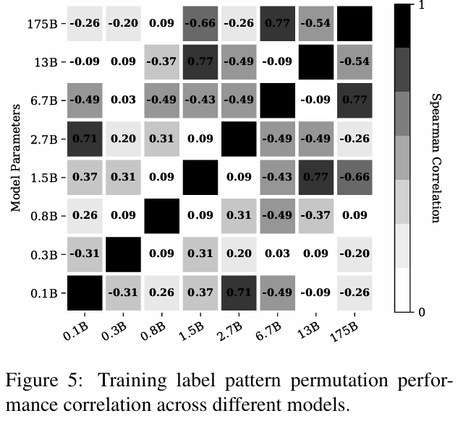
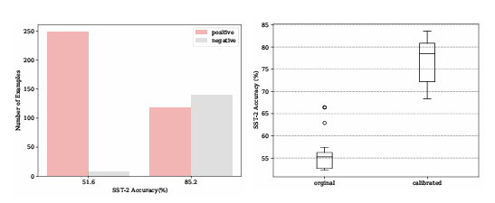
Order Sensitivity
Performant label orderings are not consistent across models
Inconsistent Label patterns (e.g., PNPN, NPPN)
Same pattern -> Different Behavior
Correlations again low → label ordering ≠ stable factor
Degenerate behavior of bad prompts
Poor prompts -> Unbalanced label distributions (one label)
Calibration improves accuracy but not variance
Bad label distribution = strong indicator of poor prompt ordering

Slide 8
Methodology
Transform
Transform training samples into a template format (input + label → natural language)
Enumerate
Enumerate all permutations of these samples (e.g., 24 permutations)
Sample
For each permutation, sample text from the LM → this becomes the probing set
Compute
Compute entropy metrics: 1. Global Entropy: distribution balance across labels 2. Local Entropy: model’s confidence spread per sample
Rank
Rank permutations using these scores
Select
Select top-K (e.g., best 4) prompt orders for inference

Slide 9
Experimental Setup
Models
GPT-2: 0.1B, 0.3B, 0.8B, 1.5B
GPT-3: 2.7B, 175B
GPT-2 use open-source checkpoints
GPT-3 use paid API
Permutation Evaluation
Each sample set: 24 permutations
Each experiment: 5 sample sets
Total: ~120 runs per model size
GPT-3 175B: 2 sets, 12 perm.
Few-Shot Configuration
Mostly 4-shot prompting (due to context window limit)
Exceptions:
AGNews: 2-shot
DBPedia: 1-shot
Prompt Ranking
Global & Local Entropy scores
Top-4 permutations as final prompts were selected
Baseline & Oracle comparisons included
Probing Set Generation
Max generation length: 128 tokens
Sampling temperature: t = 2
Block n-gram repetition penalty to encourage diverse output

Slide 10
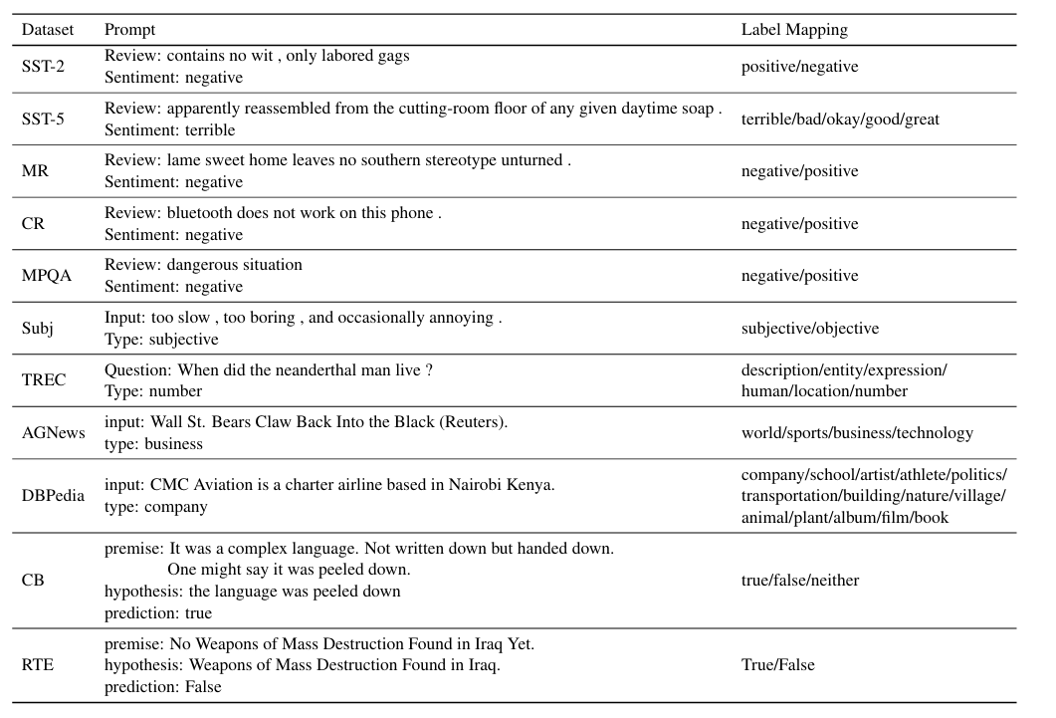
Datasets

Slide 11
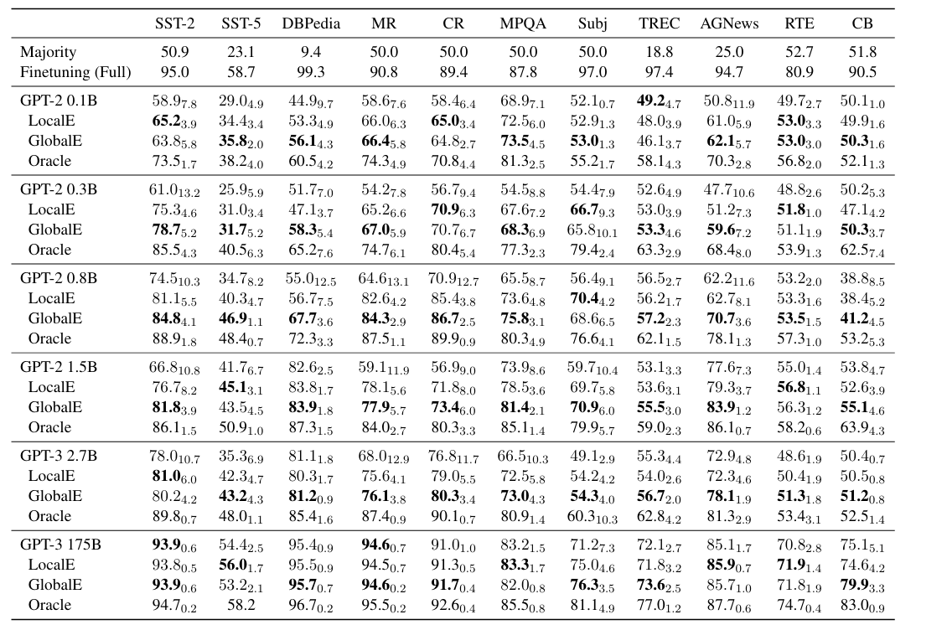
Results
Both Entropy improve accuracy across all tasks.
Average improvement: ~13% relative gain (GlobalE).
Gains are largest for small and medium-sized models.
Entropy-based selection also reduces variance significantly

Slide 12
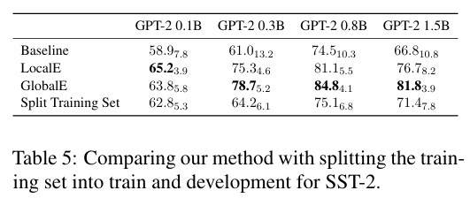
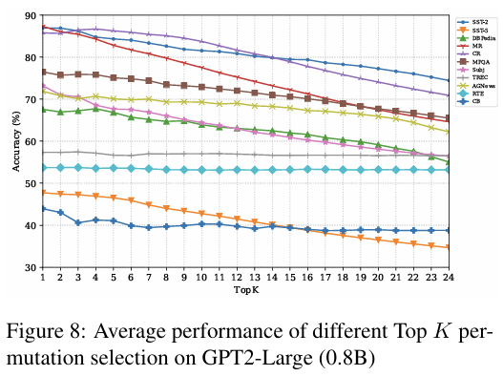
Results
Entropy-Based Ranking Effectiveness
K Increases → Accuracy Decreases → Proves Ranking Quality.
GlobalE generally outperforms LocalE.
The method works across different prompt templates.
Additional Findings & Edge Cases
Hard tasks (RTE, CB) remain difficult for small models.
Large models see significant performance jumps.
Splitting the few-shot training set into a validation set performs worse than entropy probing.(Table 5)

Slide 13
Related Work
Early Work: Task-Specific Models
Traditional NLP relied on shared-parameter models (ELMo, BERT).
One model per task → fragmented NLP. (fine-tuning)
Current Stage: Toward a Unified Interface
Efforts like Kumar et al. (2016) and T5 (Raffel et al., 2020) aim to express all tasks in a single text format.
GPT-2 shows that simple trigger tokens can shift model behavior.
GPT-3 enables task-agnostic prompting with strong zero- and few-shot performance.
Researched Paper: Filling the Missing Gap
Critical issue: order sensitivity in ICL.
Ordering can shift accuracy from near-SOTA to random.
Entropy probing picks stable prompts—filling a major gap in unified NLP.

Slide 14
Prompt Design for Pretrained Language Models
Core Challenge
Turning training data into natural-language prompts that align well with pretrained LMs.
Manual Prompting
Petroni et al. (2019): human-written natural language templates.
Issues:
High human effort
Hard to scale
Often sub-optimal performance
Key Insight
Template design was studied; ordering was not—this paper reveals its major impact.
Automatic Template Construction
Schick & Schütze (2020): cloze-style templates
Gao et al. (2020): templates generated by an external LM
Shin et al. (2020): gradient-guided search for optimal templates
Jiang et al. (2020): mining-based methods for diverse templates

Slide 15
Order Sensitivity & True Few-Shot Learning
True Few-Shot Setting
Perez et al. (2021): few-shot performance is overestimated when a validation set is available.
New method:
Uses the LM’s generative ability to create an artificial probing set
Requires no held-out data
Outperforms tuning on a real split
Order Sensitivity in Existing Work
Gao et al. (2020): fine-tuned models are less sensitive to example order.
Liu et al. (2021): with a large training set, nearest-neighbor retrieval reduces order effects.
Conclusion: after retrieving relevant samples, ordering barely matters.
Contrasting Finding
Operate in true few-shot settings (no large training set).
Example order can shift performance from near-SOTA to random.
None examined order sensitivity deeply.

Slide 16
Limitations
Shot & Scaling Constraints
Tested mainly in 4-shot settings (context limits).
Unclear how permutation sensitivity scales in higher-shot prompts.
Real few-shot tasks may require scoring thousands (more than 24)
Task & Domain Limitations
Evaluated only on text classification tasks.
Unclear in generation, multi-turn reasoning, or more complex tasks.
Probing Set Assumptions
The model generates its own probing set.
Low-quality generatio → Probing signal may be unreliable.
Future Directions
Wider tasks, domains, languages, and templates.
Richer probing-set generation strategies.
Unsupervised indicators (diversity signals, uncertainty metrics beyond entropy).

Slide 17
Conclusion
Insight
Order sensitivity is a fundamental limitation of in-context learning and, it has not been systematically examined in prior work. Results show that example ordering can radically affect model reliability.
Method
An entropy-based probing strategy selects high-quality example permutations using only model-generated probes (no validation set needed).
Impact
Consistent accuracy gains across models and tasks demonstrate that stable few-shot learning depends on understanding and controlling example order.

Slide 18
References
Lu, Y., Bartolo, M., Moore, A., Riedel, S., & Stenetorp, P. (2022). Fantastically ordered prompts and where to find them: Overcoming few-shot prompt order sensitivity. arXiv preprint arXiv:2104.08786.
Gao, T., Fisch, A., & Chen, D. (2020). Making pre-trained language models better few-shot learners. arXiv preprint arXiv:2012.15723.
Jiang, Z., Xu, F. F., Araki, J., & Neubig, G. (2020). How can we know what language models know? Transactions of the Association for Computational Linguistics, 8, 423–438.
Kumar, A., Irsoy, O., Ondruska, P., Iyyer, M., Bradbury, J., Gulrajani, I., Zhong, V., Paulus, R., & Socher, R. (2016). Ask me anything: Dynamic memory networks for natural language processing. In Proceedings of the International Conference on Machine Learning (ICML) (pp. 1378–1387). PMLR.
Liu, J., Shen, D., Zhang, Y., Dolan, B., Carin, L., & Chen, W. (2021). What makes good in-context examples for GPT-3? arXiv preprint arXiv:2101.06804.
Lu, Y., Bartolo, M., Moore, A., Riedel, S., & Stenetorp, P. (2022). Fantastically ordered prompts and where to find them: Overcoming few-shot prompt order sensitivity. arXiv preprint arXiv:2104.08786.
Perez, E., Kiela, D., & Cho, K. (2021). True few-shot learning with language models. arXiv preprint arXiv:2105.11447.
Petroni, F., Rocktäschel, T., Riedel, S., Lewis, P., Bakhtin, A., Wu, Y., & Miller, A. (2019). Language models as knowledge bases? In Proceedings of the 2019 Conference on Empirical Methods in Natural Language Processing and the 9th International Joint Conference on Natural Language Processing (EMNLP-IJCNLP) (pp. 2463–2473). Association for Computational Linguistics.
Raffel, C., Shazeer, N., Roberts, A., Lee, K., Narang, S., Matena, M., Zhou, Y., Li, W., & Liu, P. J. (2020). Exploring the limits of transfer learning with a unified text-to-text transformer. Journal of Machine Learning Research, 21, 1–67.
Schick, T., & Schütze, H. (2020). It’s not just size that matters: Small language models are also few-shot learners. arXiv preprint arXiv:2009.07118.
Shin, T., Razeghi, Y., Logan, R. L., IV, Wallace, E., & Singh, S. (2020). AutoPrompt: Eliciting knowledge from language models with automatically generated prompts. arXiv preprint arXiv:2010.15980.

