Slide 1

Chain-of-Thought Prompting Elicits Reasoning in Large Language Models
Furkan KARA
Student ID: 300201046
2025

Slide 2
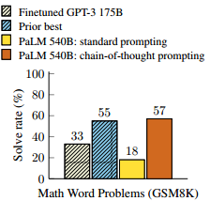
The Problem
LLMs often struggle with complex reasoning. Simply giving them a few examples of a problem and its answer (standard prompting) isn't enough.
Instead of just showing the model the question and answer, you also show it the step-by-step reasoning in natural language that leads to the answer.
This method dramatically improves the model's performance without needing expensive retraining, using only a few examples.

Slide 3
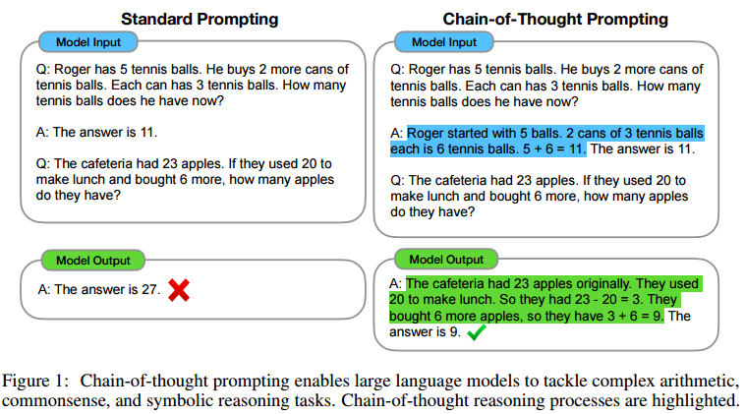

Slide 4
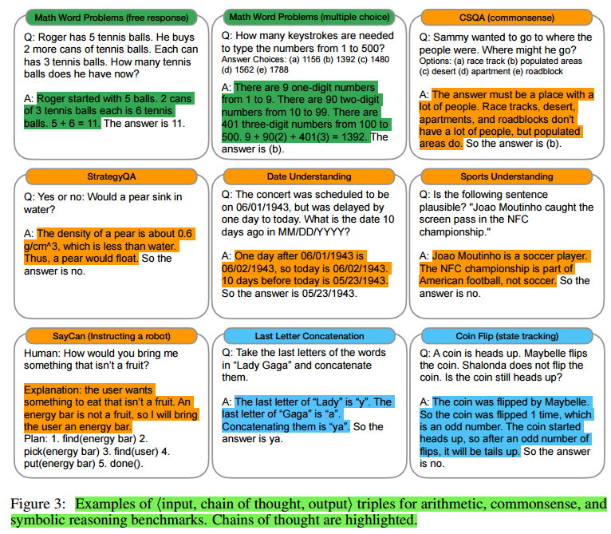

Slide 5
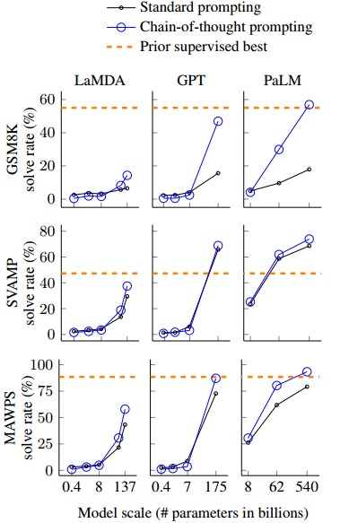
Results
It Only Works on Big Models
It Helps Most on Hard Problems
It Beats Old Methods

Slide 6
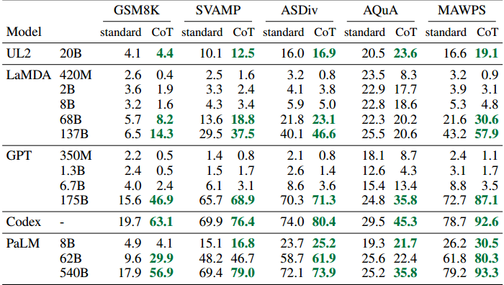

Slide 7
Related Work
First Aspect: Using Intermediate Steps (Old Methods)
They were specifically training the model to solve math problems or predict lines of code (training/fine-tuning). Forcing the model to think step by step required giving it thousands of solved examples and retraining it. This was too expensive.
Second Aspect: Prompting (Standard Prompting)
This group, on the other hand, was trying to improve performance by simply changing the input without training the models. They were changing the questioning method or adding instructions that described the task. They were simply improving the input but still asking the model directly for the output. They weren't interfering with how the model thought.

Slide 8
Related Work
What's the difference?
CoT finds the middle ground between these two approaches. Other prompt methods focus on the INPUT part (asking the question more effectively). This article focuses on the OUTPUT part. It tells the model, "Before giving the answer, write down your thoughts as part of the output."

Slide 9
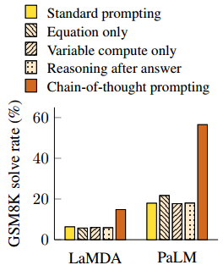
Ablation Study
Equation Only: They told the model to just output the math equation. This didn't work well. The model can't just jump to the equation.
Variable Compute Only: They let the model "think" for the same amount of time but without any actual reasoning. This also didn't work. Just giving the model more time to think without structuring those thoughts is useless. The content of the reasoning steps is what matters.
Chain of Thought After Answer: They made the model give the final answer first and then write the reasoning steps. This failed. The model needs to use the step-by-step reasoning to arrive at the answer.

Slide 10
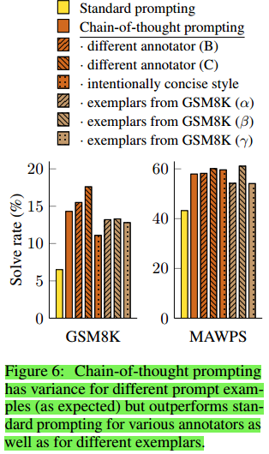
Robustness of CoT
The researchers tested how robust the CoT method is. They wanted to see if it would only work with one specific, perfectly-written example. They found:
It's not about perfect wording: Different people wrote the step-by-step reasoning in their own style (detailed vs concise). Even though the wording changed, all versions of the CoT prompts worked much better than the standard method.
It works with random examples: They also tried using examples taken directly from a training dataset, and those worked just as well as the ones they wrote themselves.

Slide 11

Limitations
We Don't Know How It Works: The model looks like it's reasoning, but we don't know if it's truly thinking like a human or just mimicking the pattern.
It Can Be Expensive to Scale: Writing step-by-step examples for a few prompts is easy, but creating thousands for training a model would be very costly.
It's Not Always Right: The model can produce logical-looking steps that are actually wrong, leading to incorrect answers.
It Needs Large Models: This ability only appears in very large, expensive models, making it impractical for many real-world applications that need faster, cheaper systems.

Slide 12
Why & How?
Why does increasing model scale improve chain-of-thought prompting?
Better Understanding: Small models often misunderstand the question's meaning. Larger models grasp the story better (semantic understanding).
Fewer Logic Gaps: Small models frequently skip a step in their reasoning. Larger models are better at following all the necessary logical steps without missing one.
Improved Basic Skills: Larger models are simply better at fundamental tasks like arithmetic and staying on-topic, which are essential for correct reasoning.

Slide 13
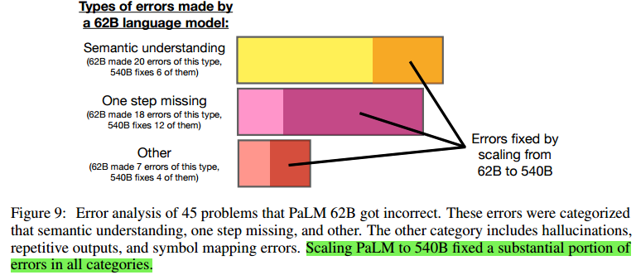
Small models perform worse with CoT prompting. They lack the basic understanding and logic skills to use it correctly. The prompt forces them to attempt a complex task they can't handle, leading to more mistakes than if they just gave a direct, simple answer.

Slide 14
Why & How?
What is the role of prompt engineering?
How sensitive the CoT method is to different ways of writing the prompts.
Different People: They had three different people write the example reasoning steps. While the performance varied a bit, all of them worked much better than not using CoT at all. It worked even with people who had no ML background.
Different Examples & Order: They tried different example problems and changed their order in the prompt. For most tasks, this didn't change the results much. The method was stable.
Different Models: They tried the same prompts on different models. The CoT improvement worked for all of them, showing it's a general technique, not just for one specific model.

Slide 15
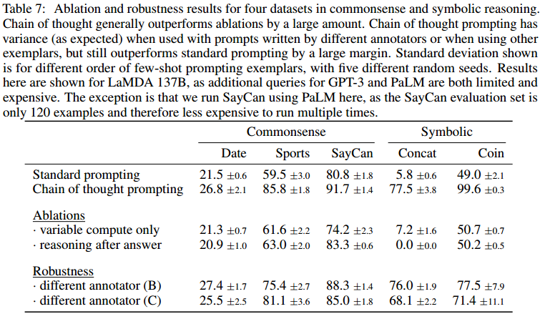
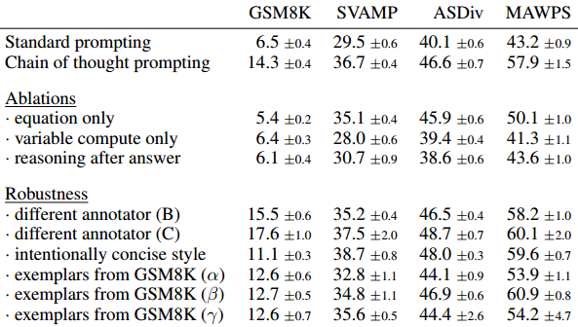

Slide 16
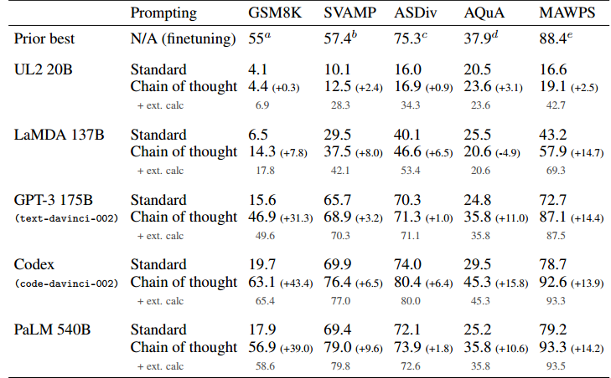
Experimental Results
LLMs are good at logic but bad at arithmetic.
When using CoT, the model would write out the correct steps and equations but then make a simple math error (25 + 17 = 33). This caused the final answer to be wrong, even though the reasoning was correct.
They gave the model a calculator. They took the equations the model wrote, calculated the correct answer, and then fed that correct number back into the model.

Slide 17
Additional Analysis
Correct Chain of Thought Analysis
As mentioned in the main text, we analyze 50 CoT that led to correct answers in the dataset. Of these 50, only one arrived at the correct answer through incorrect reasoning. The other 49 had correct logic and math. Five had minor imperfections while maintaining coherent and understandable logic:
One had underspecified statements.
One made an unrelated but correct statement.
Two had the correct logic but omitted specific steps in the equation, though it was still understandable.
One had the correct math but inverted the semantics.

Slide 18
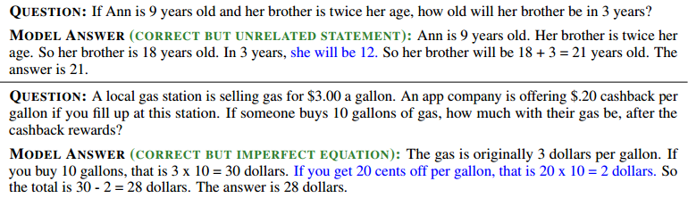

Slide 19
Additional Analysis
Incorrect Chain of Thought Analysis
The researchers manually checked 50 incorrect answers to understand why it failed. They found that many errors were actually almost correct and could be fixed with minor adjustments.
Calculator Error (8%): The model's logic was perfect, but it made a simple math mistake (like 2+2=5). Using an external calculator fixed these.
Symbol Mapping Error (16%): The reasoning was correct, but the model accidentally used the wrong numbers in its equation. For example, if the text said, "50 weeks," the model might accidentally write "30" in the formula.
One Step Missing (22%): The model was on the right track but skipped exactly one logical step needed to verify the answer. Adding that single missing step made the answer correct.

Slide 20
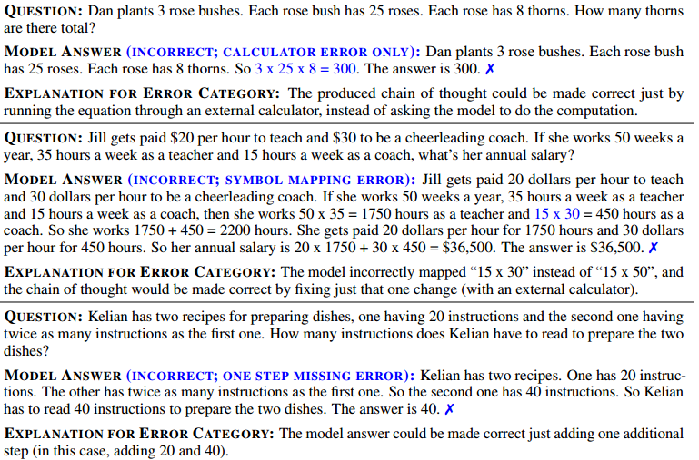

Slide 21
Additional Analysis
Incorrect Chain of Thought Analysis
54% of the incorrect cases were too serious to be fixed with simple edits. Unlike the minor math or typo errors mentioned before, these represent a fundamental failure in reasoning.
Semantic Understanding Errors: The model failed to understand the actual meaning of the question. For example, it confused who bought what.
Incoherent Chains of Thought: The model's reasoning just stopped making sense. The steps didn't follow each other logically, or the model made statements that violated basic world knowledge (100% < 50%).

Slide 22
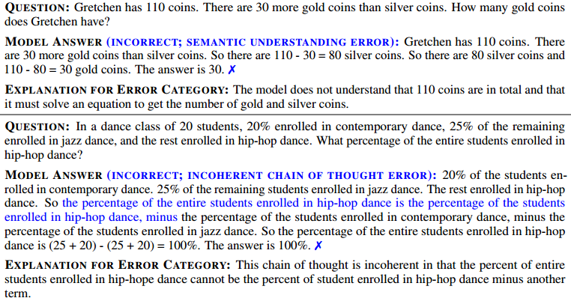

Slide 23
Additional Analysis
Additional Robustness Analysis
This section addresses whether the success of CoT prompting depends on the specific number of examples provided in the prompt.
Since the main experiments were limited to 8 examples due to input length constraints, they ran new tests with varying numbers of examples.
The Result: The method is robust. CoT consistently outperformed standard prompting regardless of the number of examples used.

Slide 24
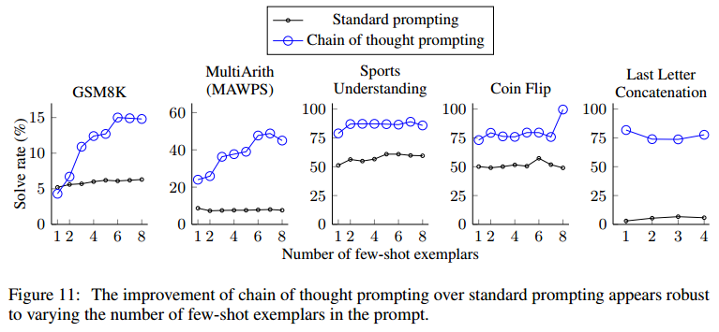

Slide 25
Strategies for Eliciting Reasoning
Decomposition: Breaking complex problems into sub-steps (e.g., Math and Logic questions).
Bridge: Accessing external knowledge by establishing a logical connection between question and answer (e.g., StrategyQA, Sports Understanding).
Translation: Translating the user's abstract request into concrete action steps/code fragments (e.g., SayCan Robotics).

Slide 26
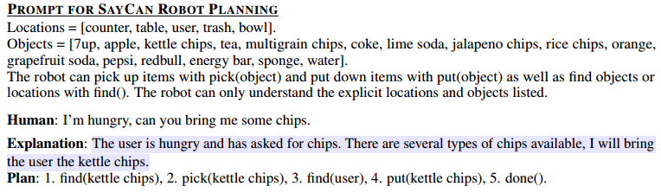

Slide 27
Conclusions
CoT is not a training change → a prompting strategy
Model size matters → CoT emerges at scale
CoT improves reasoning across domains (especially math)
LLMs are no longer just predicting answers; they are systems simulating a reasoning process.

Slide 28
Critique
If this method can only work with models with 100B+ parameters, how accessible is it for researchers with limited resources (like us)?
CoT requires much more tokens to be generated than standard prompting (Input + Chain + Output). Is this sustainable in terms of latency and inference cost in real-time applications?
Does the generated chain accurately reflect the model's decision process or is it post-hoc rationalization? Risk: "Right answer for the wrong reasons" (Accidental correctness) reduces trust.

Slide 29
References
Main Paper
Wei, J., Wang, X., Schuurmans, D., Bosma, M., Ichter, B., Xia, F., et al. (2022). Chain-of-Thought Prompting Elicits Reasoning in Large Language Models. NeurIPS.
Referenced Works
Brown, T. B., Mann, B., Ryder, N., Subbiah, M., Kaplan, J., Dhariwal, P., et al. (2020). Language Models are Few-Shot Learners. NeurIPS.
Hendrycks, D., Burns, C., Kadavath, S., et al. (2021). Measuring mathematical problem solving with the MATH dataset. arXiv.
Cobbe, K., Kosaraju, V., Bavarian, M., et al. (2021). Training verifiers to solve math word problems. arXiv.
Rae, J. W., Borgeaud, S., Cai, T., Millican, K., Hoffmann, J., Song, F., et al. (2021). Scaling language models: Methods, analysis & insights from training Gopher. arXiv.
Kaplan, J., McCandlish, S., Henighan, T., et al. (2020). Scaling laws for neural language models. arXiv.

