Slide 1

HybridFlow: A Flexible and Efficient RLHF Framework
CENG 543 - Research Paper Presentation
Eray Kocabozdoğan

Slide 2
Outline
01 02 03 04 05 06 07
Motivation & Problem Statement
RLHF Background & Challenges
HybridFlow Architecture
Core Innovation: 3D-HybridEngine
Auto Device Mapping
Evaluation & Results
Critical Analysis & Conclusion

Slide 3
Motivation: The Dilemma
Current State
RLHF is essential for aligning LLMs.
The Trade-off:
Single Controller: Flexible Code, but high overhead
Multi Controller: High efficiency, but rigid and complex code
Goal
A framework combining the flexibility of single-controller with the efficiency of multi-controller architectures.

Slide 4
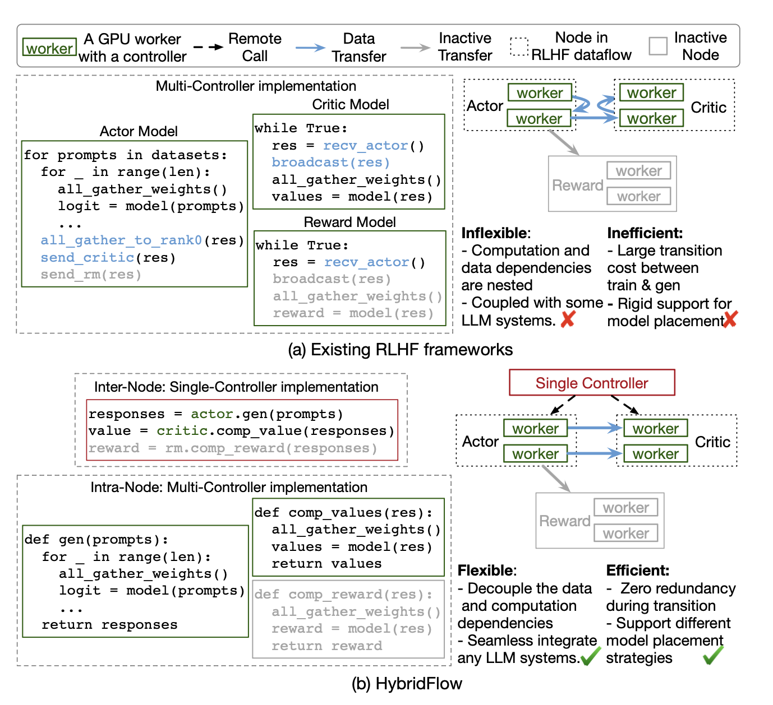
Motivation: The Dilemma
Comparison of programming models

Slide 5
Background: Why is RLHF Difficult?
Complex Dataflow
Involves Generation (Actor), Inference (Critic/Reward), and Training (Actor/Critic)
Heterogeneous Workloads
Actor model performs both Generation (Memory-bound) and Training (Compute-Bound).
Models have varying sizes (e.g., 7B Actor vs. 70B Reward).

Slide 6
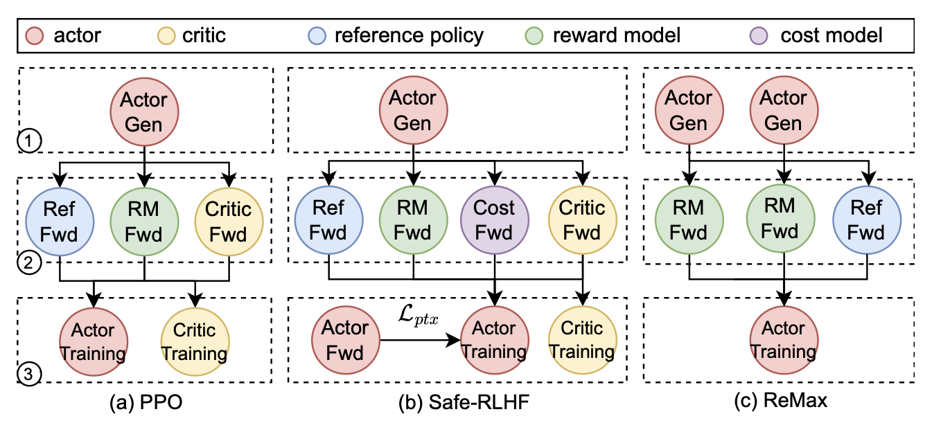
Background: Why is RLHF Difficult?
Dataflow of PPO/Safe-RLHF

Slide 7
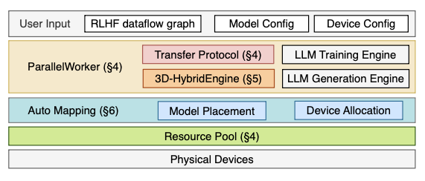
HybridFlow Overview (The Solution)
Hierarchical Architecture:
Inter-node: Single Controller for flexibility.
Intra-node: Multi Controller for performance.
System Architecture

Slide 8
Hybrid Programming Model
1
Hierarchical APIs
Encapsulates distributed computation (e.g., update_actor )
2
Transfer Protocols
Automatically handles data resharding between models.
3
Ease of Use
Implementing PPO takes only ~8 lines of code; Safe-RLHF requires just +5 lines.

Slide 9
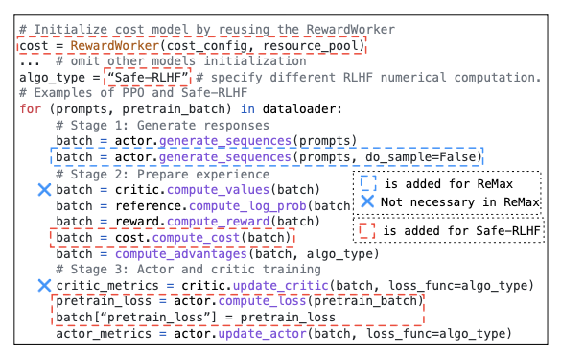
Hybrid Programming Model
Code snippet for PPO/Safe-RLHF

Slide 10
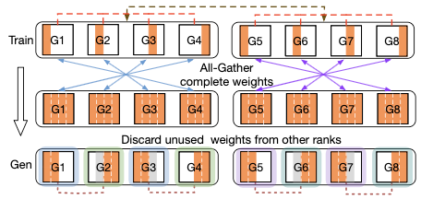
The Core Challenge: Actor Resharding
Encapsulates distributed computation (e.g., update_actor )
The Conflict:
Automatically handles data resharding between models.
The Bottleneck:
Traditional resharding with redundancy

Slide 11
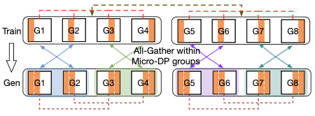
Innovation: 3D-HybridEngine
Zero Redundancy Resharding:
Reinterprets training TP groups as "Micro-DP" groups during generation.
Result: No massive data transfer; weights stay on the GPU, only the "view" changes.
Optimized resharding

Slide 12
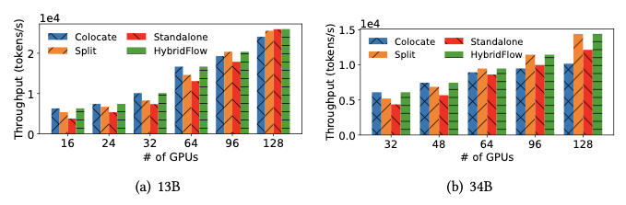
Auto Device Mapping Algorithm
Minimize end-to-end RLHF latency.
Simulates all possible placement strategies (Colocate vs. Split) and selects the best one.
Objective
Method
Adaptability
Chooses different strategies based on cluster size (e.g., colocate for small clusters, split for large ones).
Throughput under different placements

Slide 13
Experimental Setup
Hardware
128 GPUs (NVIDIA A100-80GB).
Models
Llama-2 (7B to 70B).
Baselines
DeepSpeed-Chat, OpenRLHF, NeMo-Aligner.

Slide 14
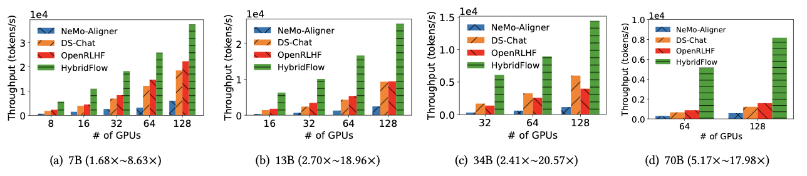
Results: Throughput Comparison
Performance
HybridFlow outperforms baselines by 1.53 to 20.57 times.
Scaling
Achieves 9.64 times speedup on average for 70B models due to efficient resharding.
PPO Throughput

Slide 15
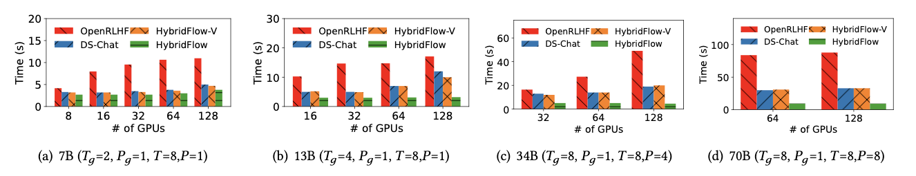
Results: Transition Overhead
Impact
Drastic reduction in transition time between training and generation.
Comparison
OpenRLHF suffers from high synchronization costs; HybridFlow remains efficient even at scale.
Transition Time Analysis

Slide 16
Critical Analysis
Strengths
Limitations
Solves the "flexibility vs. efficiency" trade-off.
Zero-redundancy mechanism is a significant engineering breakthrough.
System complexity makes debugging harder.
Performance relies on accurate offline simulations.
"Best-effort" KV Cache might risk OOM in edge cases.

Slide 17
Conclusion
HybridFlow sets a new standard for RLHF frameworks.
It successfully separates control logic from computation.
Enables efficient scaling for future Large Language Models.

Slide 18
Thanks!
Do you have any questions?
Eray Kocabozdoğan
eraykocabozdogan@std.iyte.edu.tr

Slide 19
References
Ouyang, L., et al. (2022). Training language models to follow instructions with human feedback (InstructGPT).NeurIPS.
Schulman, J., et al. (2017). Proximal Policy Optimization Algorithms (PPO). arXiv:1707.06347.
Yao, Z., et al. (2023). DeepSpeed-Chat: Easy, Fast and Affordable RLHF Training of ChatGPT-like Models at All Scales. arXiv:2308.01320.
Hu, J., et al. (2023). OpenRLHF: A Ray-based High-performance RLHF
framework. arXiv preprint.5.
Shoeybi, M., et al. (2019). Megatron-LM: Training Multi-Billion Parameter
Language Models Using Model Parallelism. arXiv:1909.08053.

