Slide 1
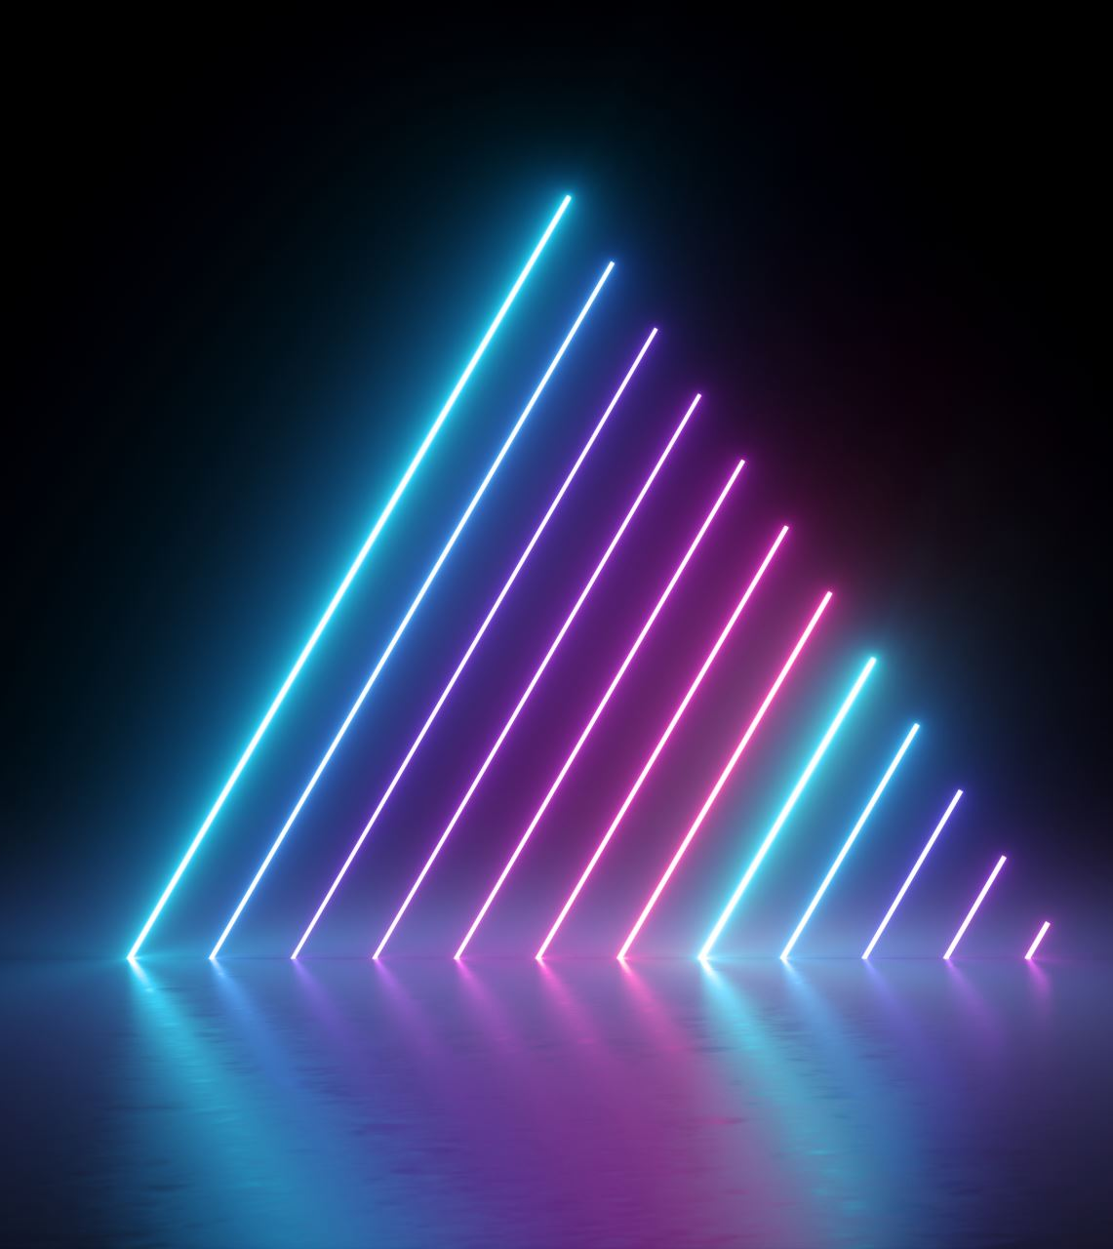
QLoRA:Efficient Finetuning of Quantized LLMs
Mert GÜNER 300201021
Prof. Aytuğ ONAN 22.12.2025

Slide 2
Table Of Contents
Problem Definition
Proposed Solutions
QLoRa Introduction
QLoRA Methodology Explaining
QLoRA Studies
Final Remarks

Slide 3
Problem:The Memory Bottleneck
As the language models get larger and larger so do their accuracy and their precision.
To improve their performance even further we apply Finetuning
This however comes at a great cost. Finetuning LLMs is prohibitively expensive
Model Size | Parameters | 16-bit (Half Precision) | 32-bit (Full Precision)
LLaMA-7B | 7 Billion | ~14 GB | ~28 GB
LLaMA-13B | 13 Billion | ~26 GB | ~52 GB
LLaMA-33B | 33 Billion | ~66 GB | ~132 GB
LLaMA-65B | 65 Billion | ~130 GB | ~260 GB
Source:https://huggingface.co/boboto/LLaMA-65B-HF
Memory requirements calculated manually with KV cache Inference overhead in mind

Slide 4
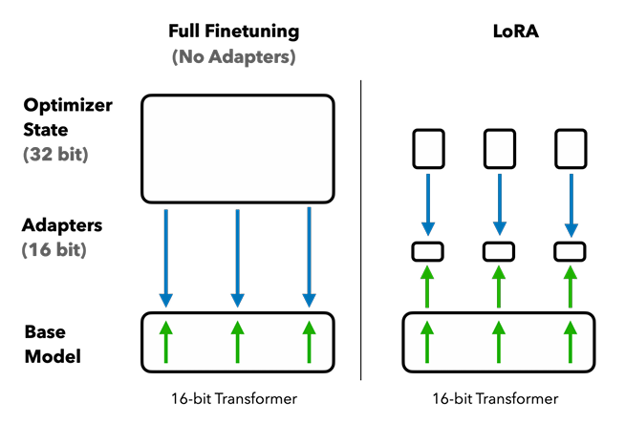

Solution 1: LoRA (Low-Rank Adapters)
What is LoRA?
Low-rank Adapter (LoRA) finetuning is a method that reduces memory requirements by using a small set of trainable parameters, often termed adapters, while not updating the full model parameters which remain fixed.

Slide 5
Solution 2: Quantization
What is quantization?
Quantization is the process of discretizing an input from a representation that holds more information to a representation with less information. It often means taking a data type with more bits and converting it to fewer bits.
Model Size | Parameters | 4-bit (Quantized) | 8-bit (Quantized) | 16-bit (Half Precision) | 32-bit (Full Precision)
LLaMA-7B | 7 Billion | ~5 GB | ~8 GB | ~14 GB | ~28 GB
LLaMA-13B | 13 Billion | ~9 GB | ~14 GB | ~26 GB | ~52 GB
LLaMA-33B | 33 Billion | ~20 GB | ~34 GB | ~66 GB | ~132 GB
LLaMA-65B | 65 Billion | ~40 GB | ~66 GB | ~130 GB | ~260 GB
Source:https://huggingface.co/boboto/LLaMA-65B-HF
Memory requirements calculated manually with KV cache Inference overhead in mind

Slide 6
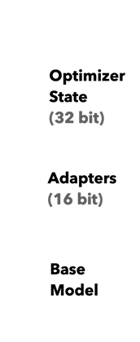
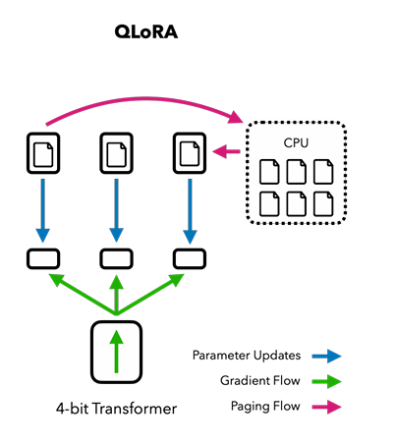
Solution 3: QLoRA (The Best of Both Worlds)
What is QLoRA?
QLoRA is just a plain simple mix of Quantization and LoRa
QLoRa is a specific finetuning approach that backpropagates gradients through a frozen, 4-bit quantized pretrained language model into Low Rank Adapters

Slide 7
QLoRa's Innovations
A new way to store data : 4-bit NormalFloat, an information theoretically optimal quantization data type for normally distributed data that yields better empirical results than 4-bit Integers and 4-bit Floats.
Double Quantization : A method that quantizes the quantization constants saving an average of about 0.37 bits per parameter (approximately 3 GB for a 65B model).
Paged Optimizers : Uses NVIDIA's Unified Memory to avoid the gradient checkpointing memory spikes in memory usage during training.

Slide 8


The Problem with Standard Quantization
Example:32-bit Floating Point (FP32) tensor into a Int8 tensor with range [−127,127]:
where c is the quantization constant or quantization scale
Dequantization is the inverse:
The problem with this approach is that if a large magnitude value (i.e., an outlier) occurs in the input tensor, then the quantization bins are not utilized well with few or no numbers quantized in some bins.

Slide 9
The Challange : Quantile Quantization
The NormalFloat (NF) data type builds on Quantile Quantization which is an information-theoretically optimal data type that ensures each quantization bin has an equal number of values assigned from the input tensor.
Limitations:
It is expensive:Calculating exact quantiles for billions of parameters is computationally heavy.
Approximation Errors: Fast algorithms (like SRAM quantiles) use approximations. This leads to large errors for outliers.But outliers are very important data for model accuracy

Slide 10
Innovation: 4-bit NormalFloat Quantization (NF4)
Pretrained Neural Network weights almost always follow a Zero-Centered Normal Distribution
Instead of calculating quantiles every time, we fix the distribution.
We compute the optimal quantiles for a theoretical N(0,1) distribution once⁶.
We scale the weights to fit into the [-1, 1] range⁷.
The "Zero" Problem: Standard symmetric quantization often has no exact representation for "0".
NF4 is asymmetric. It creates separate ranges for positive and negative numbers and merges them to ensure exactly 0 is representable (critical for padding).

Slide 11
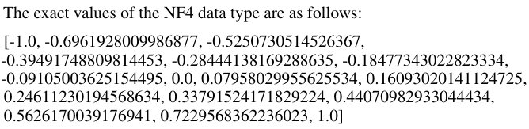
4-bit NormalFloat Quantization(Cont.)
We term the resulting data type that has equal expected number of values in each quantization bin k-bit NormalFloat (NFk), since the data type is information-theoretically optimal for zero-centered normally distributed data.
If you count the values there are 7 negative values,8 positive values and with 0 counted it totals to 16 quantiles which corresponds to 4-bit precision!

Slide 12
Innovation 2:Double Quantization (DQ)
Double Quantization treats quantization constants of the first quantization as inputs to a second quantization. This second step yields the quantized quantization constants and the second level of quantization constants .
We use 8-bit Floats with a blocksize of 256 for the second quantization as no performance degradation is observed for 8-bit quantization,
On average, for a blocksize of 64, this quantization reduces the memory footprint per parameter from 32/64 = 0.5 bits, to 8/64 + 32/(64 · 256) = 0.127 bits, a reduction of 0.373 bits per parameter.

Slide 13
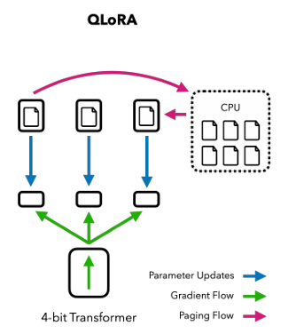
The Innovation 3: Paged Optimizers
Problem: GPU memory spikes during training can cause crashes (OOM)
Solution:Paged Optimizers use the NVIDIA unified memory feature which does automatic page-to-page transfers between the CPU and GPU for error-free GPU processing in the scenario where the GPU occasionally runs out-of-memory.
Optimizer states are evicted to CPU RAM
Optimizer states are stored on CPU RAM(Idle)
Optimizer state is paged back into GPU memory when it is needed in the optimizer update step
When the GPU runs out-of-memory:

Slide 14
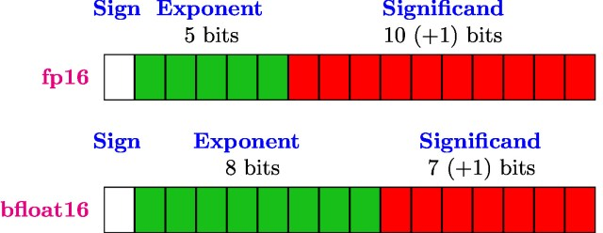
Used Data Type: Brain Float (BF16)
Bfloat16 is a 16-bit, base 2 storage format that allocates 7 bits for the significand and 8 bits for the exponent. It contrasts with the IEEE fp16 (half precision) format, which allocates 10 bits for the significand but only 5 bits for the exponent.
https://nhigham.com/2020/06/02/what-is-bfloat16-arithmetic/

Slide 15
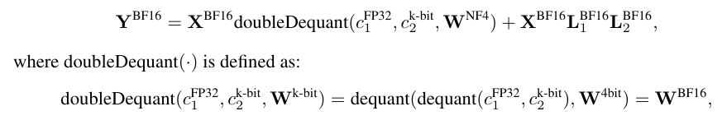
The Result: QLoRA
Combining the components described (NF4, DQ, Paged Optimizers),QLoRA is defined as the following equation:
QLoRA has one storage data type (usually 4-bit NormalFloat) and a computation data type (16-bit BrainFloat).
We dequantize the storage data type (NF4) to the computation data (BF16) type to perform the forward and backward pass, but we only compute weight gradients for the LoRA parameters which use 16-bit BrainFloat

Slide 16
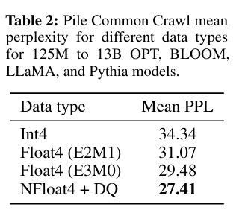
Ablation Study: Efficacy of 4-bit NormalFloat (NF4)
Question:Why did we use NF4 format and not Floating Point 4-bit or Integer 4-bit
In the following Table it is seen that NF4 outperforms INT4 and FP4 in quantization precision

Slide 17
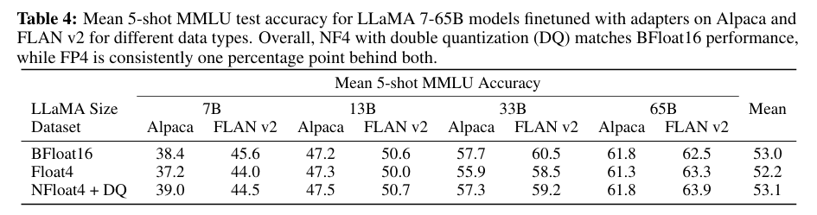
Recovering Full 16-bit Performance with 4-bit QLoRA
Question:How trustable is the recovery of 4 bit Normal Float
In the following figure it is seen that QLoRA and Brain Float 16 bit Model achieve almost identical accuracies .So it can be concluded that Quantizing to and Dequantizing from 4 bit storage does not cause data loss or performance degradation

Slide 18
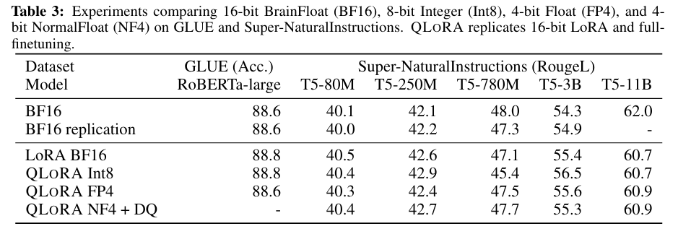
Comparison of QLoRA and traditional finetuning methods

Slide 19
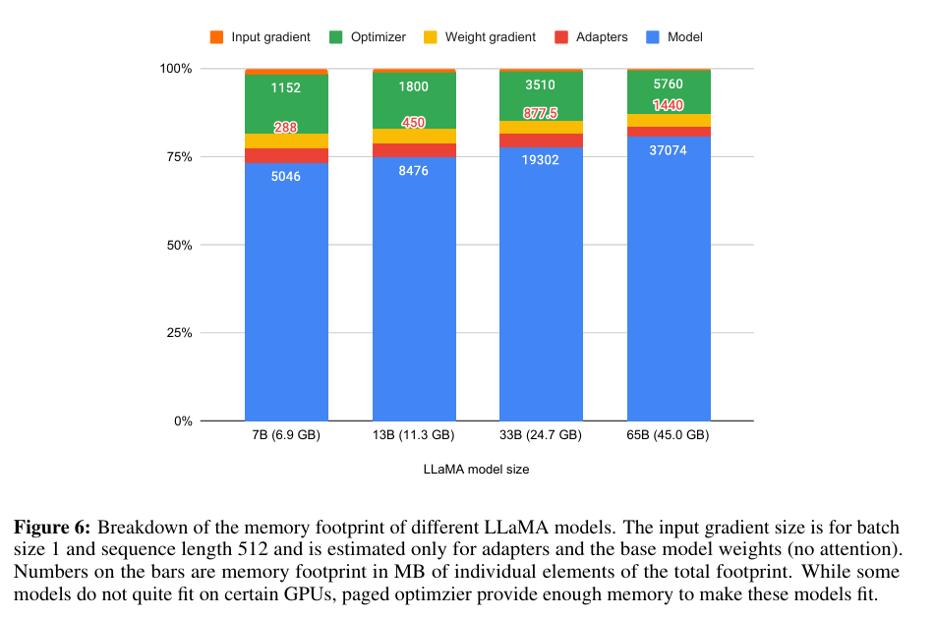
Memory Footprint Breakdown

Slide 20
Final Remarks

Slide 21
Thank You Sincerely

