Slide 1

Chapter 1
Introduction
Copyright © The McGraw-Hill Companies, Inc. Permission required for reproduction or display.

Slide 2
1-1 DATA COMMUNICATIONS
The term telecommunication means communication at a distance. The word data refers to information presented in whatever form is agreed upon by the parties creating and using the data. Data communications are the exchange of data between two devices via some form of transmission medium such as a wire cable.
Topics discussed in this section:
Components
Data Representation
Data Flow

Slide 3
1-1 DATA COMMUNICATIONS
Data Communication Criteria:
1. Delivery: System must deliver to the correct destination
2. Accuracy: Must deliver accurately
3. Timeliness: Must deliver in a timely manner
4. Jitter: Arrival of packages must not be uneven in time.

Slide 4

Figure 1.1 Five components of data communication

Slide 5
Data Representation
How do we represent stuff?
Text: Before: ASCII, Now usually Unicode
Numbers: Direct representation – converted to Binary
Images: bit patterns – usually compressed
Audio: continuous, not discrete.
Video: continuous like video cameras, or discrete – from still images.

Slide 6
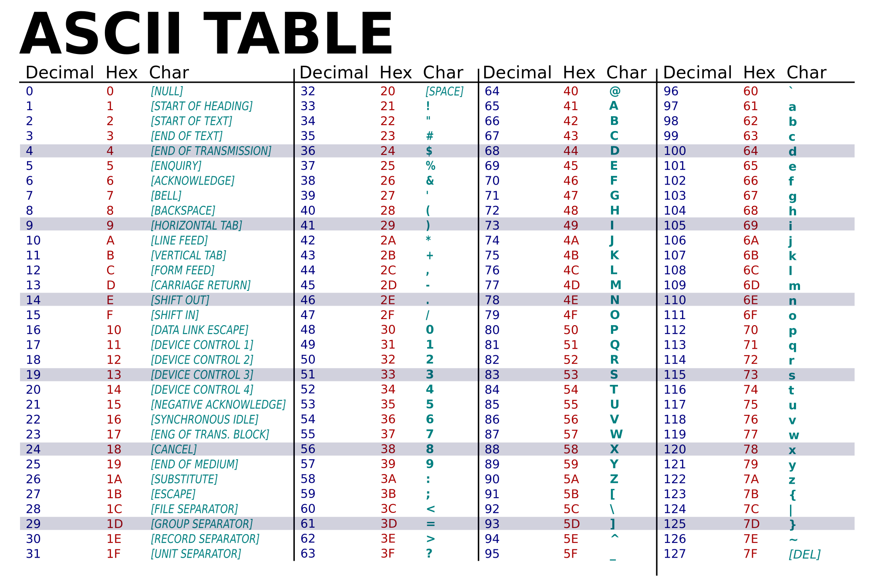
"American Standard Code for Information Interchange"

Slide 7

Figure 1.2 Data flow (simplex, half-duplex, and full-duplex)

Slide 8
1-2 NETWORKS
A network is a set of devices (often referred to as nodes) connected by communication links. A node can be a computer, printer, or any other device capable of sending and/or receiving data generated by other nodes on the network.
Topics discussed in this section:
Distributed Processing
Network Criteria
Physical Structures
Network Models
Categories of Networks
Interconnection of Networks: Internetwork

Slide 9
Network Criteria
Performance: Transit and response times
  Measured by throughput and delay
Reliability: Frequency of failure, time to recover, robustness in catastrophe
Security: Protection from unauthorized access

Slide 10

Figure 1.3 Types of connections: point-to-point and multipoint

Slide 11

Figure 1.4 Categories of topology

Slide 12

Figure 1.5 A fully connected mesh topology (five devices)

Slide 13

Figure 1.6 A star topology connecting four stations

Slide 14

Figure 1.7 A bus topology connecting three stations

Slide 15

Figure 1.8 A ring topology connecting six stations

Slide 16

Figure 1.9 A hybrid topology: a star backbone with three bus networks

Slide 17

Figure 1.10 An isolated LAN connecting 12 computers to a hub in a closet

Slide 18
Wide Area Networks
Long Distance Communications
Switched WAN
  Complex backbone
  Example: X.25, Frame Relay, ATM.
Point-to-point WAN
  Example: Leased line

Slide 19

Figure 1.11 WANs: a switched WAN and a point-to-point WAN

Slide 20

Figure 1.12 A heterogeneous network made of four WANs and two LANs

Slide 21
1-3 THE INTERNET
The Internet has revolutionized many aspects of our daily lives. It has affected the way we do business as well as the way we spend our leisure time. The Internet is a communication system that has brought a wealth of information to our fingertips and organized it for our use.
Topics discussed in this section:
A Brief History
The Internet Today (ISPs)

Slide 22
History
1967 - Advanced Research Projects Agency (ARPA) of the Department of Defense presents ARPANET: Small network of different computers
1969 – 4 ARPANET nodes (UCLA,UCSB,SRI,UU) connected their IMPs (interface message processor) using NCPs (Network Control Protocol).
1972 – Vint Cerf,Bob Kahn, “Internetting Project” , 1973: Paper on protocols for end-to-end delivery: Transmission Control Protocol (TCP)
Soon split into TCP (high level like segmentation,reassembly,error detection) and IP (low level handling of datagrams like routing)

Slide 23

Figure 1.13 Hierarchical organization of the Internet

Slide 24
1-4 PROTOCOLS AND STANDARDS
In this section, we define two widely used terms: protocols and standards. First, we define protocol, which is synonymous with rule. Then we discuss standards, which are agreed-upon rules.
Topics discussed in this section:
Protocols
Standards
Standards Organizations
Internet Standards

Slide 25
Protocols
A protocol is a particular set of rules for having a conversation between two computers to convey a specific set of information
They define exactly how data is exchanged and the expected behavior.
Syntax: Structure or format of data
Semantics: Meaning of each section of bits
Timing: When and how fast can data be sent

Slide 26
Standards
A standard is a document that specifies something that has the support and agreement of the standards making body.
De Facto: Not approved by an organization, evolved over widespread use
Examples: QWERTY, MP3, HTML, .DOC, button holes
De Jure: Standard created by an official body
Examples: Currencies, official language, measurement system, side of the road to drive
There are many organizations and thus many conflicting standards.

Slide 27
Standards Organizations
International Organization for Standardization (ISO): From various governments. For scientific, technological, and economic activities
International Telecommunications Union-Telecommunication Standards Sector (ITU-T): United Nations, CCITT committee. 1993, name changed to ITU-T
American National Standards Institute (ANSI). Private, non-profit organization, not government.
Institute of Electrical and Electronics Engineers (IEEE): Largest professional engineering society.
Internet Standards: Tested specifications called Request for Comments (RFC).

