Slide 1

Chapter 26
Remote Logging,
Electronic Mail,
and File Transfer
Copyright © The McGraw-Hill Companies, Inc. Permission required for reproduction or display.

Slide 2
26-1 REMOTE LOGGING
It would be impossible to write a specific client/server program for each demand. The better solution is a general-purpose client/server program that lets a user access any application program on a remote computer.
Topics discussed in this section:
TELNET

Slide 3

Note
TELNET is a general-purpose client/server application program.

Slide 4
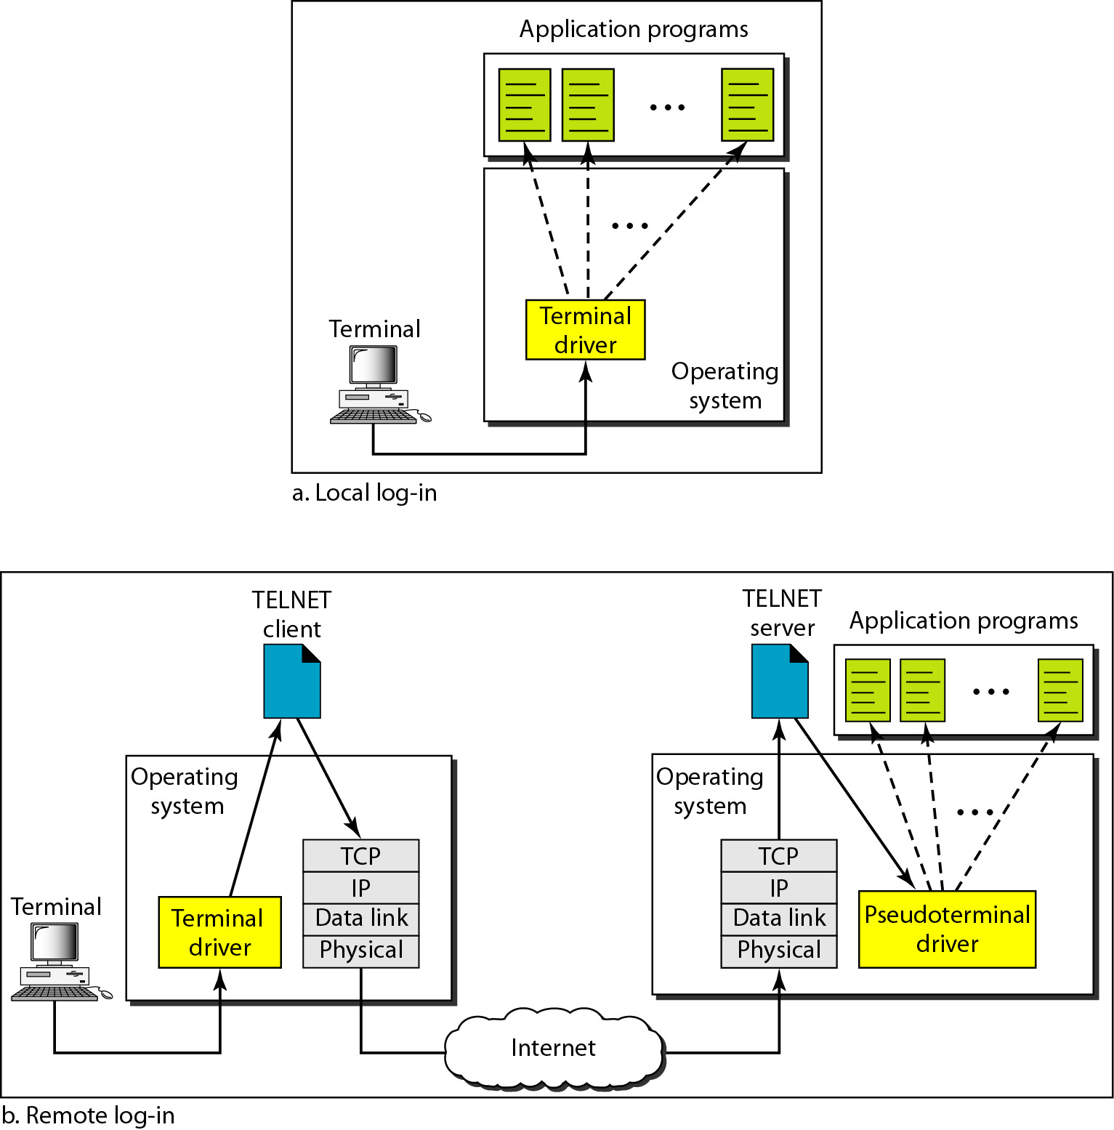
Figure 26.1 Local and remote log-in

Slide 5
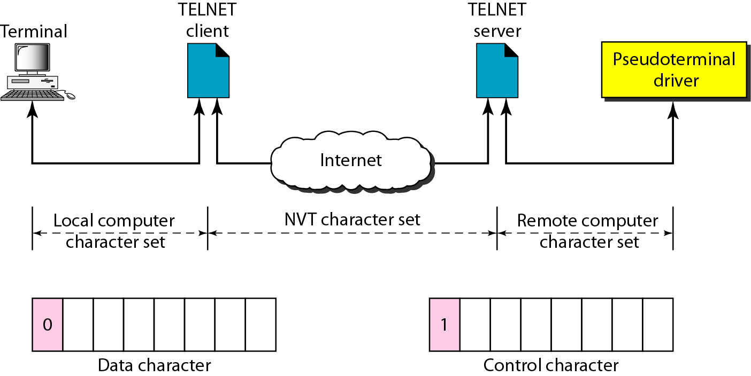
Figure 26.2 Concept of NVT

Slide 6
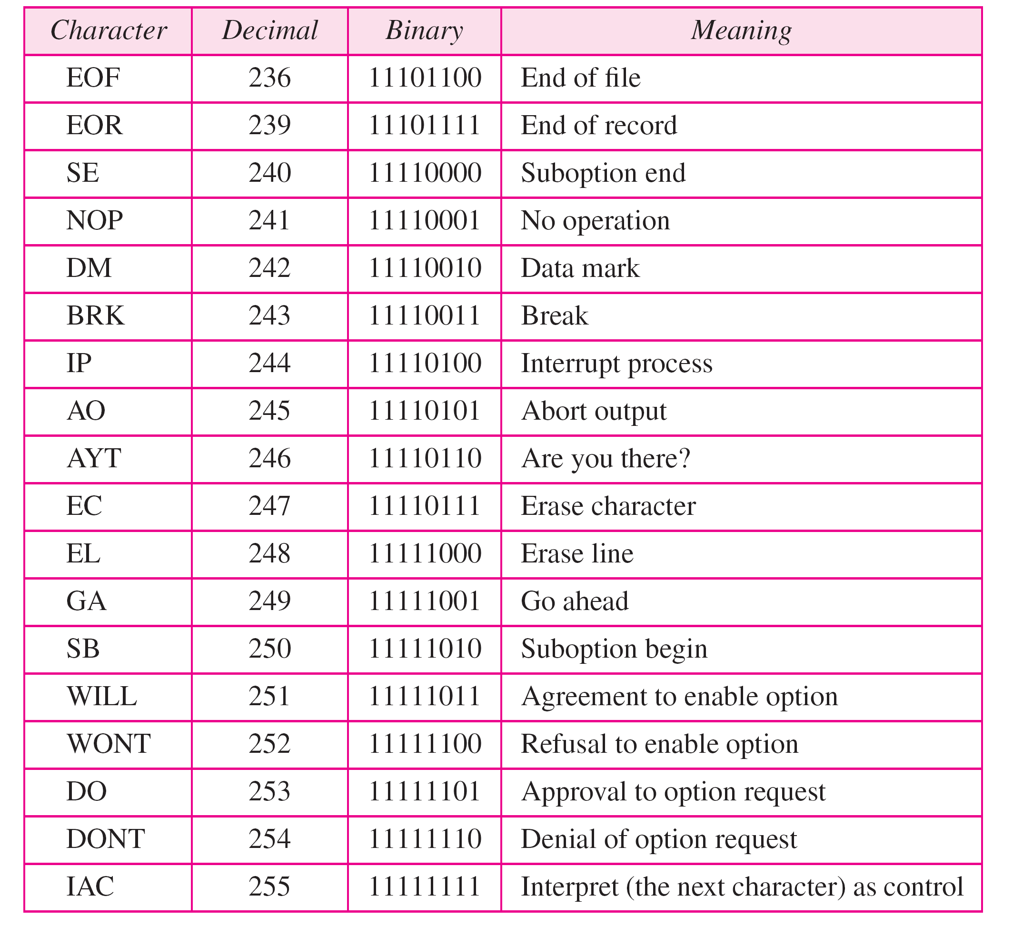
Table 26.1 Some NVT control characters

Slide 7
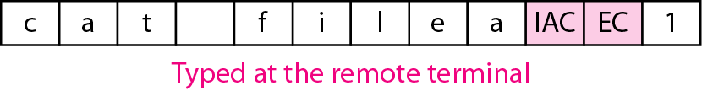
Figure 26.3 An example of embedding

Slide 8
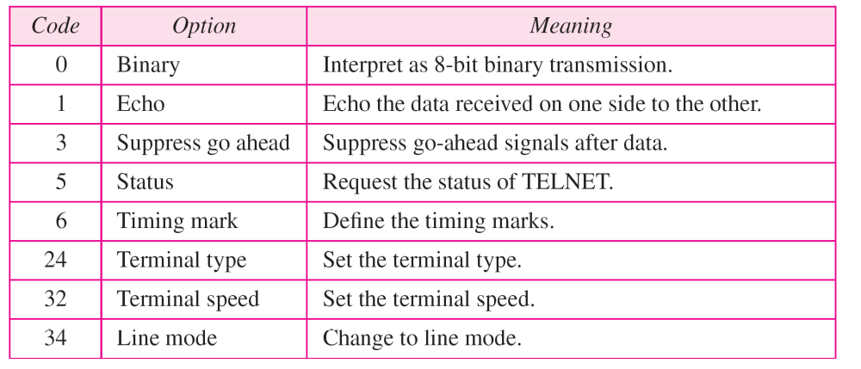
Table 26.2 Options

Slide 9
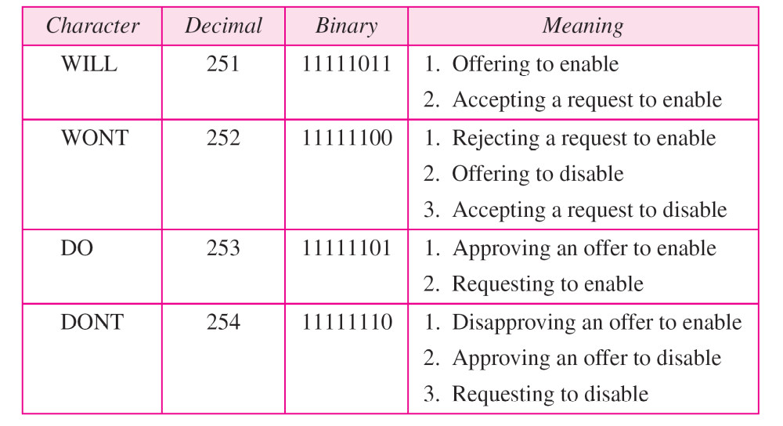
Table 26.3 NVT character set for option negotiation

Slide 10
Example 26.1
Figure 26.4 shows an example of option negotiation. In this example, the client wants the server to echo each character sent to the server. The echo option is enabled by the server because it is the server that sends the characters back to the user terminal. Therefore, the client should request from the server the enabling of the option using DO. The request consists of three characters: IAC, DO, and ECHO. The server accepts the request and enables the option. It informs the client by sending the three-character approval: IAC, WILL, and ECHO.

Slide 11
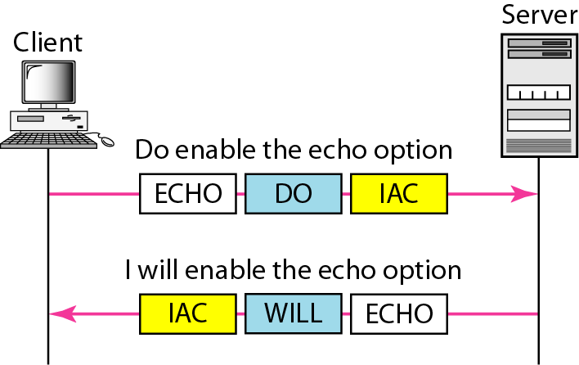
Figure 26.4 Example 26.1: Echo option

Slide 12
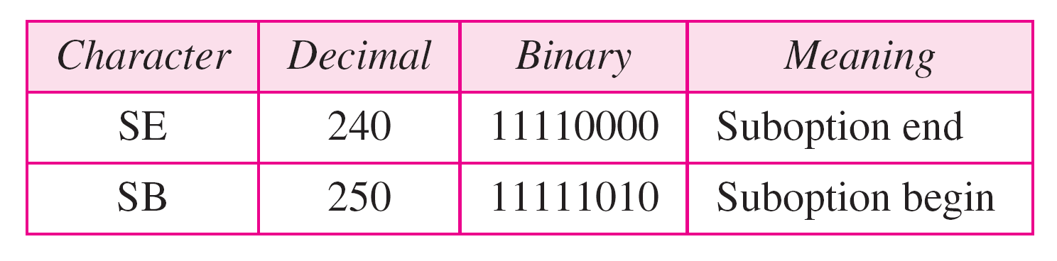
Table 26.4 Character set for suboptions

Slide 13
Example 26.2
Figure 26.5 shows an example of suboption negotiation. In this example, the client wants to negotiate the type
of the terminal.

Slide 14
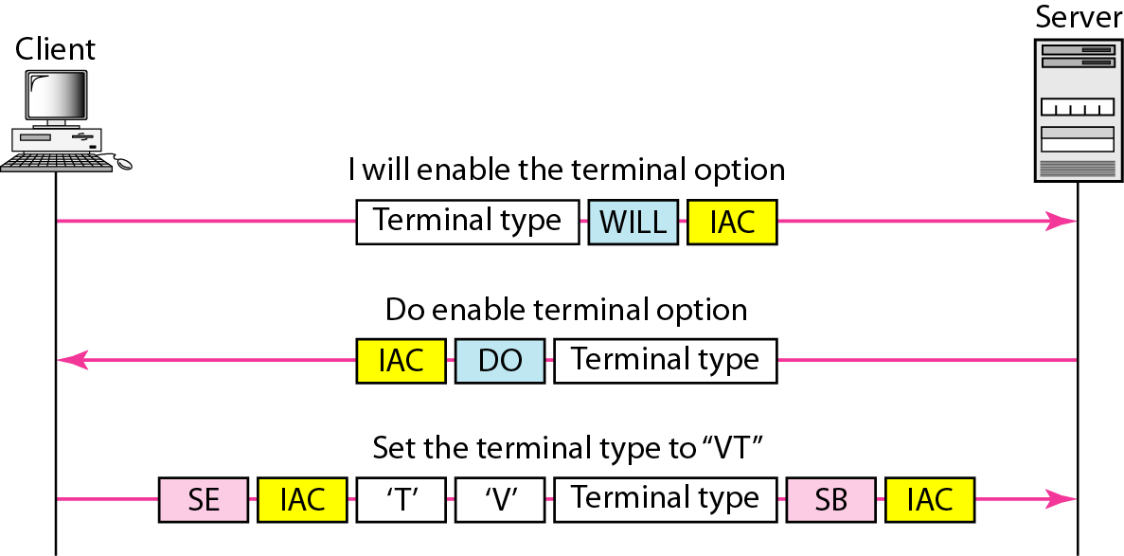
Figure 26.5 Example of suboption negotiation

Slide 15
26-2 ELECTRONIC MAIL
One of the most popular Internet services is electronic mail (e-mail). The designers of the Internet probably never imagined the popularity of this application program. Its architecture consists of several components that we discuss in this chapter.
Topics discussed in this section:
Architecture
User Agent
Message Transfer Agent: SMTP
Message Access Agent: POP and IMAP
Web-Based Mail

Slide 16

Figure 26.6 First scenario in electronic mail

Slide 17
Note
When the sender and the receiver of an e-mail are on the same system,
we need only two user agents.

Slide 18

Figure 26.7 Second scenario in electronic mail

Slide 19
Note
When the sender and the receiver of an e-mail are on different systems, we
need two UAs and a pair of
MTAs (client and server).

Slide 20

Figure 26.8 Third scenario in electronic mail

Slide 21
Note
When the sender is connected to the mail server via a LAN or a WAN,
we need two UAs and two pairs
of MTAs (client and server).

Slide 22

Figure 26.9 Fourth scenario in electronic mail

Slide 23

Figure 26.10 Push versus pull in electronic email

Slide 24
Note
When both sender and receiver are connected to the mail server via
a LAN or a WAN, we need two
UAs, two pairs of MTAs
and a pair of MAAs.
This is the most common situation today.

Slide 25

Figure 26.11 Services of user agent

Slide 26
Note
Some examples of command-driven user agents are mail, pine,
and elm.

Slide 27
Note
Some examples of GUI-based user agents are Outlook, Thunderbird
Note that “outlook” has many varieties depending on which version it is. It keeps changing names, but its quality stays low :)

Slide 28

Figure 26.12 Format of an e-mail

Slide 29

Figure 26.13 E-mail address

Slide 30
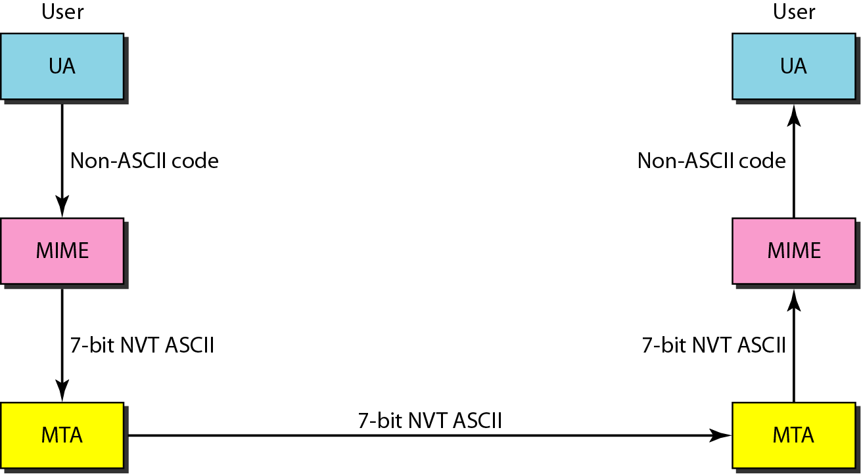
Figure 26.14 MIME

Slide 31
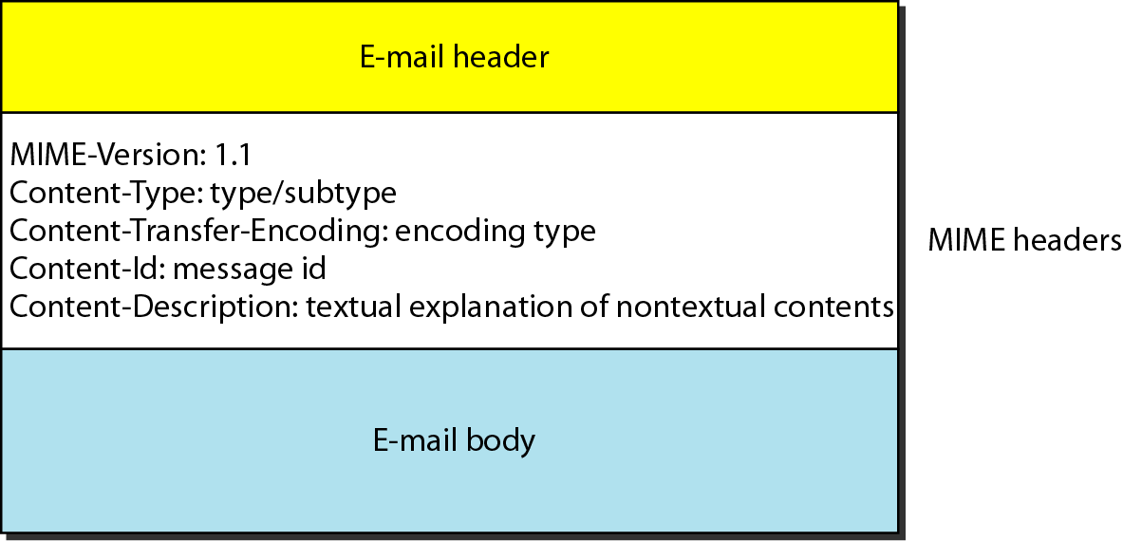
Figure 26.15 MIME header

Slide 32
Table 26.5 Data types and subtypes in MIME

Slide 33
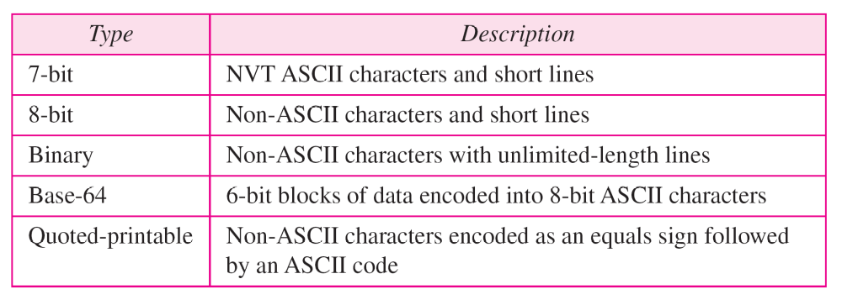
Table 26.6 Content-transfer-encoding

Slide 34
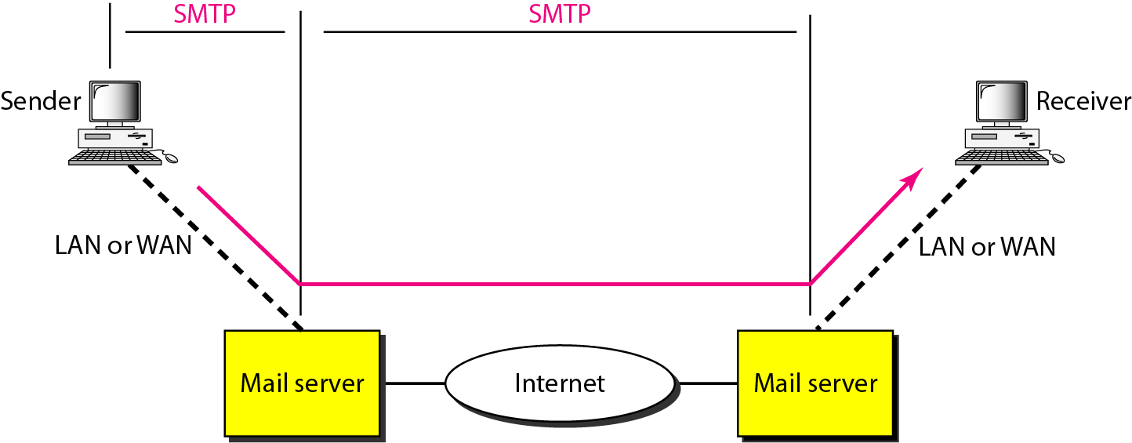
Figure 26.16 SMTP range

Slide 35

Figure 26.17 Commands and responses

Slide 36

Figure 26.18 Command format

Slide 37
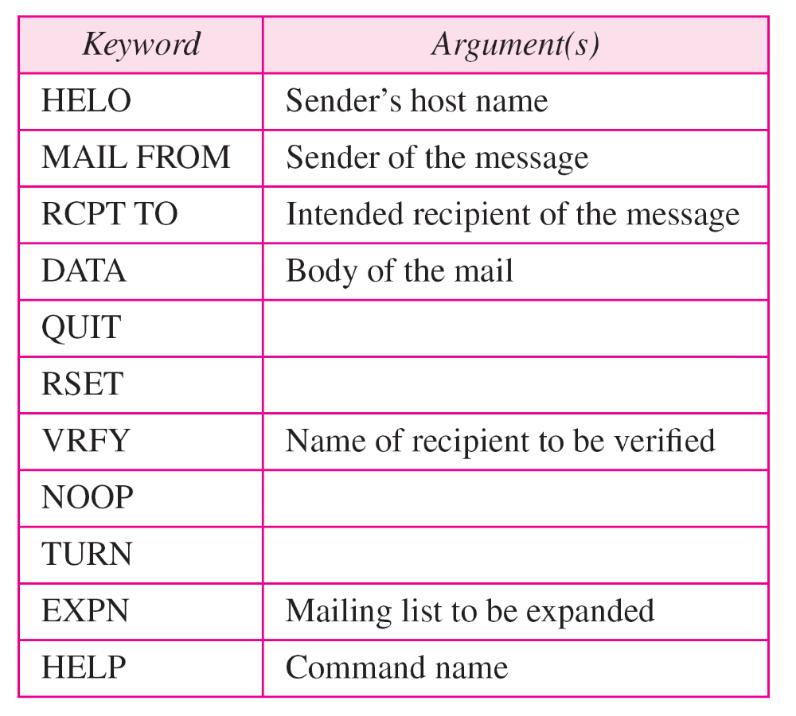
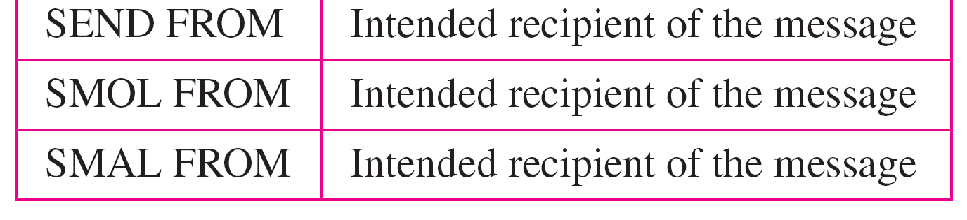
Table 26.7 Commands

Slide 38
Table 26.8 Responses

Slide 39
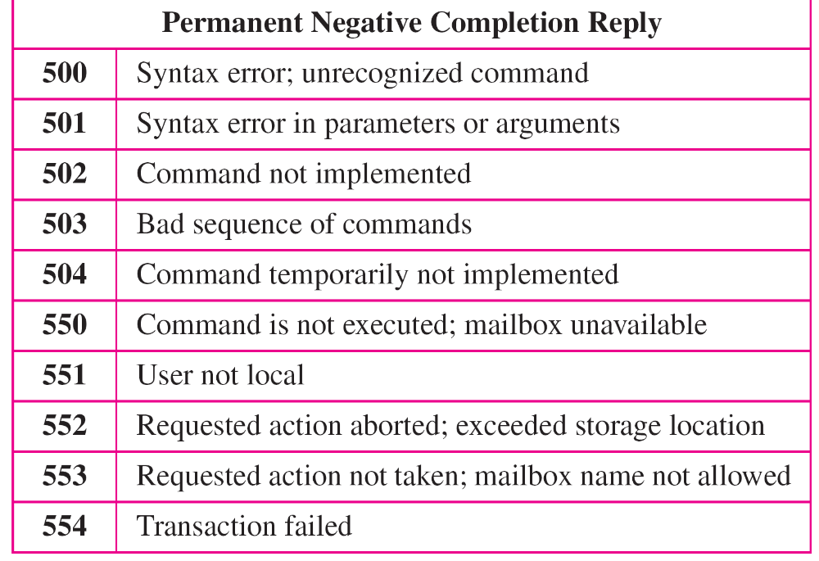
Table 26.8 Responses (continued)

Slide 40
Example 26.3
Let us see how we can directly use SMTP to send an
e-mail and simulate the commands and responses we described in this section. We use TELNET to log into port 25 (the well-known port for SMTP). We then use the commands directly to send an e-mail. In this example, forouzanb@adelphia.net is sending an e-mail to himself. The first few lines show TELNET trying to connect to the Adelphia mail server. After connection, we can type the SMTP commands and then receive the responses, as shown on the next slide. Note that we have added, for clarification, some comment lines, designated by the “=” signs. These lines are not part of the e-mail procedure.

Slide 41
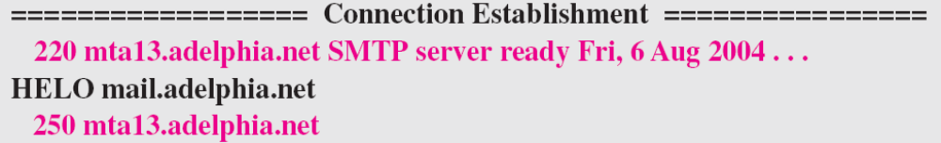
Example 26.3 (continued)
$ telnet mail.adelphia.net 25
Trying 68.168.78.100 . . .
Connected to mail.adelphia.net (68.168.78.100).

Slide 42
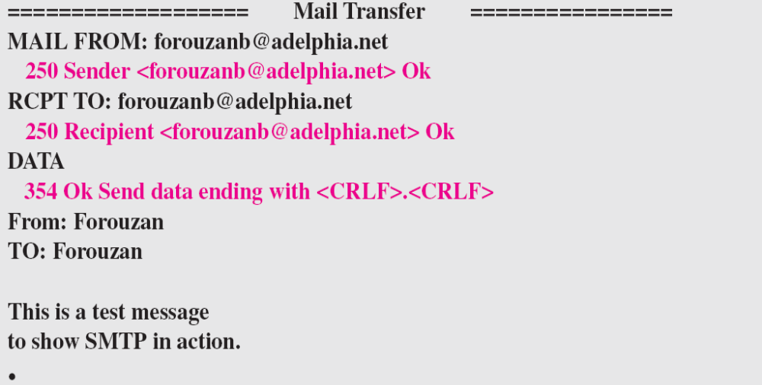
Example 26.3 (continued)

Slide 43
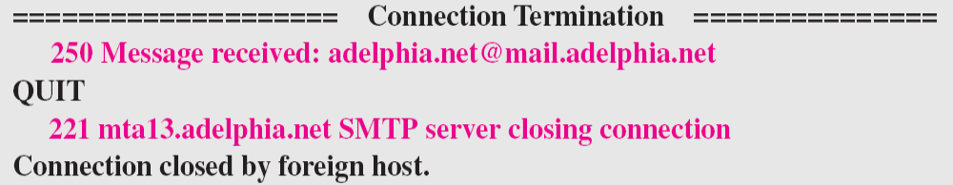
Example 26.3 (continued)

Slide 44
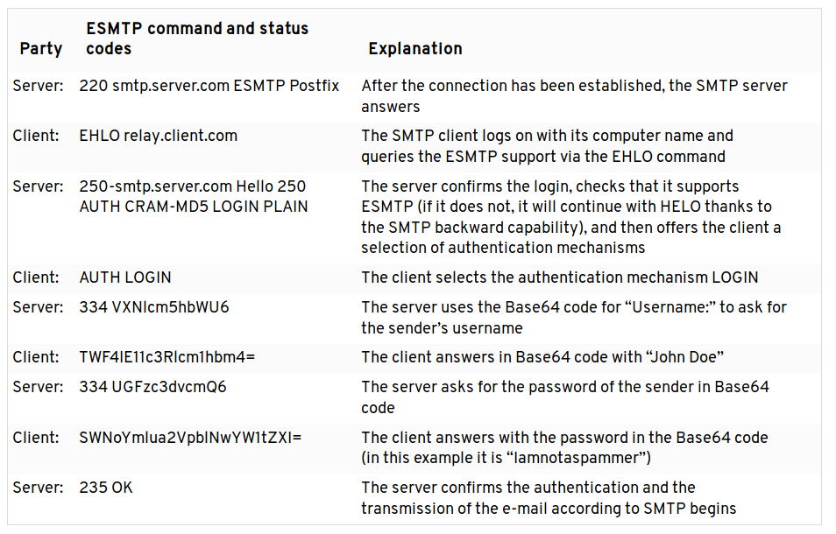

Slide 45
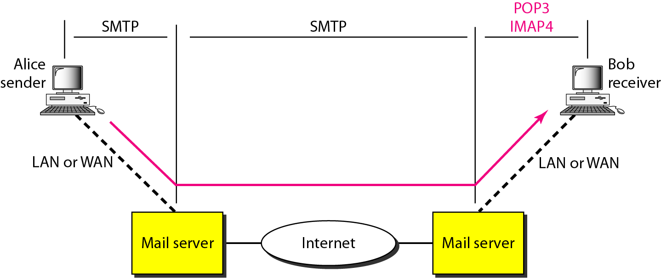
Figure 26.19 POP3 and IMAP4

Slide 46
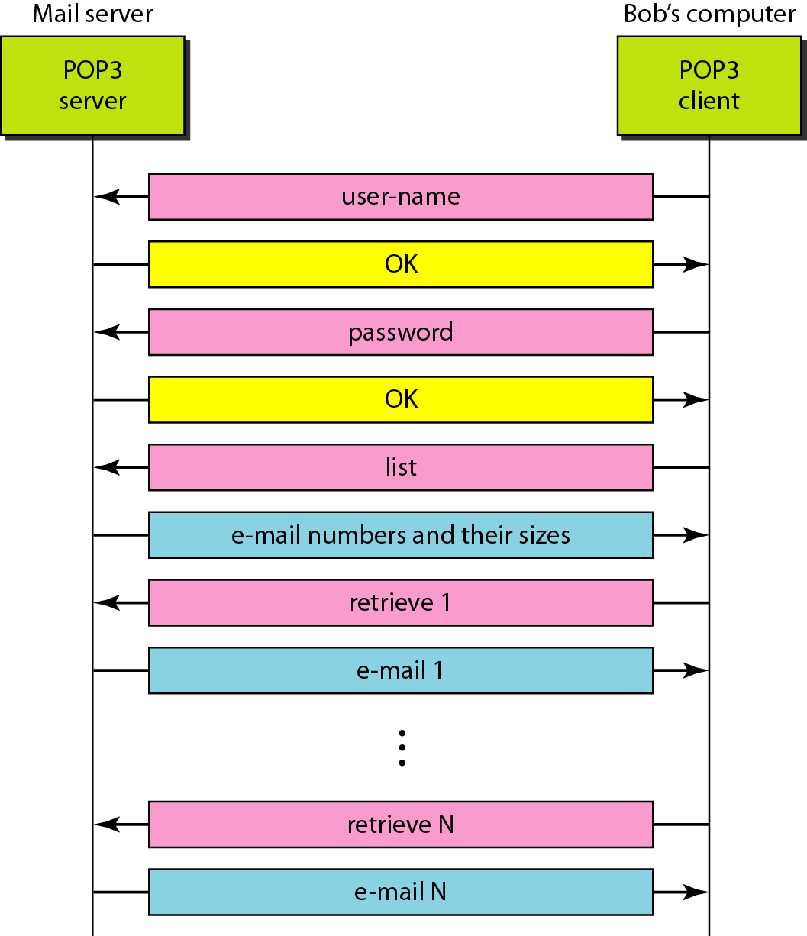
Figure 26.20 The exchange of commands and responses in POP3

Slide 47
26-3 FILE TRANSFER
Transferring files from one computer to another is one of the most common tasks expected from a networking or internetworking environment. As a matter of fact, the greatest volume of data exchange in the Internet today is due to file transfer.
Topics discussed in this section:
File Transfer Protocol (FTP)
Anonymous FTP

Slide 48
Note
FTP uses the services of TCP. It needs two TCP connections.
The well-known port 21 is used for the control connection and the well-known port 20 for the data connection.

Slide 49
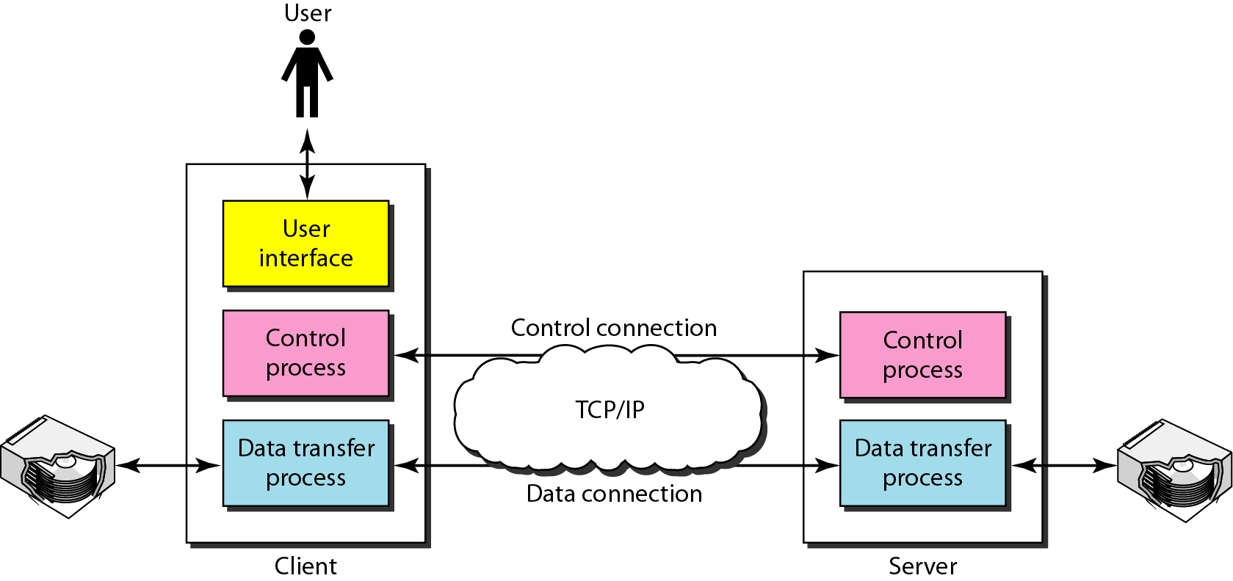
Figure 26.21 FTP

Slide 50
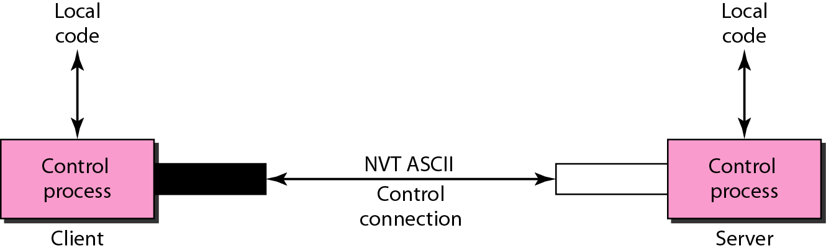
Figure 26.22 Using the control connection

Slide 51
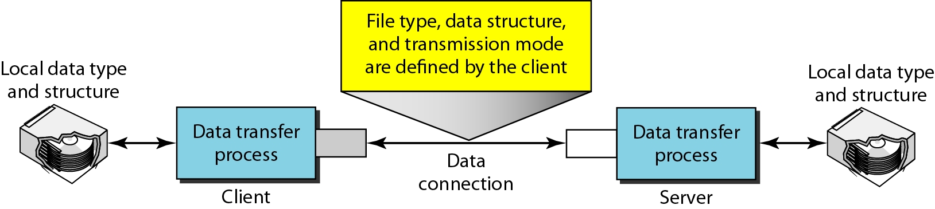
Figure 26.23 Using the data connection

Slide 52
Example 26.4
The following shows an actual FTP session for retrieving a list of items in a directory. The colored lines show the responses from the server control connection; the black lines show the commands sent by the client. The lines in white with a black background show data transfer.
1. After the control connection is created, the FTP server
sends the 220 response.
2. The client sends its name.
3. The server responds with 331.

Slide 53
Example 26.4 (continued)
4. The client sends the password (not shown).
5. The server responds with 230 (user log-in is OK).
6. The client sends the list command (ls reports) to find
the list of files on the directory named report.
7. Now the server responds with 150 and opens the data
connection.
8. The server then sends the list of the files or directories
on the data connection.
9. The client sends a QUIT command.
10. The server responds with 221.

Slide 54
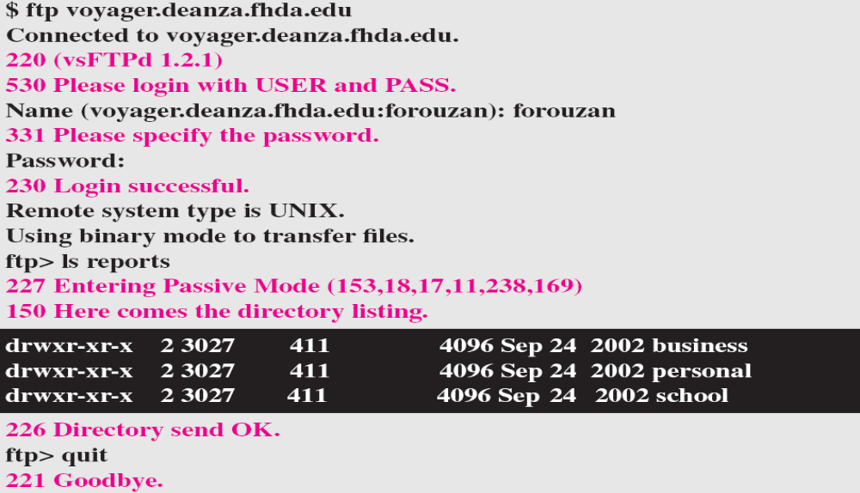
Example 26.4 (continued)

Slide 55
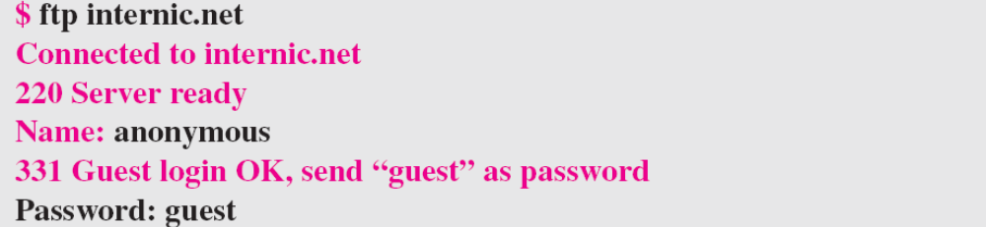
Example 26.5
We show an example of anonymous FTP. We assume that some public data are available at internic.net.
We show an example of anonymous FTP. We assume that some public data are available at internic.net.
continued on next slide

Slide 56
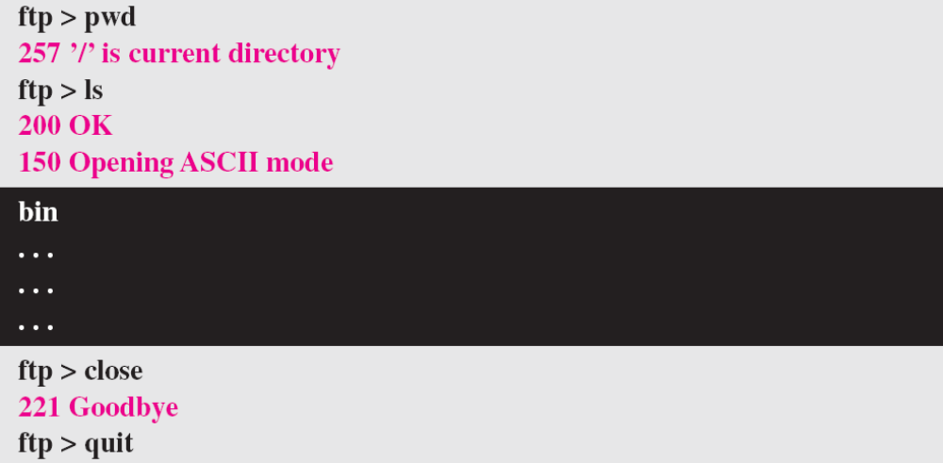
Example 26.5 (continued)

