Slide 1
CENG 383 Real-Time Systems
Lecture 1
Introduction
Prof. Dr. Tolga Ayav
Department of Computer Engineering
İzmir Institute of Technology

Slide 2






System
A system has a set of one or more inputs entering a black box and a set of one or more outputs exiting the black box.
.
.
.
.
.
.
System with n inputs and m outputs.
More formally:
Then the system is a cross product of
İzmir Institute of Technology Real-Time Systems

Slide 3
Deterministic System
Definition.
A system is said to be deterministic if for each possible state, and each set of inputs, a unique set of outputs, response times and next state of the system can be determined.
Event determinism.
Next states and outputs of the system are known for each set of inputs which trigger events.
Temporal determinism.
The response time of each set of outputs is known.
İzmir Institute of Technology Real-Time Systems

Slide 4
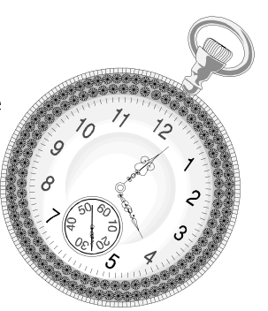
Real-Time (1)‏
The Oxford dictionary of Computing offers
this definition for real-time systems:
Any system in which the time at which the output is
produced is significant. This is usually because the input corresponds to some movement in the physical world, and the output has to relate to that same movement. The lag from input time to output time must be sufficiently small for acceptable timeliness.
Real-Time system is defined as a system where the correctness of the system depends not only the result of computations but also on the time at which it is produced. Therefore the time is the most important item to be managed.
Definition in Laplante's book:
A real-time system is a system that must satisfy explicit (bounded) response-time constraints or risk severe consequences, including failure.
İzmir Institute of Technology Real-Time Systems

Slide 5
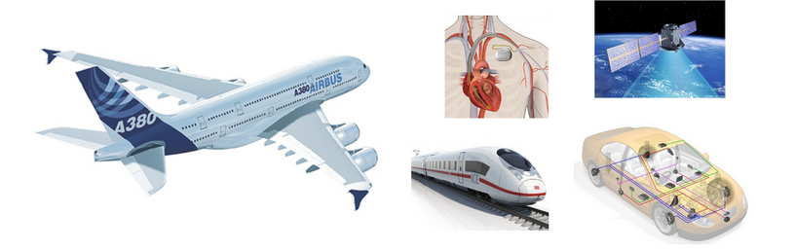
Real-Time Systems
Controllers in particularly safety critical systems like planes, trains, cars,
satellites, etc. are expected to finish tasks within time bounds (deadlines).
İzmir Institute of Technology Real-Time Systems

Slide 6
Real-Time (2)‏
It can be argued that
all practical systems are real-time!
Hard Real-Time
Systems where failure to meet system response time constraints leads to a system failure are called hard real-time systems.
Soft Real-Time:
Systems where performance is degraded but not destroyed by failure to meet system response time constraints.
Firm Real-Time:
Systems with hard deadlines where some low probability of missing deadline can be tolerated.
İzmir Institute of Technology Real-Time Systems

Slide 7
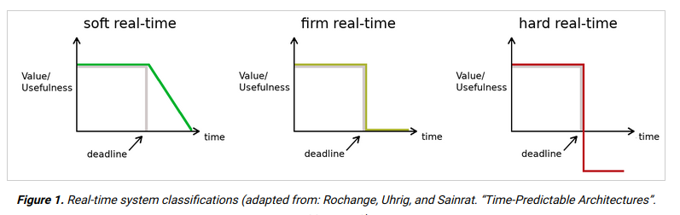
Hard, Soft, Firm RT
İzmir Institute of Technology Real-Time Systems

Slide 8
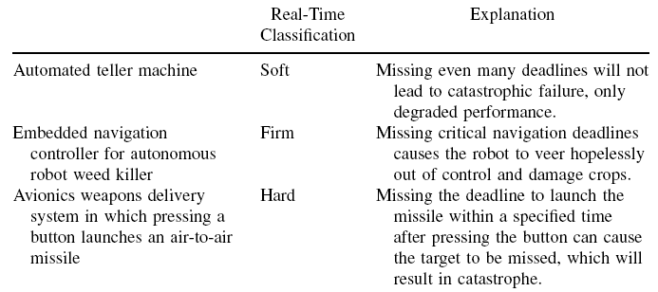
A Sample of Hard, Soft and Firm
RT Systems
İzmir Institute of Technology Real-Time Systems

Slide 9
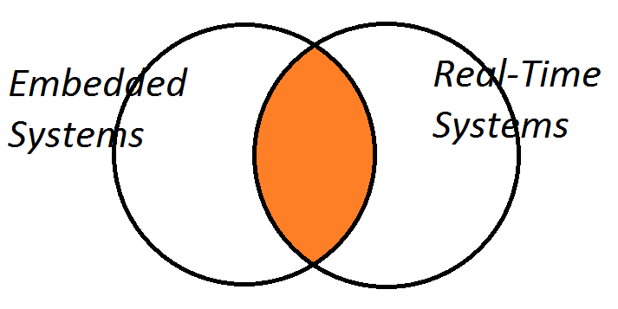
Real-Time System Embedded System
İzmir Institute of Technology Real-Time Systems

Slide 10
Main Characteristics of
Real-Time Systems
Determinism in terms of time
Reliability
Dependability
İzmir Institute of Technology Real-Time Systems

Slide 11
Common Terms
Dependability: the property of a computing
system which allows reliance to be placed on the
service it delivers;
System failure: occurs when the delivered service
deviates from service stated by the specification;
An error is that part of the system state which is
liable to lead to failure;
A fault is an adjudged cause of an error;
An error is thus the manifestation of a fault in the
system and a failure is the effect of an error on
the service.
Fault Chain:
FAULT -> ERROR -> FAILURE -> FAULT -> ...
İzmir Institute of Technology Real-Time Systems

Slide 12
Common Terms
In order to achieve a dependable computing system,
a number of diverse techniques can be used at
various stages of the system design Probably the
most successful method of achieving reliable
systems is to use a combination of one or more of
the following:
Fault Avoidance: how to prevent, by construction, fault
occurrence or introduction;
Fault Tolerance: how to provide, by redundancy, a
service complyingwith the specification in spite of faults;
Fault Removal: how to minimize, by verification, the
presence of faults;
Fault Forecasting: how to estimate, by evaluation, the
presence, the creation and the consequences of faults.
İzmir Institute of Technology Real-Time Systems

Slide 13
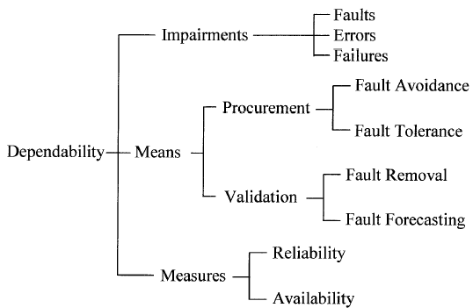
Relationship between Dependability and its Impairments, Means and Measures
İzmir Institute of Technology Real-Time Systems

Slide 14
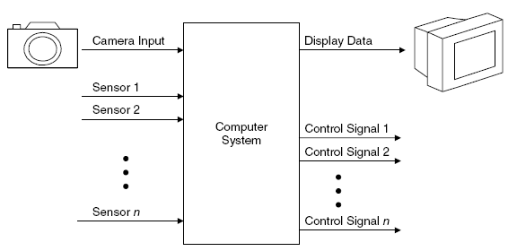
Typical Real-Time Control System
İzmir Institute of Technology Real-Time Systems

Slide 15
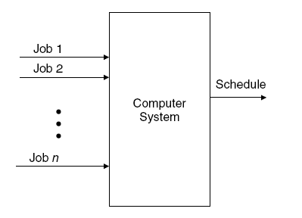
Representation of RT Systems
İzmir Institute of Technology Real-Time Systems

Slide 16
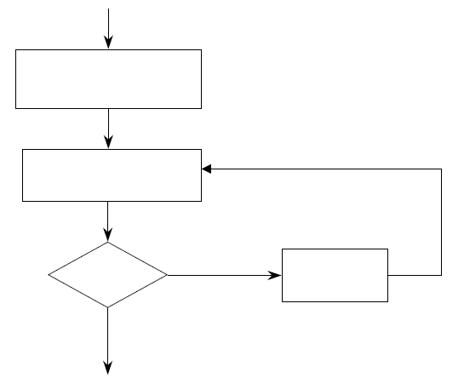
Events
Any occurrence that causes the program counter to
change nonsequentially is considered a change of
flow-of-control, and thus an event.
Change in flow-of-control means
EVENT!
İzmir Institute of Technology Real-Time Systems

Slide 17
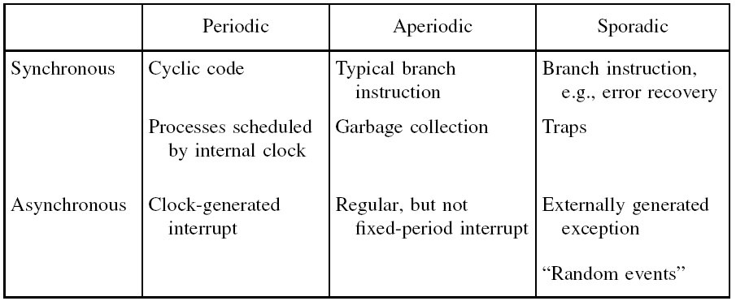
Synchronous vs. Asynchronous Events
İzmir Institute of Technology Real-Time Systems

Slide 18

Measuring System Performance
CPU Utilization:
where C is execution time and T is the period of a task.
İzmir Institute of Technology Real-Time Systems

Slide 19
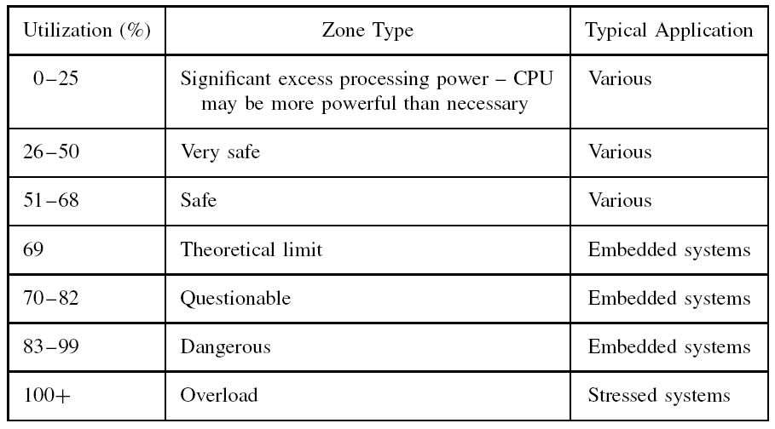
CPU Utilization Zones
İzmir Institute of Technology Real-Time Systems

Slide 20
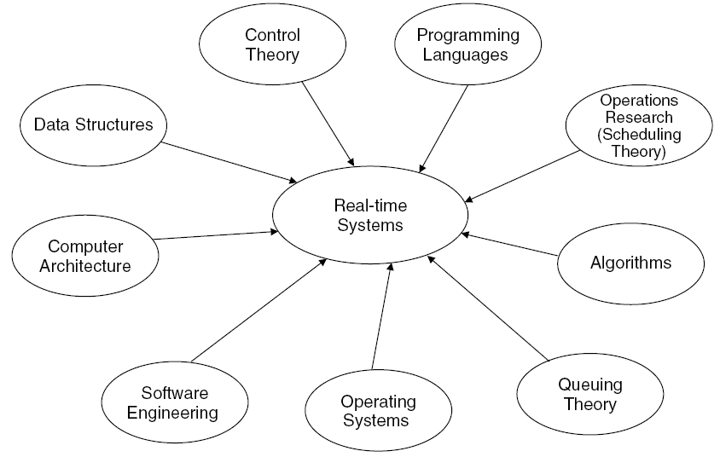
Disciplines that have impact on
RT Systems
İzmir Institute of Technology Real-Time Systems

Slide 21
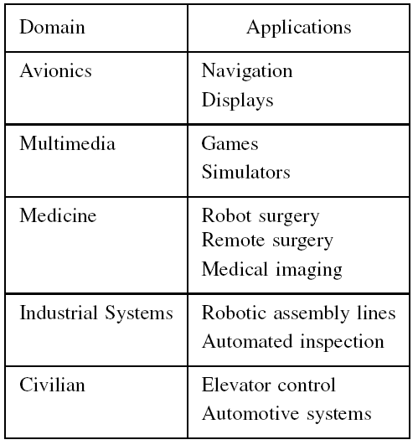
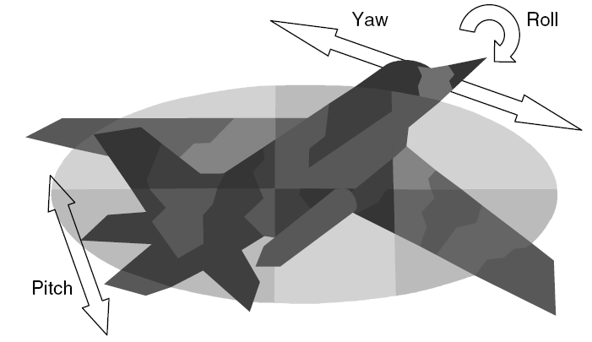
Domains and Applications of
RT Systems
İzmir Institute of Technology Real-Time Systems

Slide 22
Task Characteristics in terms of
System Requirements
İzmir Institute of Technology Real-Time Systems

Slide 23
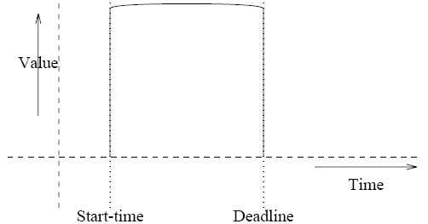
Hard Deadline
İzmir Institute of Technology Real-Time Systems

Slide 24
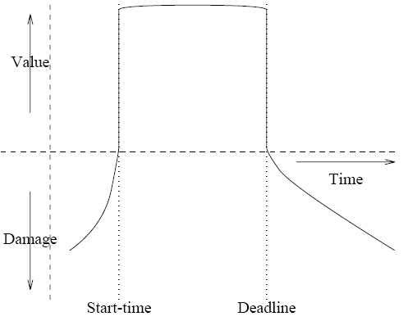
Safety Critical System
İzmir Institute of Technology Real-Time Systems

Slide 25
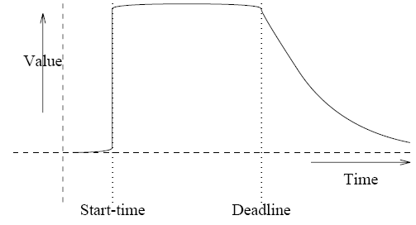
Soft Deadline
İzmir Institute of Technology Real-Time Systems

Slide 26
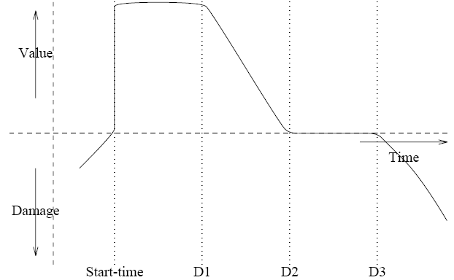
Hybrid System

Slide 27
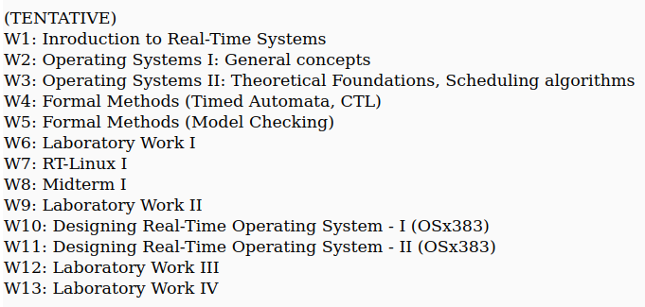
Syllabus

