Slide 1
CENG 383
Real-Time Systems
Lecture 4
Formal Methods - I
Prof. Tolga Ayav, Ph.D.
Department of Computer Engineering
İzmir Institute of Technology

Slide 2
Software Requirements Specification
Consider the following excerpt from the Software Requirements Specification for the nuclear monitoring system:
1.1 If interrupt A arrives, then task B stops executing.
1.2 Task A begins executing upon arrival of interrupt A.
1.3 Either Task A is executing and Task B is not, or Task B is executing
and Task A is not, or both are not executing.
Formalization:
p: interrupt A arrives
q: task B is executing
r: task A is executing
1.1 p ⇒￢q
1.2 p ⇒ r
1.3 (r ∧￢q) ∨ (q ∧￢r) ∨ (￢q ∧￢r)
İzmir Institute of Technology Real-Time Systems

Slide 3
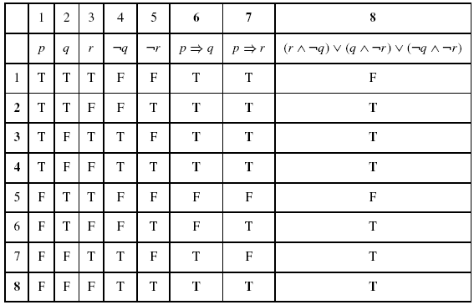
Consistency Check of Requirements
İzmir Institute of Technology Real-Time Systems

Slide 4
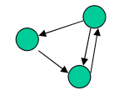
Finite State Machines
Finite state machines (FSMs) are powerful design elements used to implement algorithms in hardware.
An FSM is a 6-tuple, <Z, X, Y, δ, λ, z0>, where:
Z is a set of states {z0, z1, ... , zl},
X is a set of inputs {x0, x1, ..., xm},
Y is a set of outputs {y0, y1, ..., yn},
δ is a next-state function (i.e., transitions), mapping states and inputs to states, (Z x X → Y)‏
λ is an output function, mapping current states to outputs (Z → Y),
and
z0 is an initial state.
İzmir Institute of Technology Real-Time Systems

Slide 5
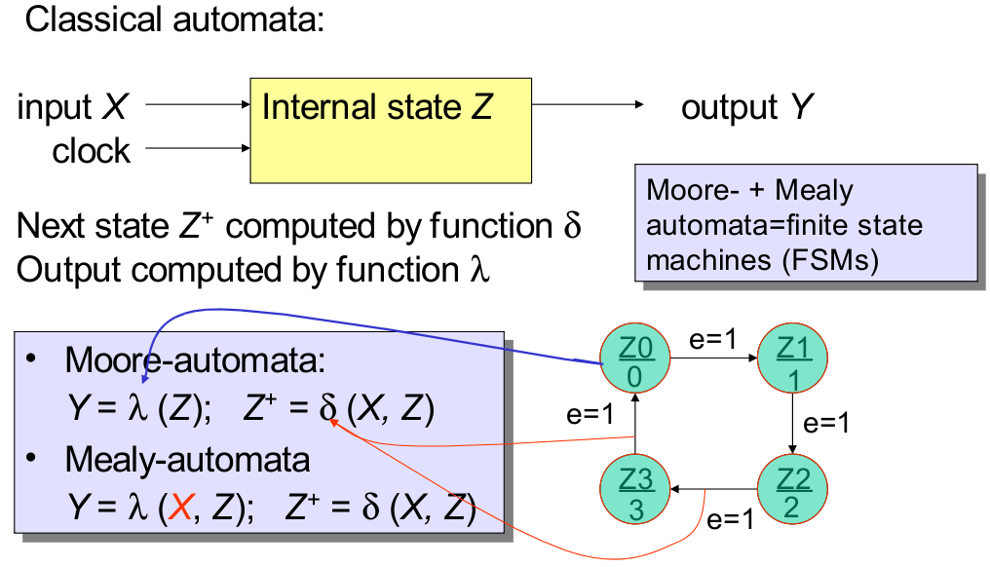
Moore and Mealy FSMs
İzmir Institute of Technology Real-Time Systems

Slide 6
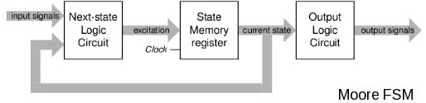
FSM Model: Moore
Outputs depends on states. λ : (Z → Y)‏
İzmir Institute of Technology Real-Time Systems

Slide 7
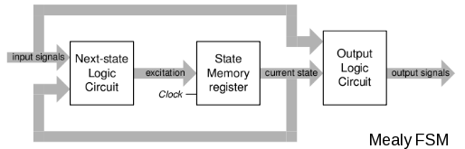
FSM Model: Mealy
Outputs depends on states and inputs. λ : (X x Z → Y)‏
İzmir Institute of Technology Real-Time Systems

Slide 8
State Machine Example
Design a Simple Seat Belt Controller:
The controller's job is to turn on a buzzer if a person sits in a seat and does not fasten the seat belt within a fixed amount of time. This system has three inputs and one output.
The inputs are a sensor for the seat to know when a person has sat down, a seat belt sensor that tells when the belt is fastened, and a timer that goes off when the required time interval has elapsed. The output is the buzzer
seat
1: person sat down
0: no person
timer_on
Seat belt
controller
belt
1: seat belt fastened
0: not fastened
buzzer
timer
1: expired
0: not expired
İzmir Institute of Technology Real-Time Systems

Slide 9
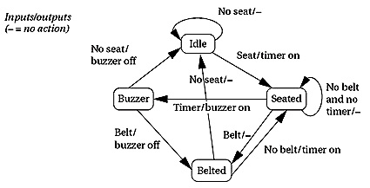
FSM for the Seat Belt Controller
İzmir Institute of Technology Real-Time Systems

Slide 10
C Code:
#define IDLE 0
#define SEATED 1
#define BELTED 2
#define BUZZER 3
void FSM()‏
{
switch(state)‏
{
case IDLE:
if(seat) {state=SEATED; timer_on=1;}
break;
case SEATED:
if(belt) state=BELTED;
else if(timer) state=BUZZER;
break;
case BELTED:
if(!seat) state=IDLE;
else if(!belt) state=SEATED;
break;
case BUZZER:
if(belt) state=BELTED;
else if(!seat) state=IDLE;
break;
}
}
State diagram
void main()‏
{
while(1) FSM();
}
İzmir Institute of Technology Real-Time Systems

Slide 11
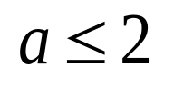
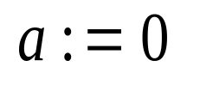
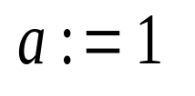

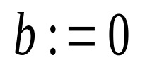
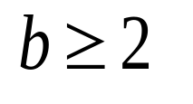
Timed Automata
Location
guard
reset
Transition
Clocks: {a,b}
İzmir Institute of Technology Real-Time Systems

Slide 12
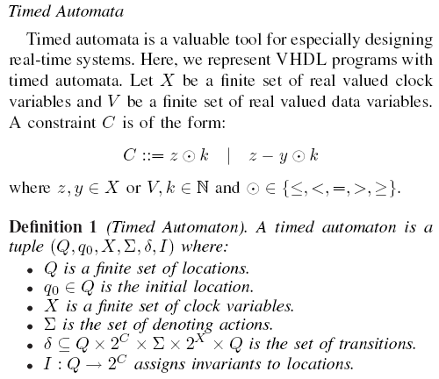
Formal Definitions-I
İzmir Institute of Technology Real-Time Systems

Slide 13
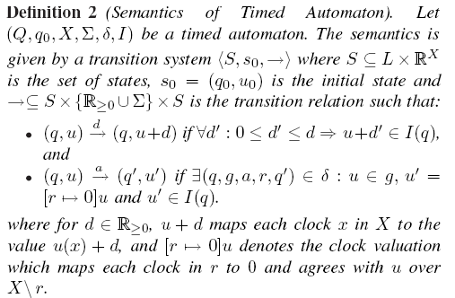
Formal Definitions-II
İzmir Institute of Technology Real-Time Systems

Slide 14





Reachability Example
İzmir Institute of Technology Real-Time Systems

Slide 15
Example
Classical Semantics
İzmir Institute of Technology Real-Time Systems

Slide 16
Example
Classical Semantics
İzmir Institute of Technology Real-Time Systems

Slide 17
Example
Classical Semantics
İzmir Institute of Technology Real-Time Systems

Slide 18
Example
Classical Semantics
İzmir Institute of Technology Real-Time Systems

Slide 19
Example
Classical Semantics
İzmir Institute of Technology Real-Time Systems

Slide 20
Example
Classical Semantics
İzmir Institute of Technology Embedded Systems Lab

Slide 21
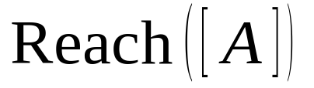
Example
Classical Semantics
İzmir Institute of Technology Embedded Systems Lab

Slide 22
Simple Light Control
Press
Off
Press
Light
Press
Bright
Press
WANT: if press is issued twice quickly
then the light will get brighter; otherwise the light is
turned off.
İzmir Institute of Technology Embedded Systems Lab

Slide 23
Simple Light Control
Press
Off
Press
x:=0
Light
Press
Bright
x<=3
x>3
Press
Solution: Add a real-valued clock x
Adding continuous variables to state machines
İzmir Institute of Technology Embedded Systems Lab

Slide 24
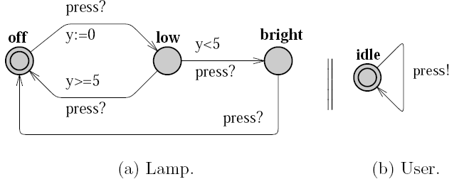
Network of Timed Automata
İzmir Institute of Technology Embedded Systems Lab

Slide 25
Adding Invariants
n
x<=5
Clocks: x, y
x<=5 & y>3
Transitions
wait(3.2)
Location
Invariants
( n , x=2.4 , y=3.1415 )
a
wait(1.1)
( n , x=2.4 , y=3.1415 )
( n , x=3.5 , y=4.2415 )
x := 0
m
y<=10
g4
g1
g3
g2
Invariants ensure progress!!
İzmir Institute of Technology Embedded Systems Lab

Slide 26
Timed Automata Examples and Timing Behaviours
İzmir Institute of Technology Embedded Systems Lab

Slide 27
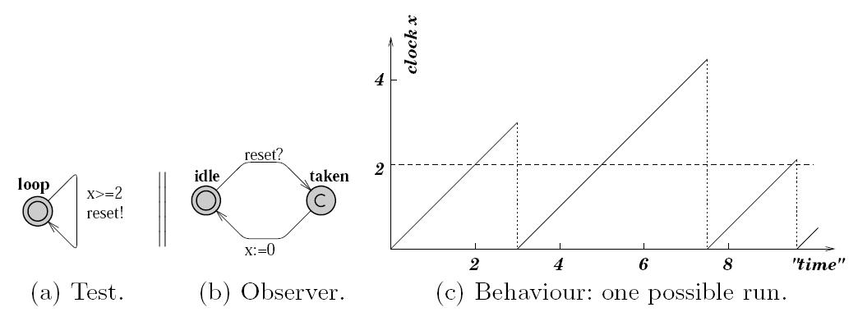
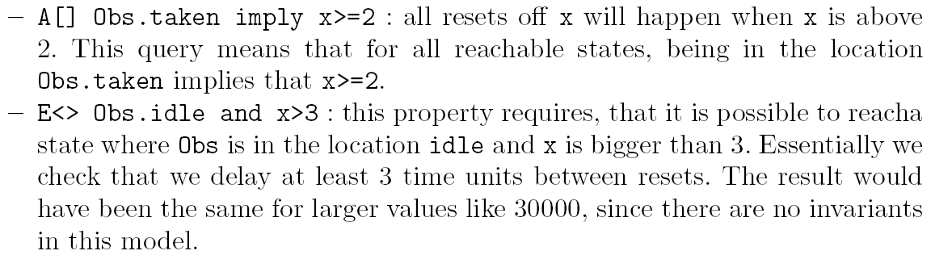
İzmir Institute of Technology Embedded Systems Lab

Slide 28
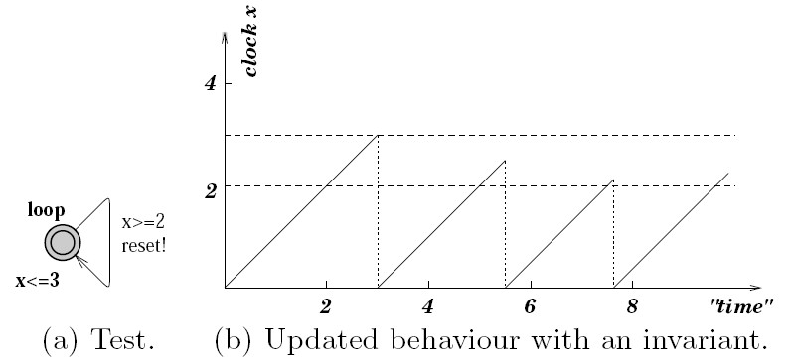
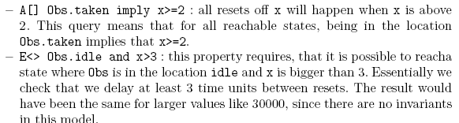
İzmir Institute of Technology Embedded Systems Lab

Slide 29
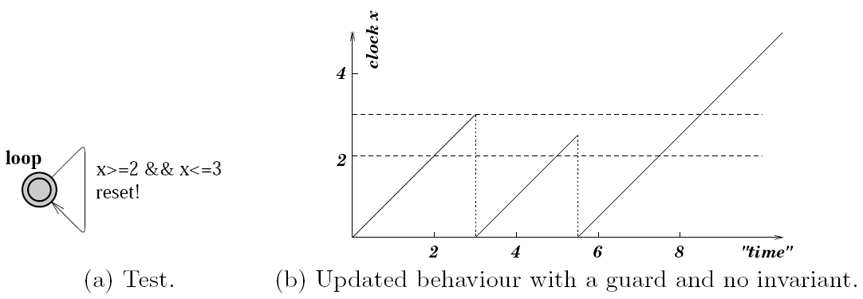
Property A[] not deadlock will not satisfy!
İzmir Institute of Technology Embedded Systems Lab

Slide 30
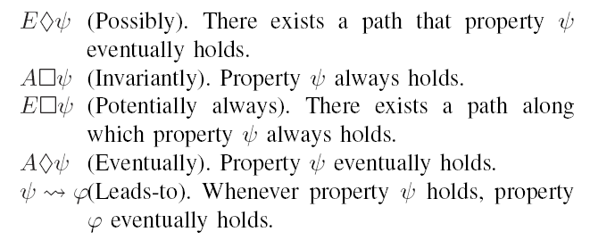
CTL (Computation Tree Logic)
SAFETY
LIVENESS
İzmir Institute of Technology Embedded Systems Lab

Slide 31
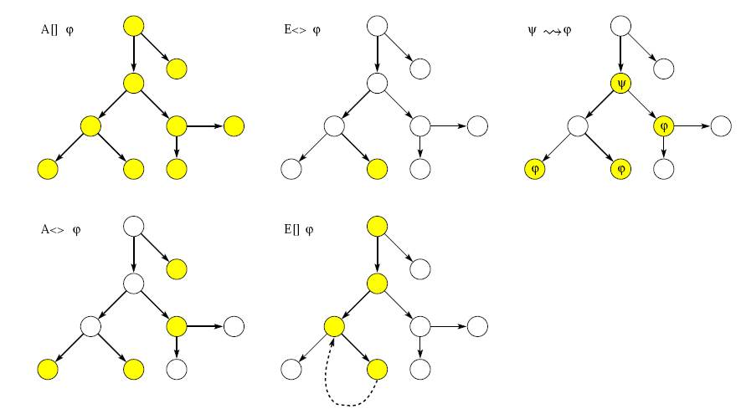
Path Formulae
İzmir Institute of Technology Embedded Systems Lab

Slide 32
model
Model Checker
yes
temporal
property
error-trace
Advantages
  Automated formal verification, Effective debugging tool
Moderate industrial success
  In-house groups: Intel, Microsoft, Lucent, Motorola…
  Commercial model checkers: FormalCheck by Cadence
Obstacles
  Scalability is still a problem (about 500 state vars)
  Effective use requires great expertise
Still, a great success story for CS theory impacting practice, and a vibrant area of research
İzmir Institute of Technology Embedded Systems Lab

Slide 33
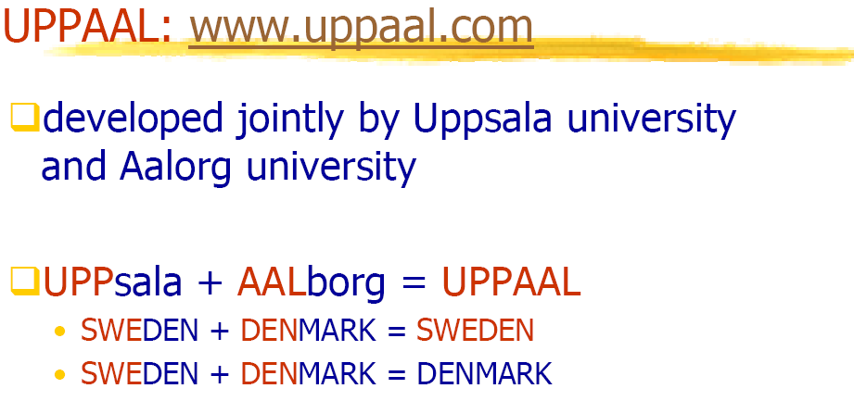
İzmir Institute of Technology Embedded Systems Lab

Slide 34
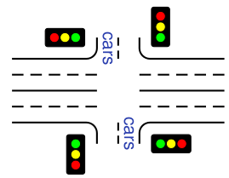
Assignment: Traffic Light Controller
Traffic light controller controls a traffic light at the intersection of a busy highway and a farm road. Normally, the highway light is green but if a sensor detects a car on the farm cars road, the highway light turns yellow then red. The farm road light then turns green until there are no cars or after a long timeout. Then, the farm road light turns yellow then red, and the highway light returns to green. The inputs to the machine are the car sensor, a short timeout signal, and a long timeout signal. The outputs are a timer start signal and the colors of the highway and farm road lights.
Create a Timed Automata to model this intersection.
Draw your timed automata in UPPAAL.
İzmir Institute of Technology Embedded Systems Lab

