Slide 1
CENG 383
Real-Time Systems
Lecture 2
General Concepts of RTOS
(Real-Time Operating System)
Prof. Dr. Tolga Ayav
Department of Computer Engineering
İzmir Institute of Technology

Slide 2
Operating System
Specialized collection of system programs is
called operating system.
Must provide at least three specific functions:
  Task scheduling
  Task dispatching
  Intertask communication
Kernel (Nucleus): The smallest portion of OS that
provides those three essential functions.
İzmir Institute of Technology Real-Time Systems

Slide 3
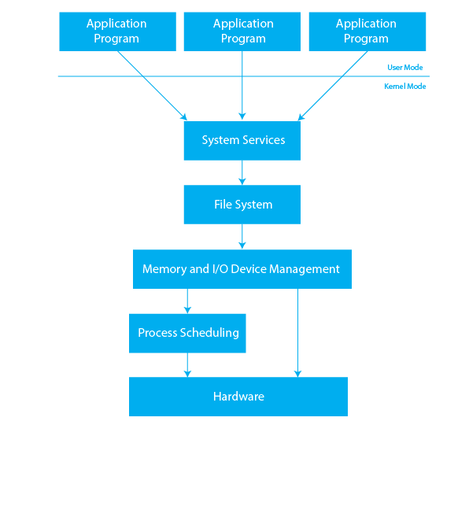
Operating System: Layered Architecture
İzmir Institute of Technology Real-Time Systems

Slide 4

Real-Time OS
Every real-time system contains some operating system-like functionality to provide an interface to the input/output hardware and coordination of virtual concurrency in a uniprocessor environment—or even
true concurrency with multi-core processors and distributed system architectures. Such a central piece of system software has the following principal aims:
to offer a reliable, predictable, and low-overhead platform for multitasking and resource sharing;
to make the application software design easier and less hardware bound;
and to make it possible for engineers in various industries to concentrate
on their core product knowledge and leave the computer-speciﬁc issues
increasingly to specialized consultants and software vendors.
İzmir Institute of Technology Real-Time Systems

Slide 5
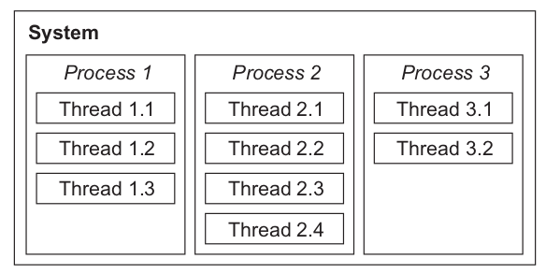
Tasks, threads
A process (synonymously called “task”
throughout this text) is an abstraction of a
running program and is the logical unit of work
schedulable by the real-time operating system.
İzmir Institute of Technology Real-Time Systems

Slide 6
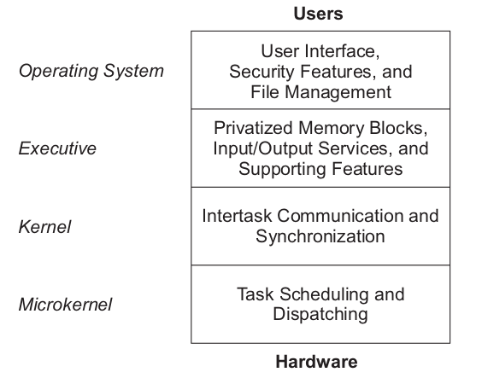
Role of the Kernel
İzmir Institute of Technology Real-Time Systems

Slide 7
Three Kernel Functions
OS Kernel - 3 functions:
Task Scheduler : To determine which task will
run next in a multitasking system
Task Dispatcher: To perform necessary
bookkeeping to start a task
Intertask Communication: To support
communication between one process (i.e. task)
and another
İzmir Institute of Technology Real-Time Systems

Slide 8
Kernel Design Strategies
Polled Loop Systems
Cyclic Executive
Cooperative Multitasking
Interrupt-Driven Systems
Foreground/Background Systems
Full featured RTOS
İzmir Institute of Technology Real-Time Systems

Slide 9
1. Polled Loop Systems
Polled loops are used for fast response to single devices.
In a polled-loop system, a single and a repetitive instruction is used to test a flag that indicates whether or not some event has occurred. If the event has not occurred, then the polling continues.
Example: suppose a software system is needed to handle packets of data
that arrive at a rate of no more than 1 per second. A flag named packet_here
is set by the network, which writes the data into the CPU’s memory via direct
memory access (DMA). The data are available when packet_here = 1. Using
a C code fragment, such a polled loop to handle such a system is:
for(;;) { /* do forever */
if (packet_here) { /* check flag */
process_data(); /* process data */
packet_here=0; /* reset flag */
}
}
İzmir Institute of Technology Real-Time Systems

Slide 10
Synchronized Polled Loop (1)
A variation on the polled loop uses a fixed clock interrupt to pause between the time when the signaling event is triggered
and then reset. Such a system is used to treat events that exhibit switch bounce.
Example: suppose a polled-loop system is used to handle an event that occurs
randomly, but no more than once per second. The event is
known to exhibit a switch-bounce effect that disappears after 20 milliseconds.
A 10-millisecond fixed-rate interrupt is available for synchronization. The event
is signaled by an external device that sets a memory location via DMA. The C
code looks like the following:
for(;;) { /* do forever */
if(flag) { /* check flag */
pause(20); /* wait 20 ms */
process_event(); /* process event */
flag=0; /* reset flag */
}
}
İzmir Institute of Technology Real-Time Systems

Slide 11
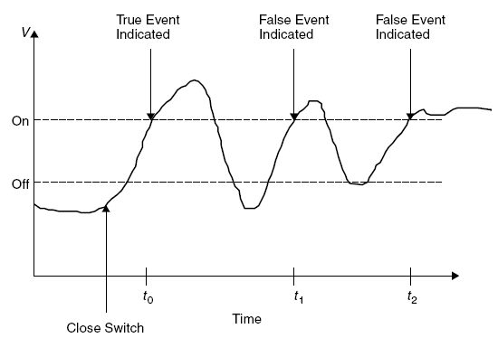
Synchronized Polled Loop (2)
for(;;) { /* do forever */
if(flag) { /* check flag */
counter = 0;
while(counter<3);
process_event(); /* process event */
flag=0; /* reset flag */
}
}
10ms interrupt service routine
might look like:
counter=counter+1;
İzmir Institute of Technology Real-Time Systems

Slide 12
2. Cyclic Executive
Cyclic executives are noninterrupt-driven systems
that can provide the illusion of simultaneity by taking advantage of relatively short processes on a fast processor in a continuous loop.
for(;;) {
task_1();
task_2();
...
task_n();
}
for(;;) {
task_1();
task_2();
task_1();
task_3();
}
If each process is relatively short and uniform in size, then reactivity
and simultaneity can be achieved without interrupts. Moreover, if each
process is carefully constructed including synchronization through messaging
or global variables, complete determinism and schedulability can be achieved.
İzmir Institute of Technology Real-Time Systems

Slide 13
3. Cooperative Multitasking
Two or more processes are coded in the state-driven fashion just discussed, and after each phase is complete, a call is made to a central dispatcher. The dispatcher holds the program counter for a list of processes that are executed in round-robin fashion; that is, it selects the next process to execute. Known as code-driven finite state automata approach.
void process_a(void)
{
for(;;){
switch(state_a){
case 1: phase_a1();
break;
case 2: phase_a2();
break;
case 3: phase_a3();
break;
case 4: phase_a4();
break;
case 5: phase_a5();
break;
}
}
}
void process_b(void)
{
for(;;){
switch(state_b){
case 1: phase_b1();
break;
case 2: phase_b2();
break;
case 3: phase_b3();
break;
case 4: phase_b4();
break;
case 5: phase_b5();
break;
}
}
}
“break” commands call dispatcher. State_a and state_b are global variables managed
by the dispatcher. This is simpliest form of fairness scheduling.
İzmir Institute of Technology Real-Time Systems

Slide 14
4. Interrupt-Driven Systems
In interrupt-driven systems, the main program is a single jump-to-self instruction. The various tasks in the system are scheduled via either hardware or software interrupts, whereas dispatching is performed by the interrupt-handling routines.
void main(void)
{
for(;;);
}
void _isr_1(void)
{
...
}
void _isr_n(void)
{
...
}
...
Hardware Interrupt: A signal generated by a peripheral device and sent to the CPU. In turn, the CPU executes an interrupt service routine (ISR), which takes action in response to the interrupt.
Software Interrupt: Similar to the hardware interrupt, in that it causes one code module to pass control to another.
İzmir Institute of Technology Real-Time Systems

Slide 15
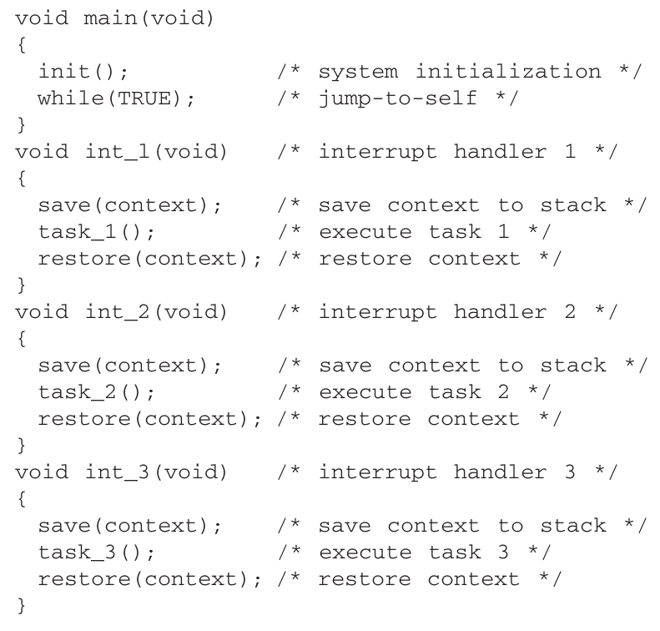
İzmir Institute of Technology Real-Time Systems

Slide 16
Hardware Interrupts and ISRs
An interrupt can happen at any time (Asynchronous).
CPU invokes the ISR.
Around the code that reads/writes to the shared resources
interrupts are disabled in the application.
Synchronization mechanisms cannot be used in ISR,
because ISR should not wait indefinitely.
When interrupts are disabled, the system’s ability to
receive stimuli from the outside world is minimal.
It is important to keep the critical sections of code
in which the interrupts are disabled as short as possible.
ISRs can be reentrant where applicable
A snapshot of the machine – called the context – must be
preserved upon switching tasks so that it can be restored upon
resuming the interrupted process.
İzmir Institute of Technology Real-Time Systems

Slide 17
Context Switch
Saving the minimume amount of information necessary to safely restore any process after it has been interrupted. This information ordinarily includes:
Contents of general purpose registers
Contents of the program counter
Contents of special registers (e.g. Flags)
Memory page register
Images of memory mapped I/O locations (mirror
images)
void main(void)
{
for(;;);
}
void _isr_1(void)
{
save(context);
task_1();
restore(context);
}
void _isr_n(void)
{
save(context);
task_n();
restore(context);
}
...
İzmir Institute of Technology Real-Time Systems

Slide 18
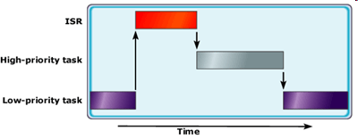
Preemptive-Priority Systems
A higher-priority task is said to preempt a lower-priority task if it interrupts the lower-priority task. Systems that use preemption schemes instead of round-robin or first-come-first-served scheduling are called preemptive-priority systems.
İzmir Institute of Technology Real-Time Systems

Slide 19
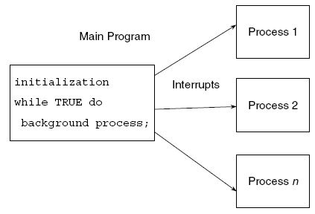
5. Foreground-Background Systems
Foreground/background systems are an improvement over the interrupt-only systems in that the polled loop is replaced by code that performs useful processing. Foreground/background systems are the most common architecture for embedded applications.
Initialization:
1. Disable interrupts
2. Set up interrupt vectors
and stacks
3. Perform self-test
4. Perform system initialization
5. Enable interrupts
İzmir Institute of Technology Real-Time Systems

Slide 20
Background Process
Not time critical
What kind of funtions are appropriate ?
p: time-loading factor for all foreground tasks
e: execution time of background task
t: background process execution period
t = e / (1 - p)
Execution period can be very low!
İzmir Institute of Technology Real-Time Systems

Slide 21

Example Background Process:
Watchdog Timer
void task_1(void)
{
while(1){
wdt_1=0;
...
wdt_1=0;
...
wait();
}
}
void task2_n(void)
{
while(1){
wdt_n=0;
...
wait();
}
}
...
more frequently
void main(void)
{
for(;;){
wdt_1++; ... wdt_n++;
if(wdt_1>10)
reset_system();
...
else if(wdt_n>500)
reset_system();
}
}
İzmir Institute of Technology Real-Time Systems

Slide 22
Example 1
void interrupt yourisr() /* Interrupt Service Routine (ISR) */
{
disable();
/* Body of ISR goes here */
count--;
oldhandler();
outportb(0x20,0x20); /* Send EOI to PIC1 */
enable();
}
#include <dos.h>
#define INTNO 0x08 // Timer Interrupt
void interrupt (*oldhandler)();
int count=30;
void main(void) {
  oldhandler = getvect(INTNO); /* Save Old Interrupt Vector */
  setvect(INTNO, yourisr); /* Set New Interrupt Vector Entry */
  /* Body of Program Goes Here */
  while(count>0);
  setvect(INTNO, oldhandler); /* Restore old Interrupt Vector */
}
İzmir Institute of Technology Real-Time Systems

Slide 23
Example 2
char far * scr=0xb8000000;
char flag=0;
void interrupt yourisr() /* Interrupt Service Routine (ISR) */
{
disable();
count++;
if(count==10){count=0; flag=1; *scr=‘A’;}
oldhandler();
outportb(0x20,0x20); /* Send EOI to PIC1 */
enable();
}
Real-Time
#define INTNO 0x08 // Timer Interrupt
void interrupt (*oldhandler)();
void main(void) {
  oldhandler = getvect(INTNO); /* Save Old Interrupt Vector */
  setvect(INTNO, yourisr); /* Set New Interrupt Vector Entry */
  while(1)
  if(flag){ flag=0; *scr=‘A’; };
  setvect(INTNO, oldhandler); /* Restore old Interrupt Vector */
}
Background
İzmir Institute of Technology Real-Time Systems

Slide 24
Full-Featured RTOS
The foreground/background solution can be extended into an
operating system by adding additional functions such as
network interfaces, device drivers, and complex debugging
tools. These types of systems are readily available as commercial
products. Such systems rely on a complex operating system
using round-robin, preemptivepriority, or a combination of both
schemes to provide scheduling; the operating system represents
the highest priority task, kernel, or supervisor.
VxWorks
Real-Time Unix
Real-Time Linux
...
İzmir Institute of Technology Real-Time Systems

Slide 25
Real-Time Kernels
A Kernel, executive or nucleus is the smallest portion of the OS
that provides these functions
Rea-Time kernels must provide:
  A. Interrupt handling, guaranteed interrupt response
  B. Process management (Support for scheduling of real-time
  processes and preemptive scheduling)
  C. Interprocess communication and synchronization.
  D. Time management.
  E. Memory management
  F. I/O support (Support for communication with peripheral
  devices via drivers)
  G. High speed data acquisition
  H. Resource management (User control of system resources)
  I. Error and exception handling
İzmir Institute of Technology Real-Time Systems

Slide 26
Real-Time Kernel Features
A real-time OS should provide support for the creation,
deletion and scheduling of multiple processes
A real-time OS must be able to response an event and take
deterministic (well-defined in terms of function and time)
action based on the event.
A real-time OS should support interprocess communications via
reliable and fast facilities, such as semaphores, shared
memory and message passing.
A real-time system must be able to handle very high burst rates in
high speed data acquisition applications.
İzmir Institute of Technology Real-Time Systems

Slide 27
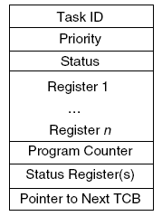
Task Control Block Model
İzmir Institute of Technology Real-Time Systems

Slide 28
Task States
Executing
Ready
Suspended (or blocked)
Dormant (or sleeping)
İzmir Institute of Technology Real-Time Systems

Slide 29
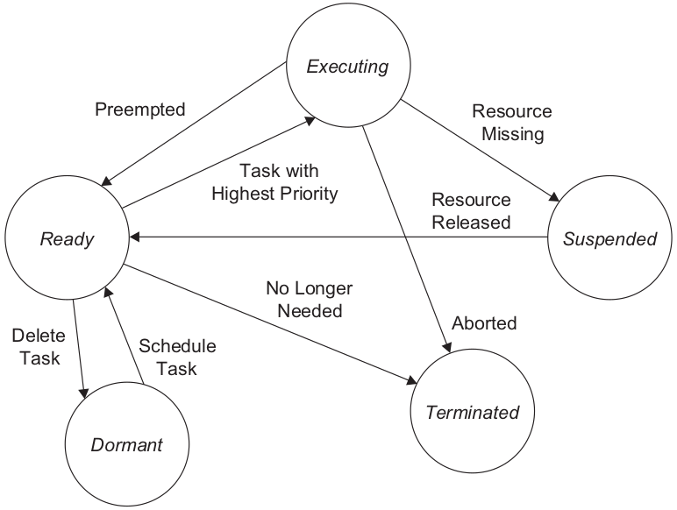
Task State Diagram
İzmir Institute of Technology Real-Time Systems

