Slide 1
CENG 383
Real-Time Systems
Lecture 5
Formal Methods II
Model Checking
Prof. Tolga Ayav, Ph.D.
Department of Computer Engineering
İzmir Institute of Technology

Slide 2
model
Model Checker
yes
temporal
property
error-trace
Advantages
  Automated formal verification, Effective debugging tool
Moderate industrial success
  In-house groups: Intel, Microsoft, Lucent, Motorola…
  Commercial model checkers: FormalCheck by Cadence
Obstacles
  Scalability is still a problem (about 500 state vars)
  Effective use requires great expertise
Still, a great success story for CS theory impacting practice, and a vibrant area of research
İzmir Institute of Technology Real-Time Systems

Slide 3
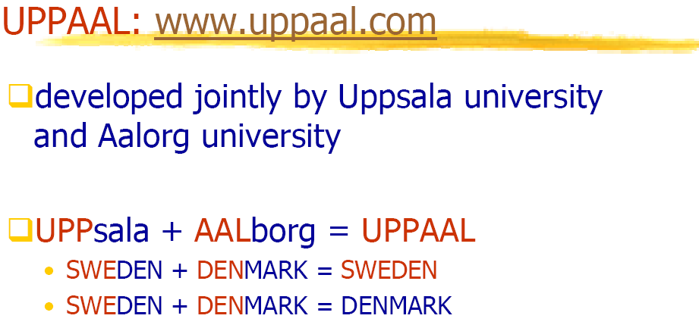
İzmir Institute of Technology Real-Time Systems

Slide 4
State Machine Example
Design a Simple Seat Belt Controller:
The controller's job is to turn on a buzzer if a person sits in a seat and does not fasten the seat belt within a fixed amount of time. This system has three inputs and one output.
The inputs are a sensor for the seat to know when a person has sat down, a seat belt sensor that tells when the belt is fastened, and a timer that goes off when the required time interval has elapsed. The output is the buzzer
seat
1: person sat down
0: no person
timer_on
Seat belt
controller
belt
1: seat belt fastened
0: not fastened
buzzer
timer
1: expired
0: not expired
İzmir Institute of Technology Real-Time Systems

Slide 5
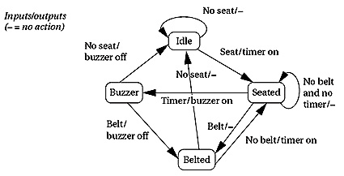
FSM for the Seat Belt Controller
İzmir Institute of Technology Real-Time Systems

Slide 6
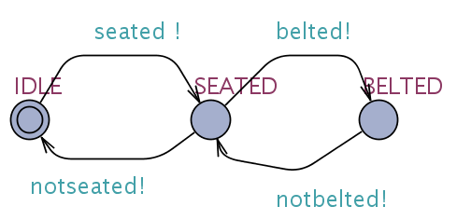
Timed Automaton for Driver
İzmir Institute of Technology Real-Time Systems

Slide 7
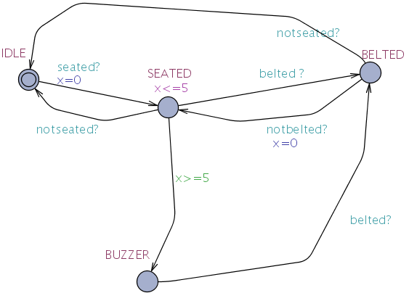
Timed Automaton of
Car’s Seatbelt Controller
İzmir Institute of Technology Real-Time Systems

Slide 8




Property Verification
||
We can check if TA1 || TA2 satisfy the following
CTL properties:
İzmir Institute of Technology Real-Time Systems

Slide 9
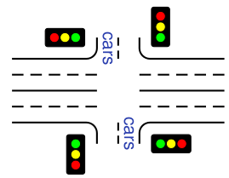
Case Study: Traffic Light Controller
Traffic light controller controls a traffic light at the intersection of a busy highway and a farm road. Normally, the highway light is green but if a sensor detects a car on the farm cars road, the highway light turns yellow then red. The farm road light then turns green until there are no cars or after a long timeout. Then, the farm road light turns yellow then red, and the highway light returns to green. The inputs to the machine are the car sensor, a short timeout signal, and a long timeout signal. The outputs are a timer start signal and the colors of the highway and farm road lights.
Create a Timed Automata to model this intersection.
Draw your timed automata in UPPAAL.
Verify your model.
İzmir Institute of Technology Real-Time Systems

Slide 10
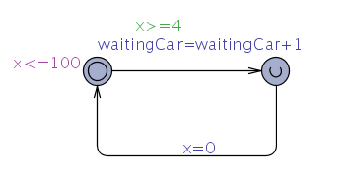
Automaton for Car Arrival at Farm Road
İzmir Institute of Technology Real-Time Systems

Slide 11
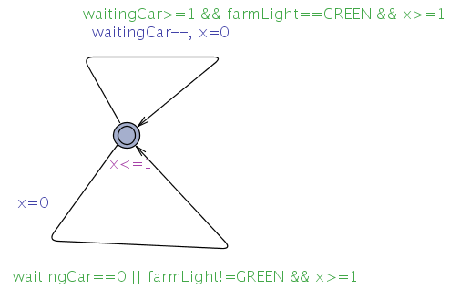
Automaton for Car Passing at Farm Road
İzmir Institute of Technology Real-Time Systems

Slide 12
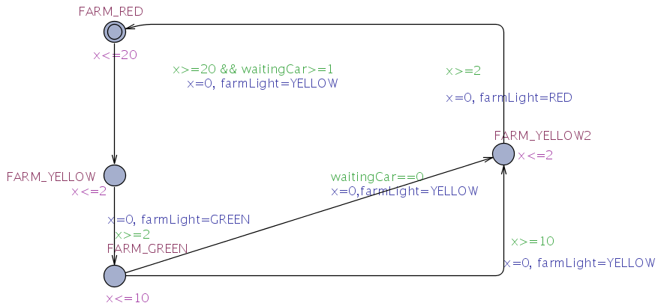
Automaton for Traffic Lights at Farm Road
İzmir Institute of Technology Real-Time Systems

Slide 13
Simulation and Verification
Simulate your model in UPPAAL model checker
Write down the necessary properties.
Verify the model using UPPAAL verification
tool.
Using verification, find an answer to the
following question:
  What is the maximum number of waiting cars on farm
  road?
İzmir Institute of Technology Real-Time Systems

Slide 14
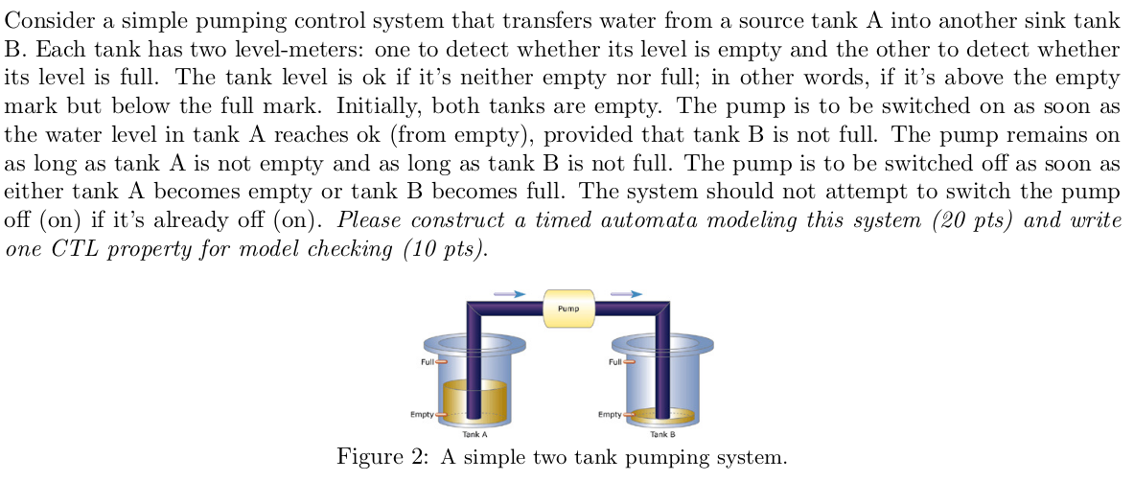
Example 1

Slide 15
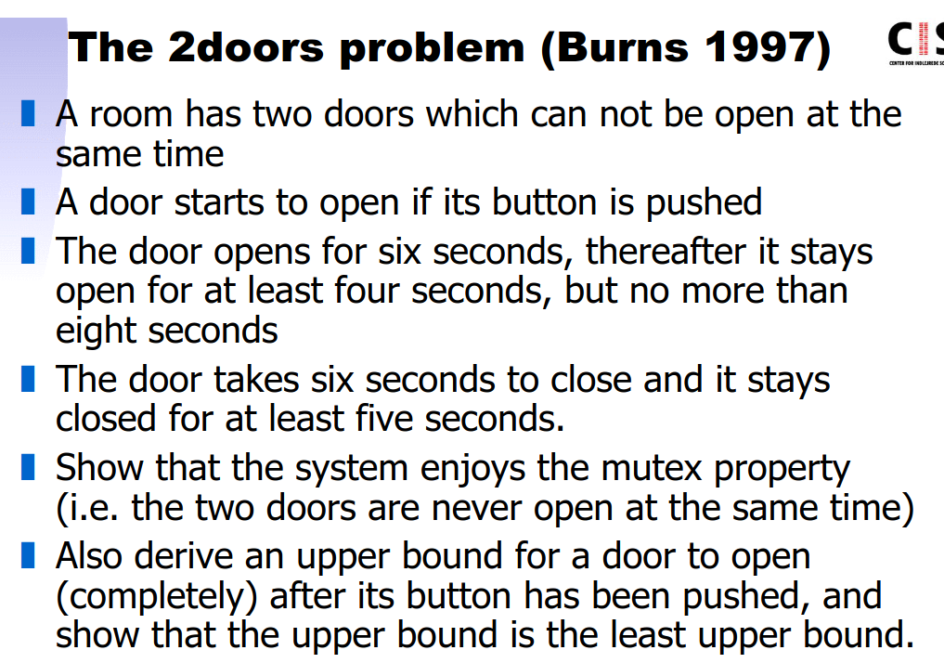
Example 2

Slide 16
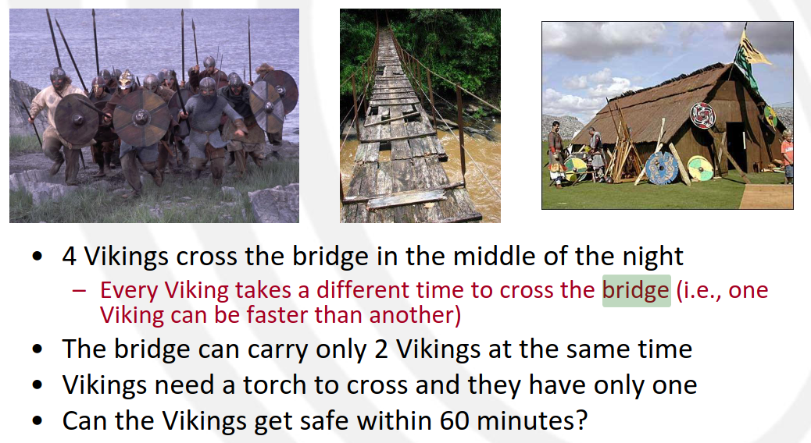
Example 3

