Slide 1
CENG 383
Real-Time Systems
Fault-Tolerance
Prof. Tolga Ayav, Ph.D.
Department of Computer Engineering
İzmir Institute of Technology

Slide 2

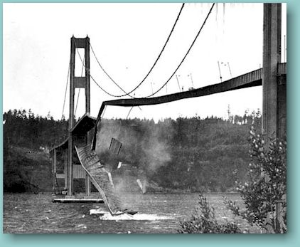
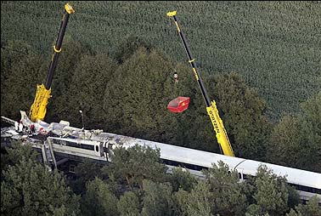
Faults->Errors->Failures
1912
1940
2006
“When a complex system succeeds, that success masks its proximity to failure. . . . Thus, the failure of the Titanic contributed much more to the design of safe ocean liners than would have her success. That is the paradox of engineering and design.”
Henry Petroski, Success through Failure: The Paradox
of Design, Princeton U. Press, 2006, p. 95

Slide 3
Fault-Tolerance
Assuming that the system is functionally correct.
How do you keep on complying with the
specifications in case of faults?
How do you keep on satisfying real-time
properties in case of faults?
Under what fault assumptions?

Slide 4
Fault-Tolerance
Fault-tolerance can be defined as the ability to comply with the
specification in spite of faults. Fault-Tolerance can be classified as:
Hardware Fault-Tolerance
Software Fault-Tolerance
(Software Implemented Hardware
Fault-Tolerance)
In all types, fault-tolerance is achieved through redundancy:
Physical/Spatial
Fault-Tolerance
(Adding extra node)
Temporal
Redundancy
(Allowing extra time)

Slide 5
Fault-Tolerance Chain
FAULT → ERROR → FAILURE → FAULT → ...
In terms of duration:
Permanent faults
Transient faults
Intermittent faults
Over 80% of faults are transient or intermittent!

Slide 6
Physical Redundancy
(1) Passive Redundancy:
N-Modular Redundancy (NMR) technique is the most common technique among passive
hardware redundancy techniques, and is used in this study as well. Two or more replicas of a node are run in
parallel and a voter decides about the output of these replicas. 3MR, which is also abbreviated as TMR [10, 12],
is the most common passive redundancy technique.
(2) Active Redundancy:
Relies on replacing the faulty node with an identical spare node as soon as a failure is
detected [13].
(3) Hybrid Redundancy:
NMR and spare nodes are combined. For instance, a hybrid 3MR+2 (5 nodes) can tolerate
three failed nodes whereas 5MR can only tolerate two failures.

Slide 7

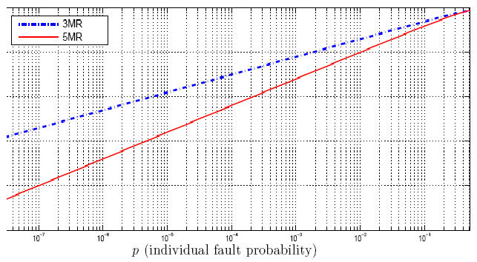
N Modular Redundancy
İzmir Institute of Technology Embedded Systems Lab

Slide 8
Software Implemented Hardware Fault-Tolerance
Many techniques such as NMR can be
implemented by software:
Double, triple execution
Repeating execution
Replicating variables
Re-sending information on network
Signature checking
...
İzmir Institute of Technology Embedded Systems Lab

Slide 9
Double Execution
fault
b=132
int a=3;
int b;
...
b=a+2;
printf(“res=%d”,b);
res=132
fault
b=132
int a=3;
int b1,b2;
...
b1=a+2;
b2=a+2;
if(b1==b2)printf(“res=%d”,b1);
else printf(“error”);
error
İzmir Institute of Technology Embedded Systems Lab

Slide 10
Triple Execution
fault
b=132
int a=3;
int b;
...
b=a+2;
printf(“res=%d”,b);
res=132
fault
b=132
int a=3;
int b,b1,b2,b3;
...
b1=a+2;
b2=a+2;
b3=a+2;
if(majority_exists(b1,b2,b3))
{
b=majority_vote(b1,b2,b3);
printf(“res=%d”,b);
}
else printf(“error”);
res=5

Slide 11
Triple Execution (2)
fault
b=132
int a=3;
int b;
...
b=a+2;
printf(“res=%d”,b);
res=132
fault
b=132
int a=3;
int b,b1,b2,b3;
...
b1=a+2;
b2=a+2;
b3=a+2;
if(majority_exists(b1,b2,b3))
{
b=majority_vote(b1,b2,b3);
printf(“res=%d”,b);
}
else printf(“error”);
fault
b=24
error

Slide 12
Triple Execution (3) at
Stuck-at Fault
fault
b=132
int a=3;
int b;
...
b=a+2;
printf(“res=%d”,b);
res=132
fault
b=37
int a=3;
int b,b1,b2,b3;
...
b1=a+2;
b2=a+2;
b3=a+2;
if(majority_exists(b1,b2,b3))
{
b=majority_vote(b1,b2,b3);
printf(“res=%d”,b);
}
else printf(“error”);
res=37

Slide 13
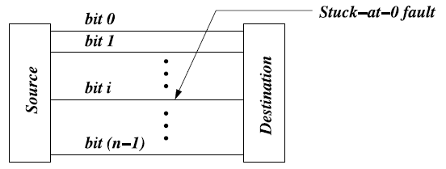
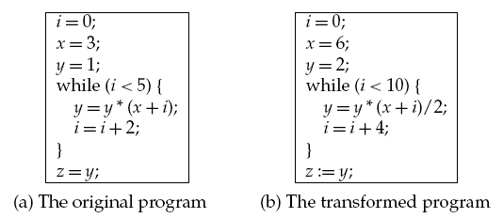
Stuck-at Fault
NMR or multiple execution do not help!
By executing these two programs and comparing the results, it is highly possible to detect a stuck-at fault
İzmir Institute of Technology Embedded Systems Lab

Slide 14
Double Execution with Reference (Golden) Check
fault
b=132
int a, a2=55;
int b,b1,b2,b3;
...
a=3;
b1=a+2;
b2=a2+2;
if(b2!=57) printf(“error”);
b3=a+2;
if(b1==b2)printf(“res=%d”,b1);
else printf(“error”);
error
İzmir Institute of Technology Embedded Systems Lab

Slide 15
Code Duplication
Usually in assembly level, all commands are
executed twice or more and the results are
compared:
add ax, cx
push dx
add ax, cx
mov dx, ax
add ax, cx
cmp ax, dx
...
pop dx
İzmir Institute of Technology Embedded Systems Lab

Slide 16
Replicating Variables
int a, b;
a=3;
...
b=a+2;
int a, b;
int a1, b1;
a=a1=3;
...
if(a==a1)
b=b1=a+2;
else
printf(“error”);
İzmir Institute of Technology Embedded Systems Lab

Slide 17
Error Detection and Correction Code (EDAC)
int *p;
int *a, *b, *c;
int crc;
p=malloc(6);
a=p; b=p+1; c=p+2;
...
*a=2;
crc=_code(p,3);
...
*b=*a+2;
crc=_code(p,3);
printf(“%d”,*b);
int a, b, c;
...
a=2;
...
b=a+2;
printf(“%d”,b);
insert the following
Check periodically
İn the program:
if(_code(p,3)!=crc))
printf(“error”);
İzmir Institute of Technology Embedded Systems Lab

Slide 18
Control Flow Error Detection
Signature bits
incorrect jump!
bool x=false;
...
if(x) printf(“error”);
if(a>3)
{
x=x+1;
...
x=x+1;
}
if(x) printf(“error”);
...
...
if(a>3)
{
...
}
...
İzmir Institute of Technology Embedded Systems Lab

Slide 19
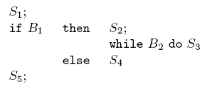

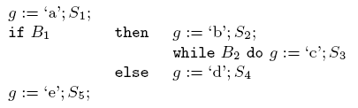
Control Flow Error Detection
Control flow check with regular expressions
The regular expression produced from the
program is
After each assignment to g,
a check is done. For example:
İzmir Institute of Technology Embedded Systems Lab

Slide 20
Software Fault-Tolerance
N-Version Programming:
N independent teams develop the same software.
N-versions of software are executed at the same
time and the results are compared at run-time.
İzmir Institute of Technology Embedded Systems Lab

Slide 21
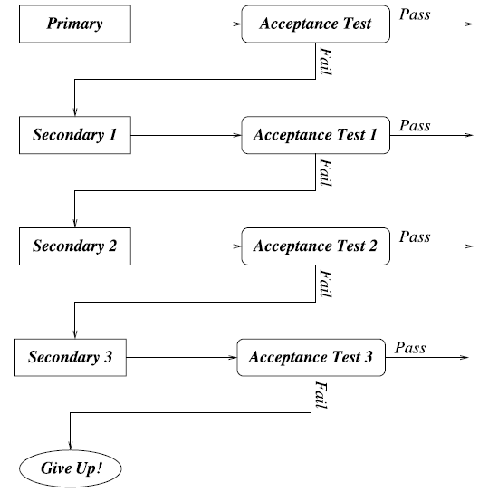
Software Fault-Tolerance
Recovery Block Approach: N independent teams
develop
the same
software.
İzmir Institute of Technology Embedded Systems Lab

Slide 22
Fault Detection
Push and Pull Messaging
Node 1
I’m alive (periodically)
Monitor
Node 2
I’m alive (periodically)
Node 3
Are you alive?
Yes, I’m alive
One common example to push messaging is Watchdog timers used in
microprocressors/microcontrollers.
İzmir Institute of Technology Embedded Systems Lab

Slide 23
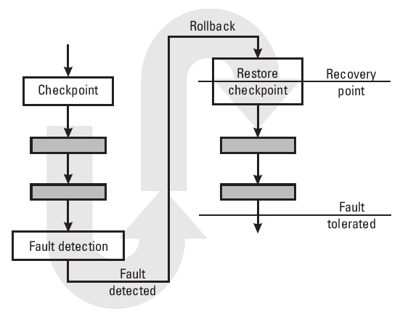
Recovery:
Checkpointing/Rollback
İzmir Institute of Technology Embedded Systems Lab

Slide 24
Checkpointing Level
Kernel-level: Transparent to the user. Many OSs
take checkpoints but it does not help to fault-
tolerance.
User-level: Library is provided to user.
Application programs are linked to this library.
Application-level: Application is responsible for
carrying out all the functions. Provides user with
the greatest control over the checkpointing
process.
İzmir Institute of Technology Embedded Systems Lab

Slide 25
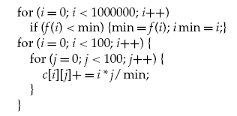
Checkpointing
Checkpoint context: Registers, program counter (or simply Task
Control Block)
Checkpointing overhead: The extra execution time needed to take
a checkpoint
Checkpointing latency: Generally identical to the overhead.
But, writing to a disk may require more time! The size of
checkpoint context plays an important role.
Consider the following code:
Here, checkpoint context
includes i, min and imin.
Here, checkpoint context is large since
it includes i, j and all c[i][j]s.
İzmir Institute of Technology Embedded Systems Lab

Slide 26
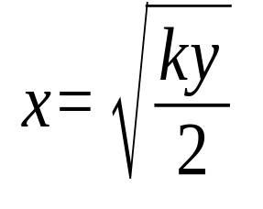
Optimum Checkpoint Period
Checkpoint
(overhead=k)
Program
(Execution
Time=y)
k<<x
Total execution time in case of a fault is
E= y + y . k / x + x
We want to minimize E.
∂E/∂x = 0 =>
Checkpointing
Period=x
İzmir Institute of Technology Embedded Systems Lab

