Slide 1
CENG 383
Real-Time Systems
Lecture Notes
Kernel Development for x86 Systems
Prof. Tolga Ayav, Ph.D.
Department of Computer Engineering
İzmir Institute of Technology

Slide 2
Kernel Development for x86
Not an easy task!
Core to an OS
Good familiarity with hardware
Manages the most important resources:
  CPU
  Interface to I/O and other hardware
  Time
  Memory
  ...

Slide 3
Overview of Kernel Dev.
Setting up your development environment
The basics: Setting the stage for GRUB
Linking in other files and calling main()
Printing to the screen
Setting up a custom Global Descriptor Table (GDT)
Setting up a custom Interrupt Descriptor Table (IDT)
Setting up Interrupt Service Routines (ISRs) to handle your Interrupts and IRQs
Remapping the Programmable Interrupt Controllers (PICs) to new IDT entries
Installing and servicing IRQs
Managing the Programmable Interval Timer / System Clock (PIT)
Managing Keyboard IRQs and Keyboard Data
...

Slide 4
Required Hardware
Actual test computer:
- a 100% IBM Compatible PC with:
- a 386-based processor or later (486 or later recommended)
- 4MBytes of RAM
- a VGA compatible video card with monitor
- a Keyboard
- a Floppy Drive (that will contain the kernel)
We test our kernel using VirtualBox or any of its equivalent environments on Windows. Kernel will be developed on Ubuntu (gcc & nasm installed).

Slide 5
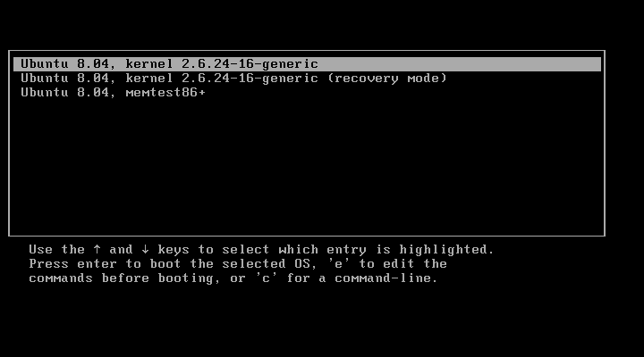
GNU GRUB (Grand Unified Bootloader)
GNU GRUB (short for GNU GRand Unified Bootloader) is a boot loader package
from the GNU Project. GRUB is the reference implementation of the
Multiboot Specification, which provides a user the choice to boot one of
multiple operating systems installed on a computer, or select a specific
kernel configuration available on a particular operating system's partitions.
A sample
screenshot
of grub

Slide 6
Files
boot.s
isr.s, isr.h, isr.c
interrupt.s
gdt.s
descriptor_tables.h, descriptor_tables.c
common.h, common.c
monitor.h, monitor.c
timer.h, timer.c
main.c
link.ld

Slide 7
initial boot code
boot.s

Slide 8
MBOOT_PAGE_ALIGN equ 1<<0 ; Load kernel and modules on a page boundary
MBOOT_MEM_INFO equ 1<<1 ; Provide your kernel with memory info
MBOOT_HEADER_MAGIC equ 0x1BADB002 ; Multiboot Magic value
; NOTE: We do not use MBOOT_AOUT_KLUDGE. It means that GRUB does not
; pass us a symbol table.
MBOOT_HEADER_FLAGS equ MBOOT_PAGE_ALIGN | MBOOT_MEM_INFO
MBOOT_CHECKSUM equ -(MBOOT_HEADER_MAGIC + MBOOT_HEADER_FLAGS)
[BITS 32] ; All instructions should be 32-bit.
[GLOBAL mboot] ; Make 'mboot' accessible from C.
[EXTERN code] ; Start of the '.text' section.
[EXTERN bss] ; Start of the .bss section.
[EXTERN end] ; End of the last loadable section.
mboot:
dd MBOOT_HEADER_MAGIC ; GRUB will search for this value on each
dd MBOOT_HEADER_FLAGS ; How GRUB should load your file / settings
dd MBOOT_CHECKSUM ; To ensure that the above values are ; correct
dd mboot ; Location of this descriptor
dd code ; Start of kernel '.text' (code) section.
dd bss ; End of kernel '.data' section.
dd end ; End of kernel.
dd start ; Kernel entry point (initial EIP).

Slide 9
[GLOBAL start] ; Kernel entry point.
[EXTERN main] ; This is the entry point of
; our C code
start:
push ebx ; Load multiboot header location
; Execute the kernel:
cli ; Disable interrupts.
call main ; call our main() function.
jmp $
; Enter an infinite loop, to stop the processor
; executing whatever rubbish is in the memory
; after our kernel!

Slide 10
main.c
#include "monitor.h"
#include "descriptor_tables.h"
int main(struct multiboot *mboot_ptr)
{
init_descriptor_tables();
monitor_clear();
monitor_write("Welcome to OSx311!\n");
return 0xDEADBABA;
}

Slide 11
Makefile
SOURCES=boot.o main.o monitor.o common.o descriptor_tables.o
isr.o interrupt.o gdt.o timer.o
CFLAGS=-nostdlib -nostdinc -fno-builtin -fno-stack-protector
LDFLAGS=-Tlink.ld
ASFLAGS=-felf
all: $(SOURCES) link
clean:
-rm *.o kernel
link:
ld $(LDFLAGS) -o kernel $(SOURCES)
.s.o:
nasm $(ASFLAGS) $<

Slide 12
link.ld
ENTRY(start)
SECTIONS
{
.text 0x100000 :
{
code = .; _code = .; __code = .;
*(.text)
. = ALIGN(4096);
}
.data :
{
data = .; _data = .; __data = .;
*(.data)
*(.rodata)
. = ALIGN(4096);
}
.bss :
{
bss = .; _bss = .; __bss = .;
*(.bss)
. = ALIGN(4096);
}
end = .; _end = .; __end = .;
}

Slide 13
Compiling, linking, running
cd src
make clean
make
mount /media/floppy0
cp kernel /media/floppy0
umount /media/floppy0
Boot the system with the floppy inserted

Slide 14
Implementation of common functions
common.h
common.c

Slide 15

Using the Screen in Text Mode
Video-controller’s dedicated memory starts at 0xB8000000 (Color VGA).
Size: 80 x 25 x 2 = 4 KB

Slide 16
- Discuss monitor.c
- How to switch to graphics mode?

Slide 17
Global Descriptor Table
Interrupt Descriptor Table
GDT - IDT

Slide 18
Segmentation - Paging
X86 has two memory protection system:
  Segmentation
  Paging
Segmentation: The memory address is added to the segment's base address, and checked against the segment's length.
Paging: the address space is split into (usually 4KB, but this can change) blocks, called pages. Each page can be mapped into physical memory - mapped onto what is called a 'frame'. Or, it can be unmapped. Like this you can create virtual memory spaces.

Slide 19
Segmentation - Paging
Segmentation is becoming obsolete
x86-64 architecture requires a flat memory model (one segment with a base of 0 and a limit of 0xFFFFFFFF) for some of it's instructions to operate properly.
Paging is more common today
Segmentation has one advantage: ring levels 0, 1, 2, 3. A ring is a privilege level - zero being the most privileged, and three being the least. Processes in ring zero are said to be running in kernel-mode, or supervisor-mode, because they can use instructions like sti and cli, something which most processes can't. Normally, rings 1 and 2 are unused. They can, technically, access a greater subset of the supervisor-mode instructions than ring 3 can. Some microkernel architectures use these for running server processes, or drivers.

Slide 20
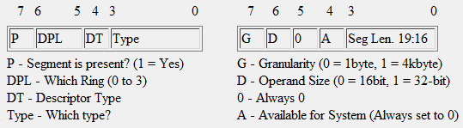
GDT Structure
The GDT itself is a list of 64-bit long entries. These entries define where in memory that the allowed region will start, as well as the limit of this region, and the access privileges associated with this entry. One common rule is that the first entry in your GDT, entry 0, is known as the NULL descriptor. No segment register should be set to 0, otherwise this will cause a General Protection fault, and is a protection feature of the processor.
Each GDT entry also defines whether or not the current segment that the processor is running in is for System use (Ring 0) or for Application use (Ring 3). There are other ring types, but they are not important. Major operating systems today only use Ring 0 and Ring 3.

Slide 21
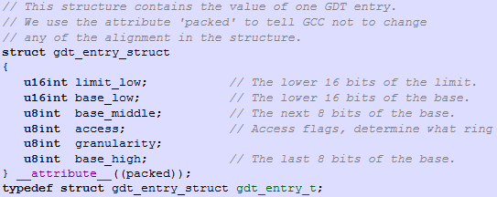
GDT Entries
We will use flat memory model: base address is 0 and offsett ranges from 0x00000000 to 0xFFFFFFFF
In descriptor_tables.h:

Slide 22
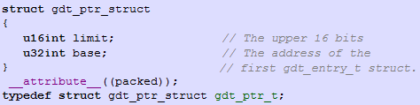
GDT Entries
To tell the processor where to find our GDT, we have to give it the address of a special pointer structure
The base is the address of the first entry in our GDT, the limit being the size of the table minus one (the last valid address in the table).

Slide 23
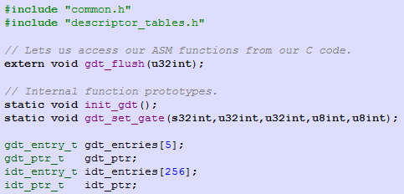
descriptor_tables.c -1

Slide 24
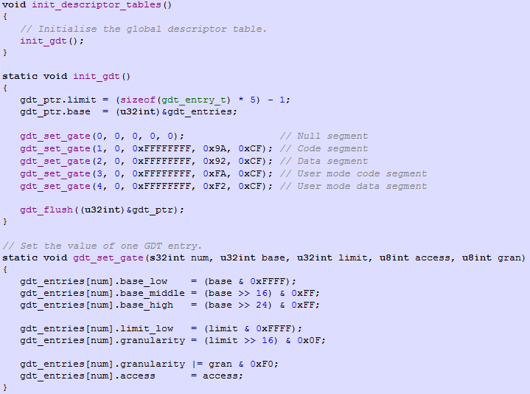
descriptor_tables.c - 2

Slide 25
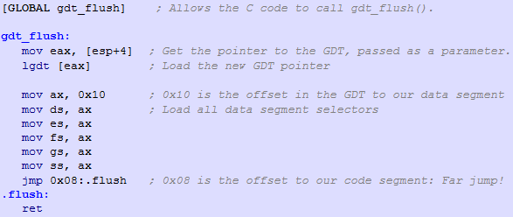
gdt.s
Now, we rewrite GDT pointer:

Slide 26
Interrupts
There are 256 interrupts.
The first 32 interrupts belong to the processor:
  0 - Division by zero exception
  1 - Debug exception
  2 - Non maskable interrupt
  3 - Breakpoint exception
  4 - 'Into detected overflow'
  5 - Out of bounds exception
  6 - Invalid opcode exception
  7 - No coprocessor exception
  8 - Double fault (pushes an error code)
  9 - Coprocessor segment overrun
  10 - Bad TSS (pushes an error code)
  11 - Segment not present (pushes an error code)
  12 - Stack fault (pushes an error code)
  13 - General protection fault (pushes an error code)
  14 - Page fault (pushes an error code)
  15 - Unknown interrupt exception
  16 - Coprocessor fault
  17 - Alignment check exception
  18 - Machine check exception
  19-31 - Reserved

Slide 27
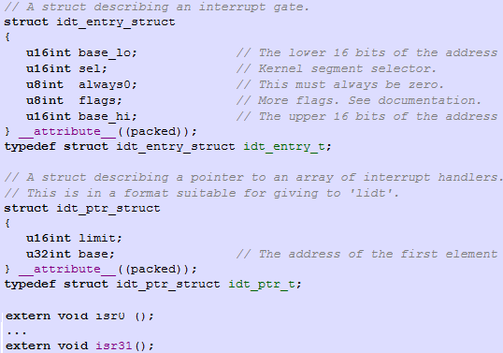
in descriptor_tables.h

Slide 28
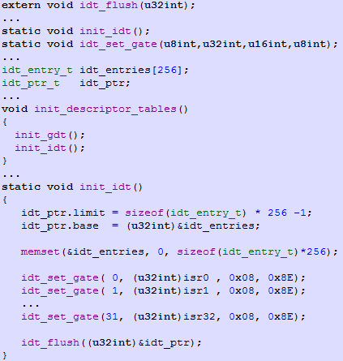
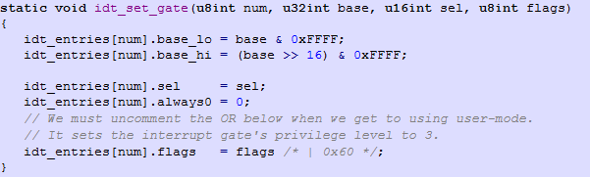
in descriptor_ tables.c

Slide 29

in gdt.s

Slide 30
interrupt.s
When the processor receives an interrupt, it saves the contents of the essential registers (EIP, SP, CS, DS EFLAGS) to the stack.
It then finds the interrupt handler location from our IDT and jumps to it.
In ISRs, there are many duplicated parts. To write one common handler we need to pass the interrupt number to this handler. Processor has no such feature. So, we write all handlers that just push the interrupt number and then call the common handler.

Slide 31
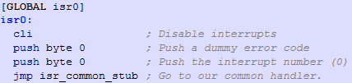
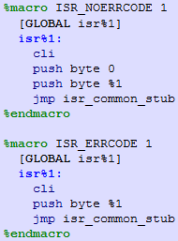
interrupt.s
instead of writing 32 ISRs like above we use macros:
ISR_NOERRCODE 0
ISR_NOERRCODE 1
...
ISR_NOERRCODE 9
ISR_ERRCODE 10
ISR_ERRCODE 11
ISR_ERRCODE 12
ISR_ERRCODE 13
ISR_ERRCODE 14
ISR_NOERRCODE 15
...
ISR_NOERRCODE 31

Slide 32
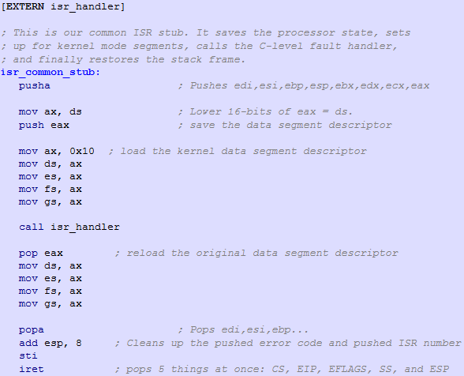
isr_common_stub (in interrupt.s)

Slide 33
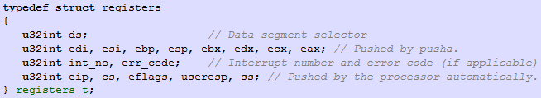
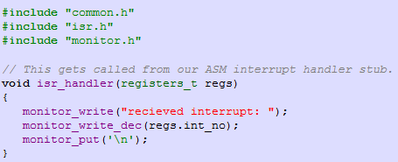
isr.h, isr.c

Slide 34
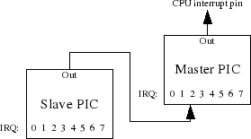
Interrupt Requests
There are 15 external interrupt channels
PIC behaves like a multiplexer
Provides remapping: changing ISR numbers
Queues the requests, uses priorities

Slide 35
Remapping PIC
When computer boots, default interrupt mappings are:
  IRQ 0..7 - INT 0x8..0xF
  IRQ 8..15 - INT 0x70..0x77
IRQ 0..7 conflicts with CPU’s 32 interrupts (ISR 0..31)
The PICs are communicated with via the I/O bus. Each has a command port and a data port:
  Master - command: 0x20, data: 0x21
  Slave - command: 0xA0, data: 0xA1

Slide 36
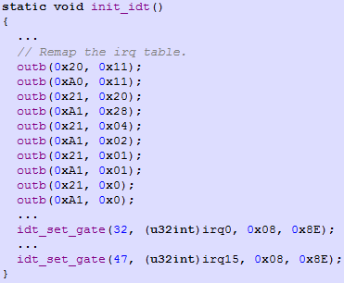
Remapping PIC
Remap IRQ 0..15 to ISR 32..47 (0..31 are used by CPU)

Slide 37
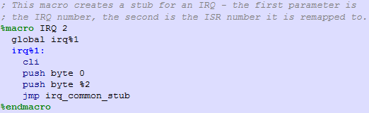

Setting IDT entries

Slide 38
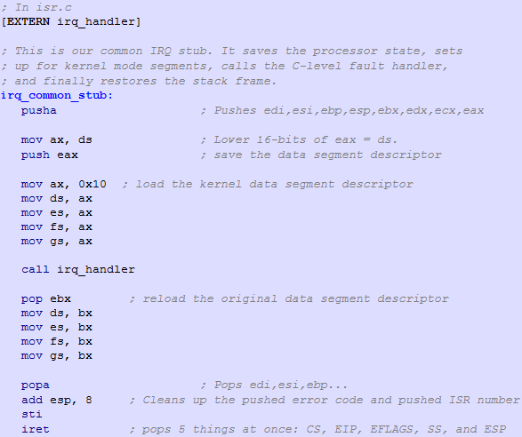
irq_common_stub

Slide 39
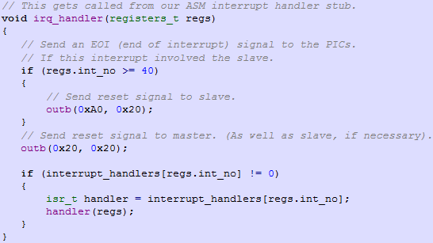
irq_handler()

Slide 40
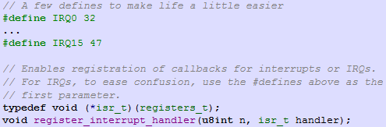

Custom Handlers

Slide 41
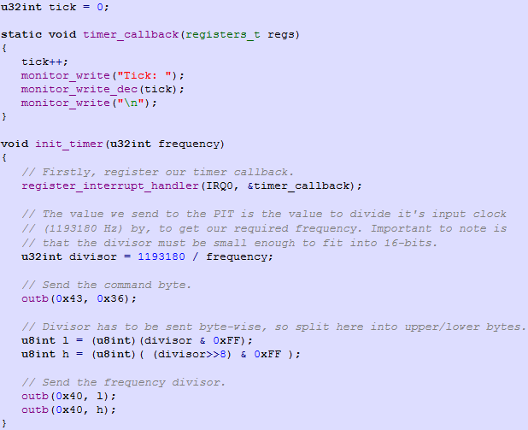
8253 PIT and timer interrupt

