Slide 1
Theory of Computation
Asst. Prof. Dr. Selma TEKİR

Slide 2
Theory of Computation
Automata Theory
Automata-Self-moving devices.
Robot-Labor, work.
Computer-Reasoning.

Slide 3
Theory of Computation
Fundamental ideas, models, and results that permeate computer science, the basic paradigms of our field.

Slide 4
The Invention of Computer
The happenings in the 20th century.
The theory of relativity, the rise and fall of communism, psychoanalysis, nuclear war…

Slide 5
Computability
While most of the world is (correctly) preoccupied by the question of how best to do something, we shall be completely absorbed with the question of whether certain tasks can be done at all. Our main conclusions will be of the form:
"this can be done" or "this can never be done."

Slide 6
Methodology
Interplay between languages and machines
Mathematical model = Machine = Automata

Slide 7
Cantor-Hilbert
Paradoxes in set theory (Cantor)
Famous Russell’s (Barber) paradox
Entscheidungs problem (Hilbert)
The Entscheidungsproblem asks for an algorithm to decide whether a given statement of first-order logic is provable from the axioms using the rules of logic.
Proof-generators.

Slide 8
Even before the first computer was ever built, some people were asking the question of what programs can be written.

Slide 9
Gödel-Turing
Gödel’s Undecidability Theorem
Any mathematical system containing all the theorems of arithmetic is an incomplete system. (That is, there is a statement within this system that is true, but can never be proven true.)
In its proof, the usage of Gödel’s Unique Numbering Scheme.
The Halting Problem
There can be no program, no algorithm to tell whether arbitrary programs would halt or loop forever.
Universal Algorithm Machine (Turing Machine)
A program written in a language can interpret any program in the same language.
A Turing machine can be fed into another as input. (Due to Gödel Numbering Scheme)

Slide 10
Half the intellectual forces in the world were leading to the invention of the computer, while the other half were producing applications that were desperate for its arrival.
Linguistics (The Chomsky Hierarchy)
Computational Science
In the 1980s, science visionaries from many fields saw ways to employ high-performance computers to solve “grand challenge” problems in science. They said computing is not only a tool for science, but also a new method of thought and discovery in science. (Aha! Computational thinking!) They defined computational science as a new branch of science imbued with this idea.

Slide 11
The Basic Questions
What can a computer do at all?
(Computability-Decidability)
What can a computer do efficiently?
(Complexity-Intractability)

Slide 12
Definitions
Alphabet: Σ: A finite set of symbols.
Empty string, e.
Σ*:
The set of all strings, including the empty string, over an alphabet Σ.
Language:
Any set of strings over an alphabet Σ-that is any subset of Σ*.

Slide 13
The Representations of Languages by Finite Specifications
Mismatch
The cardinality of Σ*
The cardinality of 2^{Σ*}

Slide 14
Finite Representations-Regular Expressions
e and each member of Σ is a regular expression.
If α and β are regular expressions, then so is (αβ). (Concatenation).
If α and β are regular expressions, then so is (α∪β). (Alternation).
If α is a regular expression, then so is α*.
Nothing is a regular expression unless it follows from (1) through (4).

Slide 15

Example Regular Expressions
All strings that end in a double letter given the alphabet
All strings that do not end in a double letter.
$$({\left(a∪b\right)}^{∗}\left(ab∪ba\right))∪a∪b∪e.$$

Slide 16
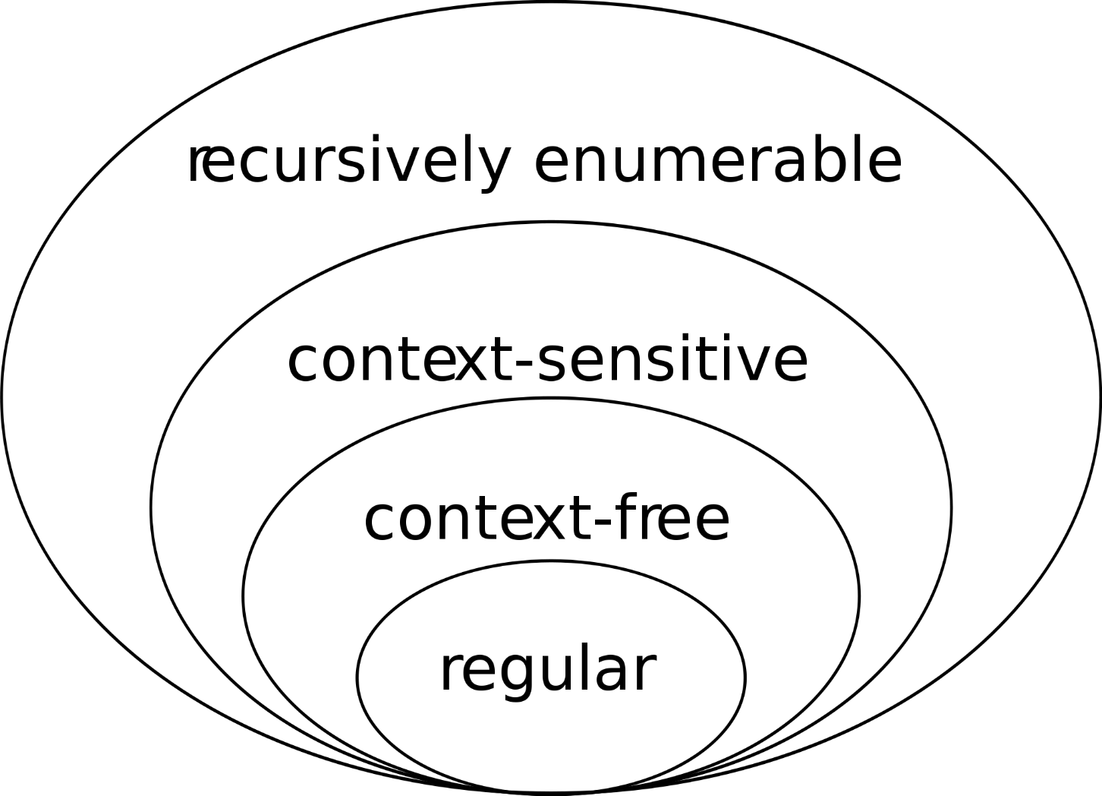
The Chomsky Hierarchy (Language Hierarchy)

Slide 17
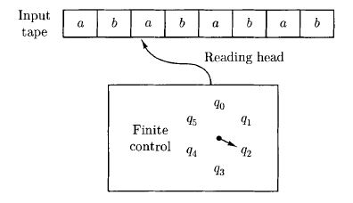
Finite Automata

Slide 18
Machine Execution
The movement of the machine is determined by the current state and input symbol.

Slide 19
Finite Automata

Slide 20
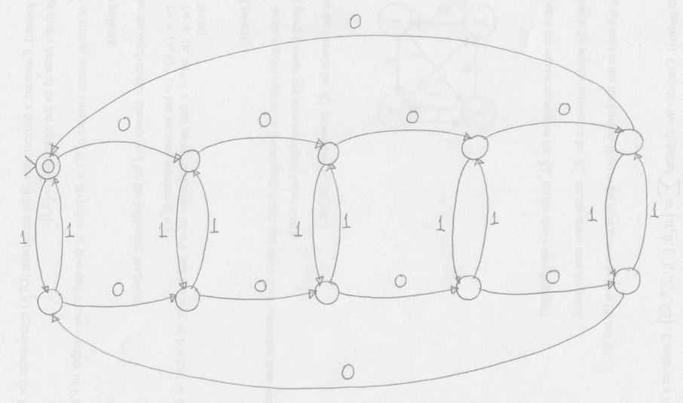
Finite Automata
The set of strings whose number of 0’s is divisible by five and whose number of 1’s is even.

Slide 21
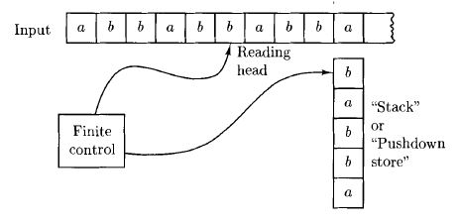
Pushdown Automata

Slide 22
Pushdown Automata

Slide 23
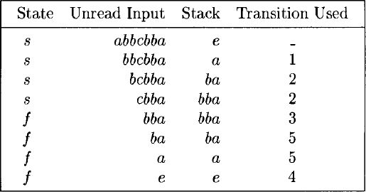
Pushdown Automata

Slide 24
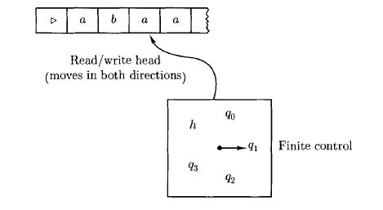
Turing Machines

Slide 25
Turing Machines

Slide 26
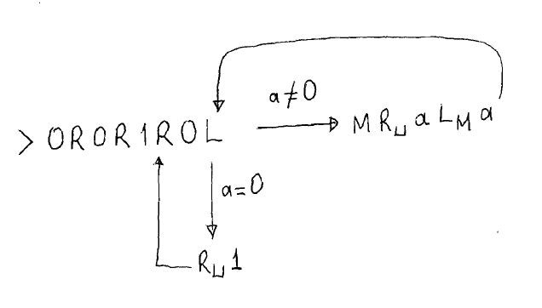
Turing Machines

Slide 27
Interplay between Languages and Machines (Automata)
Regular Languages-Finite Automata
Context-Free Languages-Pushdown Automata
Recursive Languages-Deterministic Turing Machines
Recursively Enumerable Languages-Nondeterministic Turing Machines

Slide 28
Determinism vs. Nondeterminism
The movement of the machine is only partially determined by the current state and input symbol.
It can enter into a new state by consuming nothing.
It has potential to move into more than one state.

