Slide 1

RoomTab by Gokhan Ceylan
An AI that explains who should pay what, and why
(Commit To Change)

Slide 2
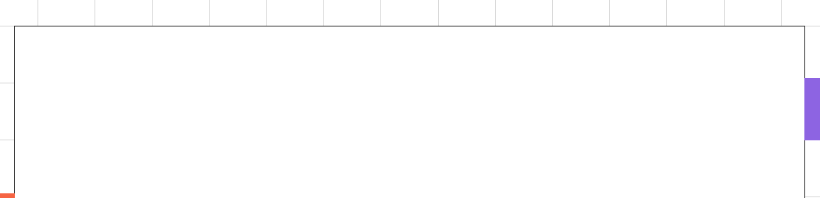
Problem
  Splitting costs is easy, until it’s not.
  The Edge Case Mess: Someone showed up late, someone didn’t drink, someone brought their partner, now what? Traditional split apps freeze.
  The Invisible Bias: Most tools divide evenly or by percentage. But they don’t ask why. Should the student pay less? Does the vegan pay for BBQ?
  The Explanation Void: “Why did I pay more?” is a common question. Current apps give numbers, not logic.
Fair splits are not just math, they’re context. We’re missing the “why.”

Slide 3
Solution
  RoomTab is an AI agent that thinks before it splits.
  Context-Aware Logic: Give it a situation (“A didn’t drink”, “B was late”), and it rebalances the split with reasoning.
  Transparent Outputs: Every decision comes with a friendly explanation — no black boxes.
  Built-in Fairness Audit: You can replay any decision, see the trace, and check how the logic holds up.

Slide 4
Demo
  https://room-tab.vercel.app/

Slide 5
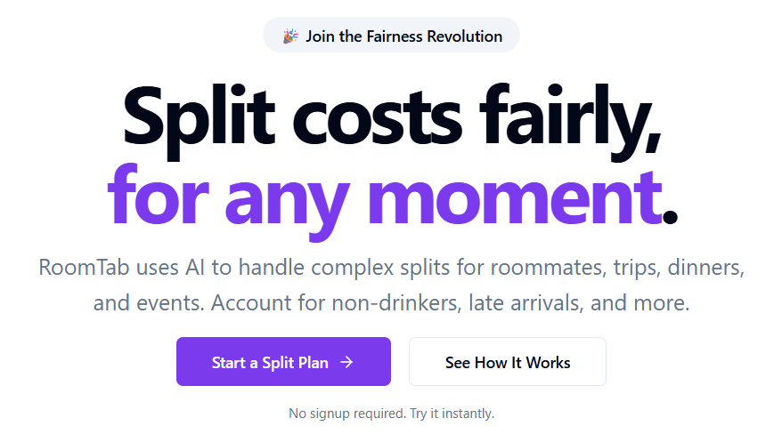
RoomTab

Slide 6
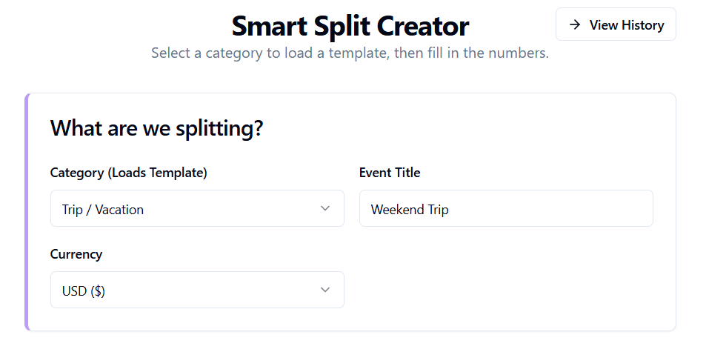
Create Plan #1

Slide 7
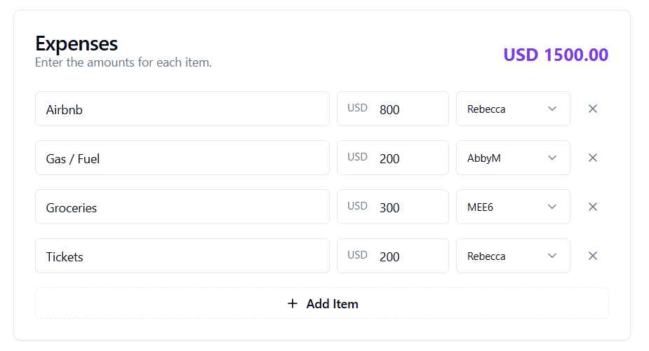
Create Plan #2

Slide 8
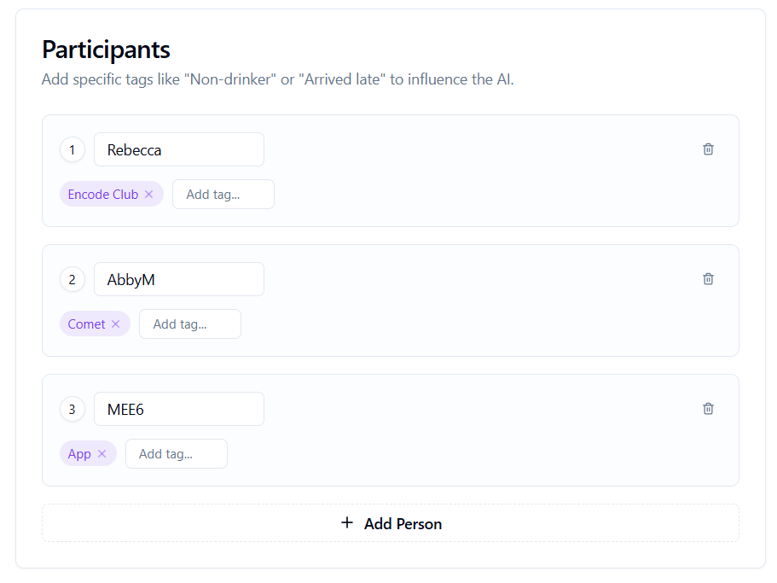
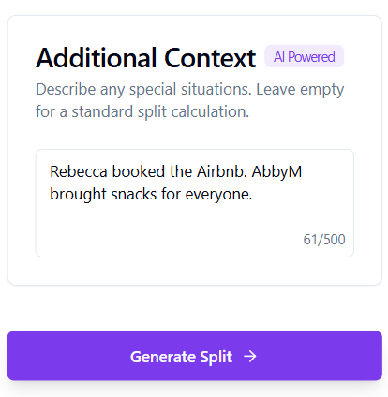
Create Plan #3

Slide 9
Create Plan #4

Slide 10
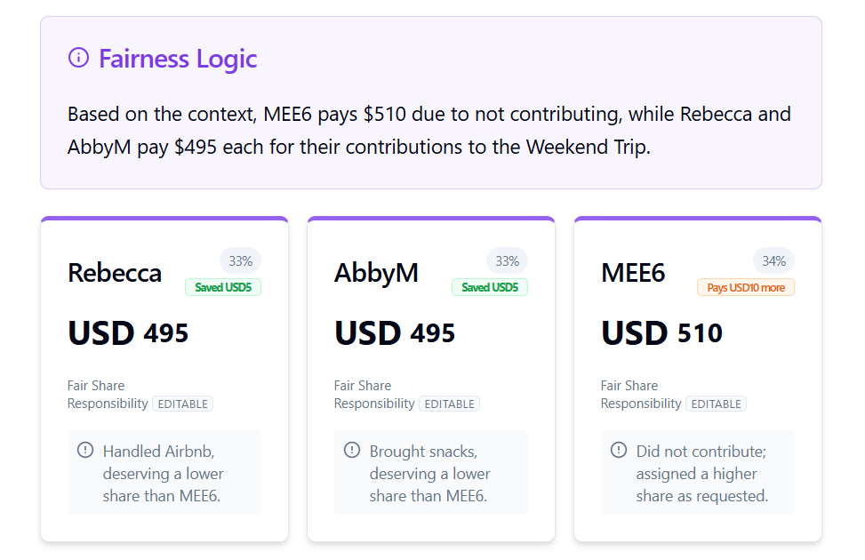
Create Plan #5

Slide 11
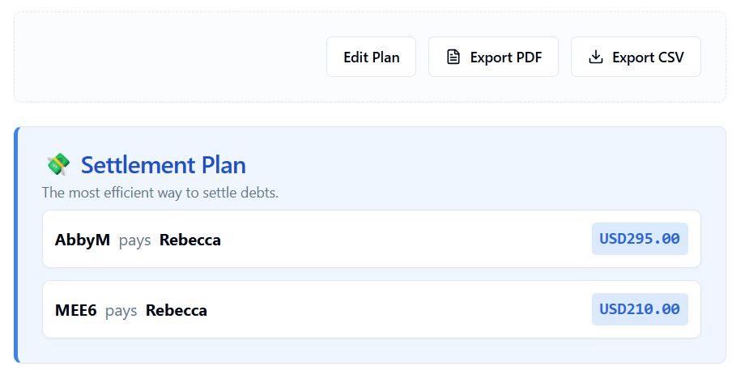
Create Plan #6

Slide 12
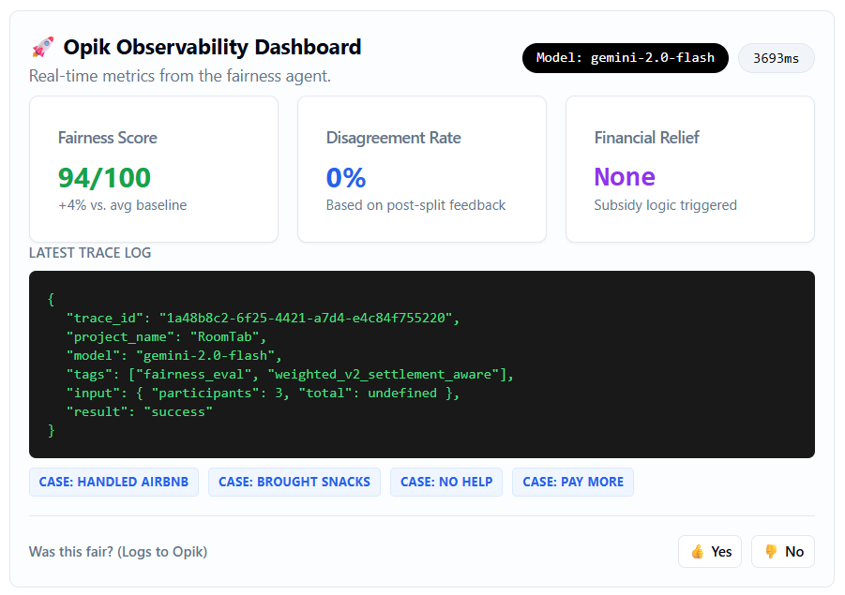
Create Plan #7

Slide 13
Observability with Opik
  Fairness Isn’t Just a Feeling, we made it verifiable.
  Every decision is traceable: We log latency, token count, model version, and context for each split.
  Users can see why someone paid more or less: No magic, just logic.
  "Was this fair?" is logged live: Closing the loop for real accountability.
  Scenario tags (like vegan, arrived_late, premium_room) make it easy to filter and evaluate edge cases.
  No hidden AI guessing: We can audit it all at /audit.
  We didn’t just use Opik: We built around it to prove the system is fair under pressure.

Slide 14
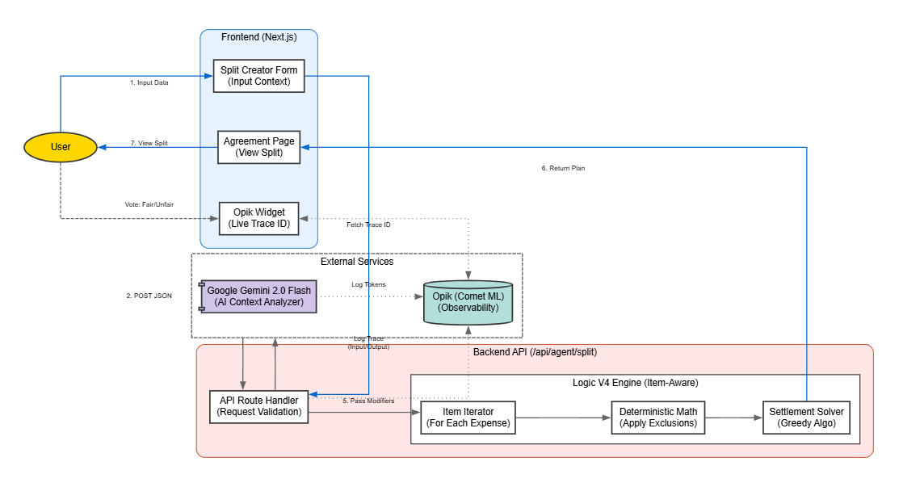
System Architecture

Slide 15
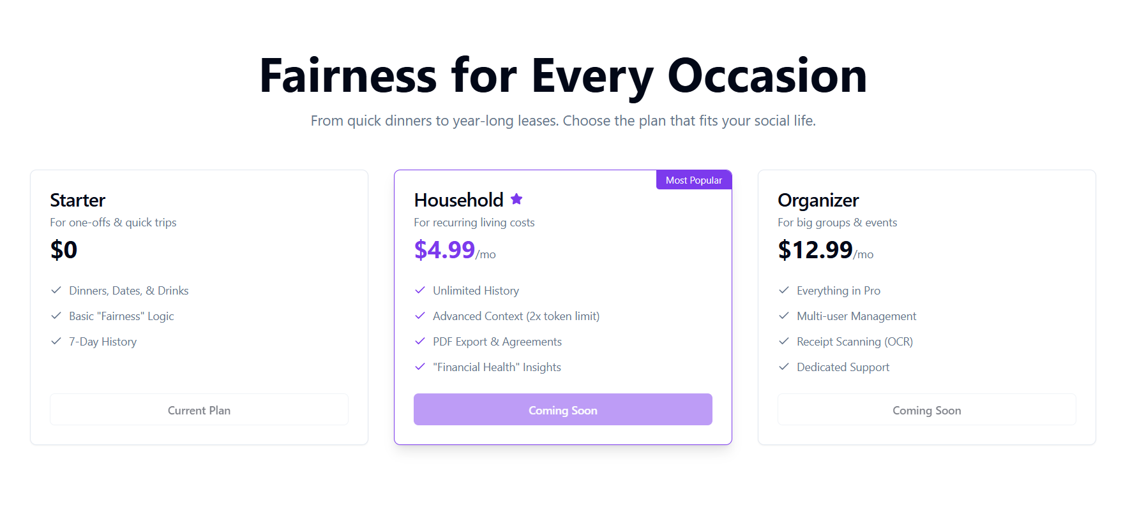
Revenue Model

Slide 16
Links
• Live Demo: https://room-tab.vercel.app/
• Demo Video: https://youtube.com/tbu
• Source Code: https://github.com/GokhanCey/RoomTab
• Pitch Deck: https://github.com/GokhanCey/RoomTab/blob/main/PD.pdf

Slide 17
RoomTab
AI that explains who should pay what, and why
Thank you.
Notes:
Our motto

