Slide 1
SAS - Mini Project
Saleh Hassan Nasir

Slide 2
Understand the Data
Proc Contents
Type of Variables
Format of Variables
Total Observations
Proc SQL
Identify Primary Key
Explore Extreme Values of Data
Check Population Rate of Variables
Data Step
Load data using infile
Have a look at the data before loading

Slide 3
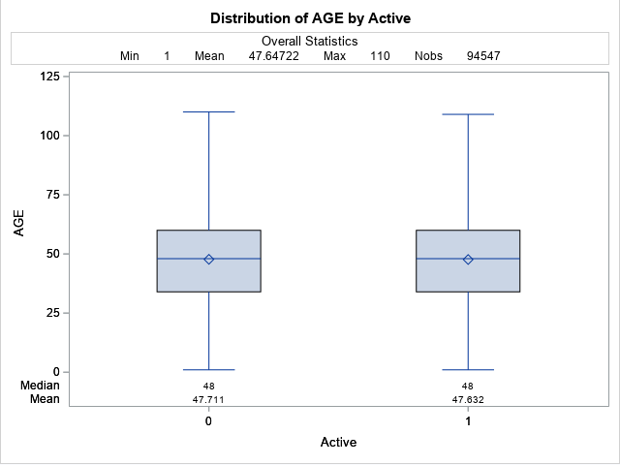
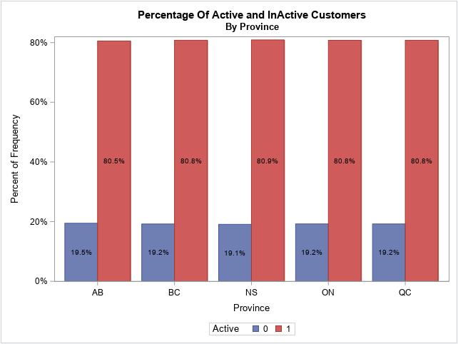
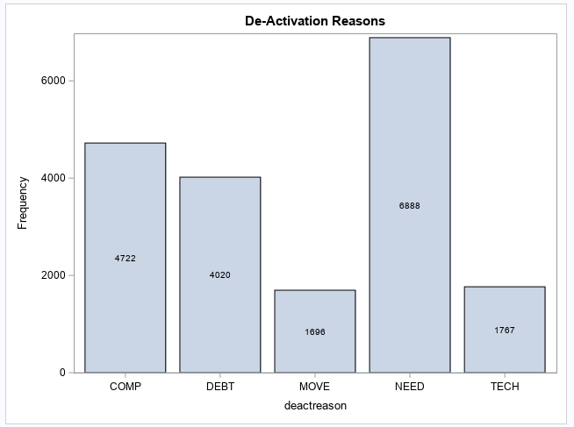
Active and In-Active Customers
Use SQL to add flag for Active and In-Active Customers
Explore Reasons for leaving
Provincial breakdown of Active Status
No Trend in Age of Customers

Slide 4
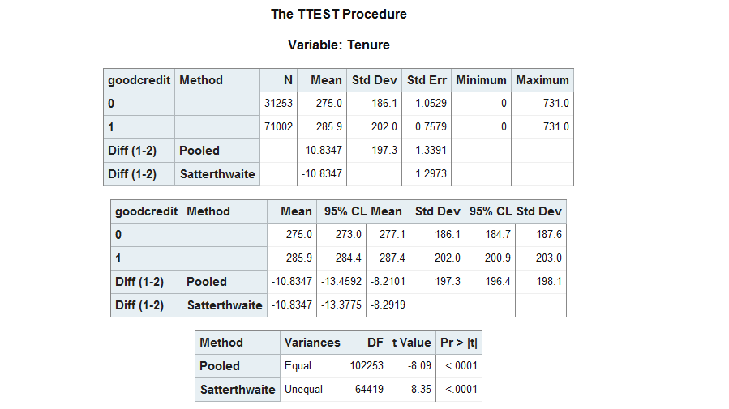
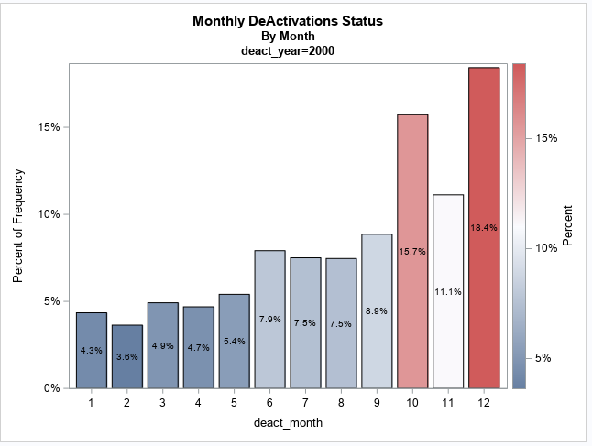
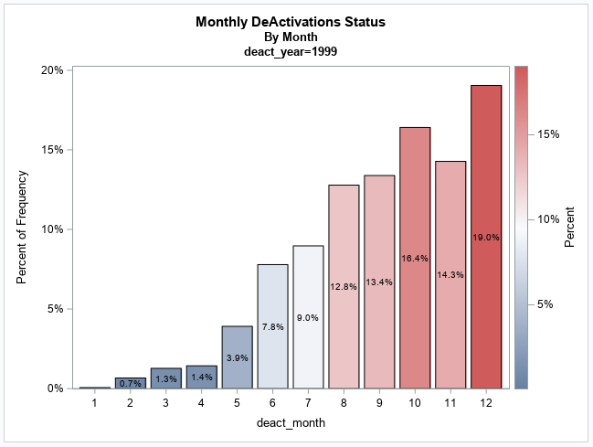
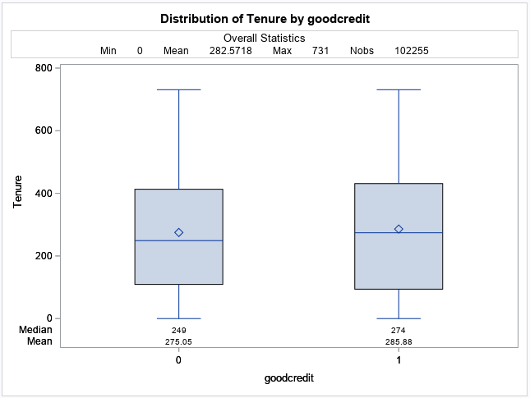
Tenure of Customers
Use the 'intck' function to identify tenure
Basic Analysis using Proc Means.
Box Plot reveals Customers with Good Credit tend to have longer tenure.
Customers tend to leave at the end of the year.

Slide 5
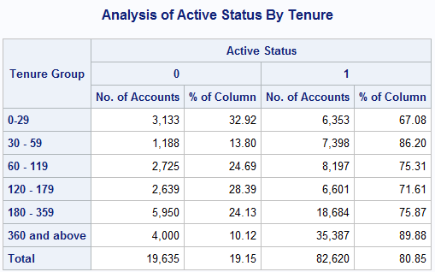
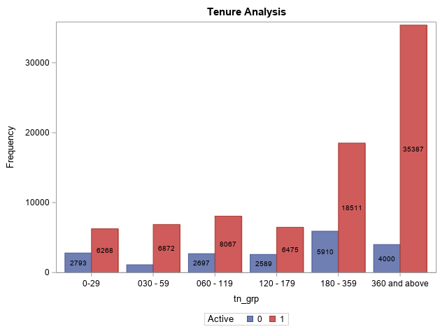
Tenure of Customers
Create Customer segments using tenure.
Overall 19.15% customers discontinue.
Customers who stay for 1 year tend to stay longer as they have low disconnection rate (10.12%)
Most customers leave within the first year (Approx 24.8%)

Slide 6
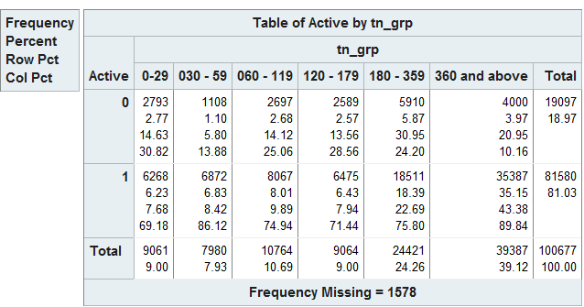
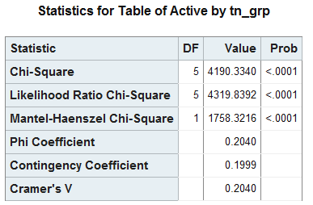
Tenure of Customers (contd.)
Create Customer segments using tenure.
Overall 19.15% customers discontinue.
Customers who stay for 1 year tend to stay longer as they have low disconnection rate (10.12%)
Most customers leave within the first year (Approx 24.8%)

Slide 7
Conclusion
Key Points
Customers with good credit tend to stay longer with company.
New customers have a higher tendency to move on within the 1st year.
Action Items:
Marketing needs to target customers with good credit.
Company should roll out better offers for new customers to win loyalty.
Further explore reason for de-activation.

