Slide 1
Soccer Prediction Application

Slide 2
Guideline
Introduction: goal of the application
Games, bet-odds, teams…
Domain of the application
Application modules and what they deal with
Crawler part → new matches/teams/player/bet-odds…
Machine Learning →
User Interface
Representation, algorithm → looking for the best
ML input/ML algorithm
Graphs
RUN: need just a (temporary) internet connection on your laptop

Slide 3

Football, Winning & Money
“FOOTBALL’S NOT JUST A SCORING GOALS, IT’S ABOUT WINNING” - [Alan Shearer]
“WINNING INCREASES THE DOPAMINE RECEPTORS IN THE BRAIN, WHICH MAKES YOU SMARTER AND MORE BOLD” - [IAN H. ROBERTSON]
“EVERY BAD DECISION I’VE MADE HAS BEEN BASED ON MONEY” - [Eddie Murphy]

Slide 4
Domain
Team
Group of people that aims to win a match
Match
Challenge between two teams, in which one tries to beat the other
Teams are different, pattern are recurrent
Bet-odd
Almost every day, a match is played
It is an opportunity to make money
Based on time, team can be strong or weak
Notes:
Teams change every year → the statics of a winner/looser team not.
Use power of statics to gain advantage in placing a bet.

Slide 5
Modules
Crawl: new unstructured data
SQLite: store structured data
Machine Learning: predict tomorrow and evaluate the accuracy of yesterday predictions
Repeat until TRUE
SQLite
Machine Learning
Crawl

Slide 6
Prediction
Machine Learning Algorithm Input. Match representations:
Team Form: combination of points gathered by the teams
Team Home Away Form: combination of points gathered by the teams, considering matches played at home and away.
Match Statistics: combination of previous match statistics performed by teams.
Kekko input: features an human uses to gather information before placing a bet.
Poisson input: home strength and away strength (average goal a team will score)
Notes:
1.1 [home_form / home_n, away_form / away_n]
1.2 [home_form // home_n, away_form // away_n]
1.3 [home_form / home_n - away_form / away_n]
1.4 [home_form // home_n - away_form // away_n]
2.1 home_form / home_n, home_team_home_form / home_n1, home_team_away_form / home_n2, away_form / away_n, away_team_home_form / away_n1, away_team_away_form / away_n2]
2.2 [home_form // home_n, home_team_home_form // home_n1, home_team_away_form // home_n2, away_form // away_n, away_team_home_form // away_n1, away_team_away_form // away_n2]
2.3 [home_form / home_n - away_form / away_n, home_team_home_form / home_n1 - away_team_home_form / away_n1, home_team_away_form / home_n2 - away_team_away_form / away_n2]
2.4 [home_form // home_n - away_form // away_n, home_team_home_form // home_n1 - away_team_home_form // away_n1, home_team_away_form // home_n2 - away_team_away_form // away_n2]
3. [home_goal, away_goal, home_shoton, away_shoton, home_goal_ratio, away_goal_ratio, home_form, away_form]

Slide 7
prediction
Machine Learning Algorithm:
Knn
SVM multiclass
Random Forest
“Poisson”
Train Window: how much a match in the past matters?
Number of previous stages to include in the training [9,11,19,35,71,105,141,175,211,245,281]

Slide 8

Looking for the best
5 input types
4 representations for 2 inputs
3 ML algorithms
1 Hybrid
11 different time windows
$11×\left(3×\left(3+2×4\right)\right)+1)=275$ possible settings

Slide 9
Start from the easiest
Team form, Representaion1 : numeric values of the team forms, normalized to interval [0, 3].

Slide 10
Overcome difficulties
Problems:
Time: 1 day of computation
Bigger windows seems to be more precise, but they allow to predict lesser matches
Accuracy of smaller windows cannot be comparable with the one’s from bigger (N vs n, N >> n )
Solution:
Consider only valuable windows
Try to predict the same matches for every predictor

Slide 11
Comparisons of the bests

Slide 12
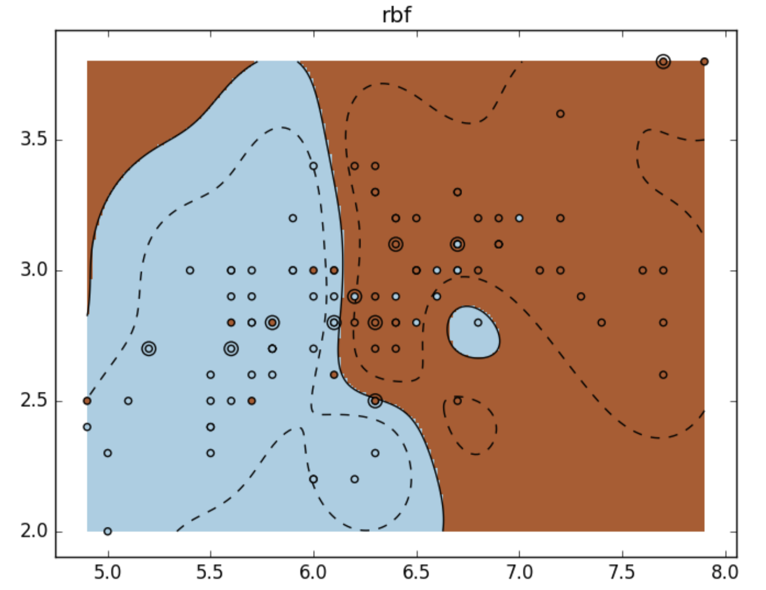
The Most precise
Input: “Team Form”, Representation: 3
Home vs Away → [home_form / home_n - away_form / away_n]
form: points gathered in the last n matches
Algorithm: Sklearn SVM (rbf Kernel)
Grid search of C and gamma
Precision: 48,9%
Secs per Match: 0,993 secs
Notes:
WHY: We want result to be comparable → SVM-RBF and RandomForest can be comparable with [Predicting Soccer Match Results in the English Premier League]
-C: trades off misclassification of training examples against simplicity of the decision surface. A low C makes the decision surface smooth, while a high C aims at classifying all training examples correctly by giving the model freedom to select more samples as support vectors
-Gamma: defines how far the influence of a single training example reaches, with low values meaning ‘far’ and high values meaning ‘close’; can be seen as the inverse of the radius of influence of samples selected by the model as support vectors

Slide 13

The fastest
Input: “Team strength”, Poisson (Maher’s model)
Serie A (2015/2016):
avg_home_goal = 1,47
avg_away_goal = 1,10
Team-i vs Team-j:
$X_{i,j}\sim P(α_{i}β_{j})$: goal team i will score to to team j
$Y_{i,j}\sim P\left(α_{j}β_{i}\right)$: goal team j will score to to team i
$α$: attack rate
$β$: defense rate
Precision: 47,2%
Secs per Match: 0,077 secs
Notes:
The basic assumption of Maher’s model is that the number of goals scored by the home and way teams in any particular game are independent Poisson variables,
Whose means are determined by the respective attack and defense qualities on each side.
Pr($X_{i,j}$=x, $Y_{i,j}$=y)= $\frac{λ^{x}e^{−λ}}{x!}\frac{μ^{y}e^{−μ}}{y!}$

Slide 14

Betting
Flat Bet: for all predictions, bet 1€
Smart Bet: for all prediction bet if and only if $p>\frac{1}{x}$ (probability > 1/bet-odd)
Most accurate teams bet: bet only on that teams that seems to be most accurate in predictions
Combination of 2 and 3

Slide 15
Serie A: Money Loss

Slide 17
Profit Percentage

Slide 18
Conclusion

Slide 19
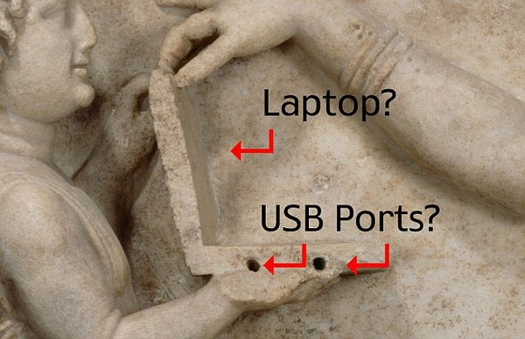
Look at the next match…

