Slide 1
Soccer Prediction Application

Slide 2
Guideline
Introduction: goal of the application
Games, bet-odds, teams…
Domain of the application
Application modules and what they deal with
Crawler part → new matches/teams/player/bet-odds…
Machine Learning →
User Interface
Representation, algorithm → looking for the best
ML input/ML algorithm
Graphs
RUN: need just a (temporary) internet connection on your laptop

Slide 3

Football, Winning & Money
“FOOTBALL’S NOT JUST A SCORING GOALS, IT’S ABOUT WINNING” - [Alan Shearer]
“WINNING INCREASES THE DOPAMINE RECEPTORS IN THE BRAIN, WHICH MAKES YOU SMARTER AND MORE BOLD” - [IAN H. ROBERTSON]
“EVERY BAD DECISION I’VE MADE HAS BEEN BASED ON MONEY” - [Eddie Murphy]

Slide 4
Domain
Team
Group of people that aims to win a match
Match
Challenge between two teams, in which one tries to beat the other
Teams are different, pattern are recurrent
Bet-odd
Almost every day, a match is played
It is an opportunity to make money
Based on time, team can be strong or weak
Notes:
Teams change every year → the statics of a winner/looser team not.
Use power of statics to gain advantage in placing a bet.

Slide 5
Modules
Crawl: new unstructured data
SQLite: store structured data
Machine Learning: predict tomorrow and evaluate the accuracy of yesterday predictions
Repeat until TRUE
SQLite
Machine Learning
Crawl

Slide 6
Prediction
Machine Learning Algorithm Input. Match representations:
Team Form: combination of points gathered by the teams
Team Home Away Form: combination of points gathered by the teams, considering matches played at home and away.
Match Statistics: combination of previous match statistics performed by teams.
Kekko input: features an human uses to gather information before placing a bet.
Poisson input: home strength and away strength (average goal a team will score)
Notes:
1.1 [home_form / home_n, away_form / away_n]
1.2 [home_form // home_n, away_form // away_n]
1.3 [home_form / home_n - away_form / away_n]
1.4 [home_form // home_n - away_form // away_n]
2.1 home_form / home_n, home_team_home_form / home_n1, home_team_away_form / home_n2, away_form / away_n, away_team_home_form / away_n1, away_team_away_form / away_n2]
2.2 [home_form // home_n, home_team_home_form // home_n1, home_team_away_form // home_n2, away_form // away_n, away_team_home_form // away_n1, away_team_away_form // away_n2]
2.3 [home_form / home_n - away_form / away_n, home_team_home_form / home_n1 - away_team_home_form / away_n1, home_team_away_form / home_n2 - away_team_away_form / away_n2]
2.4 [home_form // home_n - away_form // away_n, home_team_home_form // home_n1 - away_team_home_form // away_n1, home_team_away_form // home_n2 - away_team_away_form // away_n2]
3. [home_goal, away_goal, home_shoton, away_shoton, home_goal_ratio, away_goal_ratio, home_form, away_form]

Slide 7
prediction
Machine Learning Algorithm:
Knn
SVM multiclass
Random Forest
“Poisson”
Train Window: how much a match in the past matters?
Number of previous stages to include in the training [9,11,19,35,71,105,141,175,211,245,281]

Slide 8

Looking for the best
5 input types
4 representations for 2 inputs
3 ML algorithms
1 Hybrid
11 different time windows
$11×\left(3×\left(3+2×4\right)\right)+1)=275$ possible settings

Slide 9
Start from the easiest
Team form, Representaion1 : numeric values of the team forms, normalized to interval [0, 3].

Slide 10
Problems:
Bigger windows seems to be more precise, but they allow to predict lesser matches.
Accuracy of smaller windows cannot be comparable with the one’s from bigger (N vs n, N >> n ).
Solution:
Consider only valuable windows
Try to predict the same matches for every predictor

Slide 11
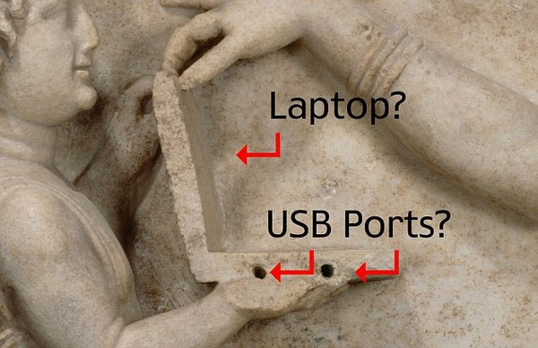
Look at the next match…

