Slide 1
Assessing the Credibility of FED and TCMB: A Dynamic Approach
Göktuğ ÜLKAR

Slide 2
Reasoning
The foremost goal of central banks is to lower long-term inflation
Therefore, central bank credibility is directly linked to their lowering long-term inflation and its expectations
Traditional methods like inflation expectations do not give realistic outcomes for countries like Turkey.
Instead, we propose a new method, inspired by Demiralp and Cakmakli (2015)

Slide 3
Reasoning
Instead of inflation expectations, we look at 10-year bond yields and how they change according to central bank announcements.
10-year bond yields are safe investments that investors usually acquire to offset the cost of inflation
Therefore, the yield on a 10-year bond is directly linked to long-term inflation expectations.

Slide 4
Methodology
Gather the daily bond yield return data for both US and Turkey between 2010-2022
Get the dates of interest rate announcements of FED and TCMB
Take the average of the bond yields ten days before the announcement and ten days after
If the bond yields increase, then the central bank`s policy has failed, meaning an uncredible central bank

Slide 5
Results
Out of 147 announcements by TCMB, 86 have caused the decline of 10-year bond yields, while 61 have increased them.
This means a credibility score of 0.585, or 58.5%
Out of 105 announcements by FED, 58 have caused the decline of 10-year bond yields, while 47 have increased them.
This means a credibility score of 0.552, or 55.2%

Slide 6
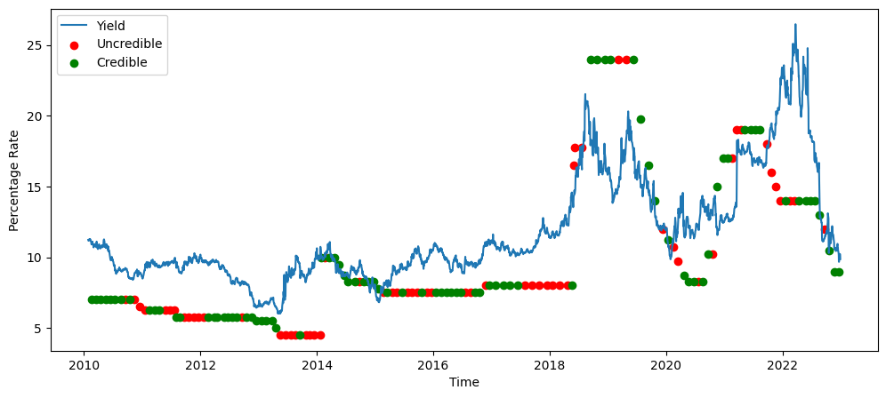
TR Data

Slide 7
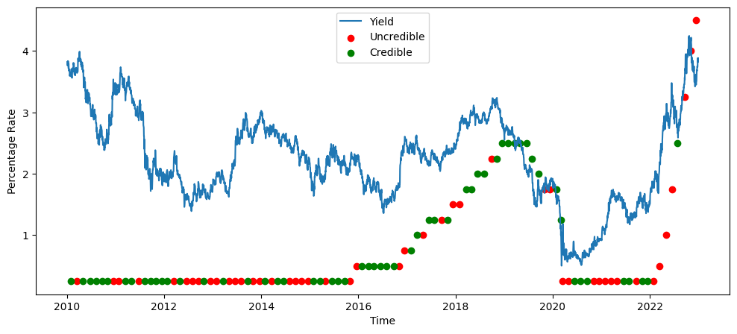
US Data

Slide 8
Thank You For Listening

