Slide 1
CSE445 IMAGE PROCESSING FINAL PROJECT PRESENTATION
Automatic Number Reading System for Inhaler Production Line
GROUP 1
EZGİ ALTIOK
GÖKTÜRK CAN
KAMİL SEFA CESUR

Slide 2
Problem Definition and Importance
Problem : Ensuring the accuracy of the numbers indicating the dosage of drugs on the production line is a critical process in inhaler manufacturing. In this process, it is essential to ensure that the amount of medication contained in each inhaler is correct. Any deficiency or excess in the required medication amount can hinder patients from receiving the correct treatment, leading to serious health issues.
Limitations of Traditional Methods:
Manual control: Time-consuming, error-prone, and costly.
Human errors: Can lead to incorrect dosing and product defects.

Slide 3
Project Objective
The objective of this project is to develop a fast, accurate, and automated control system for verifying the accuracy of drug dosages indicated by numbers on the production line in inhaler manufacturing. This system aims to ensure that each inhaler contains the correct amount of medication, thereby preventing potential health risks associated with under-dosing or overdosing. By automating this control process, the goal is to eliminate the need for manual intervention, reducing the risk of human errors and enhancing efficiency. The developed control system should be capable of precisely measuring the medication quantity in each inhaler and promptly alerting operators in case of any deviations from the specified dosage standards. Ultimately, the implementation of this solution will enhance patient safety, improve production efficiency, and reduce costs within the inhaler manufacturing process.

Slide 4
Team Roles
Project Manager (Göktürk Can): Project planning, organization, and time management. Coordinating team communication and task distribution. Providing leadership and guidance in technical decision-making.
Algorithm Developer (Kamil Sefa Cesur): Applying image processing techniques using OpenCV (noise reduction, contrast enhancement, ROI detection).Developing algorithms to segment and recognize digits accurately (using OpenCV, scikit-image, and scikit-learn).Training and testing machine learning models.
Literature Researcher (Ezgi Altıok): Reviewing the latest academic publications and articles on OCR, digit recognition, and image processing. Preparing a literature review report that highlights the project's originality and innovative aspects.

Slide 5
Similar Solutions in Literature and Differentiation
Overview:
Optical Character Recognition (OCR) and digit recognition have advanced significantly, especially with deep learning. Recent advancements in Optical Character Recognition (OCR) and digit recognition, particularly through the utilization of basic image processing techniques such as noise reduction, thresholding, contour extraction, and segmentation, have significantly improved the accuracy and efficiency of text and digit recognition across diverse image types.
Relevant Studies:
Cireșan et al. (2012): Multi-column deep neural networks for image classification.
Jaderberg et al. (2015): Deep convolutional neural networks for text detection in natural images.
Suykens (2017): An approach combining kernel machines with deep learning.
Differentiation: Our project focuses on the specific challenges of inhaler displays (font variety, size variability, lighting differences). It targets the recognition of two-digit numbers specific to medication dosages.

Slide 6
Why OCR?
Visual Data Processing Need: Checking the displayed drug quantities on inhaler screens requires visual data processing. OCR can automate this process by recognizing symbols like text or numbers from images.
High Accuracy and Speed: Advanced OCR algorithms can offer high accuracy and speed. This is crucial for precise dosage control on the inhaler production line.
Examples in the Literature: Studies have shown the effectiveness of deep neural networks (such as those by Cireșan et al. and Jaderberg et al.) in tasks like text recognition and image classification.

Slide 7
Project Scope and Solution Approach Image Processing
Noise Reduction: Cleaning unwanted noise in images using methods like median filtering.
Segmentation: Dividing the image into meaningful regions, often to isolate individual digits.
Thresholding: Converting grayscale images to binary images by setting a threshold value, aiding in separating digits from the background.
ROI (Region of Interest) Detection: Identifying and extracting specific areas in an image that contain relevant information (in this case, the digits on the inhaler display).

Slide 8
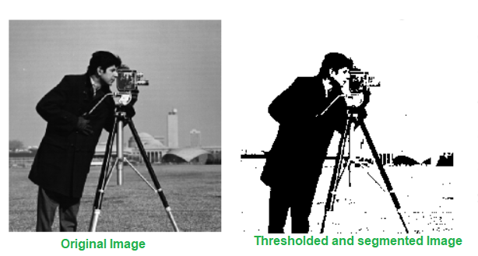
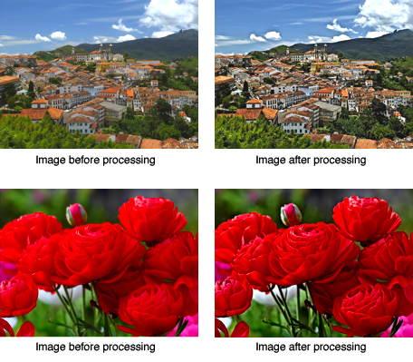
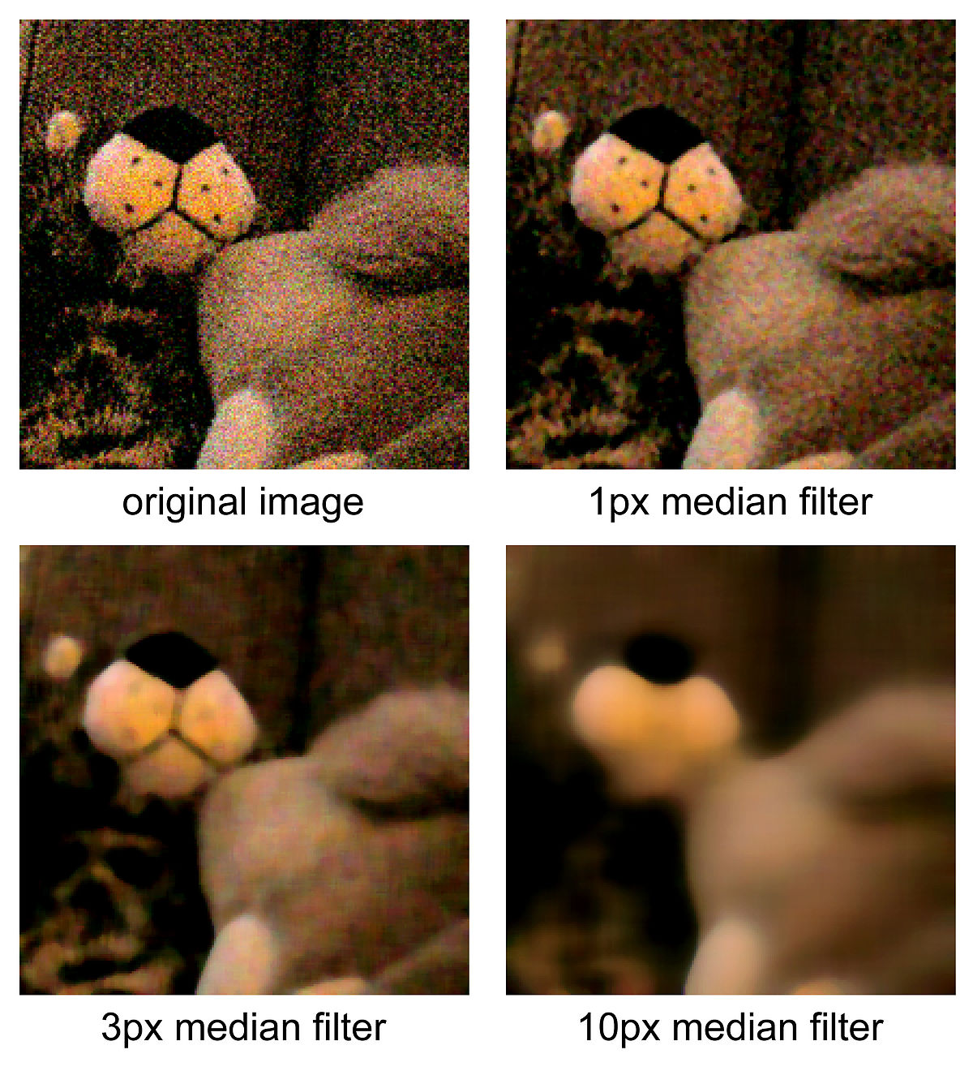
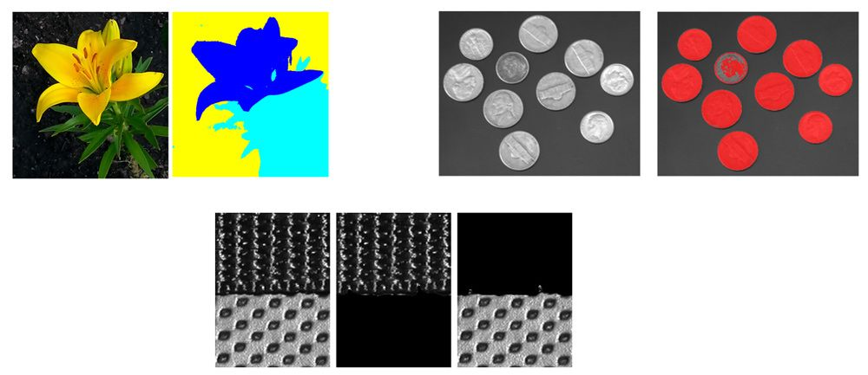
E
X
A
M
P
L
E
S

Slide 9
Unique Contributions of the Project
Customization for Inhaler Displays:
Font Variety: Using a model trained with various font styles to recognize different fonts used by different manufacturers.
Size Variability: Processing digits of different sizes accurately using adaptive scaling or region of interest (ROI) detection.
Lighting Differences: Accurate recognition under different lighting conditions through techniques like contrast adjustment or histogram equalization.

Slide 10
Unique Contributions of the Project
Targeted Two-Digit Recognition:
Digit Segmentation: Identifying individual digits using connected component analysis or contour detection.
Contextual Integration: Converting segmented digits into meaningful two-digit numbers according to the specific requirements of inhaler displays.
Integration with Production Line:
Real-Time Processing: Ensuring the algorithm operates fast enough to keep up with the production line speed.

Slide 11
Equipment and Software to be Used
Hardware:
Smartphone Camera: High resolution and cost-effective.
Desk Lamp and White Paper Diffuser: Practical solution for proper lighting.
Software:
Open Camera App (Android): Flexible image settings.
OpenCV (Python): Comprehensive image processing library.
Data Storage:
Local File Storage (CSV): Simple and free.
Cloud Storage (Google Drive, Dropbox): Scalable and secure.

Slide 12
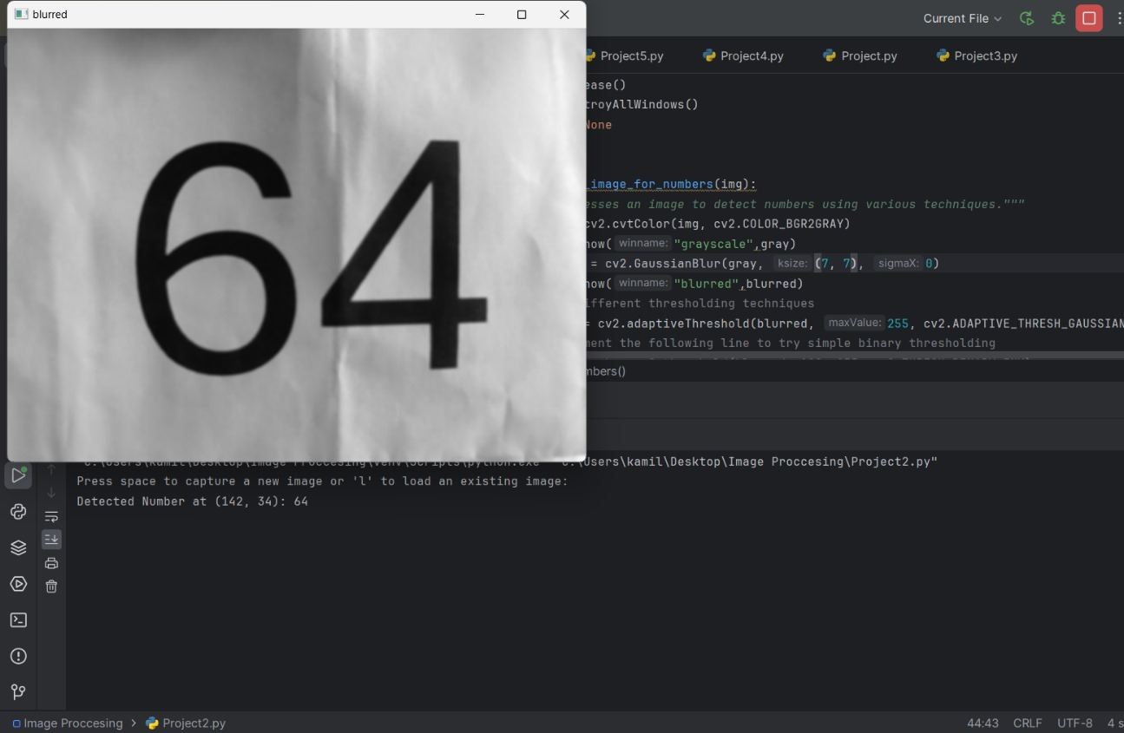
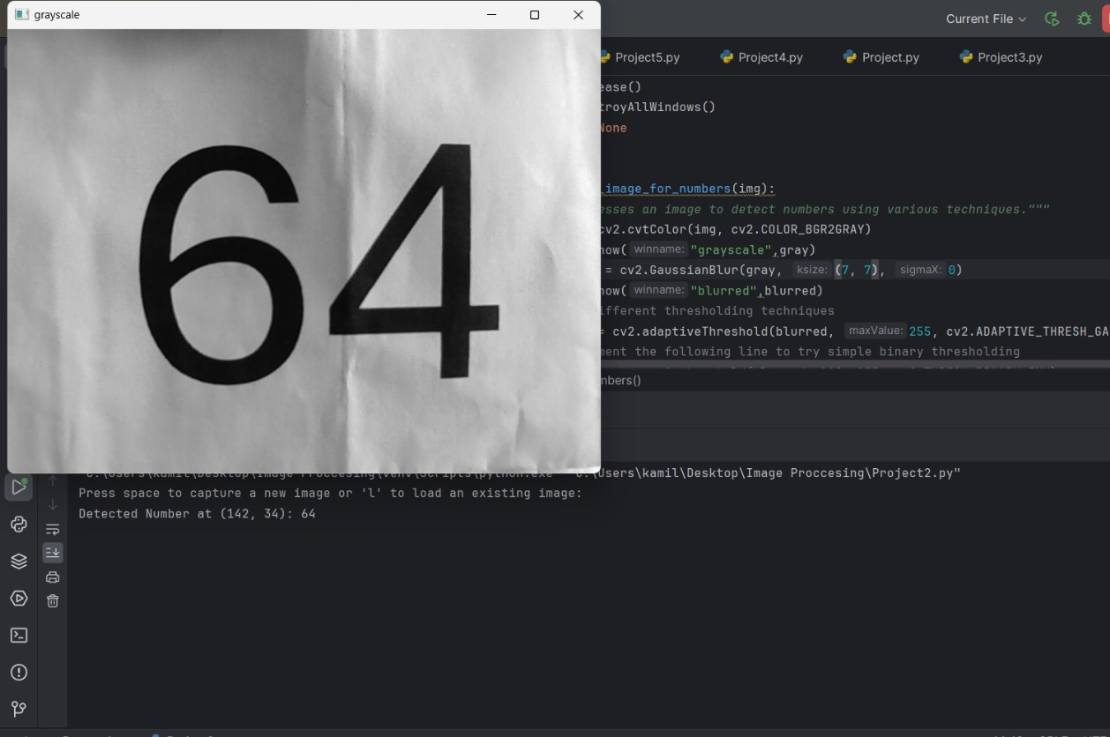

blurred
grayscale

Slide 13
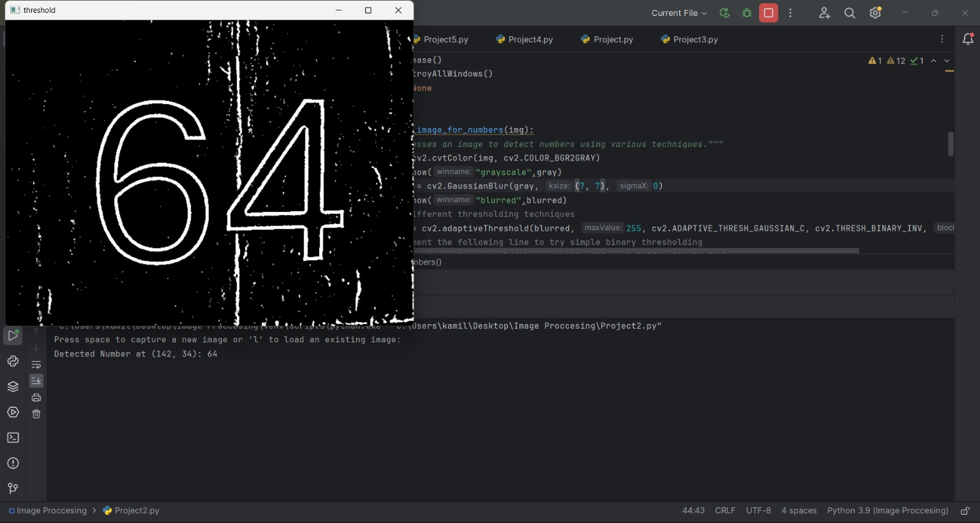
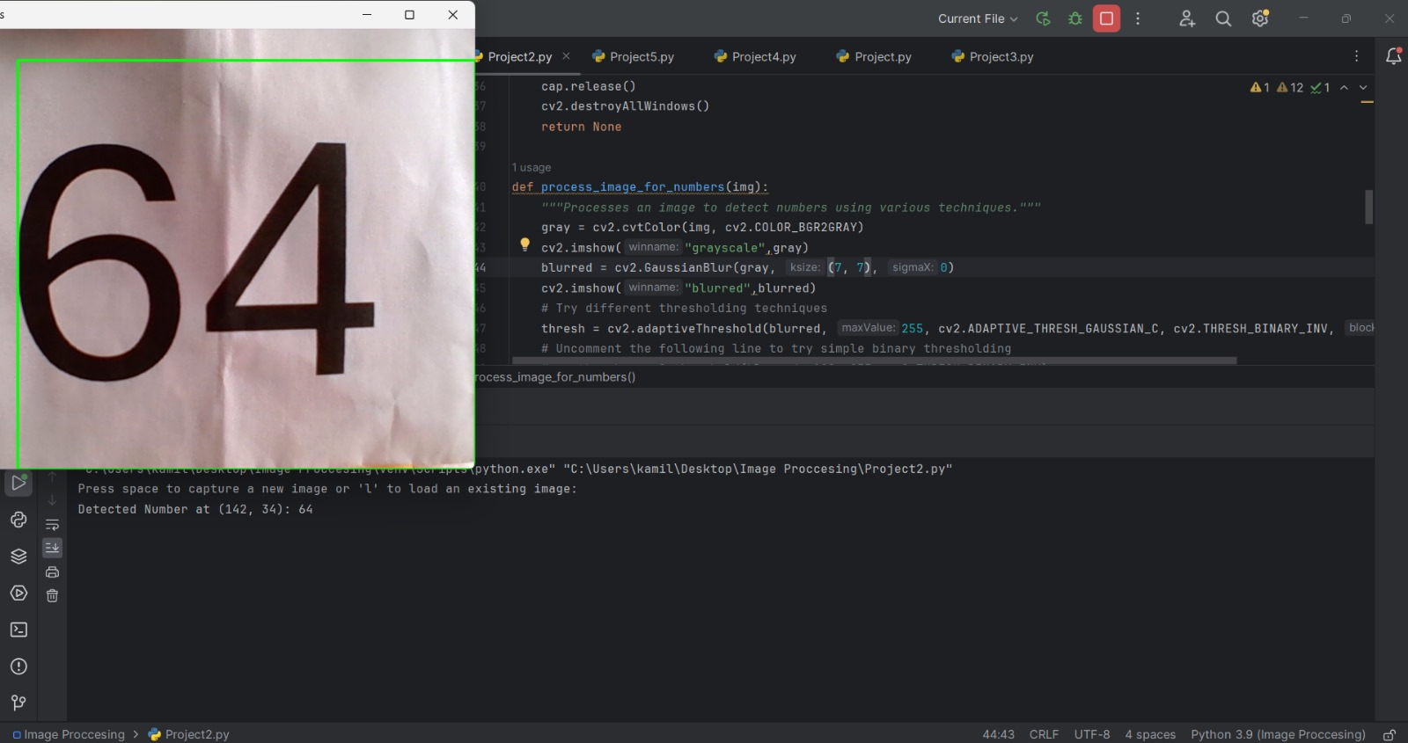
treshold
detection

Slide 14
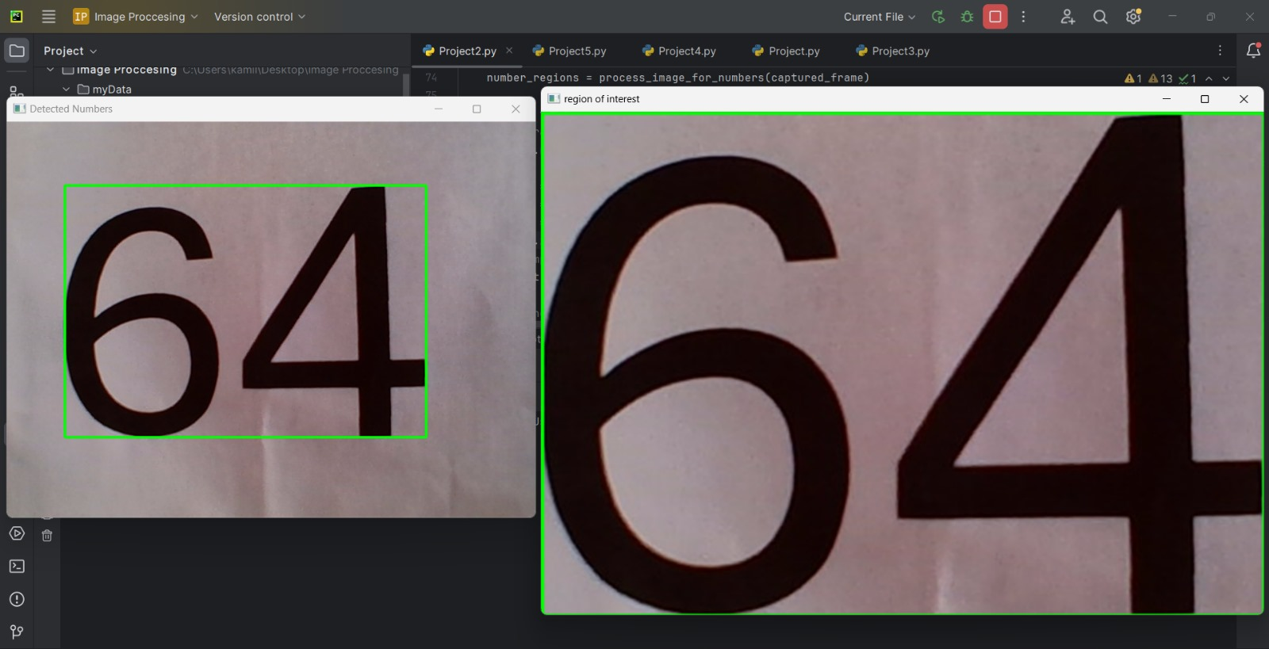

Slide 15
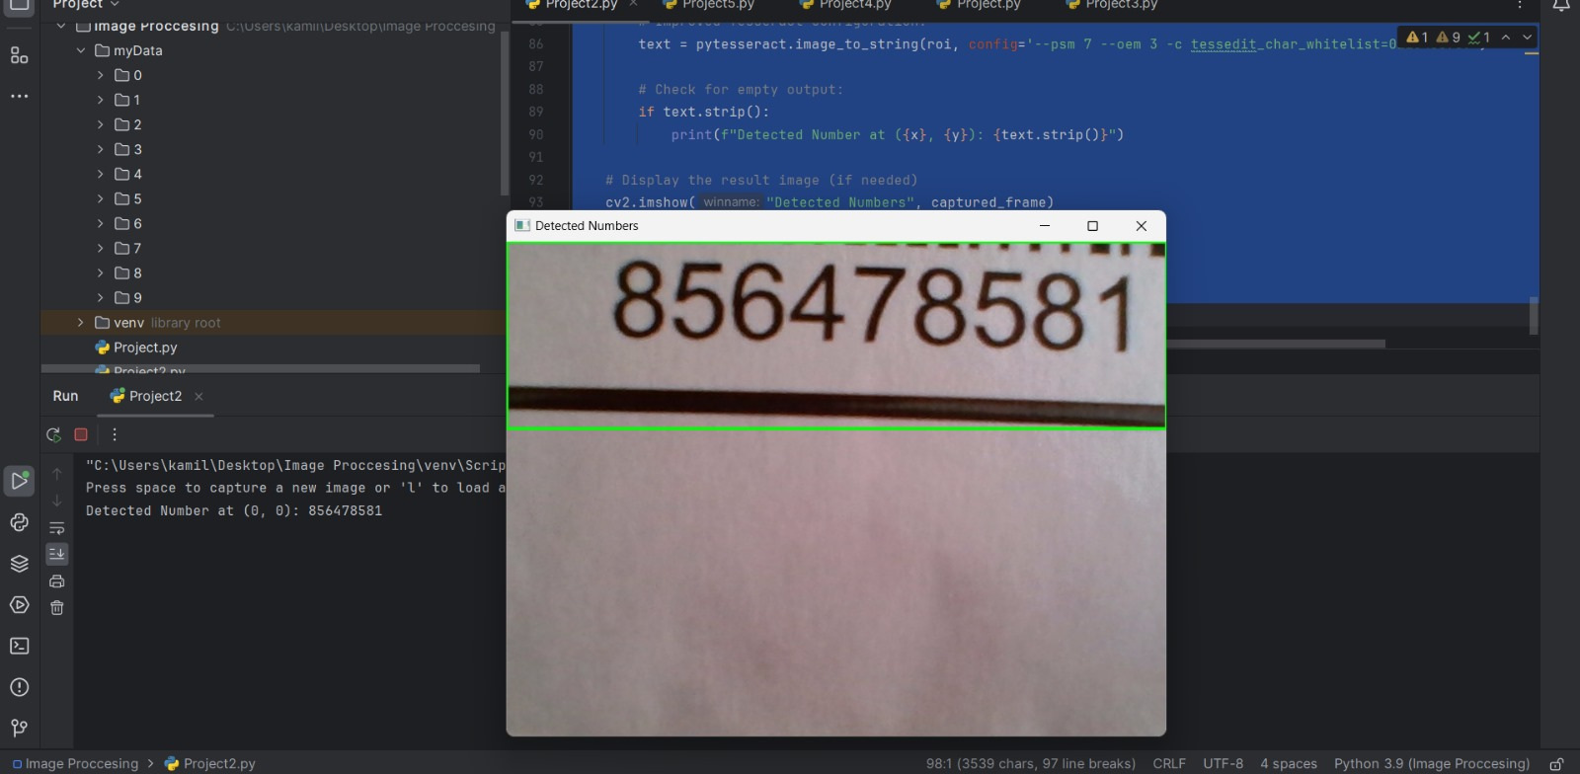

Slide 16
Project Plan and Timeline
Week 1:
Literature Review: Reviewing relevant studies and the latest technologies.
Algorithm Design: Creating the project architecture and determining methods.
Weeks 2-3:
Data Collection: Creating a dataset from various inhaler images.
Data Preprocessing: Preparing images for analysis (noise reduction, contrast adjustment, etc.).

Slide 17
Project Plan and Timeline
Weeks 3-4:
Algorithm Integration: Combining all components into a complete system.
Testing and Optimization: Testing and improving the algorithm in a simulated environment.
Weeks 4-5:
Deployment in Real Environment: Integrating the optimized algorithm into the production line.
Documentation: Completing the project report and sharing the results.

Slide 18
References
Gonzalez, R. C., & Woods, R. E. (2002). Digital image processing (2nd ed.). Upper Saddle River, NJ: Prentice Hall.
Jaderberg, M., Simonyan, K., Vedaldi, A., & Zisserman, A. (2015). Deep structured output learning for unconstrained text recognition. In International Conference on Learning Representations (ICLR).
Ciresan, D. C., Meier, U., Masci, J., & Schmidhuber, J. (2012). Multi-column deep neural networks for image classification. In 2012 IEEE Conference on Computer Vision and Pattern Recognition (pp. 3642-3649). IEEE.

