Slide 1
Factors That Affect a Country on Sustainable Growth
World Economic Indicator

Slide 2
Data Used
World Economic Indicator Dataset:
The dataset contains various information which
has different countries and regions' GDP, population, and other factors that might
impact GDP/Capita.
Like:
Energy Usage
Tourism
Human Resource
Business

Slide 3
Executive Summary
Problem
How a country can attain sustainable growth
Approach
GDP per capita which is GDP/ population
To improve GDP per Capita, find the factors that have:
A strong or positive relationship with the GDP
A strong or negative relationship with the Population

Slide 4
Insights
Energy Usage has the highest correlation coefficient with GDP among all the factors listed, indicating a strong positive relationship between the two variables.
CO2 Emissions have the second-highest correlation coefficient with GDP, which suggests that countries with higher economic output tend to emit more CO2.
Tourism Inbound has a high positive correlation coefficient with GDP, which suggests that countries with more inbound tourists tend to have a higher economic output.
Health Exp/Capita has a higher correlation coefficient with GDP than Health Exp % GDP, indicating that the amount spent on health care per person is a better predictor of a country's economic output than the percentage of GDP spent on health care.

Slide 5
Insights
Population Total and Population 65+ have a moderate positive correlation with GDP, which suggests that countries with larger populations and a higher proportion of elderly people tend to have a higher economic output.
Birth Rate, Infant Mortality Rate, Population 0-14, and Population 15-64 have a negative or low correlation coefficient with GDP, indicating a weak or negative relationship with economic output.
Lending Interest, Business Tax Rate, Days to Start Business, Ease of Business, and Mobile Phone Usage have a low correlation coefficient with GDP, indicating a weak or negligible relationship with economic output.
Internet Usage has a moderate positive correlation coefficient with GDP, indicating that countries with higher internet usage tend to have a higher economic output.

Slide 6
Detailed Analysis
 |  | Correlation with GDP | Correlation with Population
 | Factors | Correlation coefficient | Correlation coefficient
GDP | Health Exp % GDP | 0.327206386 | -0.054020935
 | Health Exp/Capita | 0.450360179 | 0.008410515
 | Lending Interest | -0.059875669 | 0.007037956
ENERGY | Energy Usage | 0.698783768 | 0.578142833
 | CO2 Emissions | 0.610897735 | 0.57743853
HUMAN RESOURCES | Birth Rate | -0.154900794 | -0.033172924
 | Infant Mortality Rate | -0.14580523 | 0.03133025
 | Life Expectancy Female | 0.144844603 | 0.052831665
 | Life Expectancy Male | 0.14667627 | 0.062283911
 | Population 0-14 | -0.135772912 | 0.000148286
 | Population 15-64 | 0.115741983 | 0.103515242
 | Population 65+ | 0.275983149 | 0.032063091
 | Population Total | 0.379397915 | 1
 | Population Urban | 0.167221418 | -0.060784636
TOURISM | Tourism Outbound | 0.535809462 | 0.276065576
 | Tourism Inbound | 0.873616877 | 0.304237109
Business | Business Tax Rate | 0.052575346 | 0.066681357
 | Days to Start Business | -0.034541657 | 0.027612256
 | Ease of Business | -0.011417067 | 0.015635224
 | Hours to do Tax | 0.063208927 | 0.123215942
 | Internet Usage | 0.266791564 | -0.030658863
 | Mobile Phone Usage | 0.130668415 | -0.040174161

Slide 7
Row Labels | Average of Population Total | Average of GDP_If_missing | Average of GDP/CAPITA
Africa | 17665922.03 | 25075088370 | 2104.596335
Asia | 108212254.3 | 3.618E+11 | 6859.209975
Europe | 16701733.42 | 3.45217E+11 | 26469.34614
Middle East | 14852352.28 | 1.13868E+11 | 17384.03017
Oceania | 2265297.908 | 63739145108 | 24143.74791
The Americas | 20426273.35 | 4.16821E+11 | 104421.2197
Grand Total | 31608742.96 | 2.46266E+11 | 32840.42337
The Americas have the highest average GDP/Capita among all the regions listed, indicating a higher standard of living in this region.
Europe has the highest average GDP among all the regions listed, indicating a higher overall economic output in this region.
Africa has the lowest average GDP/Capita among all the regions listed, indicating a lower standard of living in this region.
Despite having a relatively lower GDP/Capita, Africa has the highest population among all the regions listed. This could indicate a potential for growth in the future as the economy develops.

Slide 8
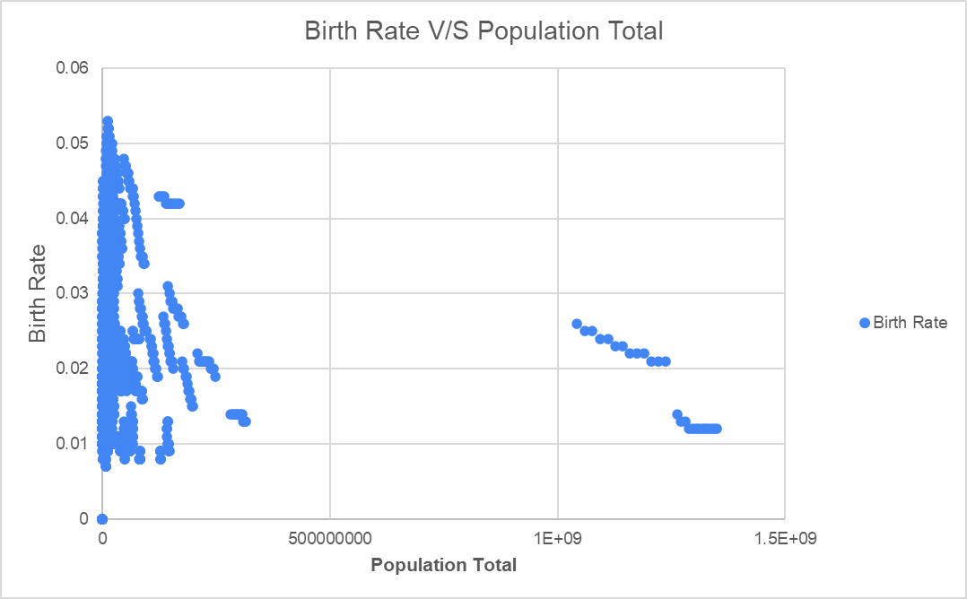
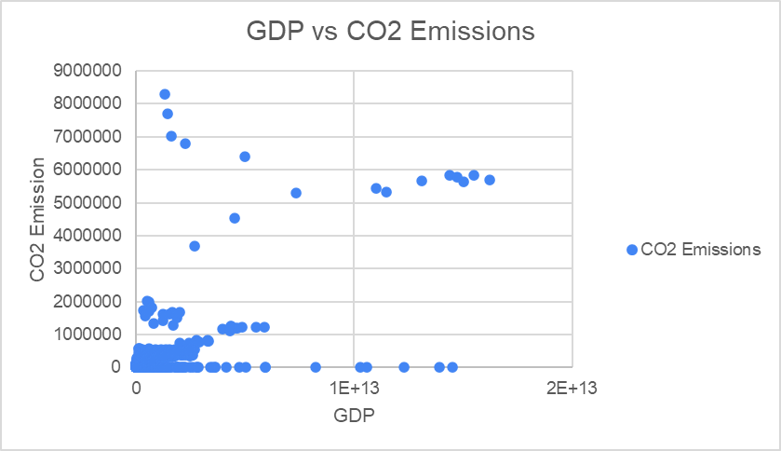

Slide 9
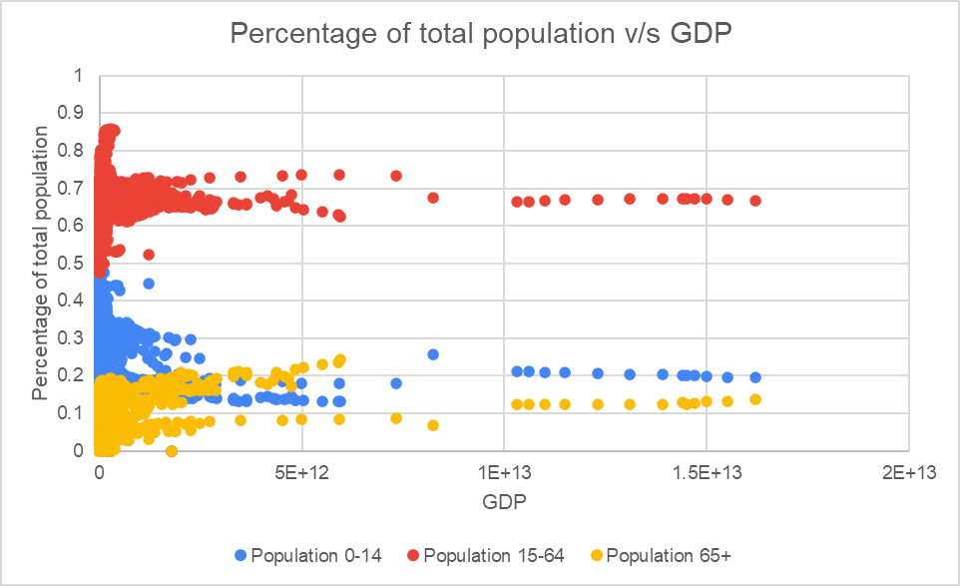

Slide 10
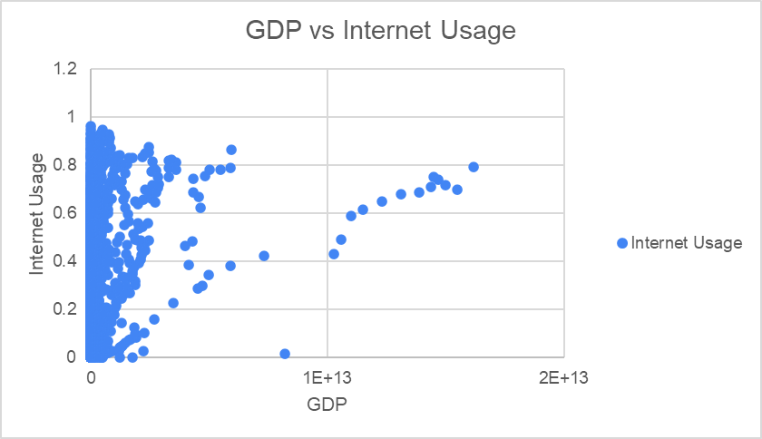
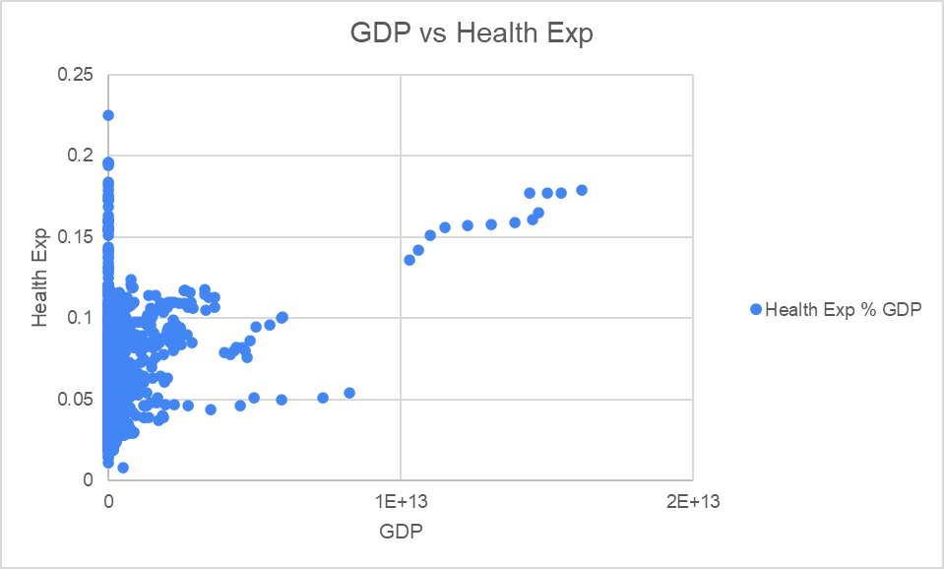

Slide 11
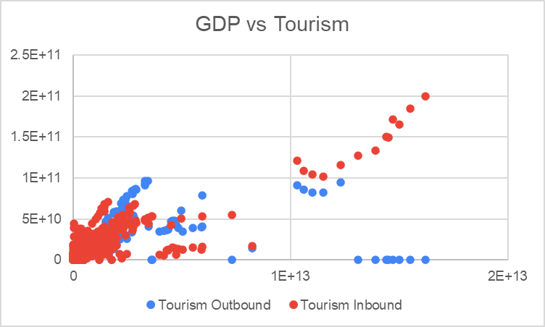
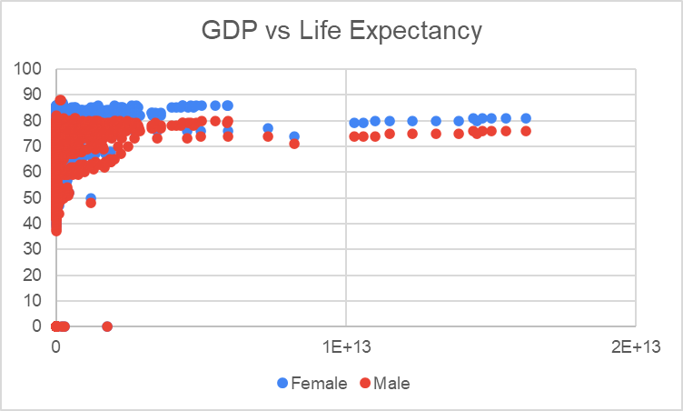

Slide 12
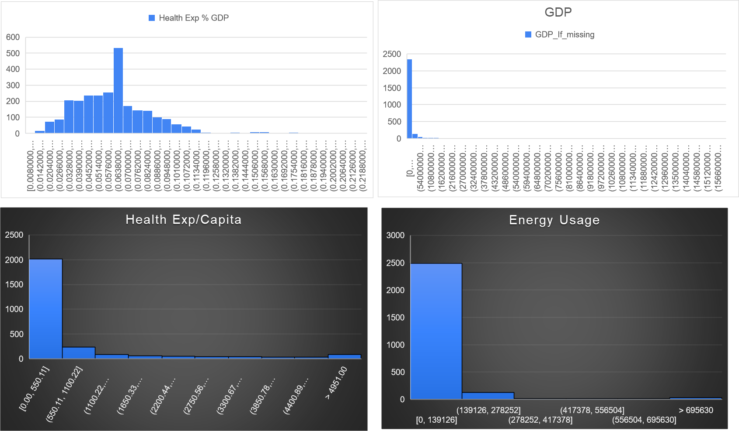

Slide 13
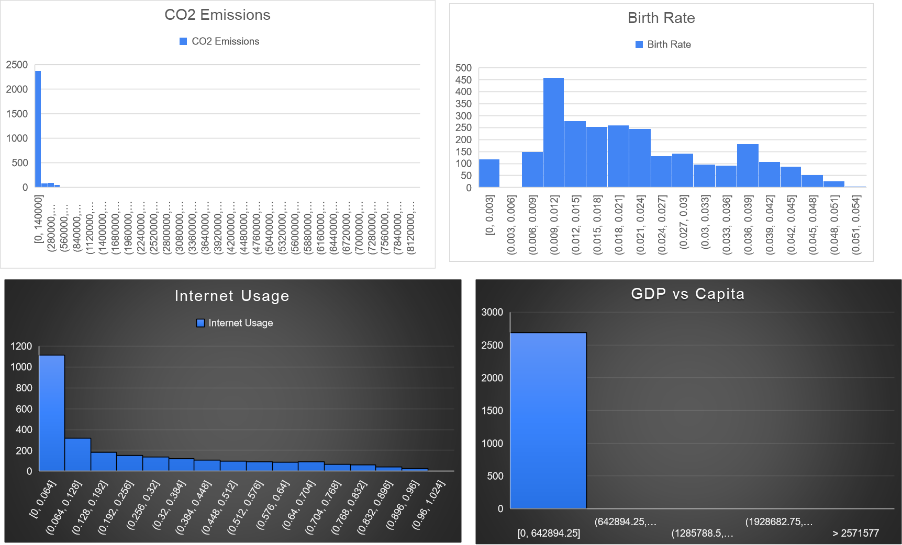

Slide 14
