Slide 1

Iowa Liquor Sales Analysis
DATASCIENCE–3253 Machine learning
TERMPROJECT
(Group Members : Jie Cui, Gokulan Thedchana, Xuemei Xie)

Slide 2
Index
OBJECTIVE
DATA SOURCES
DATA PREPARATION
DAILY SALES ANALYSIS
WEEKLY SALES ANALYSIS
LSTM ANALYSIS & FORECAST
CONCLUSIONS

Slide 3
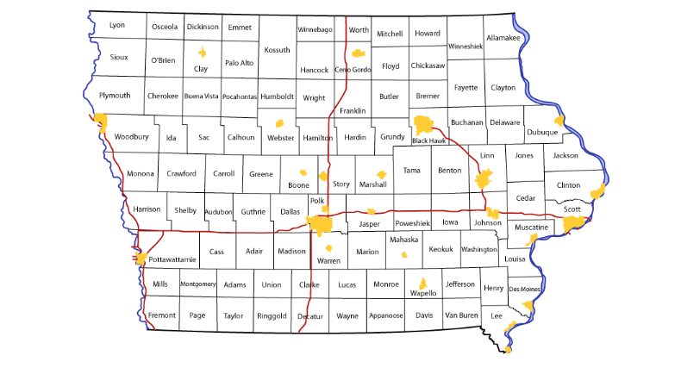
Introduction
The state of Iowa controls wholesales of alcoholic beverages with content of alcohol higher than 10%. That excludes wines and beers.
All stronger alcoholic beverages either imported or purchased by the state owned Iowa Alcoholic Beverages Division that adds universal markup of 50%, that increases the price for alcoholic beverages 1.5 times when sold to stores and wholesale distributors.

Slide 4
Objective
Our Prime Objective is to
Analyze liquor sales across Iowa State for predicting spikes and dips in sales throughout the years to encourage proactive preparation of inventory, promotions, scheduling.
We also seek to predict any general trends in sales to help retailers understand which focus areas would be most impactful

Slide 5
Our DataSet
Briefly, the dataset comprised over 18 million rows of data, as of February 29, 2020. Each observation contained information including:
The date of purchase (mm/dd/yyyy)
Details on the vendor making purchase (e.g., assigned store number, county and city details);
The type and brand of liquor purchased (e.g., Jack Daniel’s Tennessee Whiskey);
The bottle size (e.g., 750 ml) and number of bottles purchased;
The total sale amount, including State and retail costs per bottle; and
The total volume of liquor sold, in liters and gallons

Slide 6
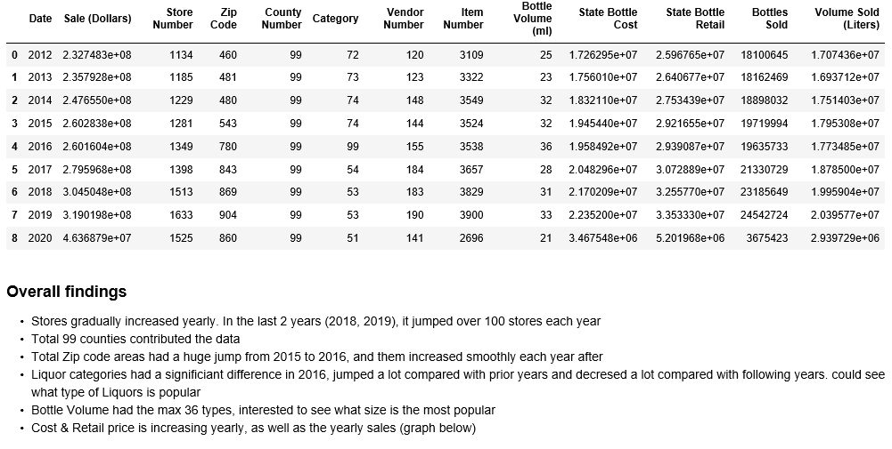
First Glance at Data

Slide 7
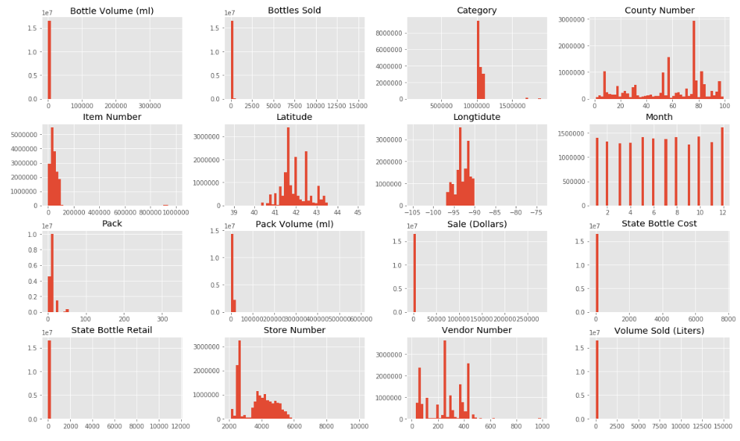
First Glance at Data

Slide 8
Random Forest Regression
DailY Sales: Statewide

Slide 9
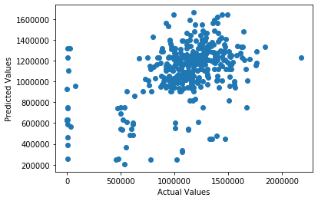
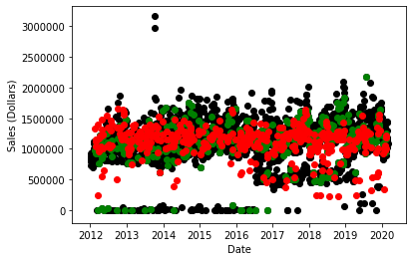
Predicting Total Daily Sales: Statewide
Actual Test Values vs Predicted Values
RMSE = 314811.03
Original Aggregate Sales (Black)
Test Set (Green), Predicted Values (Red)

Slide 10
Random Forest Regression
Weekly Sales: Statewide

Slide 11
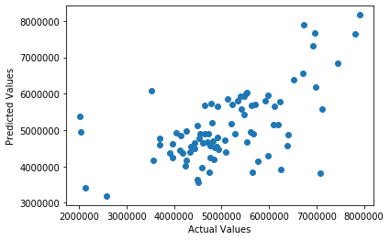
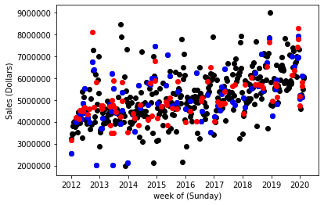
Predicting Total Weekly Sales: Statewide
Actual Test Values vs Predicted Values
RMSE = 985491.59
Original Aggregate Sales (Black)
Test Set (blue), Predicted Values (Red)

Slide 12
Random Forest Regression
Weekly Sales By County

Slide 13
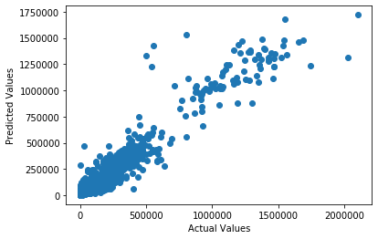
Predicting Weekly Sales By County
RMSE = 34977.24

Slide 14
Random Forest Regression
Weekly Sales By Vendor

Slide 15
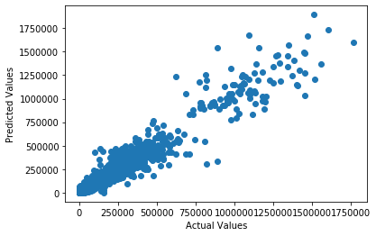
Predicting Weekly Sales By Vendor
RMSE = 36989.16

Slide 16
Random Forest Regression
Weekly Sales By County and Vendor

Slide 17
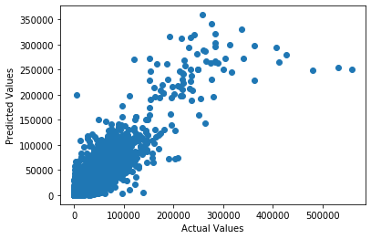
Predicting Weekly Sales By County and Vendor
RMSE = 3344.59

Slide 18
LSTM(Long Short-Term Memory) Model

Slide 19
Terminology
Resource- https://en.wikipedia.org/wiki/Long_short-term_memory
Long short-term memory (LSTM) is an artificial recurrent neural network (RNN) architecture used in the field of deep learning. Unlike standard feedforward neural networks, LSTM has feedback connections. It can not only process single data points (such as images), but also entire sequences of data (such as speech or video).
LSTM networks are well-suited to classifying, processing and making predictions based on time series data, since there can be lags of unknown duration between important events in a time series.

Slide 20
Consolidating Data
Converting counties and categories name attributes into binary vectors by using onehot encoder transformation
Using resample function to generate timeseries data
Applying 14- days rolling total sale data to fit the data model, after checking daily, weekly data check. The rolling data will be helpful to smooth the curve.

Slide 21
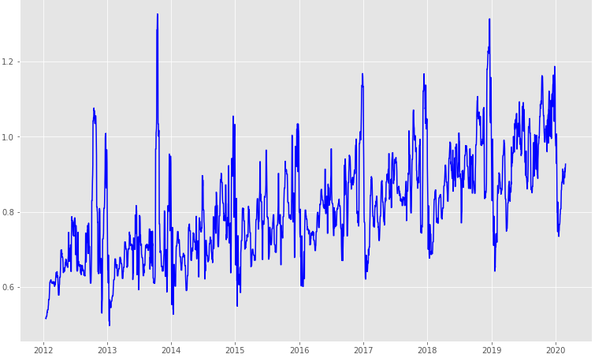
Consolidating Data
14-days Rolling Total Sale Distribution

Slide 22
Setup & Fitting The Model
Standardizing data before applying them into the model
Using ‘Relu’ as the activation function
Compiling the model with RMSprop optimizer along with ‘Mean Absolute Error’ loss function

Slide 23
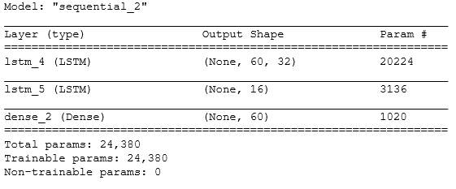
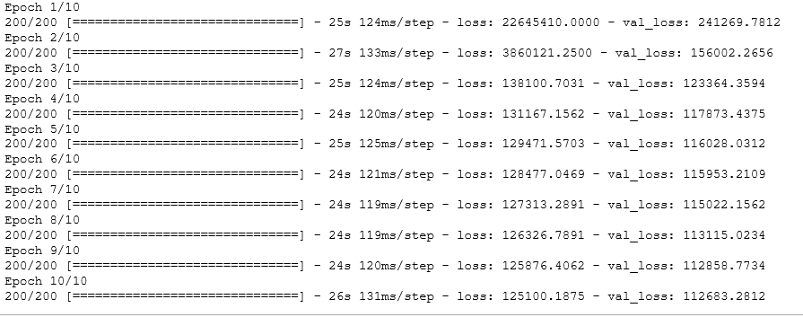
Setup & Fitting The Model
The result after setup LSTM model
The result of fitting the model with standardized training data

Slide 24
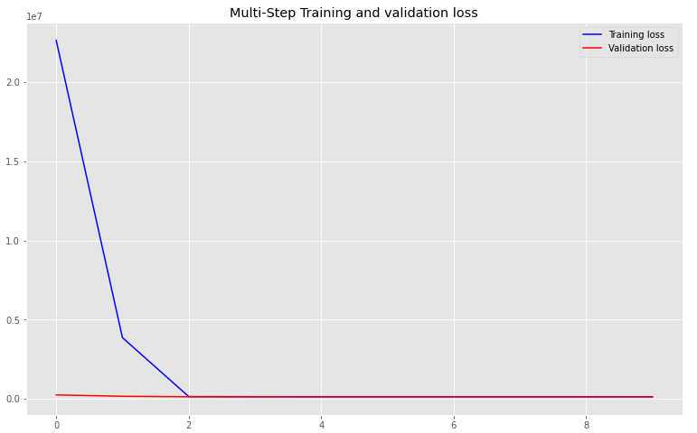
Setup & Fitting The Model
The gap of training loss and validation loss is getting smaller & almost converged eventually, which means the performance on validation dataset is reasonable.

Slide 25
Testing Result
Applying test data with trained model, for sampled 10 forecasting, the result as below:
accuracy mean: 0.9339574386523521 (i.e. inaccuracy mean: 0.06604256134764781)
Deviation: 0.03646670941507

Slide 26
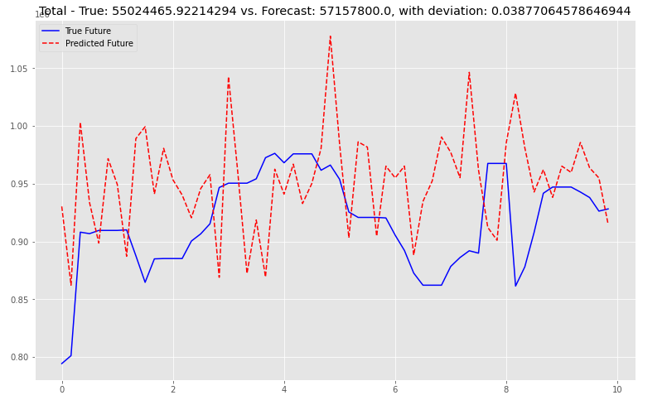
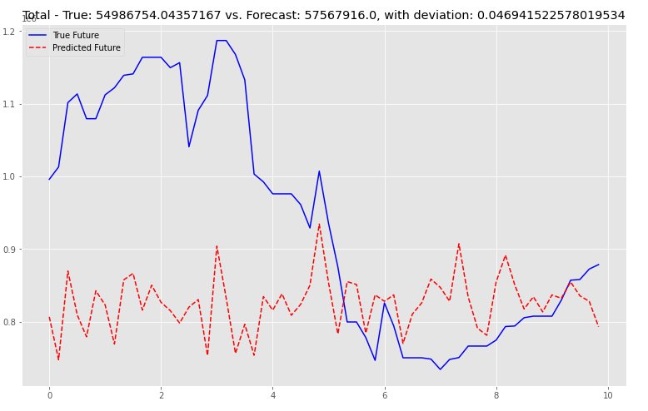
Testing Result
Some results

Slide 27
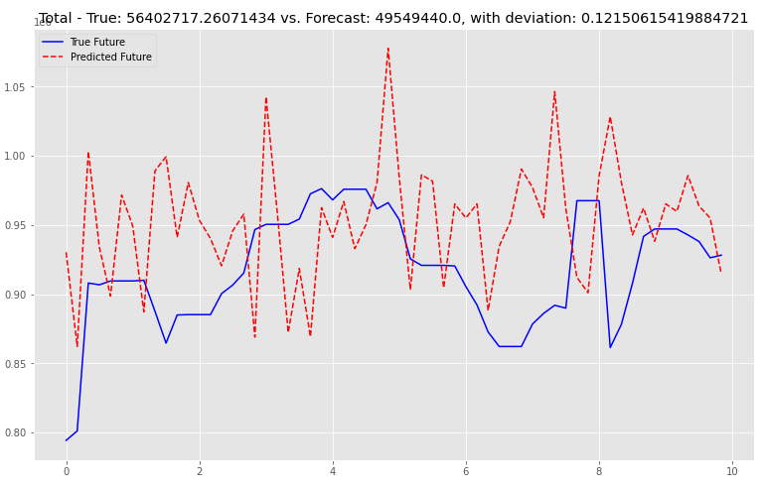
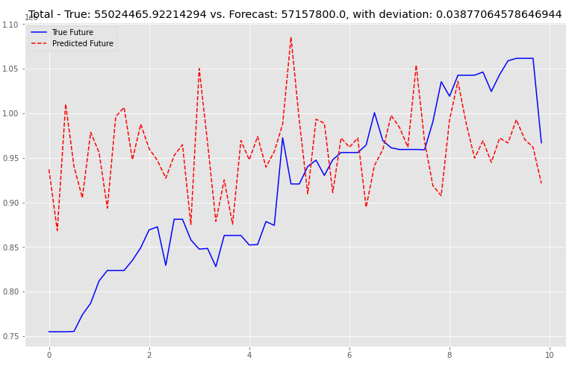
Testing Result
Some results

Slide 28
Conclusion
For statewide daily and weekly sales, the predicted values overlap the general region covered by actual test values reasonably well. However, the Random Forest Regression model does not perform as well as it does when county and/or vendor is considered. The Actual Values vs Predicted Values plots appear to show a correlation between the predicted data and the actual data.
LSTM model works well regarding time series forecasting 60 days sales. However, it tends to be worse if forecasting longer future steps.

Slide 29
Resources
Iowa Data
https://data.iowa.gov/Sales-Distribution/Iowa-Liquor-Sales/m3tr-qhgy
L.E.K.
https://www.lek.com/insights/ei/top-10-trends-affecting-spirits-industry

