Slide 1
ML-Based Runtime Malware Detection in Containerized Workloads
IST 584
Gokul Gopakumar

Slide 2
Summary
IST 584
Modern containerized threats, like Kinsing cryptojackers, bypass traditional signature-based defenses by hiding within cluster network traffic.
The Solution: A Random Forest Fusion Classifier that integrates Kubernetes infrastructure data with container misuse metrics.
Core Value: Provides a transparent, automated defense mechanism that minimizes the need for human intervention during rapid security incidents.
Current Status: The system has been validated through 60-tick real-time simulations with high performance.

Slide 3
BLUF (The Bottom Line)
IST 584
High Accuracy: Detected containerized malware with 94% accuracy and a 94% Macro F1-score from a pool of 158,621 records.
Autonomous Mitigation: Enables immediate threat response via KILL_POD and QUARANTINE_NETNS actions triggered by machine learning confidence levels.
Explainability: Leverages SHAP results to provide human-readable justifications for every automated security action taken.

Slide 4
Methodology
Goal
Step 1
Step 2
Step 3
Step 4
IST 584
Data Integration and Fusion
Feature Engineering & Selection
Model Training
Real-Time Simulation & Validation
Achieve a production-ready system capable of independent KILL_POD and QUARANTINE_NETNS alerts to mitigate cloud-native threats.

Slide 5
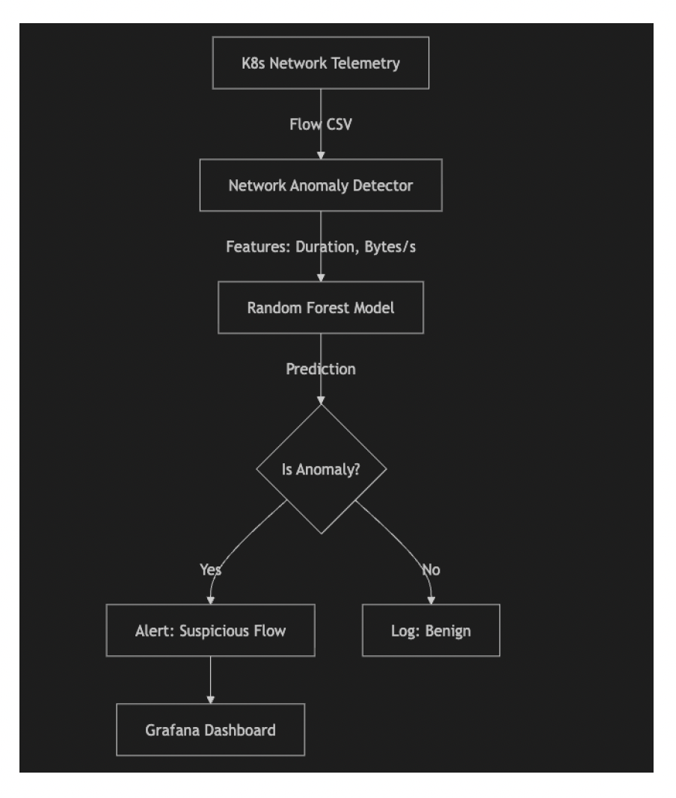
Process and Architecture
IST 584

Slide 6
Methodology
IST 584
Data Fusion: Combined the Kubernetes Anomaly Detection and AINA Container Misuse datasets to cover both infrastructure and attack-specific vectors.
Feature Engineering: Identified the 65 most significant fluctuating features, focusing on flow-level metrics such as Packet Length and Inter-Arrival Times.
Response Framework:
High Risk (>85%): Automated KILL_POD to halt malicious operations.
Moderate Risk (60-85%): QUARANTINE_NETNS for network isolation.
Low Risk (<60%): LOG_AND_MONITOR for administrative review.
Explainable AI: Integrated SHAP to show exactly which feature (e.g., a 0.055 increase in Packet Length) triggered the anomaly.

Slide 7
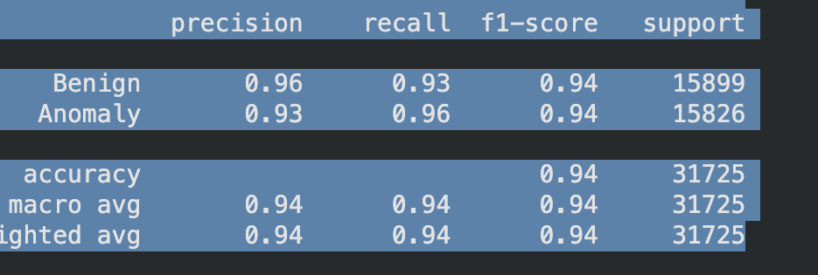
Performance Results
IST 584
The system was evaluated through a 60-tick real-time simulation, yielding the following performance benchmarks:

Slide 8
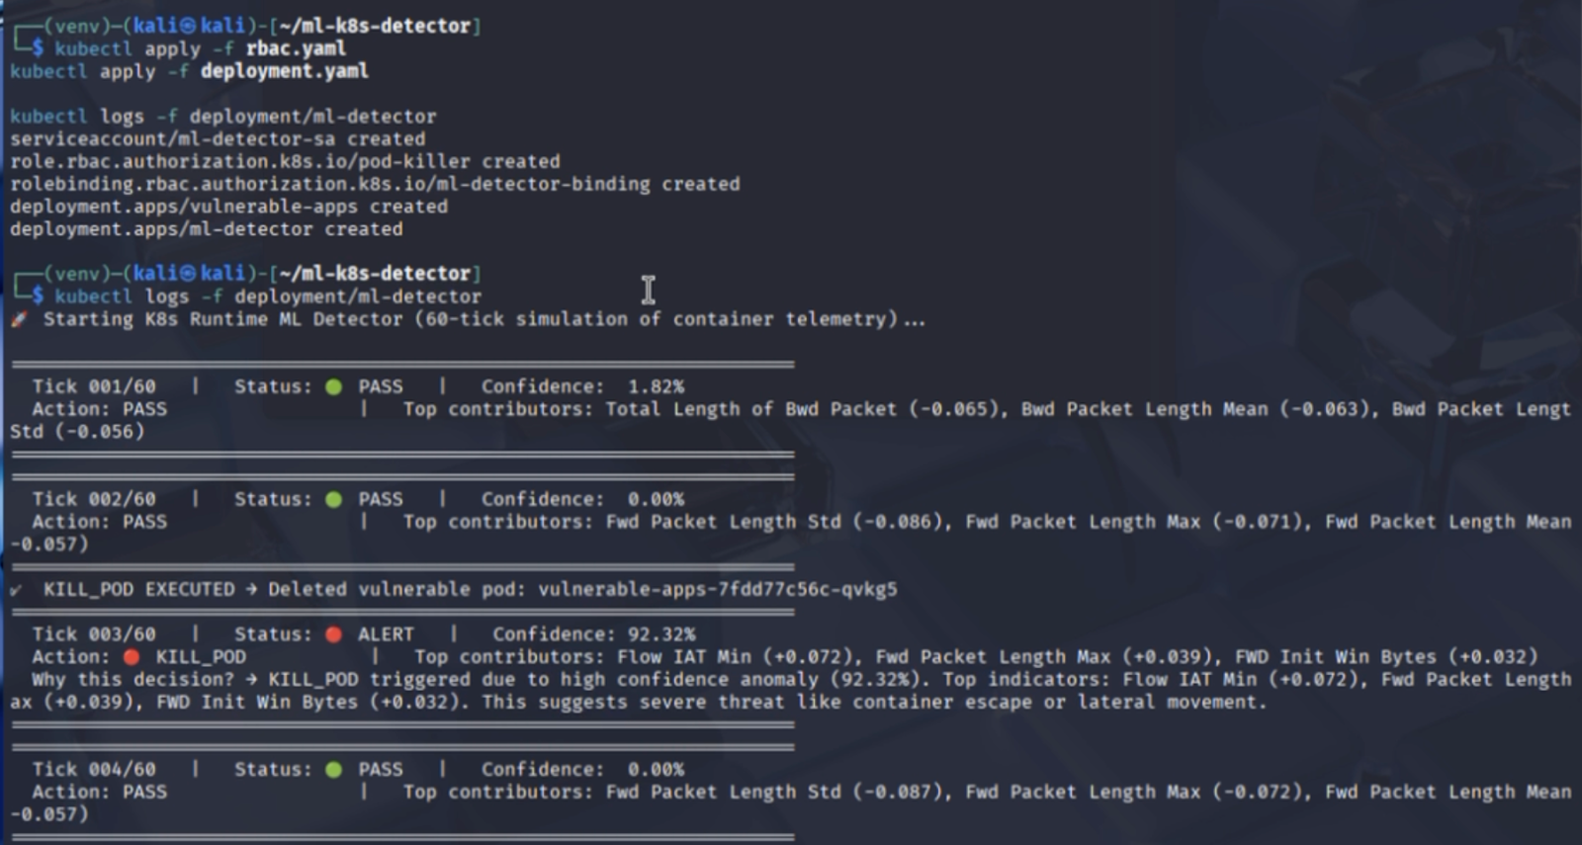
Example output logs
IST 584

Slide 9
Conclusion
IST 584
Summary: The project successfully bridged the gap between raw network packet analysis and focused on Kubernetes security enforcement.
Impact: Reduced resource exhaustion and prevented potential data exfiltration by identifying threats that operate under the radar of traditional tools.
Future Outlook: Scale the Fusion Classifier to support more diverse cloud-native attack patterns.
Enhance the "Human-in-the-loop" transparency to further build trust in automated response systems.

