Slide 1
Capstone of Gokul
Statistics & Modeling
Coding with Performance on Big Data
Communicating Results for Decision-Making
Venn Diagram of Data Science Skills

Slide 2
Contribution of Competitor’s Article
Using Social Media Post for a one-month period from different cities to Predict the Air Quality Index
In Text processing the documents are represented into a bag-of-words vector
The calculated weight of the word haze on the social media post is positively correlated with AQI
Markov Random Field(MRF) model to model the correlation between AQI and social media post
KNN is used to estimate the AQI for the nearby cities from where the social media post were collected

Slide 3
Description of Your Contribution
Used multilayer perceptron feedforward network for predicting the air quality index
The MLP consist of one hidden layer and 14 neurons on the hidden layer
Created a document vector for each document and the dimension of the vectors will be the number of distinct terms in the Bag of Words.
Calculated the absolute frequency of a term for each bag of words that created for each tweets

Slide 4
Data Source and Content
Collected tweets using Twitter API that are posted from New York City about air pollution for a 10 day time period
City Pulse Air pollution dataset which has the values for carbon monoxide, nitrogen dioxide, sulfur dioxide, particulate matter and ozone index levels.
The measurements of these Pollutants are collected from August 2014 to October 2014 from a 449 sensors City of Brasov in Romania

Slide 5
Your Method
Twitter Data
Text Pre-Processing
Bag of Words Creator
Calculated weights for word
Grouping by time
Document vector

Slide 6
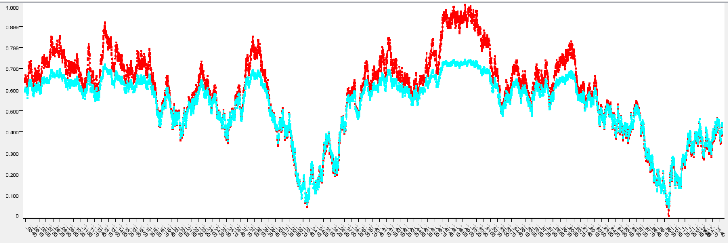
Quantitative Results 1
Measure | Score
R^2 | 0.86
mean absolute error | 0.052
mean squared error | 0.06

Slide 7
Quantitative Results 2
Date | Normalized weight (Air)
2017-04-22 | 0.0450
2017-04-23 | 0.0333
2017-04-24 | 0.0654
2017-04-25 | 0.0714
2017-04-26 | 0.0875
2017-04-27 | 0.0883
2017-04-28 | 0.0861
2017-04-29 | 0.0715
2017-04-30 | 0.0909

Slide 8
Discussion: Comparison With Your Competitor
Competitor’s Results
Your Results
AQI Prediction with the full Bag of Words vector
AQI Prediction with K-Nearest Neighbor
AQI Prediction with Markov Random Field
AQI Prediction using the selected Bag of the words Vector
Normalized the AQI to train the neural network
AQI Prediction using Multi Layered Perceptron

Slide 9
Performance on Big Data: Time Measurements
Method | Time
Bag of Words Creator | 5.09
Multilayered Perceptron | 2:53
Text Preprocessing | 0:18

Slide 10
Conclusion
Analyzing the social media data may be a solution to reducing the cost involved in deploying the sensors to monitor air pollution in cities plagued by an increasing rate of pollution.
They can be more useful in the places where there are no monitoring stations to estimate the air quality

Slide 11
Quiz for Your Classmates
What statistical method was used?
What programming tool was used?
What scientific contribution was made?
What idea could be useful for your project?

