Slide 1
DEVELOP A SEO TOOL TO ANALYZE LIVE WEB PAGES
Submitted by
Akash Iyengar………………S181174600500
Selvin joseph……………….S181174600499
Akshay K M……………......S181174600532

Slide 2
ABSTRACT
The project aims to develop a generic SEO toolset in python IDLE which will scrape and analyze the webpage with the help of various python libraries especially beautiful soup and requests library which in turn help a web developer analyze live web pages for keywords and other components of the page which contribute to SEO.
The user should be able to provide the keyword of interest and understand their density patterns across the various components of the HTML page. The content present in the webpage is stored in the CSV (comma separated value) which is used for transfer a large database between programs.
At first when the user types the URL to analyze the contents present in the webpage it firsts check whether the webpage is a valid or not. If it is a valid webpage then it returns the status code as 200 otherwise it will display the status code as 404 which indicate the webpage not found.
After the webpage is valid it will scrap using the requests python library. The output is in the form of HTML content in order to remove the HTML tags present in the webpage beautiful soup python library. It will parse the whole HTML document and takes the content present inside each of the tag present in the document.

Slide 3
We can convert the whole document in the form of list for searching purpose and store it in the file for storing purpose. After written the whole content in the file we can convert into the CSV file format where each words is separated with the comma.
Finally we can search and find the number of times it has been used in the particular webpage is done with the help of normal search algorithm and print the count and the status of the searched word whether it is found in the webpage or not.

Slide 4
ACKNOWLEDGEMENT
No work is completed without thanking the people who have made it possible. I am greatly indebted to these people who have supported me through the project.
We express our sincere thanks to NIIT ANNANAGAR for providing us an opportunity to work on this project.
We express our heartfelt thanks to my faculty MR.PRINCE for his immense and timely help during this project work. We also thank him for giving this opportunity to work under him. We would like to thank our entire department faculty members and friends for valuable suggestions and support given during this project work.

Slide 5
INTRODUCTION
Search Engine Optimization (SEO) it is the process of affecting the online visibility of a web page in a web search engine. It is an important aspect of a webpage to gain importance for a search engine to be able to display it earlier in the search list.
The optimization is based on a lot of factors such as title, description, header tags and keyword density. Different search engines will have their own mechanisms that calculate the score of a keyword on the page and thus work out its ranking in the search order. When performing data science tasks, it's common to want to use data found on the internet. You'll usually be able to access this data in csv format, or via an Application Programming Interface (API).
However, there are times when the data you want can only be accessed as part of a web page. In cases like this, you'll want to use a technique called web scraping to get the data from the web page into a format you can work with in your analysis.

Slide 6
Web Scraping
To put in a nutshell, web scraping is a process of data extraction from websites. The entire job is carried out by a piece of code which is called a “scraper”. First, it sends a “GET” query to a specific website. Then, it parses an HTML document based on the received result. After it’s done, the scraper searches for the data you need within the document, and, finally, converts it into whatever specified format
The data can be the following:
product items;
images;
videos;
text;
Contact information, e.g. emails, phone numbers etc.

Slide 7
Use of Web Scraping
Separate services that work through an API or have a web interface (Embedly, DiffBot etc.)
Various open source projects implemented in different programming languages (Python: Goose, Scrapy; PHP: Goutte; Ruby: Readability, Morph, etc.).
On top of that, you can always try and make your own web scraping tool. Luckily, there are plenty of libraries available. For example, you can use the Scrapy library to make a python based scraper.

Slide 8
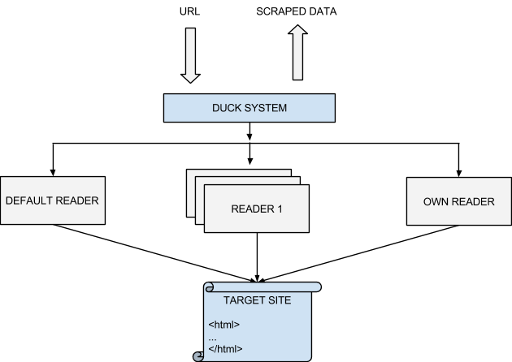

Slide 9
WEB SERVER
Any web page that is accessible or viewable over the internet is inherently hosted by a Web Server. In other words, without Web Servers there will not be any Web pages to browse over the Internet.
The images, videos, GIF or any text document or PDF that is available on a remote computer must be served and made accessible to the users via Web pages hosted by the Web Servers. Web servers mainly respond to requests initiated by the user anywhere in the world accessed via the World Wide Web.
They generally process the HTTP requests that are made by the client via the various and numerous network protocols. The main components in the webpage are HTML, CSS AND JS.

Slide 10
The components of a web page
When we visit a web page, our web browser makes a request to a web server. This request is called a GET request, since we're getting files from the server. The server then sends back files that tell our browser how to render the page for us. The files fall into a few main types:
HTML — contains the main content of the page.
CSS — add styling to make the page look nicer.
JS — JavaScript files add interactivity to web pages.
IMAGES — image formats, such as JPG and PNG allow web pages to show pictures.
After our browser receives all the files, it renders the page and displays it to us. There's a lot that happens behind the scenes to render a page nicely, but we don't need to worry about most of it when we're web scraping. When we perform web scraping, we're interested in the main content of the web page, so we look at the HTML.

Slide 11
HTML
Hyper Text Markup Language (HTML) is a language that web pages are created in. HTML isn’t a programming language, like python instead, it’s a markup language that tells a browser how to layout content.
The basic elements are <html>, <title>, <head> and <body>. And each tag should be closed by the following </>. In our project, scraping of the web contents will be in the form of HTML.

Slide 12
SAMPLE CODE:
<html>
<head>
</head>
<body>
<p>
Here's a paragraph of text!
<a href="https://www.dataquest.io">Learn Data Science Online</a>
</p>
<p>
Here's a second paragraph of text!
<a href="https://www.python.org">Python</a>
</p>
</body>
</html>

Slide 13
REQUESTS
Requests library is an Apache2 Licensed HTTP library, written in Python. It is designed to be used by humans to interact with the language. This means you don’t have to manually add query strings to URLs, or form-encode your POST data. Don’t worry if that made no sense to you. It will in due time.

Slide 14
Use of Requests Library
Requests will allow you to send HTTP/1.1 requests using Python. With it, you can add content like headers, form data, multipart files, and parameters via simple Python libraries. It also allows you to access the response data of Python in the same way.
In programming, a library is a collection or pre-configured selection of routines, functions, and operations that a program can use. These elements are often referred to as modules, and stored in object format.
Libraries are important, because you load a module and take advantage of everything it offers without explicitly linking to every program that relies on them. They are truly standalone, so you can build your own programs with them and yet they remain separate from other programs.

Slide 15
Requests library for Web Scraping
The first thing we’ll need to do to scrape a web page is to download the page. We can download pages using the python requests library.
The requests library will make a get request to a web server, which will download the HTML contents of a given web page for us.
There are several different types of request we can make using requests of which get is just once.
If the response appears 200 which indicates that the webpage is successfully downloaded and if it status code shows staring with 4 or 5 indicates the error while downloading the page or it indicates page not found.

Slide 16
BEAUTIFUL SOUP
Beautiful Soup is a Python library for pulling data out of HTML and XML files. It works with your favorite parser to provide idiomatic ways of navigating, searching, and modifying the parse tree. It commonly saves programmers hours or days of work.
We can use the BeautifulSoup library to parse a document, and extract the text from the p tag. The first step is to import the library, and create an instance of the BeautifulSoup class to parse a document.
We can print out the HTML content of the page, formatted nicely, using the prettify method on the BeautifulSoup object
As all the tags of a web page are nested, we can move through the structure one level at a time. We can first select all the elements at the top level of the page using the children property of soup. Note that children return a list generator, so we need to call the list function on it.

Slide 17
FILE SYSTEM
The most important purpose of a file system is to manage the user data. This includes storing, retrieving and updating the data. In the case of python we need not import any built-in function instead directly we can read or write the contents in a file.
All the contents we got by the get_text() method will be written to the file for searching and storing purpose. Always we have to close the file when it is opened. The main functions will be used while working with the files.

Slide 18
Comma Separated Values (CSV)
Comma Separated Values is a file format for data storage which looks like a text file. The information is organized with one record on each line and each field is separated by comma.
The file can be managed via Microsoft Excel (or similar programs) and lists the merchant’s products, codes, image links, etc. The fields provided by default include path, id, name, code, price, headline and many others.

Slide 19
Algorithm
Import the necessary packages
Get the URL from the user
Use the request library to establish the connection with the web page.
Create an instance for Beautifulsoup to scrap the web page.
Use get_text() of BS to get the desired text of the HTML page
Create a list for all the words we get after scraping.
Open a text file and store the data.
Create an empty dictionary to store the word and its count as key value pair
If the instance word is present in the dictionary, increment the count by one.
Open a csv file to store the word and its count as key value pair
Write the data into the csv file using writerow()
Open the file to search the string.
Compare the user input with the existing set of words.
If word is found increment the counter value
Print the counter value

Slide 20
Source Code
import requests
from bs4 import BeautifulSoup
import csv
#getting URL input from user
url = input("enter the url")
r = requests.get(url)
print("sending the request")
print(r.status_code)
soup = BeautifulSoup(r.text,"html.parser")#scraping the web page
print("Scraping the web page")
t=soup.get_text()
lis=t.split()#getting the text as a list
print(lis)
print("storing in a text file")
f =open("vvv6.txt","w+")
for lines in t.split():
cnt=0
f.write(lines +' ')#storing the content in a text file
f.close()
print("storing in the csv file")
destname = 'vvv7.csv'

Slide 21
w={}
wd=input("enter a word")#getting the word count
for word in t.split():
if word not in w:
w[word]=1
else:
w[word]+=1
with open(destname, 'w') as csv_file:
writer = csv.writer(csv_file) #storing in a csv file
for key, value in w.items():
writer.writerow([key, value])
print("searching for the string")
with open(destname, 'r') as csvfile:
t = csvfile.read().splitlines()
count=0
with open('vvv7.csv', 'r') as csvfile:
for lines in lis:
if wd in lines: #searching for the word
count=count+1
print("count of the string is")
print(count)
print("end of the program)

Slide 22
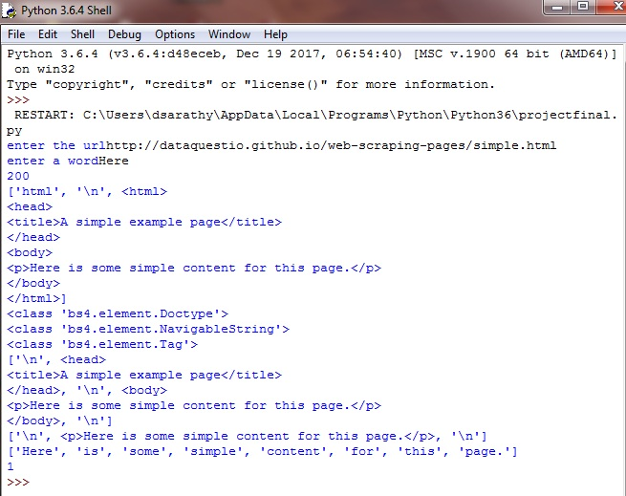
Output

