Slide 1
NLP-Sentiment Analysis
Insights & Inference

Slide 2
APPROACH:
Cleaned data by looking for null, missing values and unknown values like Nan
Converted object data type columns to lower case
Removed white spaces, special characters, stop words, punctuation and repeated words in required columns
Carried out spell check
Tokenized words in the review column using Tf-idf vectorizer
Prepared training data and test data
Mapped rating values to sentiments such as positive, neutral and negative
Built a ML model for predicting the sentiment for user reviews using logistic regression
Evaluated the models using test data set and the results are shared below
Saved the model using pickle
Loaded model in app.py file and designed Streamlit app that enables business team to enter the reviews and predict the sentiment for further enhancements

Slide 3
INSIGHT | INFERENCE
Distribution of Review Ratings | - Rating values 2 and 3 are equally distributed, indicating the users are mostly negative or neutral in the sentiment
Suggestion: | - after analysis the reviews (comments), focus more on user convenience and compatible interface to improve the rating

Slide 4
INSIGHT | INFERENCE
2. Helpful Reviews (Threshold > 10) | - 98% of the reviews were identified to be helpful by others
2. Suggestion: | - We notify every user to give their honest reviews at regular intervals so that it helps to improve user experience and the business

Slide 5
INSIGHT | INFERENCE
3. Common Keywords in Positive vs Negative Reviews | - clear response, quick, helpful are the most used words for positive reviews - mistakes, translation and complex response are the most used words for negative reviews
3. Suggestion: | - Maintain clarity and speed, but work on accuracy, language quality, and simplicity

Slide 6
INSIGHT | INFERENCE
4. Average Rating Over Time | - average rating is oscillating up and down with time
4. Suggestion: | - Maintain rating stability by consistently monitoring feedback trends and addressing recurring issues promptly

Slide 7
INSIGHT | INFERENCE
5. Ratings by User Location | - user rating are high in northern parts of continents but low is southern and eastern parts (eg: Africa)
5. Suggestion: | - Decide and implement marketing strategies to increase usage among the larger population - identify the specific problems in the areas of low rating (like east Africa) and improve the model response thereby improving the ratings

Slide 8
INSIGHT | INFERENCE
6. Platform-wise Average Ratings | - average rating is reasonably better in amazon webpage and in apple products; indicating better user experience while using the app - but below average rating in flipkart webpage and in android products
6. Suggestion: | - focus more on improving the user experience and convenience while using the app in android products

Slide 9
INSIGHT | INFERENCE
7. Verified vs Non-Verified Users | - verified users rating is in between negative and neutral sentiment compared to non-verified users
7. Suggestion: | - customer feedback team can organize meetings with verified users to understand their requirements and identify the short falls; this would help to improve the user experience for verified users

Slide 10
INSIGHT | INFERENCE
8. Review Length by Rating | - negative reviews tend to have more lengthy comments; indicates that users have more than one disappointing points to share
8. Suggestion: | - all valid points can be taken into account and can be presented to decision making team/higher management to see about further improvements

Slide 11
INSIGHT | INFERENCE
9. Top Words in 1-Star Reviews | - language problem, need fixes, lacks clarity are the top words used in 1 star ratings
9. Suggestion: | - Improve clarity by simplifying language, fixing translation issues, and ensuring responses are error-free and easy to understand

Slide 12
INSIGHT | INFERENCE
10. Highest Rated ChatGPT Version | - recent versions like GPT 4 has highest ratings; indicates that recent update and bug fixes from the previously released models are satisfying user needs and expectations;
10. Suggestion: | - there are still areas of improvement like task specific/domain specific responses (like building a pipeline for the projects); improvements can be made on less focused topics like dealing with audio/videos

Slide 13
INSIGHT | INFERENCE
11. Overall Sentiment of Reviews | - 56% reviews are negative and 36% are positive;
11. Suggestion: | - Root Cause Analysis – Identify top pain points in negative reviews (e.g., clarity, mistakes, translation issues) and fix them systematically Prioritize Quick Wins – Resolve recurring complaints first, since even small fixes can flip many negatives into neutrals/positives

Slide 14
INSIGHT | INFERENCE
12. Sentiment vs Rating | - for ratings less than 3, negative sentiment is on a higher side.
12. Suggestion: | -Focus on lifting low ratings (<3) by addressing recurring pain points: simplify responses for clarity, improve translation quality, reduce mistakes, and add faster resolution steps—turning poor experiences into at least neutral ones

Slide 15
INSIGHT | INFERENCE
13. Keywords per Sentiment | - simplified answers, generating good content, explaining complex things easily are some of the keywords used for positive sentiments - wrong answers, not handling large text, not more image friendly are some keywords used for negative sentiments
13. Suggestion: | - Preserve strengths in simplicity and clarity, while focusing on accuracy, scalability for long text, and richer image support

Slide 16
INSIGHT | INFERENCE
14. Sentiment Trend Over Time | - initially there are certain negative sentiments; but after bug fixes and updates, there is rise in positive sentiments exceeding the negative;
14. Suggestion: | - work towards continuous improvement and user satisfaction to stabilize the positive sentiment over time - observing and analyzing the user feedback regularly provides opportunity for optimizing the performance

Slide 17
INSIGHT | INFERENCE
15. Verified Users vs Non-Verified Sentiment | - overall negative sentiments are high from both verified and non-verified users; this indicates the mismatch between user expectation and the response from the app
15. Suggestion: | - customer support team can organize meetings with both the users (volunteers) to understand their requirements and identify the short falls; this would help to improve the user experience

Slide 18
INSIGHT | INFERENCE
16. Review Length vs Sentiment | - negative reviews tend to have more lengthy comments; indicates that users have more than one disappointing points to share
16. Suggestion: | - all valid points can be taken into account and can be presented to decision making team/higher management to see about further improvements

Slide 19
INSIGHT | INFERENCE
17. Sentiment by Location | - central region of the world has more positive percentage than the rest
17. Suggestion: | - Leverage the Central region as a strength by studying what drives positivity there (e.g., clarity, tone, speed) and replicate those best practices in other regions, while tailoring improvements to local language, cultural, and service expectations

Slide 20
INSIGHT | INFERENCE
18. Sentiment by Platform | - flipkart webpage has more negative sentiments than other platform users
18. Suggestion: | - Focus on improving the user experience by addressing pain points behind negative sentiments—optimize page speed, fix navigation or UI issues, ensure accurate product details, and enhance customer support—so it matches or exceeds the satisfaction levels of other platforms.

Slide 21
INSIGHT | INFERENCE
19. Sentiment by Version | - Certain ChatGPT versions are associated with higher positive sentiment (e.g., GPT‑4o), while others see lower satisfaction due to issues like inaccuracies, slower responses, or limited capabilities
19. Suggestion: | - Prioritize high-performing versions for general use (e.g., GPT‑4o), especially for tasks requiring clarity, speed, and multimodal input -Analyze version-specific complaints for lower-rated releases and fix the root causes (accuracy, response handling, long text processing, image support) -Communicate improvements clearly during version updates to set user expectations and rebuild trust if prior releases had issues -Iteratively test new versions with select users before wide release to ensure sentiment doesn’t drop

Slide 22
INSIGHT | INFERENCE
20. Negative Feedback Themes | - Not enough negative reviews available for topic modeling
20. Suggestion: | - Since there are only 50 rows in the given data set, there are not enough information for topic modeling - once when the data set grows, can use this insight to understand the topic where more negative sentiments are associated and to take necessary actions

Slide 23
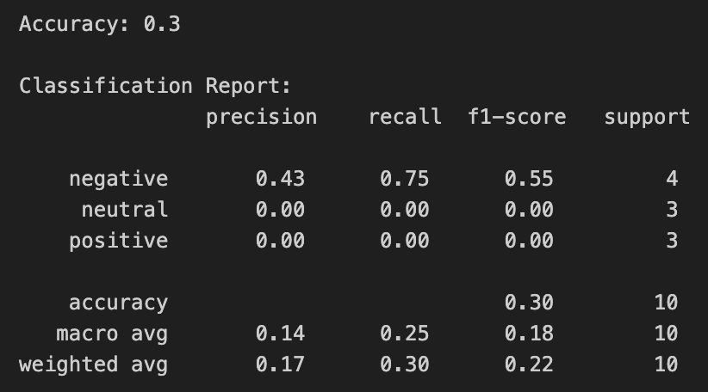
Evaluation & Deployment steps:
Streamlit App Deployment Instructions:
Open a new notebook in VS code or in Google colab
Upload the given pickle file of the NLP model in the same folder where the notebook is saved
Run the cells to Install Streamlit and app.py in the notebook
Use or click the link given in the terminal; Streamlit app appears in the web browser
Select from the options in the left pane; text box appears on the right side
Enter the user review and click Predict to see the outcome

