Slide 1
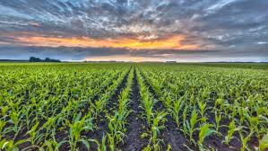
XELFUGETS 2K24
AI-Driven Crop Disease Prediction and Management System
Team Name –Agro Devs
Author – Gokul S & Jeeva R

Slide 2
IDEA TITLE
Agro Devs
Introducing the Smart Crop Disease Prediction and Management System
An innovative solution designed to help farmers effectively tackle crop diseases.
This system uses artificial intelligence to analyze crop images and disease outbreaks, and provide farmers with practical insights and treatment recommendations.
Plus, with partnerships with pesticide companies

Slide 3
IDEA TITLE
Agro
Devs
KEY BENEFITS:
Image Analysis and Disease Detection
Environmental
Data Integration
Actionable Insights and Alerts
Partnership with Pesticide Companies
User Training and Support
How It Addresses the Problem:
Early Detection
Data-Driven Decisions
Streamlined Access
Education & Support

Slide 4
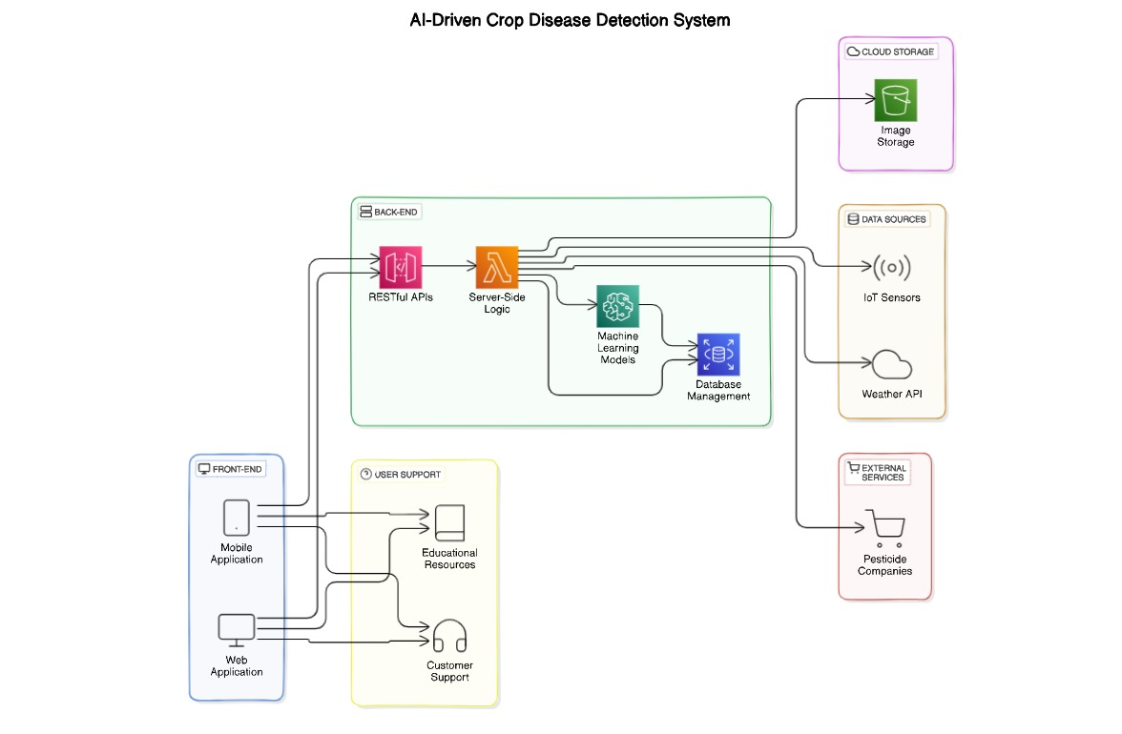



TECHNICAL APPROACH
Agro Devs
TECH STACK
MOBILE APPLICATION -
BACK END -
DATABASE -
API - RESTful APIs , Weather
ML INTEGRATION - TenserFlow

Slide 5
FEASIBILITY AND VIABILITY
Agro
Devs
Feasibility:
The system is viable due to accessible AI and smartphone use.
Challenges:
Poor image quality can lead to inaccuracies.
Farmers may resist adopting new technology.
Different farming conditions can affect predictions.
Solutions:
Improve image quality and provide capture tips.
Offer training to build user trust.
Create adaptable algorithms for various conditions.

Slide 6
IMPACT AND BENEFITS
Agro Devs
Early Disease Detection: Quick identification of crop diseases to reduce loss and boost yield
Smart Decisions: Real-time weather and soil data optimize farming practices.
Proactive Risk Management: Alerts and insights help prevent issues before they escalate.
Direct Access to Pesticides: Easy purchase of recommended pesticides through the app.
Empowering Farmers: Tutorials and support enhance farmers' knowledge and confidence.

