Slide 1




SMART INDIA HACKATHON 2026
TITLE PAGE
  Problem Statement ID – SIH26227
  Problem Statement Title - Semantic Retrieval and Multi-Temporal Change Analysis of Satellite Imagery.
  Theme- Space Technology
  PS Category- Software
  Team ID-
  Team Name - HeisenBug

Slide 2
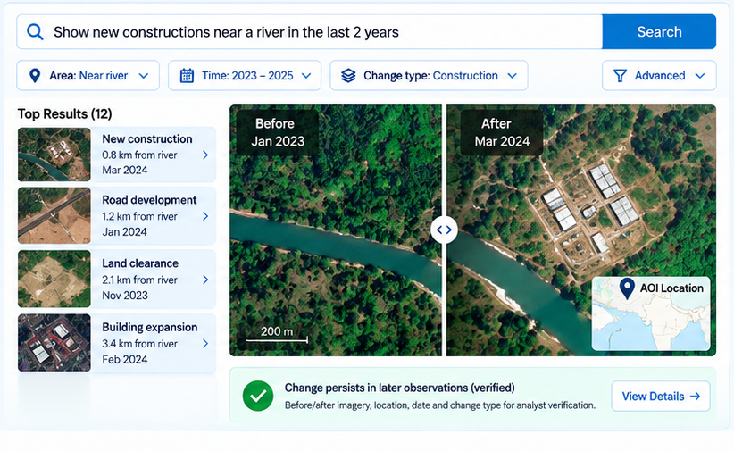
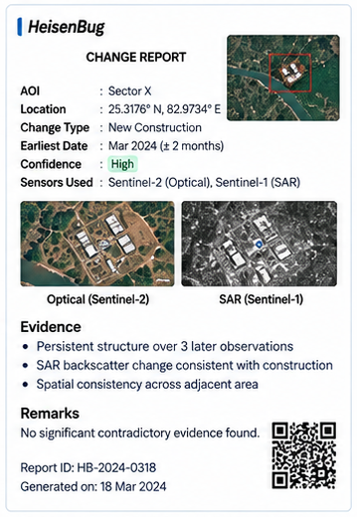











PROPOSED SOLUTION
HeisenBug
From a simple question to an evidence-backed change report
1
Ask in Plain Language
HeisenBug – Satellite Intelligence for Defence
Sample Change Report (Generated)
Analyst enters a query or
uploads an example image.
“Show new constructions
near a river in the last 2 years”
2
AI Understands the Query
Extracts location, time and target
using vision-language AI.
Location
(AOI)
Time Range
(2023 – 2025)
Target
(e.g., construction)
3
Search & Analyse
Searches local satellite archive and
performs multi-temporal change detection.
• Sentinel-1 (SAR)
• Sentinel-2 (Optical)
• Landsat
• Historical Archive
4
Get a Verified Change Report
Returns changes with evidence,
reasoning and confidence.
Key Innovations
Real Use Cases (Examples)
Impact for Defence Users
Faster discovery of critical changes
Geo-object index
Time-series based
change detection (CCDC)
Two-stage retrieval
Analyst feedback loop
Fewer false alarms
Search by meaning,
not just coordinates
Detects real changes,
not two-date difference
Keeps small targets
(e.g., buildings)
Past decisions improve
future results
Evidence-backed, auditable reports
Bridge construction
Land clearance
Road development
Facility expansion
Builtt for secure, offline operation

Slide 3




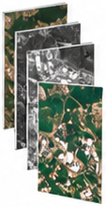



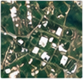
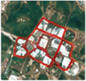



























TECHNICAL APPROACH
HeisenBug
From a natural language query to an evidence-backed change report
TECH STACK
1
Query
Understanding
2
Data Retrieval
3
Multi-Temporal
Change Detection
4
False Alarm
Filtering
5
Evidence &
Output
Data Sources
Sentinel-2
(Optical)
Cloud / shadow
detection
Before
(Mar 2023)
After
(Mar 2024)
“Show new
constructions near
a river in the last
2 years”
Jan 2022
Sentinel-1/2
Landsat
Sentinel-1
(SAR)
Seasonal
variation filter
Backend & API
Jan 2023
Python
(FastAPI)
FastAPI
Landsat
Time-Series
Analysis
(CCDC)
River-stage
changes
Jan 2024
Change Report
AI / ML & Analytics
Plain-language
or example image
query
Historical
Archive
  Change type & location
  Earliest supported date (with uncertainty)
  Evidence for / against
  Confidence level
  Analyst review and feedback stored for future queries
PyTorch
Hugging Face
Sun-angle
effects
Vector & Geospatial DB
Extract location,
time and target
(semantic intent)
  Search local archive using spatial + temporal + semantic indexing
  Analyse each location with its own historical time-series
Image
mis-registration
  Detect real changes (not just two-date difference)
Qdrant
(Vector DB)
PostGIS
(Spatial DB)
  Retrieve relevant scenes and geo-objects (structures, water, roads, cleared ground)
  Apply multiple checks to remove non-real changes
  Estimate earliest supported date with uncertainty
Visualization & UI
MapLibre
(Maps)
React
(Frontend)
Key Differentiators
Deployment
Geo-object index
Time-series based change detection
Analyst feedback loop
Designed for defence use
Not one pooled vector per tile
(CCDC) instead of two-date difference
Decisions improve future results
Offline, secure and policy compliant
Docker
Linux
(Offline/Air-gapped)
@SIH Idea submission- Template
3

Slide 4
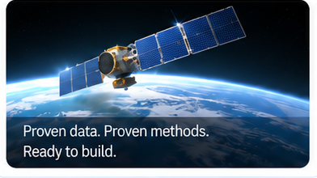
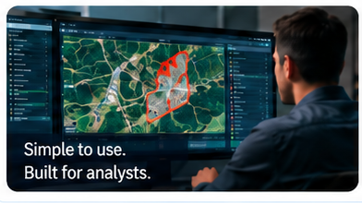

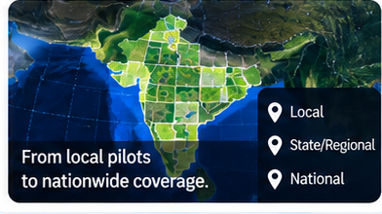











FEASIBILITY AND VIABILITY
HeisenBug
Satellite Intelligence for a Safer Tomorrow
Proven Approach. Practical Implementation. Real-World Ready.
01
Technological Feasibility
02
Operational Feasibility
03
Economic Viability
04
Scalability
Built on proven technologies.
Designed for real-world use.
High value at low cost.
Ready to grow with future needs.
Uses well-established
New satellite data can be added
Uses free and open satellite data.
Can handle large and growing
AI/ML methods.
easily over time.
satellite archives.
Works with Sentinel-1,
Handles cloud/haze and missing
No cloud costs (fully offline).
Works for small areas or large regions.
Sentinel-2 and Landsat data.
data.
Runs on standard GPU hardware.
New sensors and models can be
Relies on open-source tools.
Human-in-the-loop validation
Cost-effective compared to
added easily.
Can be deployed offline.
ensures reliable results.
commercial solutions.
Designed for multi-year,
Simple and intuitive interface
multi-terabyte data.
for analysts.
Open Data
+
Offline Deployment
=
Lower Cost
Higher Control
Local
Proven data. Proven methods.
Ready to build.
Simple to use.
Built for analysts.
From local pilots
to nationwide coverage.
State/Regional
National
Key Challenges
Our Mitigation Approach
Real-World Readiness
Cloud / monsoon gaps
Quality checks and data filtering
Seasonal false changes
Seasonal baseline comparison
A Practical, Scalable
and Cost-Effective Solution
for Real-World Deployment
Image mis-registration
Persistence check across multiple dates
Offline
& Secure
Policy
Compliant
Analyst
Friendly
Designed for
Long-Term Use
Use of SAR and optical data together
Large satellite archives
Analyst validation for critical changes

Slide 5

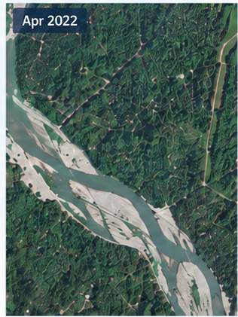
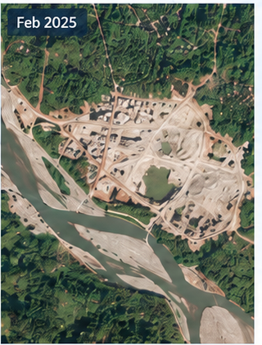








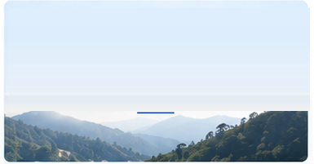








IMPACT AND BENEFITS
HeisenBug
Satellite Intelligence for a Safer Tomorrow
Real insights. Safer decisions. A more resilient tomorrow.
Faster Discovery
From
Example Use Case: Illegal Mining Detection
VALUE FOR KEY STAKEHOLDERS
Find relevant changes in
Hours
Defence & Security Agencies
seconds using natural
to
▪ Early detection of critical changes
language or image queries.
Seconds
▪ Improved situational awareness
▪ Supports strategic planning
Fewer False Alarms
Environment & Forest Departments
Higher
Environment & Forest Departments
Temporal analysis and
Accuracy
▪ Monitor deforestation, mining and land use
multi-sensor checks reduce
&
▪ Protect natural resources
noise and seasonal effects.
Reliability
▪ Supports compliance and enforcement
Government & Policy Makers
Evidence-Backed Decisions
Clear
▪ Data-driven infrastructure and urban planning
Every result comes with
and
▪ Evidence for policy and regulation
before/after imagery, location,
Auditable
▪ Cost-effective monitoring using open data
date and confidence.
Researchers & Analysts
Long-Term Value
Gets
▪ Easy access to multi-temporal satellite insights
Analyst feedback and change
Smarter
▪ Reduces manual effort
signatures are stored and
Over
Location: 24.7802° N, 92.9376° E | Change Type: Mining Activity | Earliest Date: Oct 2024
▪ Useful for academic and applied research
reused for future missions.
Time
Real-World Applications
“
Our Impact in Numbers (Illustrative)
Actionable satellite intelligence
enables proactive monitoring,
stronger governance and
a safer, more sustainable future.”
5–10×
~60%
100%
Long-term
Infrastructure Monitoring
Coastal Change
Deforestation Monitoring
Industrial Expansion
Faster area
analysis
Reduction in
false alarms
Traceable
evidence
Support for
sustainable
development
Track new roads, bridges
Monitor shoreline
Detect illegal logging
Track new facilities
and construction
changes and encroachments
and forest loss
and urban growth

Slide 6



HeisenBug
RESEARCH AND REFERENCES
Key research, datasets and standards that support our approach.
01
Methods We Implement
02
Data and Catalogue
03
Evaluation and Policy
Proven techniques adapted for real-world use.
Reliable and open satellite data sources.
Benchmarks and guidelines for real-world impact.
Continuous Change Detection (CCDC)
Copernicus Data Space
LEVIR-CD benchmark
Zhu & Woodcock (2014) — our seasonal baseline method.
Sentinel-2 optical and Sentinel-1 SAR —
Public dataset we will measure against.
https://doi.org/10.1016/j.rse.2014.01.011
primary archive.
https://chenhao.in/LEVIR/
https://dataspace.copernicus.eu/
RemoteCLIP
USGS Landsat Collection 2
Problem statement SIH26227
Vision-language model behind our semantic search.
30 m historical depth before the Sentinel era.
Ministry of Defence, Indian Army (DGIS).
https://arxiv.org/abs/2306.11029
https://www.usgs.gov/landsat-missions/
https://sih.gov.in
landsat-collection-2
ColBERT late interaction
OGC STAC
National Geospatial Policy 2022
Reranking that keeps small targets from being pooled away.
Catalogue structure we implement.
Restricted-area and licensing provisions.
https://arxiv.org/abs/2004.12832
https://www.ogc.org/standards/stac/
https://dst.gov.in/geospatial
YouTube Link
GitHub repository
Prototype video
See our solution in action
Code and build history
Walkthrough of the working system
https://youtu.be/0rxhbexTmF8?si=vX4Ko_Zk1rHASRW4
https://github.com/arjuhhareeshs/Satellite-agent
https://drive.google.com/drive/folders/1Dv0ZxFkVEFFJQMq3cFJh6ERVcJgLnBho?usp=sharing
4

