Slide 1
Banking Data Platform
End-to-End Lakehouse Architecture
Azure Data Lake
Databricks
Event Hubs
Synapse Analytics
Power BI
ADF
Logic Apps
Prepared by Gokul Sankar

Slide 2
Agenda
1
Project Overview & Business Objective
7
Streaming Gold Tables
2
Azure Services Used
8
ADF Orchestration
3
Medallion Architecture (Bronze / Silver / Gold)
9
Monitoring & Email Notifications
4
Batch Pipeline — Ingestion to Gold
10
Power BI — Batch Analytics Dashboard
5
Gold Layer — Batch pipeline
11
Power BI — Real-Time Streaming Dashboard
6
Streaming Pipeline — Event Hub to Gold
12
Key Business Insights
Banking Data Platform · Batch & Real-Time Streaming Architecture
2

Slide 3
Project Overview
What this project builds and delivers
Business Objective
Scope
Build a full lakehouse platform for a retail bank — ingesting customer, account, card, and loan data, plus real-time transaction, fraud, and login event streams — to power analytics on churn, gap analysis, city performance, and live fraud monitoring.
Two parallel pipelines feeding the same Gold and Power BI layer: Batch: historical CSV datasets (customers, accounts, cards, loans) Streaming: live transactions, fraud alerts, login events via Event Hub
Key Outcomes
Two ADF-orchestrated pipelines (batch + streaming) with scheduled triggers · Star-schema Gold model (dim/fact) for flexible analytics · 9 streaming Gold tables for near real-time monitoring · Two Power BI dashboards: Historical Analytics & Real-Time Operations · Automated email alerts on pipeline success/failure via Logic Apps
Banking Data Platform · Batch & Real-Time Streaming Architecture
3

Slide 4
Azure Services Used
Eight Azure services working together end-to-end
Azure Data Lake Storage Gen2
Bronze / Silver / Gold containers — single source of truth across all pipeline layers
Azure Key Vault
Secure storage for storage account keys and Event Hub connection strings
Azure Databricks
Spark-based ETL — Bronze ingestion, Silver cleansing, Gold aggregation (batch + streaming)
Azure Event Hubs
Real-time ingestion of transactions, fraud alerts, and login events via Kafka protocol
Azure Data Factory
Orchestrates all pipelines — scheduling, dependency chains, failure handling
Azure Synapse Analytics
Serverless SQL views over Gold Delta files — query layer for Power BI
Power BI
Two dashboards — historical batch analytics and real-time streaming monitor
Azure Logic Apps
Email notifications on pipeline success / failure via SMTP (Gmail App Password)
Banking Data Platform · Batch & Real-Time Streaming Architecture
4

Slide 5
Medallion Architecture
Bronze → Silver → Gold — progressive data refinement
RAW
BRONZE
SILVER
GOLD
Source Data
As-Is Ingestion
Cleaned & Conformed
Business-Ready
Unmodified source data ADLS raw container Event Hub (streaming)
CSV → Delta format Add tracking columns: _source_file, _ingested_at
Type casting (dates, numerics) Standardise text (initcap) Drop duplicates
Star schema (batch) Aggregated tables (streaming) Synapse views → Power BI
→
→
→
Banking Data Platform · Batch & Real-Time Streaming Architecture
5

Slide 6
Batch Pipeline
CSV datasets → Bronze → Silver → Gold (Star Schema)
01 Bronze Ingestion
02 Silver Transformation
03 Gold — Star Schema
Reads accounts, cards, customers, loans CSVs from ADLS raw container. Adds _source_file and _ingested_at tracking columns. Writes as Delta format — no data changes, schema preserved.
Casts date columns (dd-MM-yyyy → DATE type). Casts numeric types (balance → double, credit_score → int). Trims whitespace, standardises text casing with initcap.
Dimensions: dim_customer, dim_date, dim_account_type, dim_risk Facts: fact_account, fact_loan, fact_card All layers written to ADLS as Delta, read by Synapse views.
→
→
Business Outputs
Customer Churn · Signup-to-Account Gap Analysis · City Metrics · Monthly New Account & Loan Trend · Loan Risk Analysis · Customer 360
Banking Data Platform · Batch & Real-Time Streaming Architecture
6

Slide 7
Gold Layer -- Batch Tables
Business-ready tables written to ADLS and exposed via Synapse views
Dimensions
Fact Tables
dim_customer
fact_account
Stores customer details: name, city, credit score, credit tier
One row per account: balance, status, churn, gap analysis fields
dim_date
fact_loan
Full calendar table: day, month, quarter, year, weekend flag
One row per loan: amount, interest rate, risk category
dim_account_type
fact_card
Account type lookup: Savings, Checking, Business
One row per card: card type, linked to account and customer
dim_risk
Risk band lookup: Low Risk, Medium Risk, High Risk
Banking Data Platform · Batch & Real-Time Streaming Architecture
7

Slide 8
Streaming Pipeline
Event Producer → Event Hub → Bronze → Silver → Gold (every 15 min)
Event Producer (Python, local)
Event Hub
Bronze (Databricks Streaming)
Silver (Databricks Streaming)
Gold (Databricks Batch, 15-min trigger)
3 generators in parallel threads (transactions, fraud, login events)
Single hub: banking-transactions event_type field routes records
spark.readStream from Event Hub 3 continuous Delta writers
Cleansing + derived columns (amount_category, session_category)
9 aggregated tables views created in Synapse to connect to Power BI
→
→
→
→
Why Gold Runs in a Separate Pipeline
Bronze and Silver are continuous streams that never finish — they run in their own ADF pipeline triggered once. Gold re-aggregates Silver on a 15-minute schedule (streaming_gold_pipeline) since it is a batch-style summarisation, not a continuous stream.
Banking Data Platform · Batch & Real-Time Streaming Architecture
8

Slide 9
Streaming Gold Tables
9 aggregated tables for real-time dashboards
Transactions
Fraud Alerts
Login Events
stream_txn_hourly — volume & amount by hour
stream_fraud_summary — by type/severity/action
stream_login_summary — success/fail by method/device
stream_txn_city — activity by city
stream_fraud_city — alerts by city
stream_login_failures — failure reasons by city
stream_txn_type — type x channel breakdown
stream_fraud_hourly — trend & blocked count
stream_login_hourly — login activity trend
Banking Data Platform · Batch & Real-Time Streaming Architecture
9

Slide 10
Orchestration with Azure Data Factory
Three pipelines covering batch, streaming ingestion, and streaming gold
banking_batch_pipeline
Manual / Scheduled
run_bronze → run_silver → run_gold
✉ Success & failure email via Logic App on every step
streaming_pipeline
Run once (continuous)
streaming_bronze ‖ streaming_silver (parallel, never stop)
✉ Failure-only alert — continuous streams have no natural completion
streaming_gold_pipeline
Every 15 minutes
streaming_gold (re-aggregates Silver into 9 Gold tables)
✉ Success & failure email via Logic App on every run
Banking Data Platform · Batch & Real-Time Streaming Architecture
10

Slide 11
Monitoring & Notifications
Azure Logic Apps + SMTP email alerts on every pipeline run
1
ADF Web Activity
Calls the Logic App HTTP trigger at the end of each pipeline activity (green arrow = success path, red arrow = failure path)
2
Logic App Workflow
Receives PipelineName, Status, and Time as a JSON payload via HTTP POST
3
Send Email (SMTP)
Gmail App Password + smtp.gmail.com:465 delivers the notification to gokulgokz14@gmail.com
4
Coverage
banking_batch_pipeline (every step) · streaming_gold_pipeline (every run) · streaming_pipeline (failure only)
Sample JSON Payload
{ "PipelineName": "streaming_gold_pipeline", "Status": "Succeeded", "Time": "2026-07-01T10:15:00Z" }
Banking Data Platform · Batch & Real-Time Streaming Architecture
11

Slide 12
Power BI — Batch Analytics Dashboard
5 report pages built on the Gold star schema
Page 1 — Overview
5 KPI cards (customers, accounts, total balance, loans, loan amount), donut by account type, risk distribution bar chart, slicers for city / account type / year
Page 2 — Customer Churn
Churn status donut (Active / Inactive / At Risk / Churned), churn by city (Top 10), churn by credit tier — severity slicer for drill-down
Page 3 — Gap Analysis
Avg days from signup to first account opening, gap category breakdown bar chart, by city (Top 10) and by credit tier — filtered to is_first_account = True
Page 4 — City Metrics
Top 10 cities by customers, avg balance, avg credit score, total loan exposure — city dropdown slicer for cross-filtering
Page 5 — Monthly Trend
New accounts by month / year with account-type breakdown, new loans by year, seasonal column chart by month — year slicer synced across all pages
Banking Data Platform · Batch & Real-Time Streaming Architecture
12

Slide 13
Power BI — Real-Time Streaming Dashboard
3 pages built on Gold tables via Synapse views
Transaction Monitor
Fraud Monitor
Login Analytics
Total transactions / amount / avg amount / failed transactions (KPI cards)
Total alerts / amount flagged / confirmed frauds / avg risk score (KPI cards)
Total / successful / failed logins / failure rate % (KPI cards)
Transaction volume over time (line chart by hour)
Alerts by severity (donut) and by fraud type (bar)
Login success vs failure (donut), logins by method and device (bars)
Completed vs Failed vs Pending by day (stacked column)
Action taken breakdown (Blocked / Flagged / Allowed)
Failure reasons (bar), failed logins by city (bar)
Transactions by city (Top 10 bar), by type (donut), by channel (bar)
Fraud trend over time (line), fraud hotspot cities (bar), severity slicer
Login activity over time (line), device slicer for drill-down
Refresh Cadence
Gold tables refresh every 15 minutes via ADF trigger · Synapse views auto-read latest Delta files · Power BI: manual refresh in Desktop, scheduled refresh in Power BI Service
Banking Data Platform · Batch & Real-Time Streaming Architecture
13

Slide 14
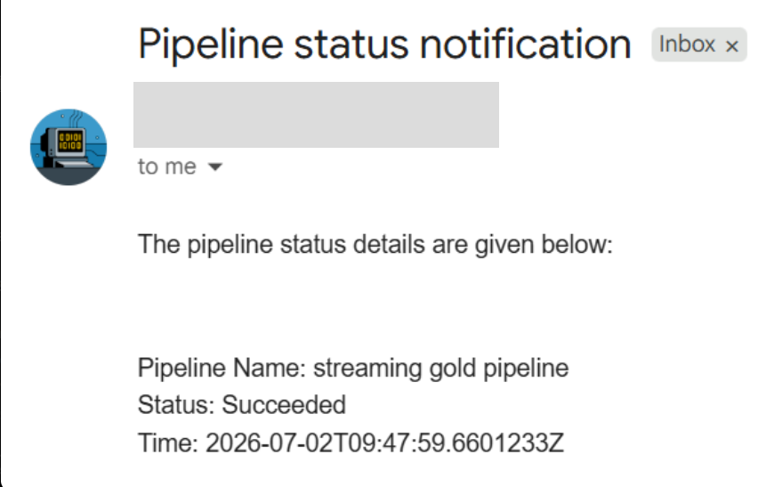
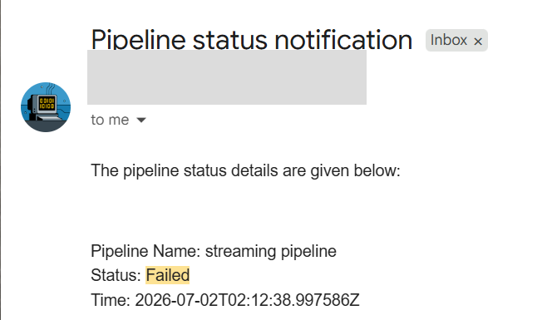
Pipeline Email Notifications
Logic Apps sends success and failure emails via SMTP (Gmail)
Success Notification
Failure Notification
How it works
ADF Web Activity (green arrow = success, red arrow = failure) calls Logic App HTTP trigger → Logic App sends email with Pipeline Name, Status and Time via SMTP
Banking Data Platform · Batch & Real-Time Streaming Architecture
14

Slide 15
Key Business Insights Delivered
Six actionable insights powered by this platform
Customer Retention
Onboarding Efficiency
Churn segmentation (Active / Inactive / At Risk / Churned) flags accounts going dormant before they close — enabling proactive outreach before the customer is lost.
Gap analysis measures how long customers wait between signup and opening their first product — a direct indicator of onboarding friction in the digital journey.
Regional Strategy
Seasonality Planning
City-level metrics (avg balance, avg credit score, loan exposure) highlight which regions carry the most value and risk — informing branch and marketing investment decisions.
Monthly trend analysis reveals peak months for account openings and loan originations, helping the bank plan staffing, promotions, and system capacity in advance.
Live Fraud Defense
Digital Channel Health
Real-time fraud dashboard surfaces severity, fraud type, and city hotspots within minutes of detection — far faster than traditional end-of-day batch reporting.
Login analytics expose failure rates by device and method, pinpointing friction in the digital banking experience before it drives customers to competitors.
Banking Data Platform · Batch & Real-Time Streaming Architecture
14

Slide 16
Thank You
Questions & Discussion
Gokul Sankar · Banking Data Platform · Batch & Real-Time Streaming Architecture

