Slide 1
Banking Data Platform
Power BI Dashboards
Batch Analytics · Real-time Streaming Operations

Slide 2
Batch Processing Dashboard
Historical Analytics — 5 Pages

Slide 3
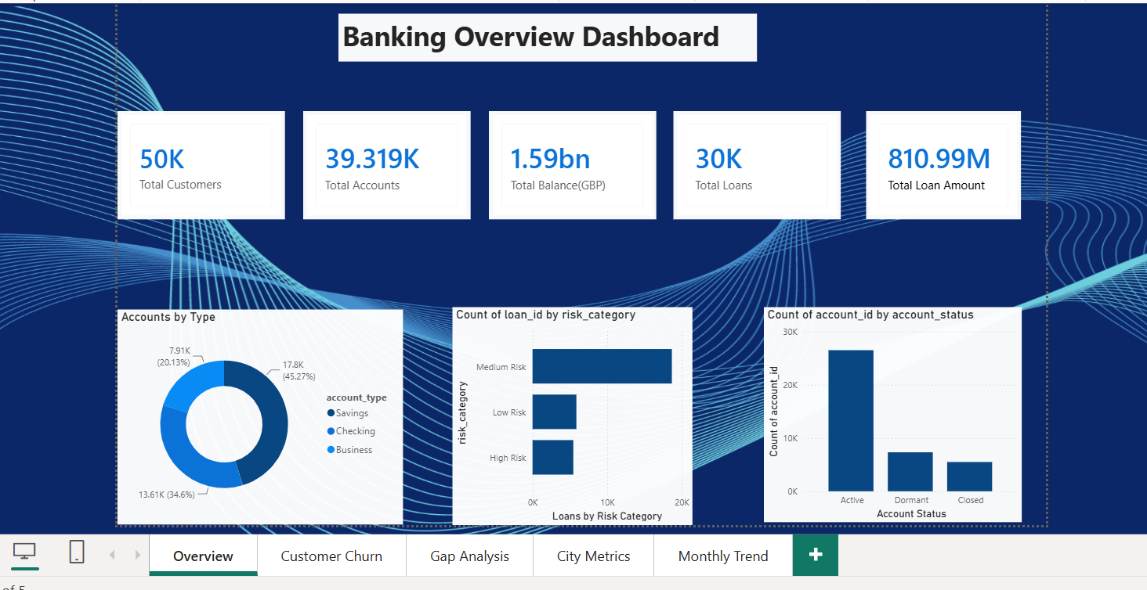

Slide 4
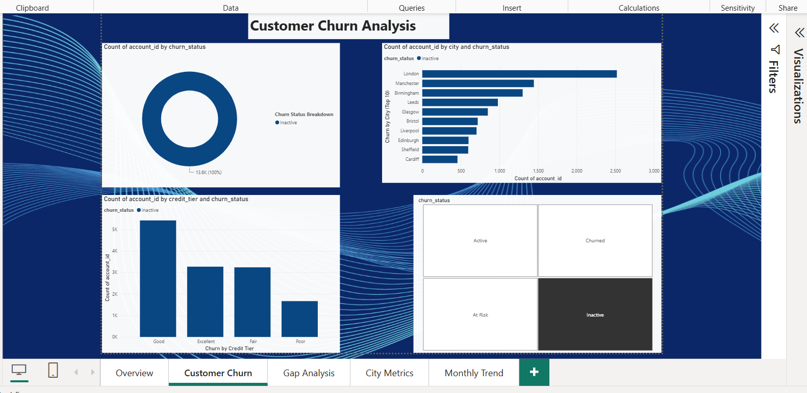

Slide 5
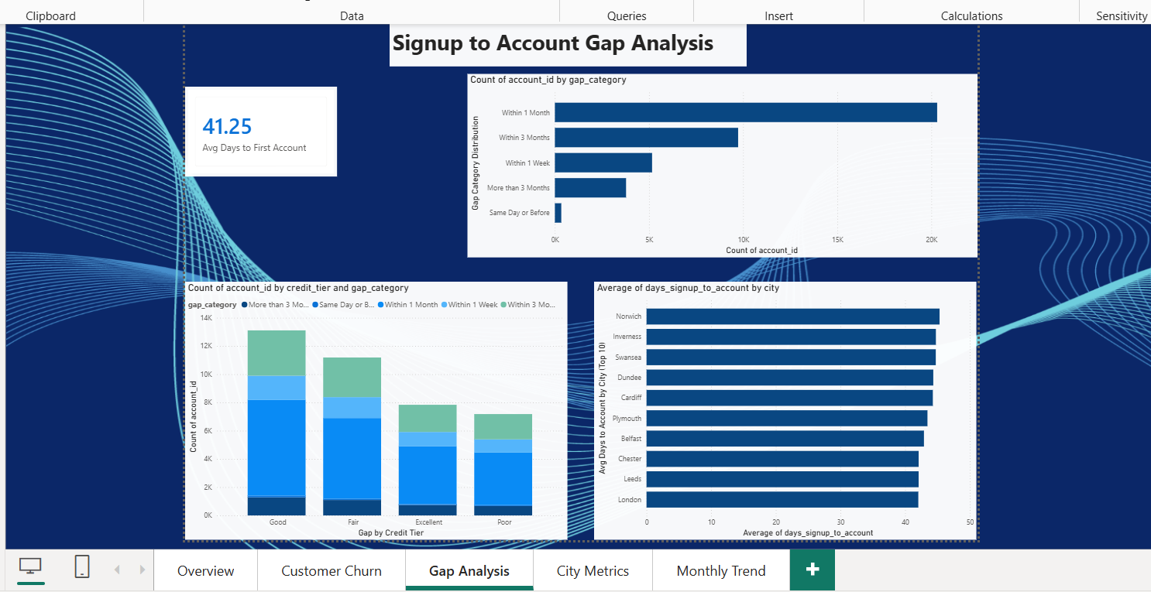

Slide 6
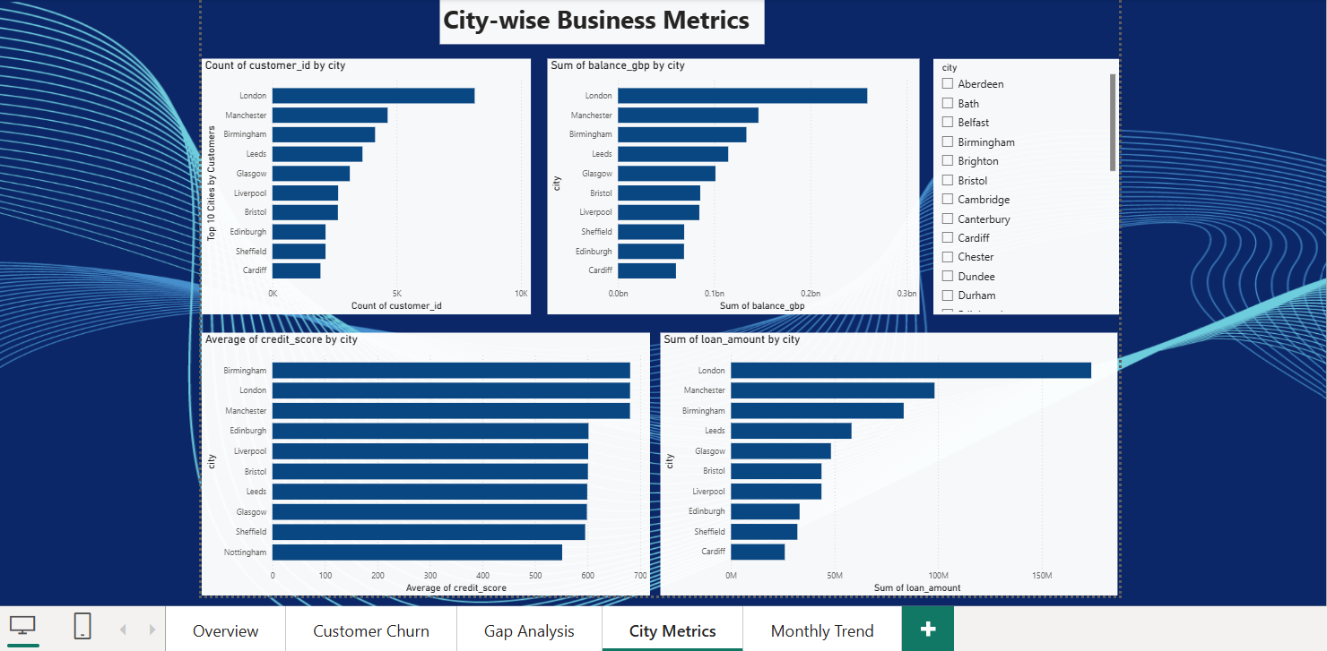

Slide 7
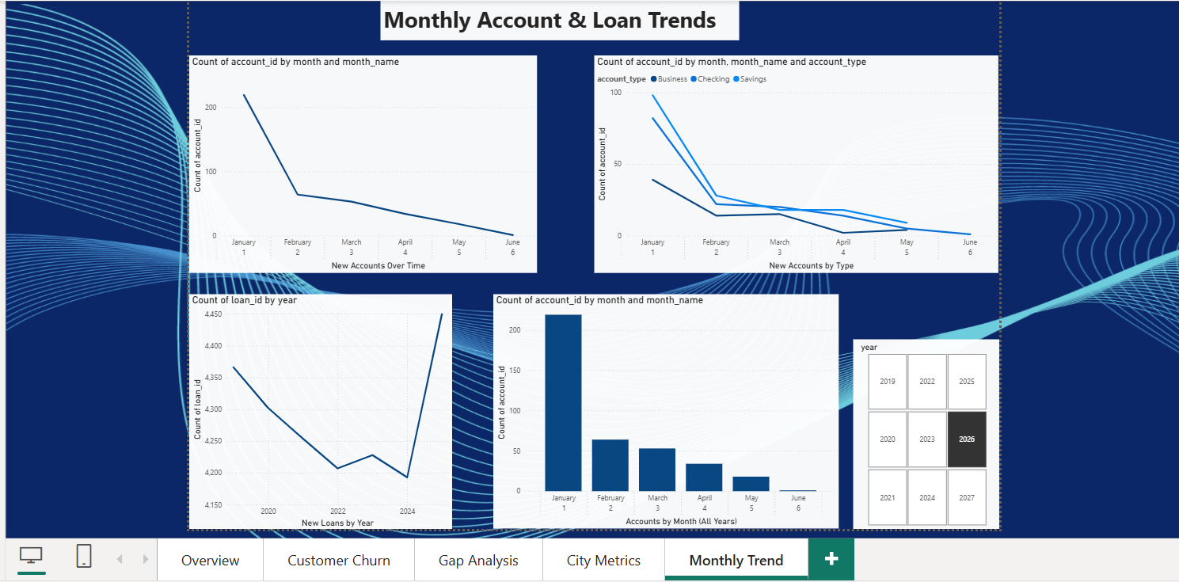

Slide 8
Streaming Dashboard
Real-time Operations — 3 Pages

Slide 9
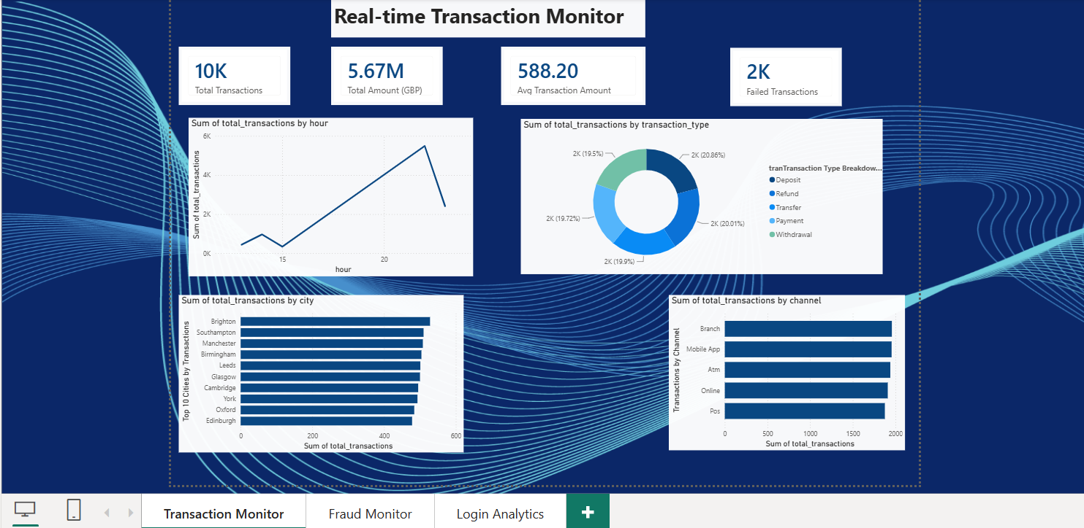

Slide 10
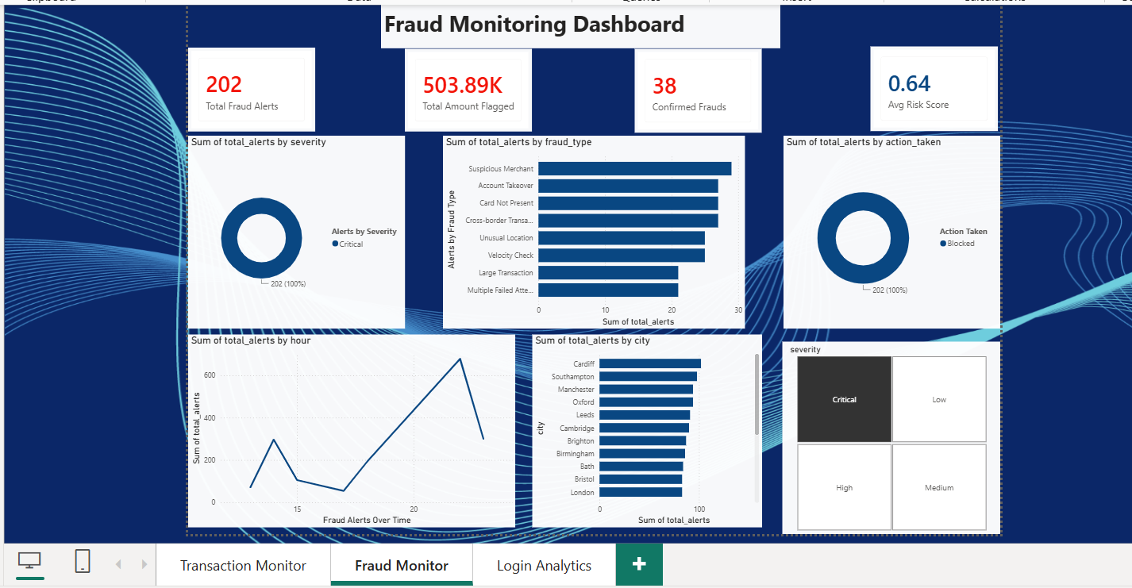

Slide 11
