Slide 1
DATABASE
By
Pradeep E, Vigneshwaran A
Programmer Analyst - Trainee

Slide 2

DATABASE

Slide 3
What is Database?
A database is a collection of data that is organized and stored in a way that allows for efficient retrieval, management, and manipulation of information.
Retrieval – Querying
Management – Storage and Maintenance of data
Data Security
Backup and Recovery
Manipulation – Performing operation on the data
Querying , Updating
Inserting , Deleting

Slide 4
Types of Databases
There are several types of databases, each designed to address specific data storage and management requirements. Here are some common types of databases:
Relation Database
Hierarchical Database
NoSql Database
Key Value
Document – Based
Graph – Based

Slide 5
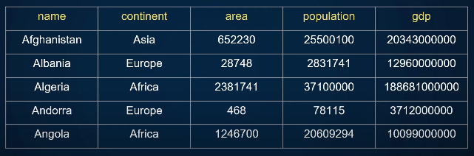
Relational Database
Relational databases store data in structured tables with rows and columns. Example : MySQL, Oracle

Slide 6
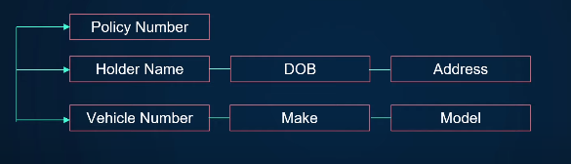
Hierarchical Database
A hierarchical database is a type of database model where data is organized in a parent-child relationships.

Slide 7
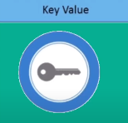
NoSql Database
NoSQL databases are designed to handle various types of unstructured, semi-structured, or highly dynamic data. They offer more flexibility in data storage and retrieval. Types of NoSQL databases include:
Key-Value : Store data as key-value pairs. Example: Amazon DynamoDB.

Slide 8
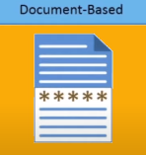
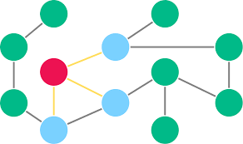
Document – Based : Store data as documents (e.g., JSON). Example: MongoDB.
Graph Databases: Store data as nodes and edges to represent
relationships. Example: Neo4j.

Slide 9
Database Management Tools
Tool | Few Examples | Speciality
Database Management Systems(DBMS) | MySQL, PostgreSQL, Oracle Database | Core functionality
Graphical User Interface(GUI) Tools | phpMyAdmin, pgAdmin, SSMS | Visual interface
Command Line Tools | MySQL CLC, pSQL CLC, SQL*Plus | Text based Interface
Data Modelling Tools | Erwin, Lucidchart, dbForge Studio | Design and Visualization assist
Query Editors | Dbeaver, HeidiSQL, SQL Workbench/J | Write and Execute SQL queries
Database Migration and ETL Tools | Apache NiFi, Talend, AWSDMS | Data Migration between Databases
Database Monitoring Tools | Prometheus, Grafana, SQLDM | Track different properties of Database
Backup and Recovery Tools | Veeam Backup, Bacula, Commvault | Automates data backup and recovery
Replication and Clustering Tools | MySQL rep., pSQL Str. rep | Enables data Synchronization
NoSQL Management Tools | MongoDB Compass, Redis DM, CQL shell | Managing NoSQL Database
In-Memory Database Tools | SAP HANA Studio, RedisInsight | Optimized for In-Memory Database
Cloud Based DBM Tools | AWSMC, GCC, Azure Portal | Web based Interfaces
Container and Orchestra Tools | Docker, Kubernetes | Containerized deployment
Database Security Tools | Imperva SS, McAfee DBS, IBM Guardium | Protects Databse

Slide 10
Cloud-based Database System
Cloud-based database services, also known as Database as a Service (DBaaS), are a type of cloud computing service that provides database management and infrastructure as a fully managed solution.
Key Aspects:
Managed Infrastructure
Automated Scaling
High Availability
Security and Compliance
Maintenance and Patching
Backup and Recovery
Global Availability
Cost Flexibility

Slide 11
Current Trends
Cloud-Native Database
Trend: Designed specifically for cloud environments.
Benefit: Enables greater flexibility, faster deployment, and reduced operational overhead.
Server less Database
Trend: Allowing developers to focus solely on application logic without managing database servers.
Benefit: Simplify development, reduce maintenance, and scale automatically.
Multi model Database
Trend: Multiple data models within a single database system, accommodating diverse data structures.
Benefit: Developers can work with varying data models within a unified platform.

Slide 12
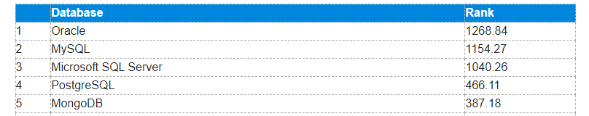
Distributed Database
Trend: Distribute data across multiple nodes or clusters to achieve scalability, fault tolerance.
Benefit: Enable organizations to handle large-scale data processing and serve global users efficiently.
Edge Computing Database
Trend: Store and process data closer to the point of data generation.
Benefit: Critical for IoT, mobile applications, and scenarios requiring rapid data analysis.
Ranking of the Most popular database management system worldwide 2023

Slide 13
Structured Query Language (SQL) [ oracle 10g ]
Data Base Management System [DBMS]
DBMS is used to store the Data in the database in specified Location
Data are stored in the forms of FILES .
We can Communicate in QUERY LANGUAGE.
DBMS Provides 2 Important Features
SECURITY
AUTHORIZATION

Slide 14
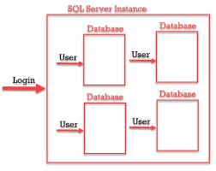

Relation Data Base Management System [RDBMS]
RDBMS is also work as DBMS to stored the Data in Particular Location
Data are stored in the forms of TABLES.
We can Communicate in STRUCTURED QUERY LANGUAGE.
RDBMS Provides 2 Important Features
SECURITY
AUTHORIZATION

Slide 15
Relation Data Base Management System [RDBMS]
Data Types
Constraints
DATA TYPES
Data types is used what kind of data or what type of data we have store in the Particular Memory Location
Char
Varchar1/varachar2
Number
Date
Large Object
Character Large Object [CLOB] ------→ Store upto 4GB
Binary large Object[BLOB]

Slide 16
CONSTRAINTS
Constraints Is used check the Additional validation of the data .
Unique
Is used to Identify the uniquely from the table
Not Null
Is used to that specified column should not be Empty
Check
Is used to check the Data the Specified data
Primary Key
Is used to identify the Record uniquely from the table
Foreign Key
Is used to Establish the connection Between the Tables.

Slide 17
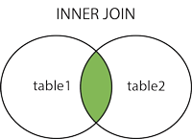
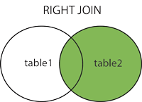
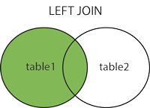
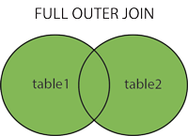
SQL --->JOINS
Joins is used to join the multiple table simultaneously.
1. Cartesian Joins
2. Natural Joins
3. Self joins
4. Inner Joins
5. Outer Joins
A-- Right outer join
B-- Left outer join
C-- Full outer join

Slide 18
Thank You

