Slide 1
Gokulkrishnan K
Final Project

Slide 2
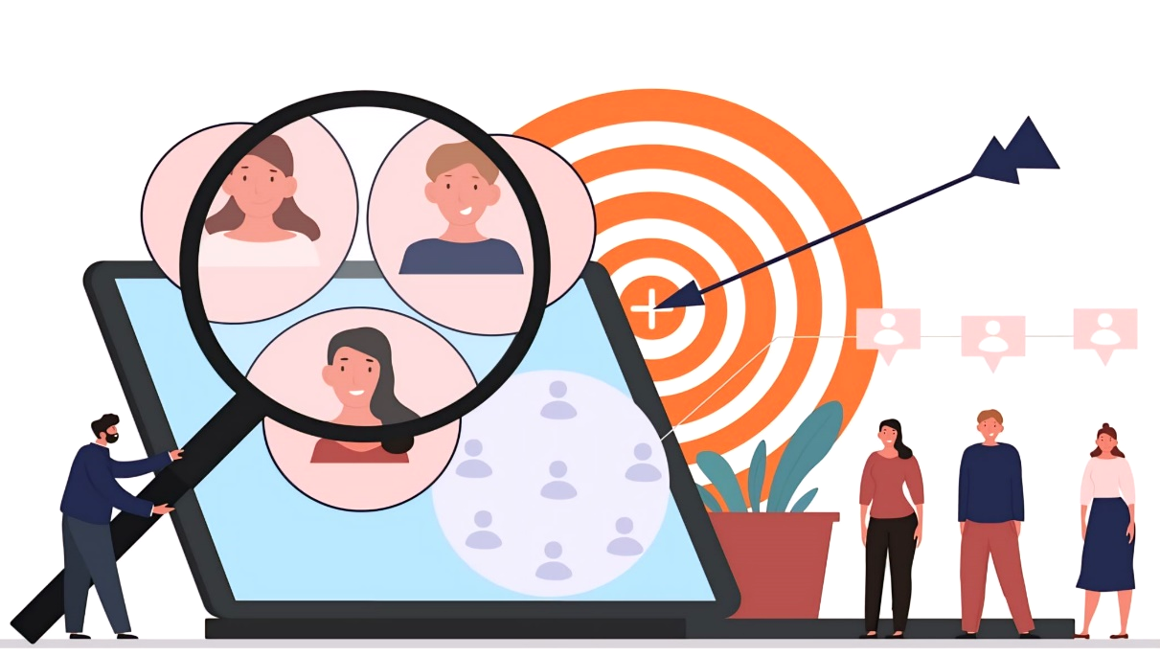
PROJECT TITLE
Customer segmentation for
Targeted marketing

Slide 3


AGENDA
Customer segmentation for targeted marketing is the process of dividing a broader customer base into distinct groups or segments based on shared characteristics, behaviors, or needs. These segments are then targeted with customized marketing strategies, messages, and offerings tailored to their specific preferences and interests.
The “target persona” (or “marketing persona”) is, by definition, a personification of a specific customer segment so it’s not uncommon for businesses to create several personas to match the various customer segments they’ve created.
Types in Customer Segmentation
* Demographic segmentation - age, gender, income, and education 0.
* Psychographic segmentation - personality, lifestyle, values, and attitudes.
* Behavioral segmentation - past purchase behavior, website activity.

Slide 4

PROBLEM STATEMENT
Traditional, one-size-fits-all marketing approaches often result in wasted resources and missed opportunities for connecting with customers on a meaningful level. To address this issue, there is a critical need for customer segmentation in targeted marketing.
The problem statement for customer segmentation in targeted marketing revolves around the necessity for businesses to overcome challenges in segmentation strategy development, implementation, and optimization to deliver more relevant and impactful marketing experiences that drive business growth.

Slide 5

PROJECT OVERVIEW
Customer segmentation for targeted marketing is a strategic process that involves dividing a heterogeneous customer base into distinct groups or segments based on shared characteristics, behaviors, or needs.
Key Components :-
Identification of Segmentation Variables
Segmentation Analysis
Development of Customer Personas
Targeted Marketing Strategies
Implementation and Testing
Iterative Optimization

Slide 6
WHO ARE THE END USERS?
In customer segmentation for targeted marketing, the end users can vary depending on the context and purpose of segmentation. However, there are several key stakeholders who typically utilize customer segmentation insights to inform their decision-making and actions:
Marketing Teams
Sales Teams
Product Development Teams
Customer Service Teams
Business Leaders and Executives
Data Analysts and Researchers

Slide 7

YOUR SOLUTION AND ITS VALUE PROPOSITION
Solution:
Customer segmentation in targeted marketing involves the strategic process of dividing a heterogeneous customer base into distinct segments based on shared characteristics, behaviors, or needs.
Value Proposition:
Increased Relevance
Optimized Resource Allocation
Enhanced Customer Experience
Improved Marketing Effectiveness

Slide 8

THE WOW IN YOUR SOLUTION
wow factor in our solution for Customer Segmentation in Targeted Marketing lies in its ability to transform businesses' marketing approach from generic and broad to personalized and precise, ultimately driving exceptional results and customer experiences.
The hyper-relevance leads to increased engagement, higher conversion rates, and ultimately, happier customers.
Businesses can achieve maximum impact with minimal investment, resulting in a significant boost to their return on investment and bottom line.
8

Slide 9
MODELLING
Customer segmentation for targeted marketing modeling involves the process of creating a structured framework to analyze and categorize customers into distinct segments based on relevant characteristics and behaviors.
Gather customer data from various sources, such as CRM systems, transaction records, website analytics, and customer surveys. Cleanse and preprocess the data to ensure accuracy, consistency, and completeness.
9

Slide 10
RESULTS
The result of effective segmentation enables businesses to tailor their marketing strategies to specific segments, thereby increasing the likelihood of engagement and conversion.
Gather relevant data about customers, including demographics, purchasing behavior, psychographics, and interactions with the brand. efine criteria for segmentation, such as age, gender, location, income level, purchase history, interests, or any other relevant factors.
Link to Colab
10

