Slide 1
Interactive Rainfall Analysis Dashboard – India
Internship Project – SoulVibe.Tech Gokul S batch: May 2025 Role: Data Analyst Intern

Slide 2
Objective
Goal:
To develop an interactive Power BI dashboard that visualizes and analyzes rainfall patterns across Indian states and districts. The goal is to identify seasonal and monthly rainfall trends, highlight regions with extreme rainfall behavior, and derive meaningful insights to support climate-related analysis and planning.

Slide 3
Dataset Overview
Contains:
State / UT Name
District Name
Monthly Rainfall (Jan–Dec)
Seasonal Aggregates (Jan–Feb, Mar–May, Jun–Sep, Oct–Dec)
Annual Rainfall
Region category

Slide 4
Data Preparation
Source: We got the raw rainfall data from its original location (like a file).
Promoted Headers: We used the first row as clear labels (like "State," "Month," "Rainfall") for our data columns.
Changed Type: We made sure the data understood what kind of information was in each column (like numbers for rainfall, text for names).
Unpivoted Columns (x2): Imagine turning a wide table into a long list. We did this twice to organize rainfall data that was spread across many columns (likely for different months or seasons) into a clearer "Month/Season" and "Rainfall Value" format.
Added Conditional Column: We created a new column based on rules (maybe to categorize rainfall as "High" or "Low").
Renamed Columns: We gave some columns clearer names like "Month" and "season_rainfall" so everyone understands them easily.
Essentially, each step is a transformation that makes the raw rainfall data cleaner, more organized, and ready to be visualized and analyzed in your presentation.

Slide 5
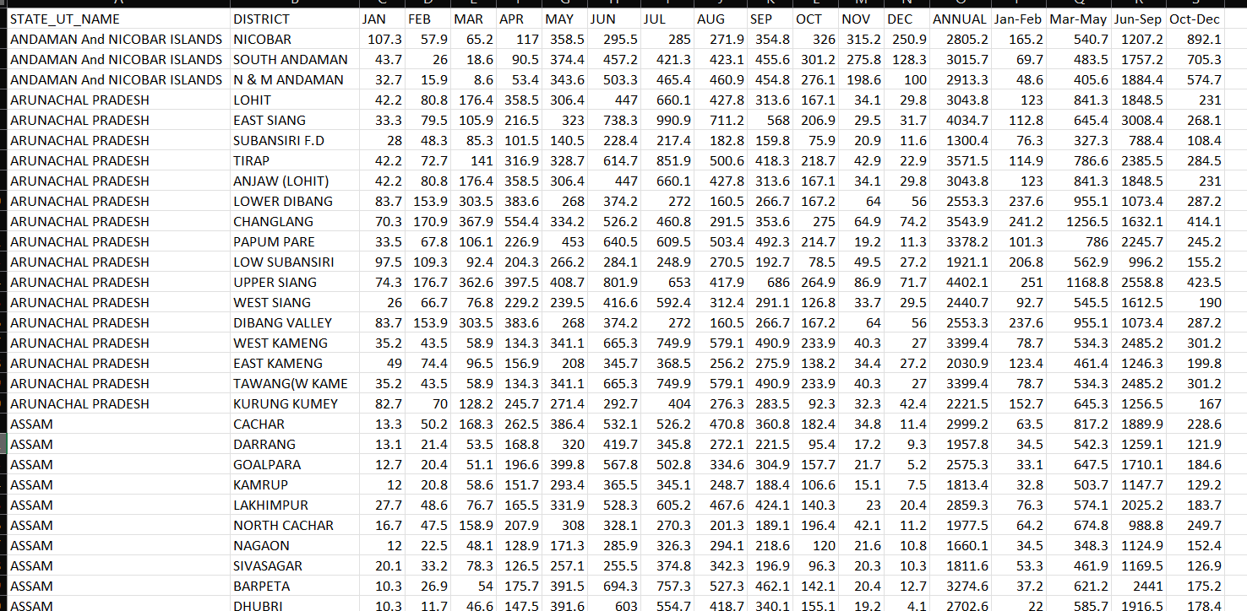
Actual Dataset

Slide 6
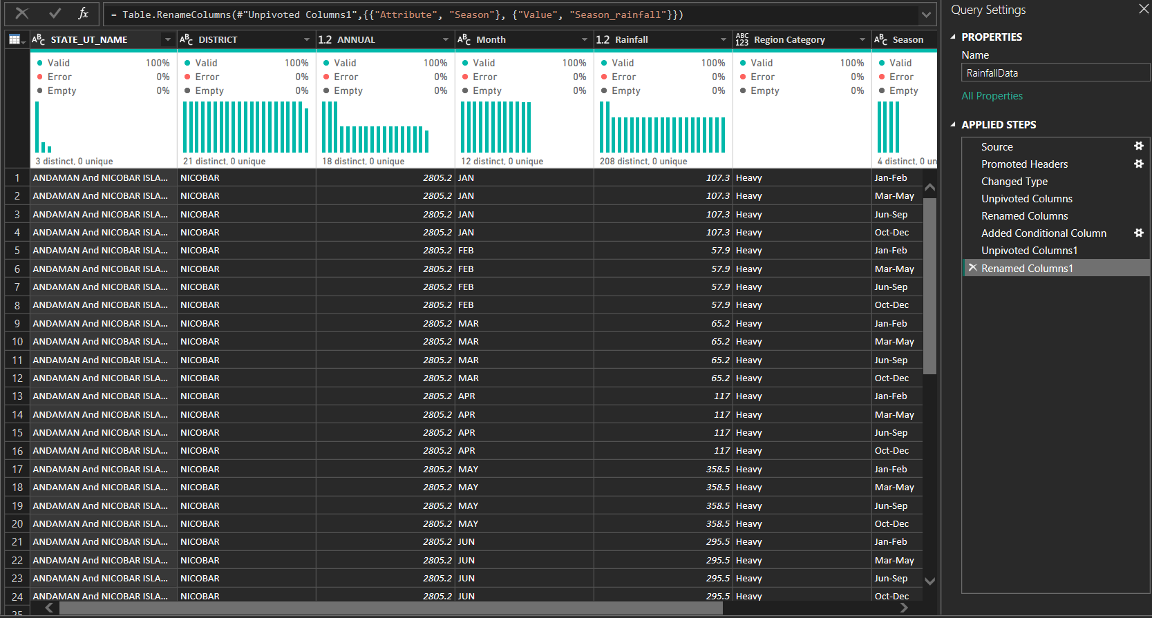
Data Cleaning

Slide 7
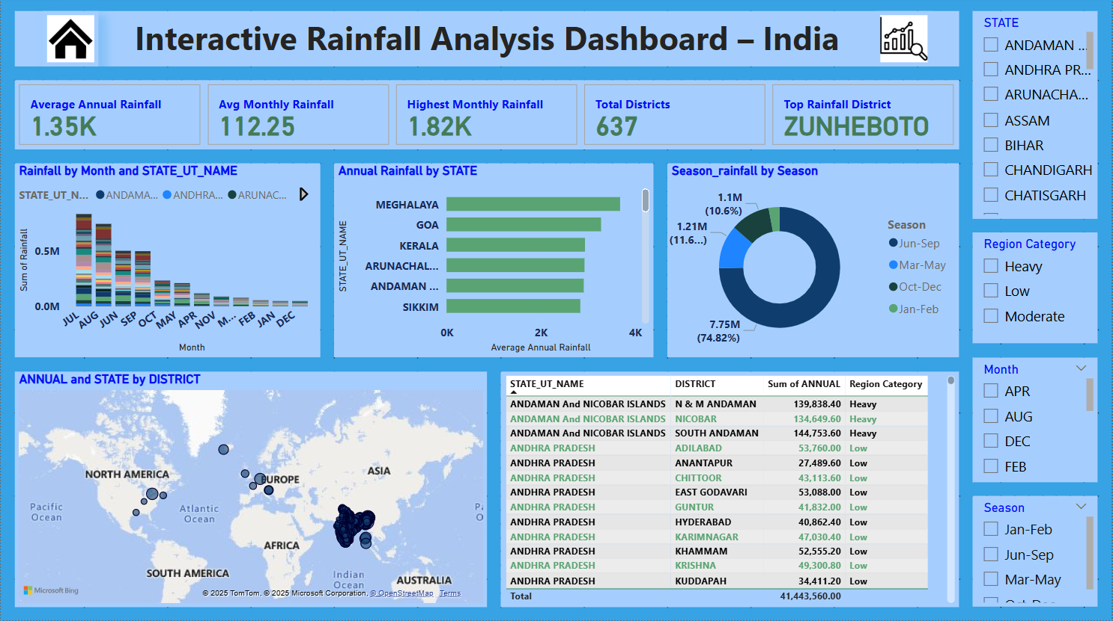

Slide 8
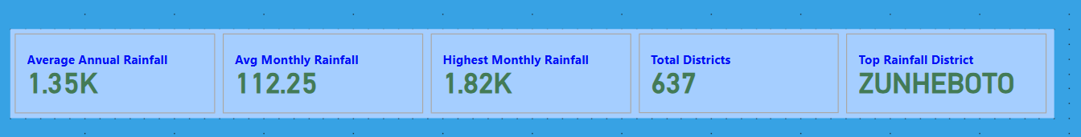
KPI Cards in Dashboard
✅ Key Rainfall Statistics for India:
This section of the dashboard provides a concise overview of India's rainfall patterns based on the analyzed data.
Average Annual Rainfall: The average total rainfall received across all locations in a year is 1.35K. The 'K' likely represents thousands, so this is 1350 mm.
Average Monthly Rainfall: On average, each month sees about 112.25 mm of rainfall across the regions studied.
Highest Monthly Rainfall: The single highest recorded rainfall in any month at any district within the dataset is 1.82K, or 1820 mm.
Total Districts Analyzed: The rainfall data encompasses a total of 637 districts across India.
Top Rainfall District: Among all the districts, ZUNHEBOTO has experienced the highest recorded rainfall.

Slide 9
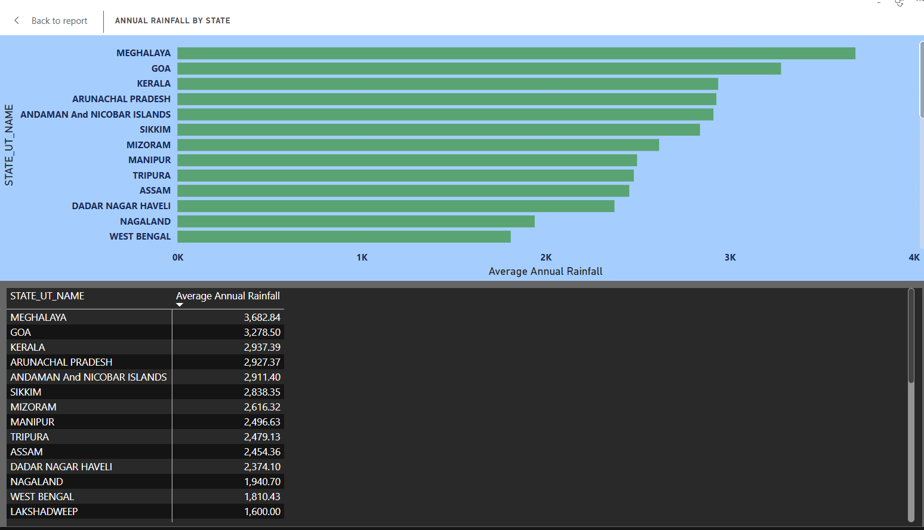
Bar Chart:
📊 Visualizing India's Rainfall: State-wise Averages
This image juxtaposes a horizontal bar chart with a data table, illustrating the average annual rainfall for Indian states and union territories. The bar chart offers a visual comparison, with bar length proportional to rainfall. The table provides precise rainfall figures (in mm) for each state/UT, ordered from highest to lowest.
✅ Key Rainfall Insights:
Meghalaya leads with the highest average annual rainfall (3682.84 mm).
Goa (3278.50 mm) and Kerala (2937.39 mm) also receive substantial rainfall.
West Bengal (1810.43 mm) and Lakshadweep (1600.00 mm) have comparatively lower averages.
This combined visualization clearly highlights the regional variations in India's annual rainfall patterns.

Slide 10
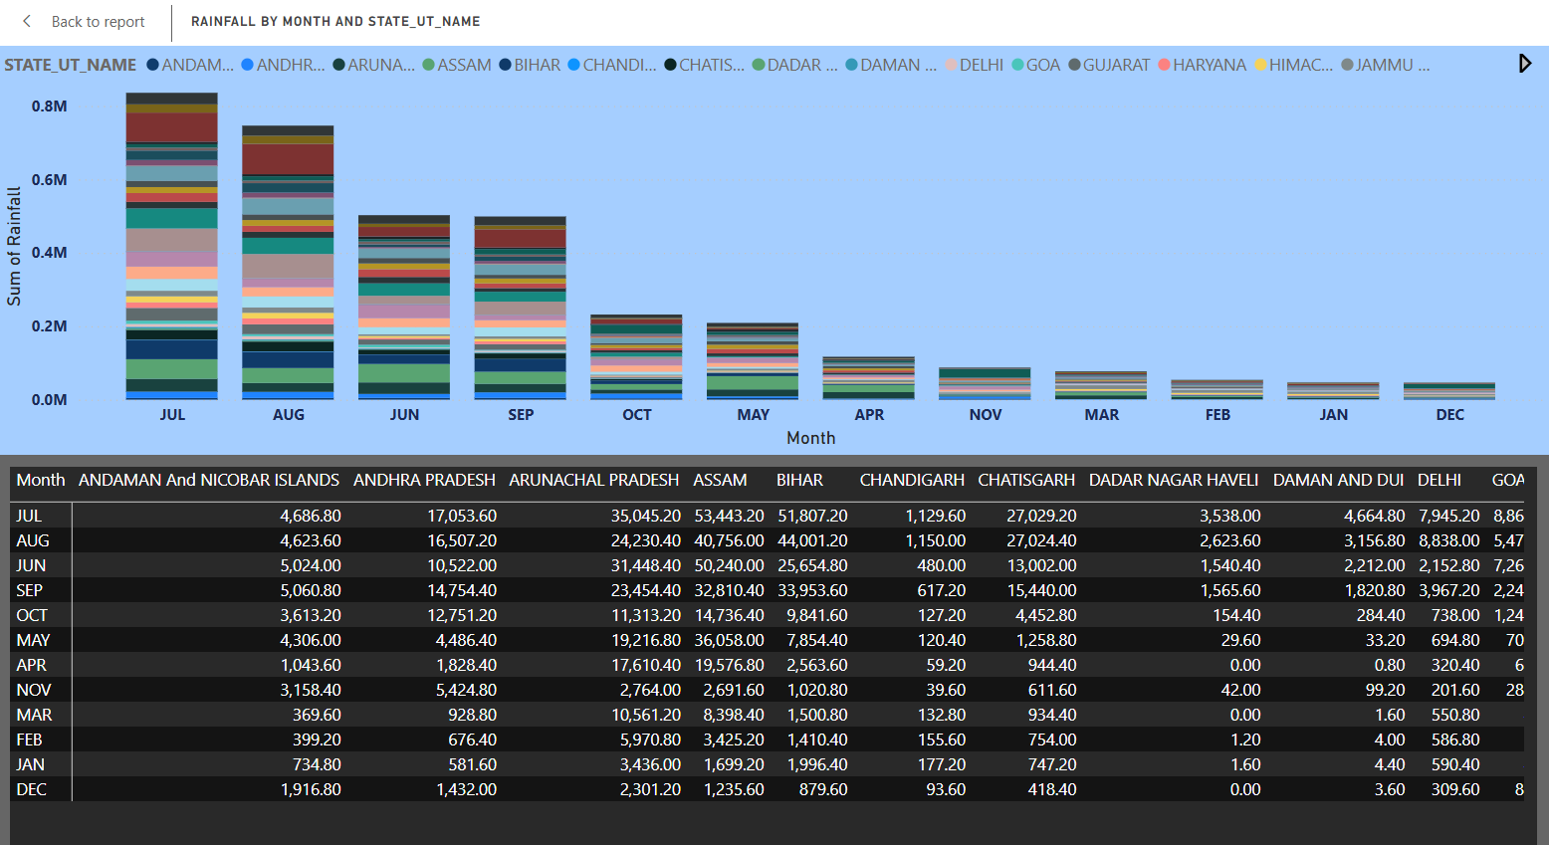
Stacked Column Chart:
📊 Visualizing Monthly Rainfall by State/UT
This image combines a stacked bar chart with a detailed table, showing the sum of rainfall for each month across different states and union territories. The bar chart visually represents the monthly rainfall distribution for each state/UT as stacked segments. The table provides the exact monthly rainfall figures (in mm) for every state/UT.
✅ Key Rainfall Distribution Insights:
July and August generally exhibit the highest rainfall across many states/UTs.
Significant variations in monthly rainfall patterns exist between different regions.
The table allows for precise comparison of rainfall amounts for specific months and locations.
This visualization effectively illustrates the temporal and spatial distribution of rainfall across India.

Slide 11
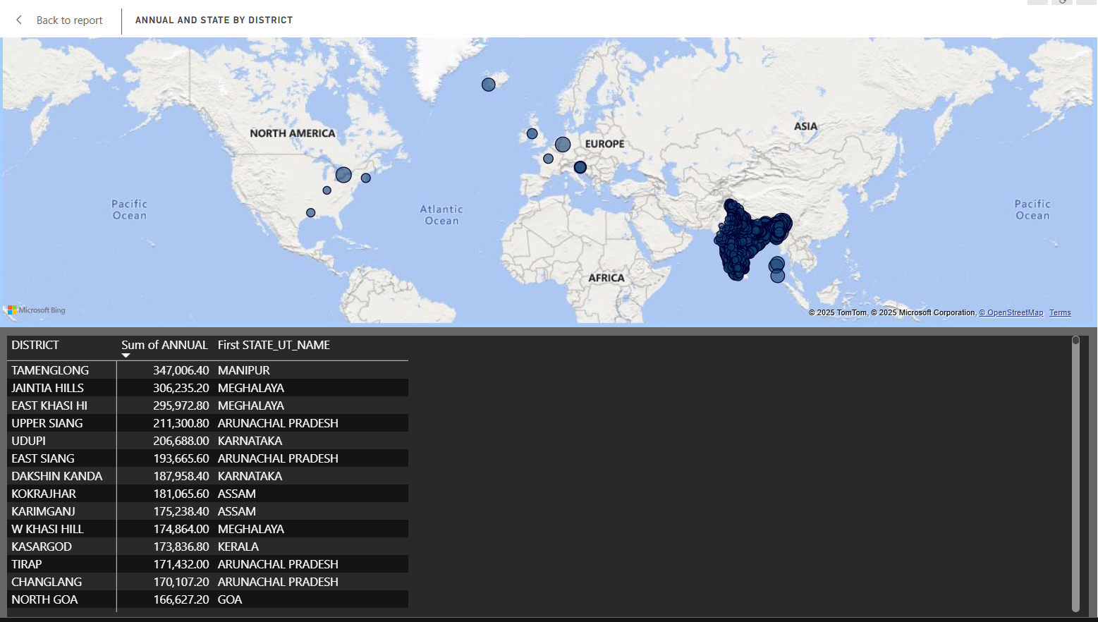
Map Visual:
🗺️ Global Rainfall Visualization: Annual and State by District
This image displays a world map with overlaid circles and a corresponding table, attempting to represent annual rainfall data associated with districts and their states. The circles on the map appear concentrated over India, with varying sizes. The table lists districts, their "Sum of Annual" values, and their "First STATE_UT_NAME".
⚠️ Potential Data Interpretation Issues:
Global Map Mismatch: The map shows global locations, but the table primarily lists Indian districts.
Unclear Circle Mapping: The connection between circle size and rainfall amount or specific districts is not explicitly defined on the map.
"Sum of Annual" Ambiguity: The unit and exact meaning of "Sum of Annual" are unclear without further context.
Therefore, while the image presents data, the visualization lacks clear mapping and context for straightforward interpretation of rainfall patterns.

Slide 12
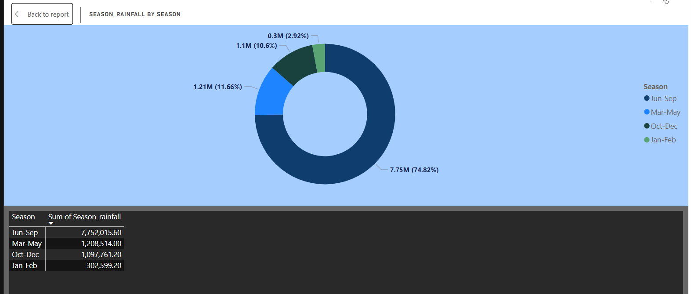
Donut Chart:
📊 Seasonal Rainfall Distribution
This image presents a donut chart and a corresponding table illustrating the distribution of rainfall across four seasons. The donut chart visually divides the total rainfall into proportions for each season. The table provides the exact sum of rainfall (in unspecified units, likely mm) for each season.
✅ Key Seasonal Rainfall Insights:
Jun-Sep (Monsoon): Dominates with the highest rainfall (7.75M, 74.82%).
Mar-May (Pre-Monsoon): Contributes a smaller portion (1.21M, 11.66%).
Oct-Dec (Post-Monsoon): Has a slightly lower contribution (1.1M, 10.6%).
Jan-Feb (Winter): Records the lowest rainfall (0.3M, 2.92%).
This visualization clearly emphasizes the significant contribution of the June-September monsoon season to the overall rainfall.

Slide 13
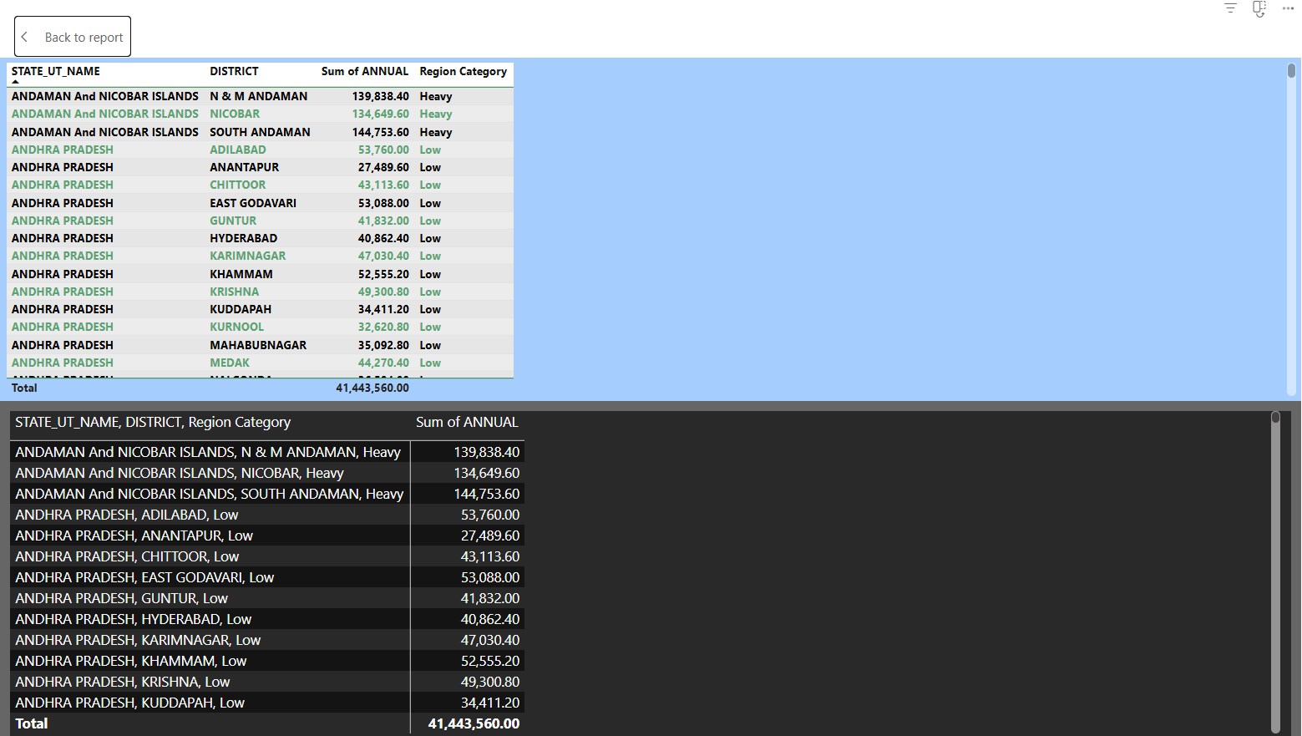
Table Visual:
📊 Annual Rainfall by District and Region Category
This image displays a table presenting the "Sum of Annual" rainfall for various districts, categorized by "Region Category," within different "STATE_UT_NAME" entries. The table shows the annual rainfall amount alongside a classification of "Heavy" or "Low" for the rainfall in each district.
✅ Key Rainfall Distribution Insights:
Andaman and Nicobar Islands: Districts within this UT (N & M Andaman, Nicobar, South Andaman) are categorized as having "Heavy" annual rainfall.
Andhra Pradesh: The numerous districts listed under Andhra Pradesh are all categorized as having "Low" annual rainfall.
Total Annual Rainfall: The table provides a "Total" sum of the "Sum of Annual" column across all listed districts, amounting to 41,443,560.00 (the units are not specified).
This table provides a direct comparison of annual rainfall amounts and their corresponding regional categories for the listed districts and states/UTs.

Slide 14
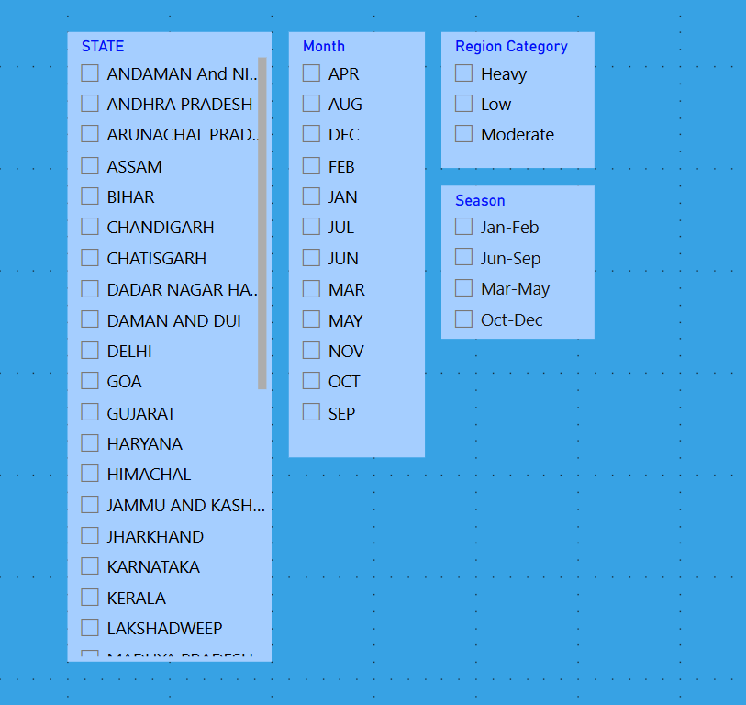
Slicer Filters:
✅ Power BI Slicer Explanation:
This image displays a set of slicers in Power BI. Slicers are visual filters that allow users to interactively filter data displayed in reports and dashboards. They provide an easy and intuitive way to explore different subsets of data.
State: This slicer allows users to filter data based on specific states or union territories. Multiple selections are possible (though none are selected in the image).
Month: This slicer enables filtering data by specific months of the year. Again, multiple month selections are possible.
Region Category: This slicer filters data based on predefined region categories, such as "Heavy" and "Low" (and "Moderate," though not selected).
Season: This slicer allows filtering data by predefined seasons, grouping months together (e.g., "Jan-Feb," "Jun-Sep").
By selecting items within these slicers, users can dynamically update the visuals on the Power BI report to show only the data relevant to their current analysis. The unchecked boxes indicate that no filters are currently applied for these categories, showing the entire dataset.

Slide 15
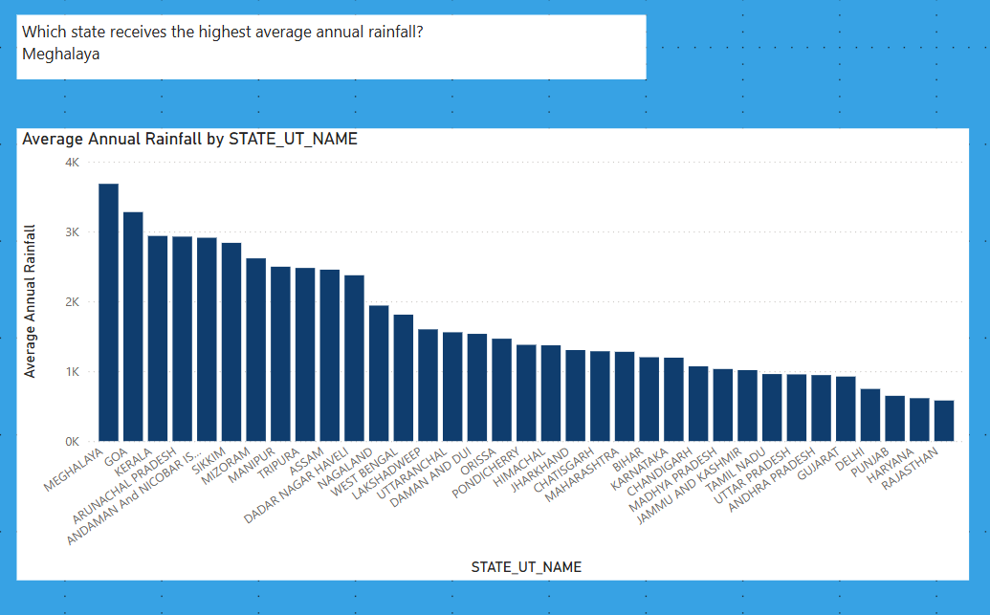
Analysis Tasks

Slide 16
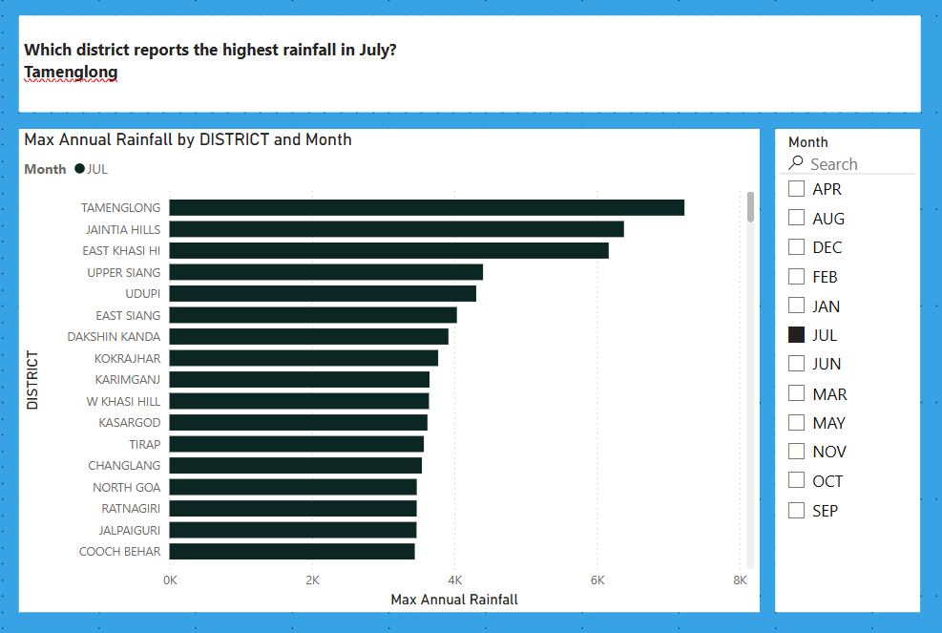
Analysis Tasks

Slide 17
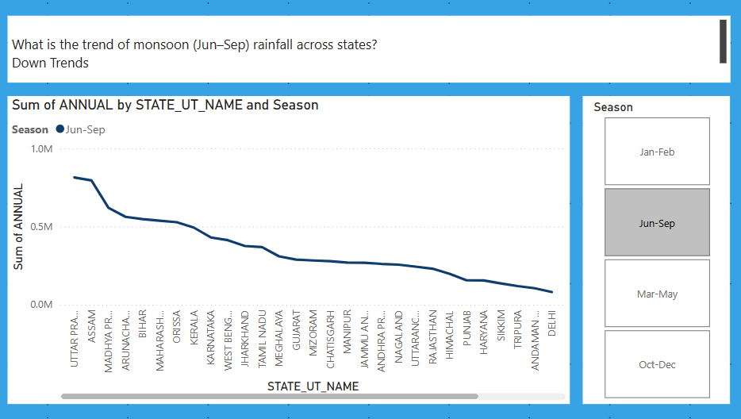
Analysis Tasks

Slide 18
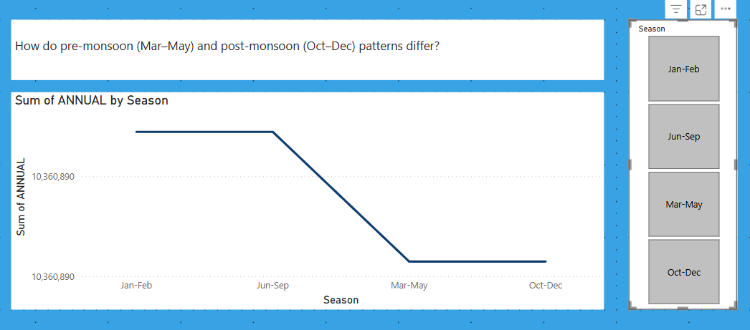
Analysis Tasks

Slide 19
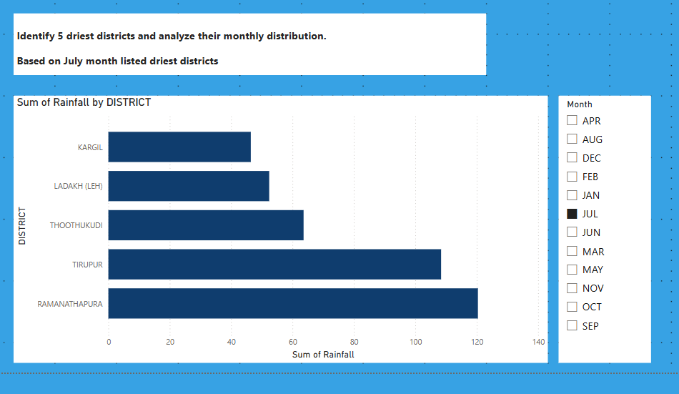
Analysis Tasks

Slide 20
Thank You

