Slide 1
ASAPP HACKATHON
SENTENCE SALIENCY SYSTEM
20R216 - GOKUL BALAJI
20R212 - DINESH KUMAR
20R242 - SRUTHIKA M K

Slide 2
LIBRARIES USED:
Pandas
Better-profanity
Sklearn
Flask
pyngrok
JSON
requests

Slide 3
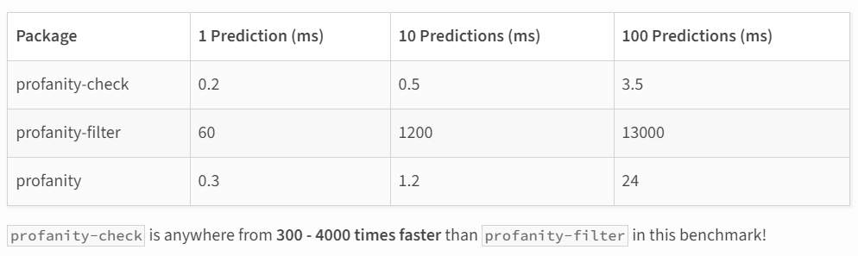
PROFANITY CHECKER:
Profanity-check uses a linear SVM (Support Vector Machine) model trained on 200k human-labeled samples of clean and profane text strings. Its model is simple but surprisingly effective, meaning profanity-check is both robust and extremely performant.

Slide 4
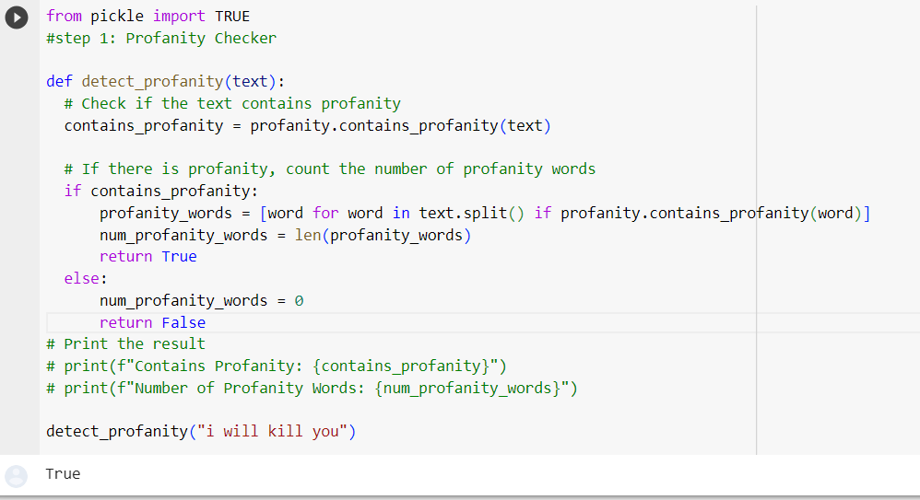

Slide 5
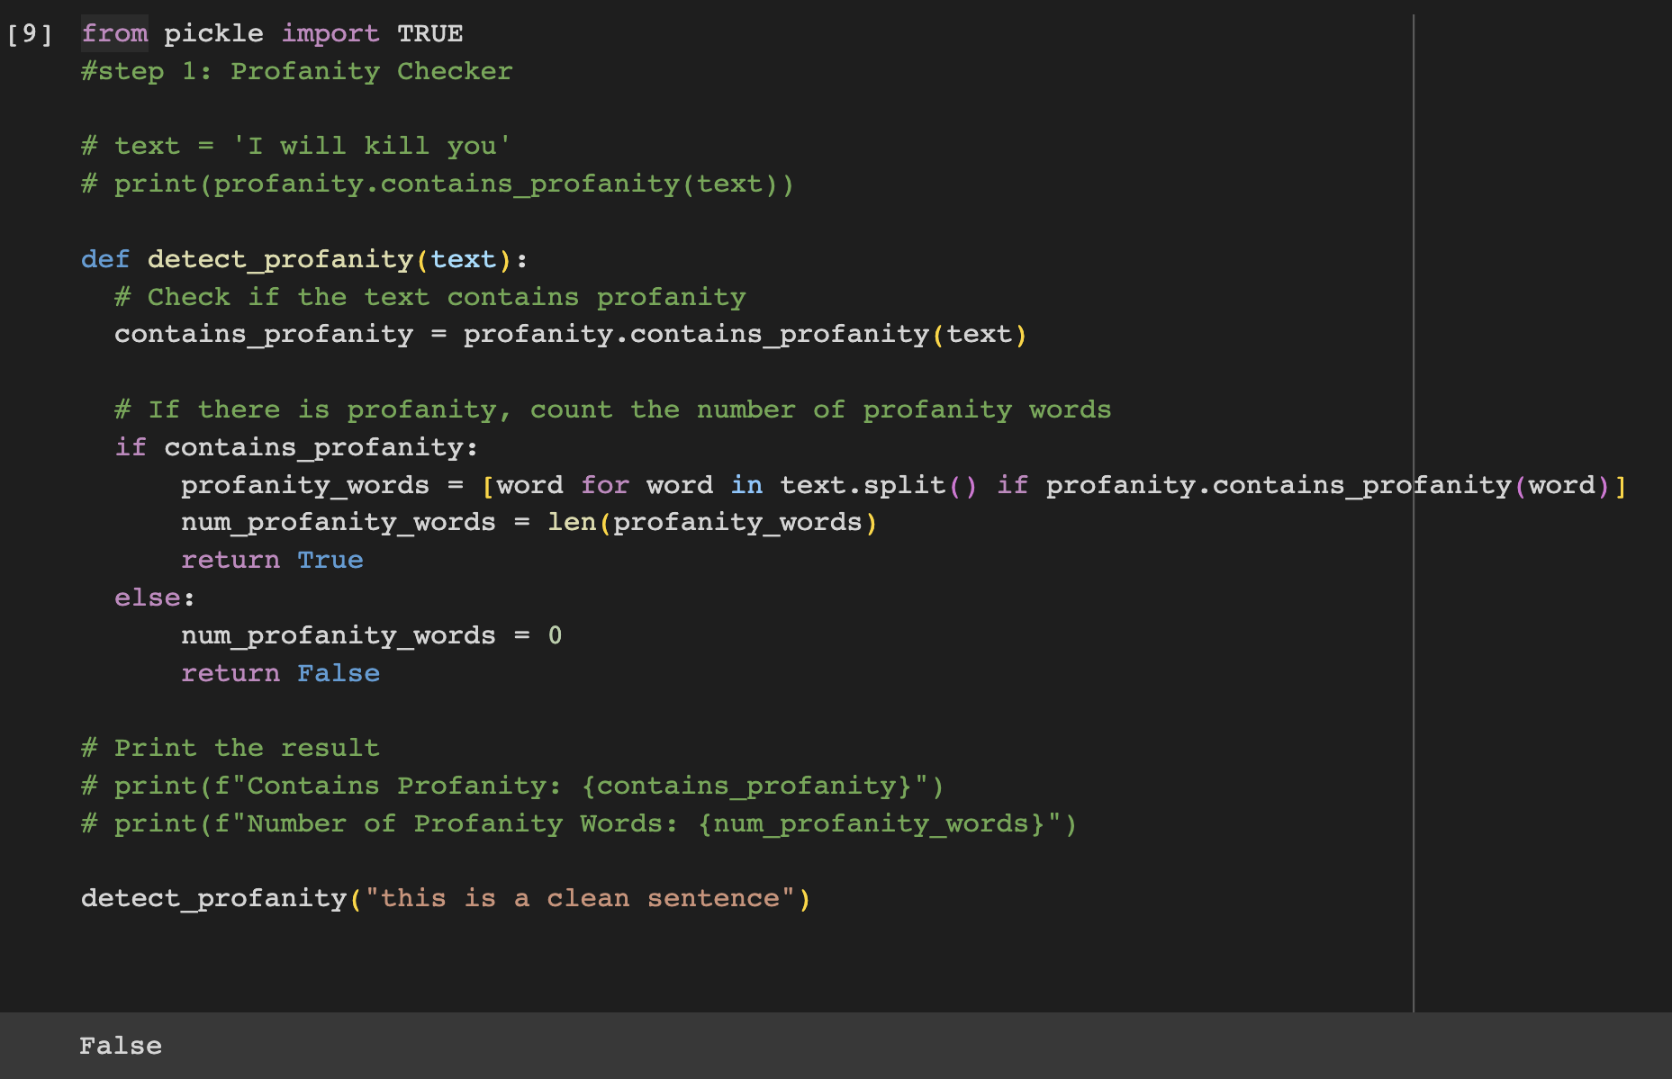

Slide 6
SALIENCY DETECTION MODEL:
Objective:
The saliency detection model aims to identify salient sentences within a given text corpus while filtering out non-salient sentences, including those containing profanity.
Data Preprocessing:
The Saliency column in the dataset was processed to convert it into binary values (0 or 1), where blanks were considered non-salient and any other value was considered salient.
Feature Extraction:
The text data was transformed into TF-IDF (Term Frequency-Inverse Document Frequency) vectors to represent the sentences numerically.
Model Training:
A support vector machine (SVM) with a linear kernel was chosen as the salience detection model.
The model was trained on the TF-IDF vectors of the text data.

Slide 7
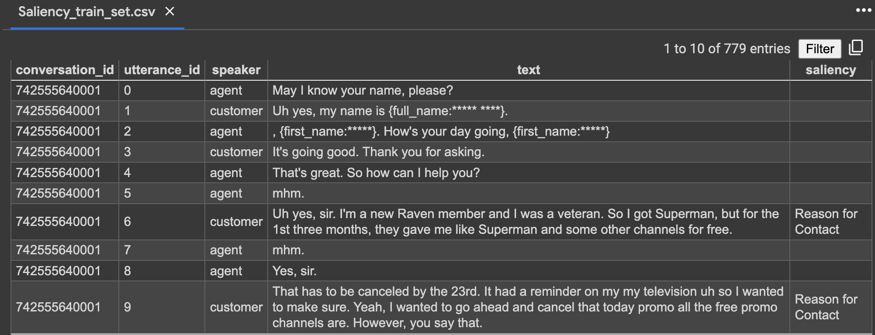

Slide 8
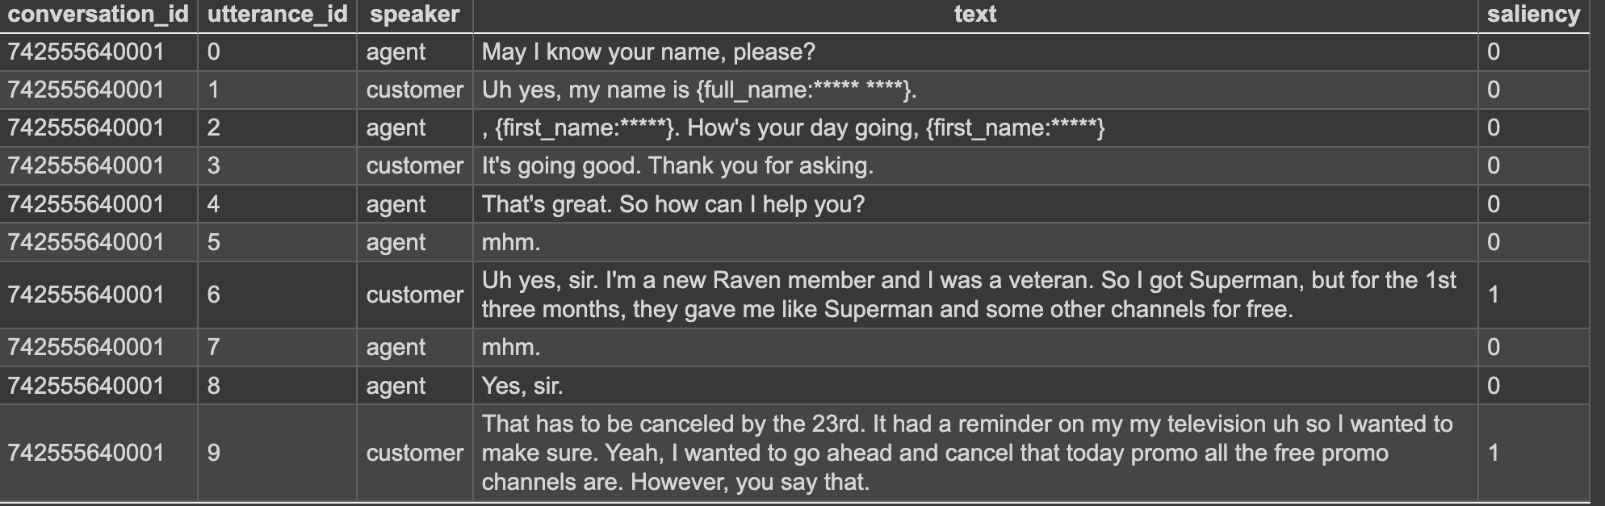

Slide 9
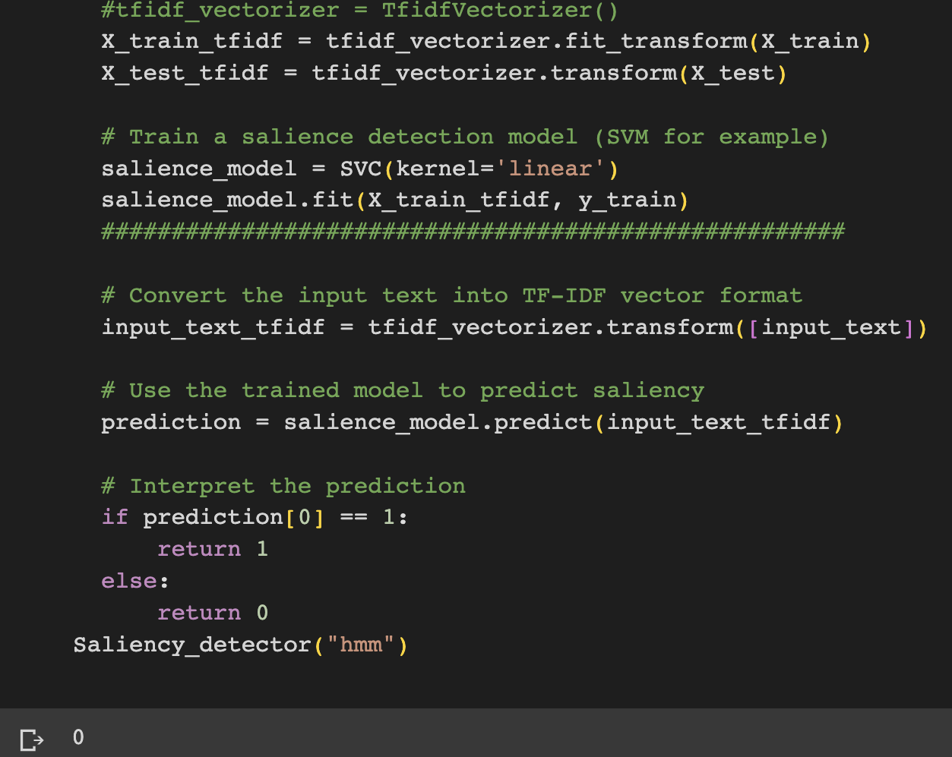
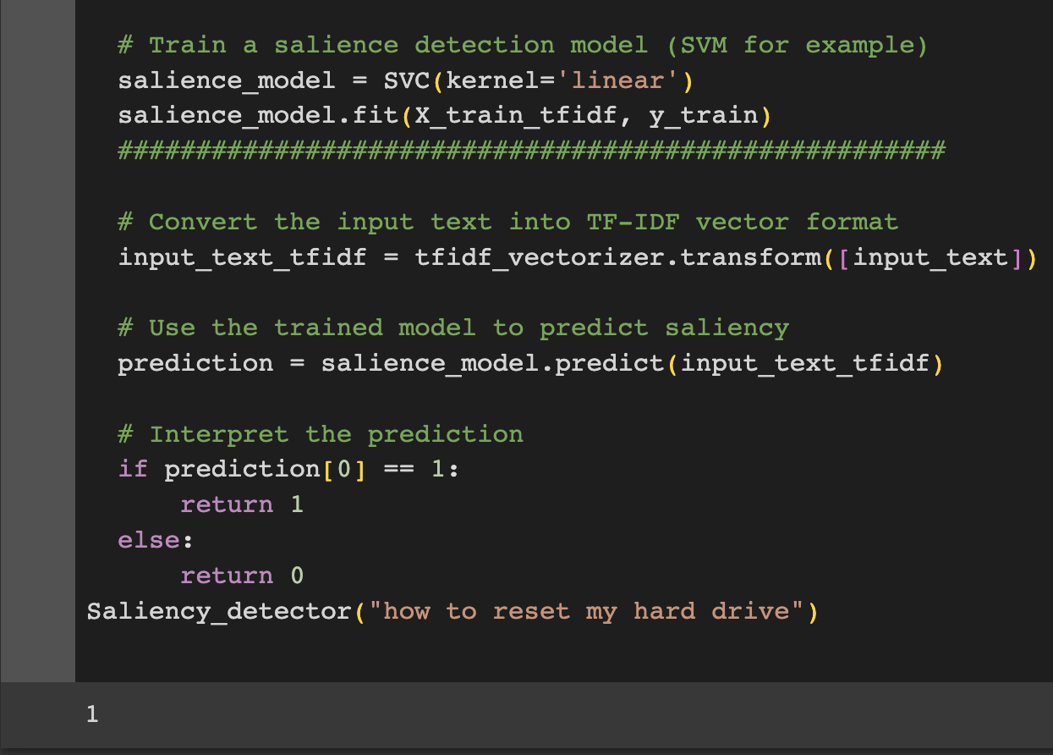

Slide 10
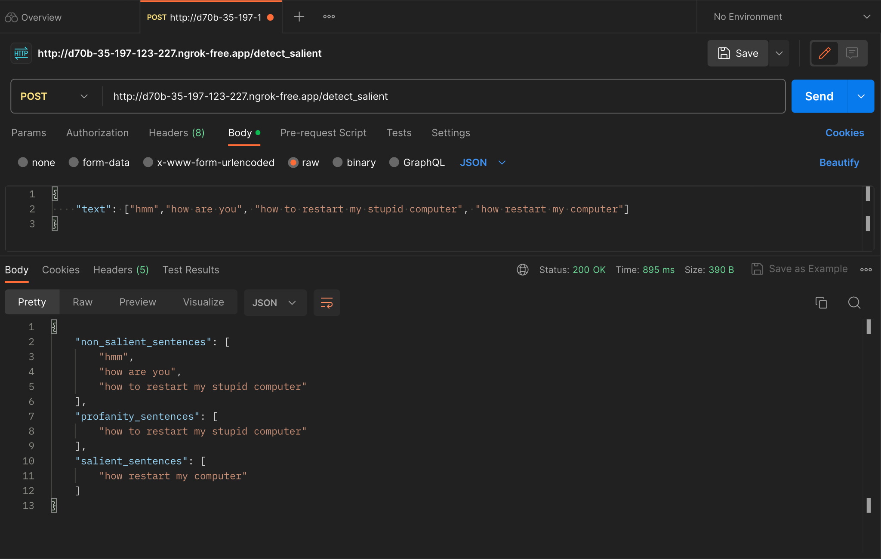
FLASK-RESTful API and Postman JSON push

Slide 11
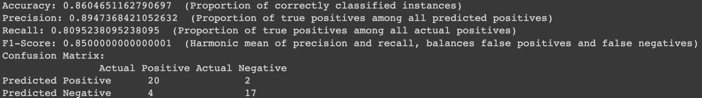
Evaluation Pipeline

Slide 12
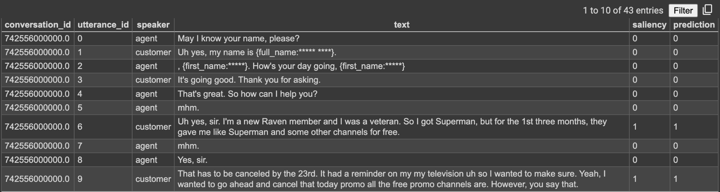
Adding Prediction Column for custom data input

Slide 13
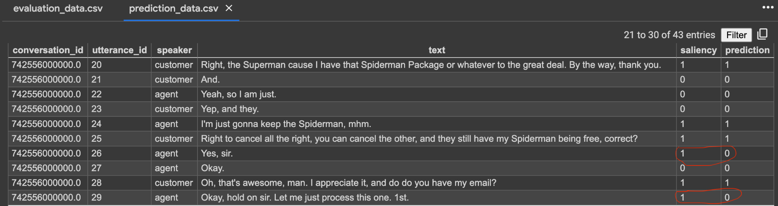
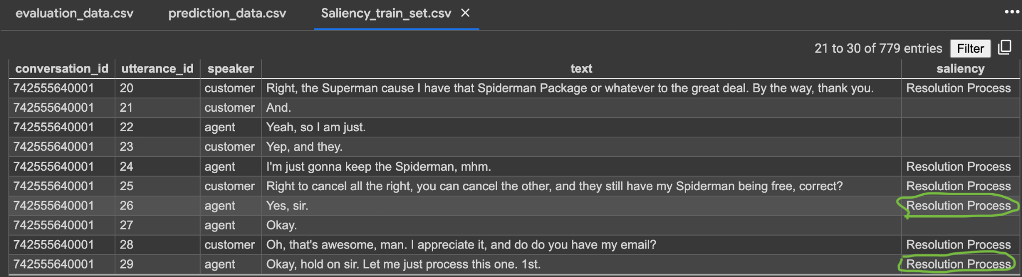
Ability to detect discrepancies in Training data

