Slide 1
The Impact of CMV on T Cell Repertoire: Insights from Transcriptomic Data Analysis
Gokul Seshadri
03/25/2025
Advisors: Bharat Thyagarajan and Adam Rothman

Slide 2
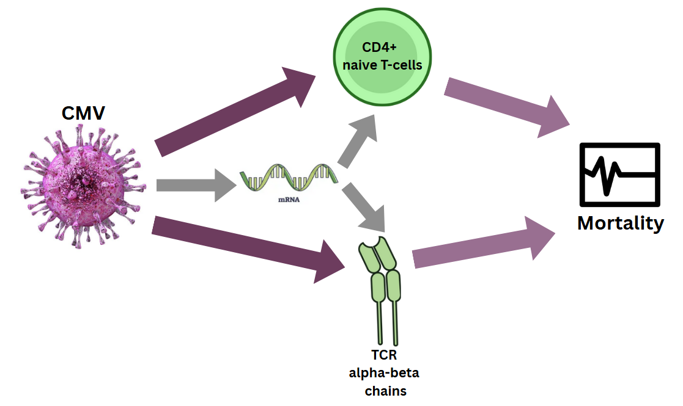
Overall Research Question
Investigating whether a common viral infection like CMV is impacting T-cell repertoire (diversity and adaptability) and their contributions to mortality risk through gene expression pathways.

Slide 3
Project Steps
Extract T-cell receptor (TCR) clones using MiXCR
Evaluate the clonal properties and their associations with mortality
Investigate whether CMV impacts T-cell repertoire, and find the pathways involved.
Identify the most influential pathway for mortality-risk.

Slide 4
Cohorts
The Health and Retirement Study (HRS) – nationally representative study of older American adults – discovery cohort
The Long-Life Family Study (LLFS) – longitudinal study of participants with ancestral longevity – validation cohort

Slide 5
Synopsis
Background :
T-cell repertoire
Extracting T-cell clones (MiXCR)
Dataset and EDA
Main Analysis:
Combining clonal properties
CMV and T-cell repertoire
Finding influential pathway for mortality-risk
Validation in an independent cohort

Slide 6
T-cell repertoire
Background

Slide 7
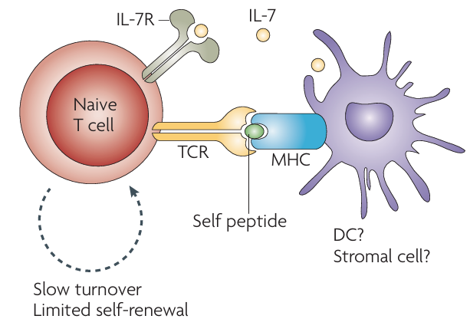
Immunophenotyping in HRS
The Health and Retirement Study (HRS) has performed extensive immunophenotyping of T cell subsets.
T-cells have antigenic memory and provide adaptive immune response.
CD4 naïve T cells (CD4N) have been negatively associated with age related diseases, biological aging and mortality.
While immunophenotyping provides information on cell distribution it does not provide information on functionality or quality of T-cell immunity.
Hence, we need T-cell receptor (TCR) sequences, which carries information on antigenic exposures
References: Ramasubramanian, R. et al. Evaluation of T-cell aging-related immune phenotypes in the context of biological aging and multimorbidity in the Health and Retirement Study. Immun Ageing 19, 33 (2022). Seshadri, G. et al. Immune cells are associated with mortality: the Health and Retirement Study. Front. Immunol. 14, 1280144 (2023). Nikolich-Žugich, J. Ageing and life-long maintenance of T-cell subsets in the face of latent persistent infections. Nat Rev Immunol 8, 512–522 (2008).

Slide 8
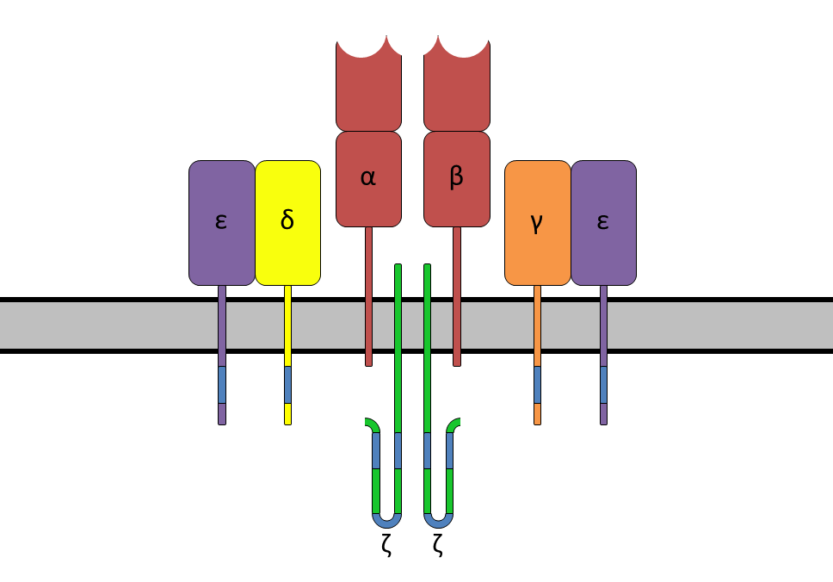
T cell receptors
T cell receptors (TCRs) are protein complexes on the surface of T cells that identify and bind to foreign substances, helping the body fight infection.
A T cell clone represents a collection of T cells with the same unique TCR sequence. This unique TCR allows them to recognize a specific antigen.
The diversity and abundance of T-cell clones are crucial for the immune system’s ability to recognize a wide array of pathogens
T cell receptors (TCRs) consists of
a combination of α and β chains (95%)
a combination of γ and δ chains (5%)

Slide 9
What is T cell repertoire?
Typically, a collection of all T-cell receptors (TCRs) in a person
The TCRs are made up of a pair of α (TRA) and β (TRB) chains
A normal range of total TCRs suggests a healthy immune system with sufficient diversity to recognize a variety of antigens.
A T cell phenotype that is widely shown to be associated with decreased mortality odds is percentage of CD4+ naïve T cells (CD4N), and it reflects the adaptability of T cells in responding to antigens.
TCR α and β chains, CD4N make up T cell repertoire in this study.

Slide 10
Extracting T-cell clones (MiXCR)
Background

Slide 11
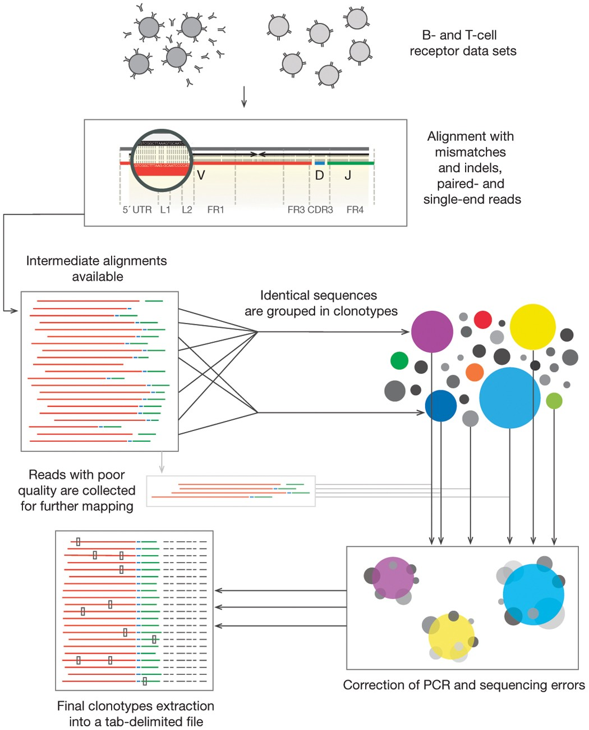
Immune Profiling
With RNA as starting material, HRS used a whole transcriptome approach (no target enrichment) to perform bulk RNA-seq.
MiXCR provides a seamless analytical pipeline for immune profiling with Next-Generation sequencing (NGS) data.
We have used rna-seq preset to extract the clonotypes from paired-end fastq files: mixcr analyze rna-seq --species hsa {R1_file} {R2_file} {output_file}
This is the first time TCR clones were extracted on a study of this vastness.
Flow Diagram
Rosati, E., Dowds, C.M., Liaskou, E. et al. Overview of methodologies for T-cell receptor repertoire analysis. BMC Biotechnol 17, 61 (2017).
Bolotin, D., Poslavsky, S., Mitrophanov, I. et al. MiXCR: software for comprehensive adaptive immunity profiling. Nat Methods 12, 380–381 (2015).

Slide 12
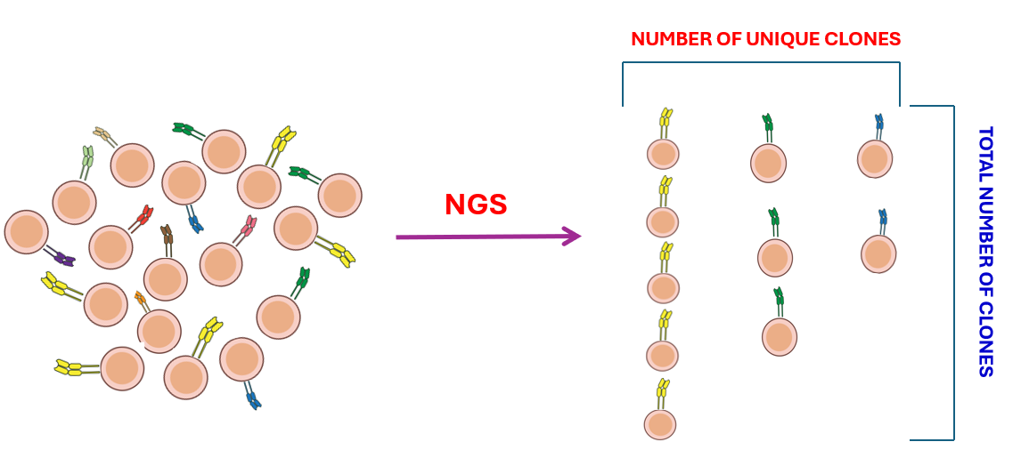
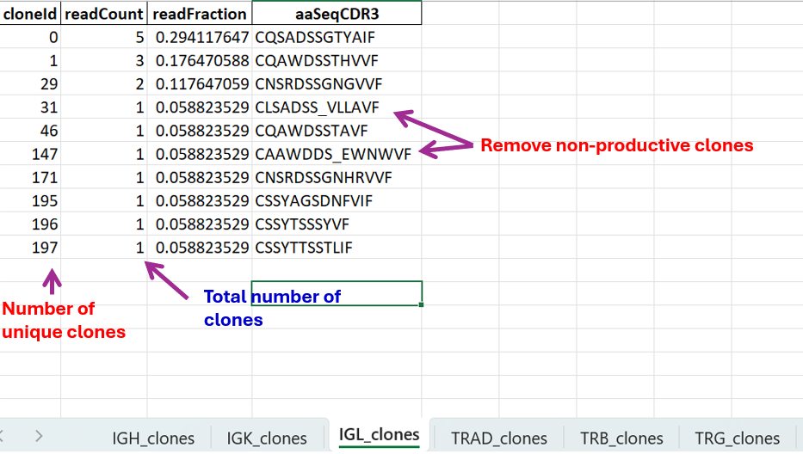
MiXCR Output
Metrics for evaluating clones
Paired end FASTQ files for 4388 samples in the HRS
On average, each sample has approximately 30-40M reads
We ran MiXCR pipeline for all these FASTQ files using slurm in the MSI
Then we extracted clonal metrics (# of unique clones and total # of clones) for each sample

Slide 13
Dataset and EDA
Background

Slide 14
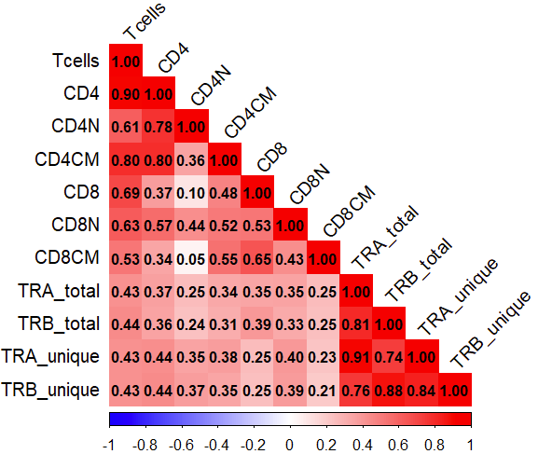
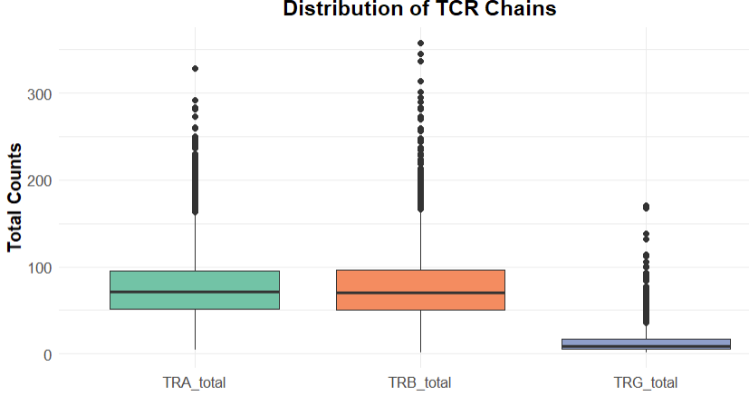
Clonal properties in HRS
Among the 9,934 HRS participants who were included in the 2016 Venous Blood Study (VBS) - whole transcriptome RNA sequences was available in 3748 HRS participants.
From MiXCR output, we have the clonal properties (total clones and unique clones) for TRA (alpha), TRB (beta), and TRG (gamma) chains.

Slide 15
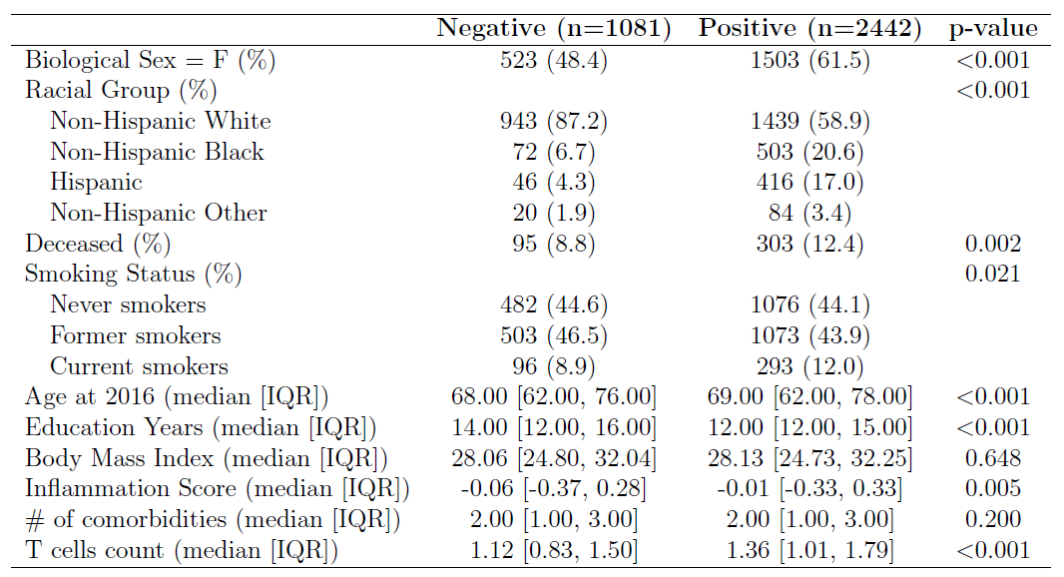
HRS participant characteristics
CMV Status

Slide 16
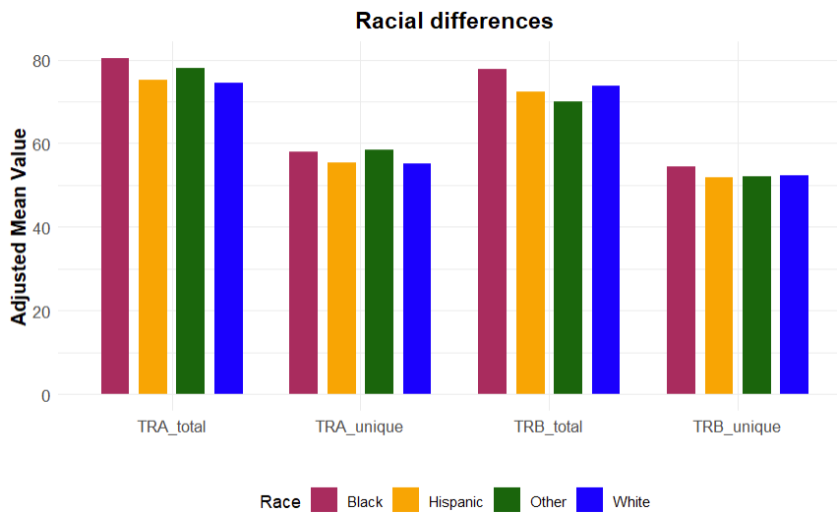
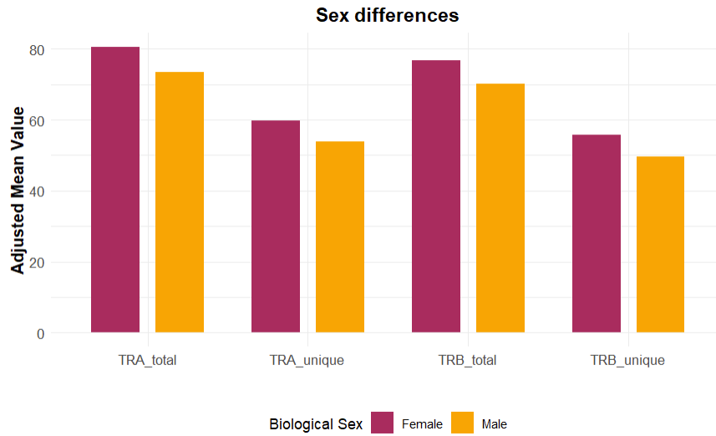
Clones and Participant Characteristics
*
*
*
*
*
*

Slide 17
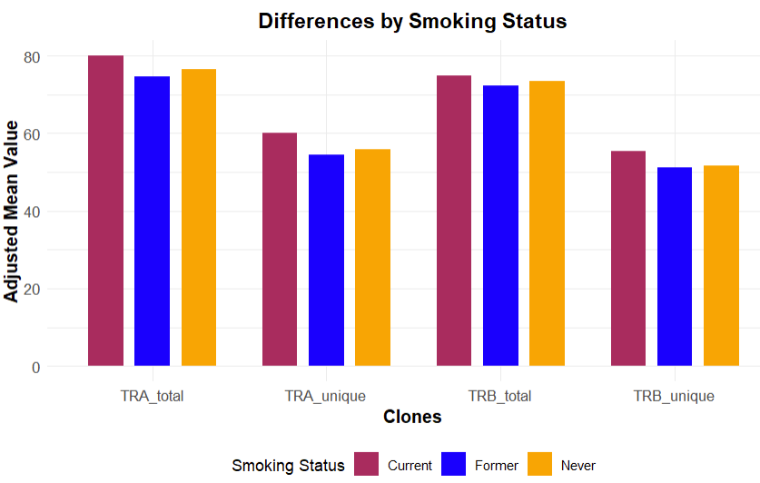
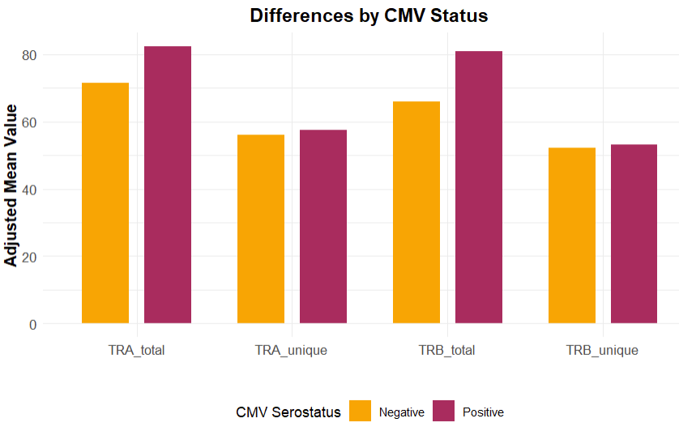
Clones and Participant Characteristics
*
*
*
*
*

Slide 18
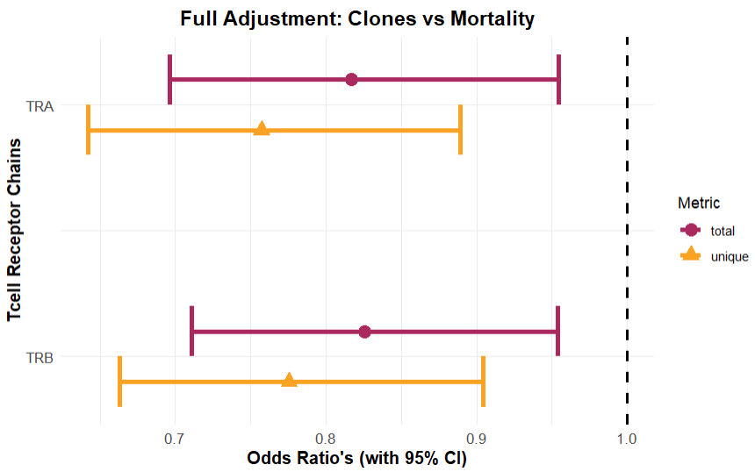
Clones and Mortality
Given the association of CD4N with reduced mortality odds, we investigated whether clonal properties are similarly associated.
Full model:
Mortality (2020) ~ clones (2016) + age + sex + race + education + smoking status + CMV status + total(read count) + BMI + inflammation+ comorbidity index
Cohort Size: 3523 participants with valid demographic and mortality information, CMV status, and TCR chain metrics

Slide 19
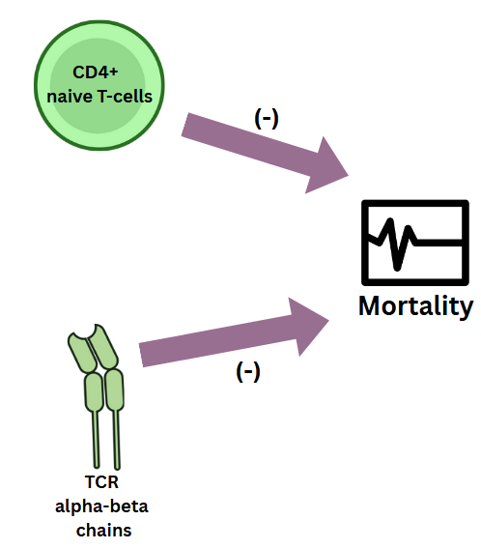
Background Summary
We are interested in TRA (alpha) and TRB (beta) chains as they are more abundant and have significant negative associations with mortality.
Another T-cell component widely shown to be associated with decreased mortality odds is CD4N - Ramasubramanian et. al.
Notes:
CMV is a very prevalent virus and was implicated widely to be a risk factor of all cause mortality. It was shown in previous studies that it can make T-cell receptors to be CMV specific and can hinder the diversity of T-cell immune response.
Smithey - MCMV⁺ mice were able to recruit clonotypes of greater diversity and the recruitment of such diverse clonotypes into the immune response is likely to be beneficial in a broader context of immune defense Attaf - CMV infection drives oligoclonal expansions of virus-specific CD8⁺ T cells, reducing overall TCR diversity.
Pourgheysari - memory inflation of CMV-specific CD4⁺ T cells contributes to evidence that CMV infection may be damaging to immune function in elderly individuals.

Slide 20
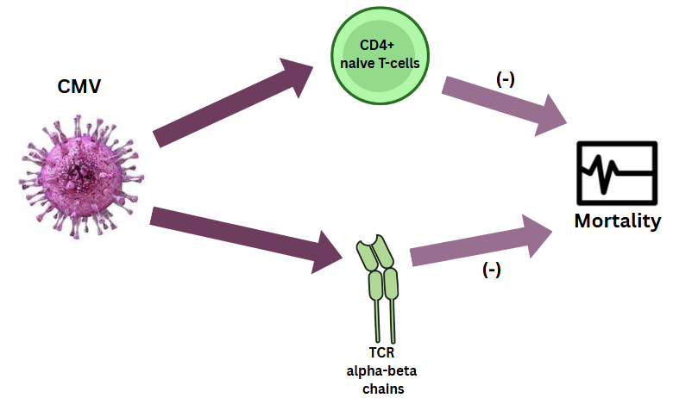
Background Summary
We are interested in TRA (alpha) and TRB (beta) chains as they are more abundant and have significant negative associations with mortality.
Another T-cell component widely shown to be associated with decreased mortality odds is CD4N - Ramasubramanian et. al.
These results prompted us to check if CMV impacts T-cell repertoire, and their associations with mortality. But why CMV? – It make T-cell receptors to be CMV specific and can hinder the diversity of T-cell immune response.
Smithey et. al., Attaf et. al., Pourgheysari et. al.
Notes:
CMV is a very prevalent virus and was implicated widely to be a risk factor of all cause mortality. It was shown in previous studies that it can make T-cell receptors to be CMV specific and can hinder the diversity of T-cell immune response.
Smithey - MCMV⁺ mice were able to recruit clonotypes of greater diversity and the recruitment of such diverse clonotypes into the immune response is likely to be beneficial in a broader context of immune defense Attaf - CMV infection drives oligoclonal expansions of virus-specific CD8⁺ T cells, reducing overall TCR diversity.
Pourgheysari - memory inflation of CMV-specific CD4⁺ T cells contributes to evidence that CMV infection may be damaging to immune function in elderly individuals.

Slide 21
Main Analysis

Slide 22
Combining Clonal Properties
Main Analysis

Slide 23
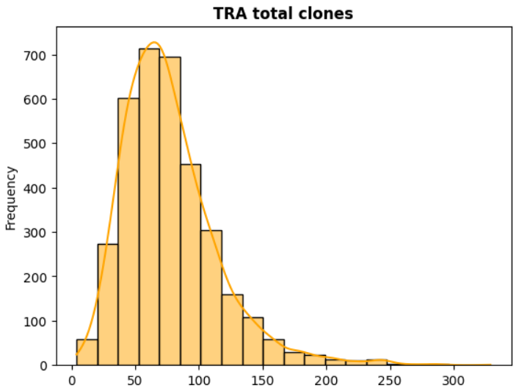
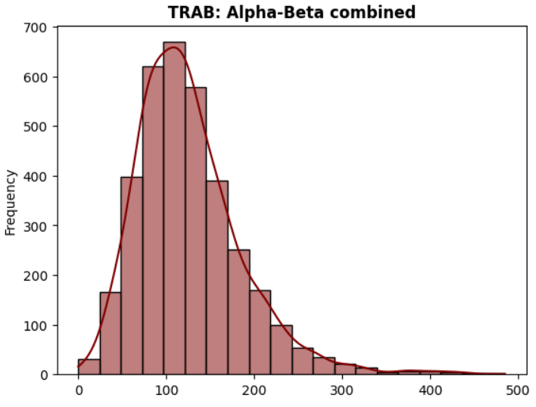
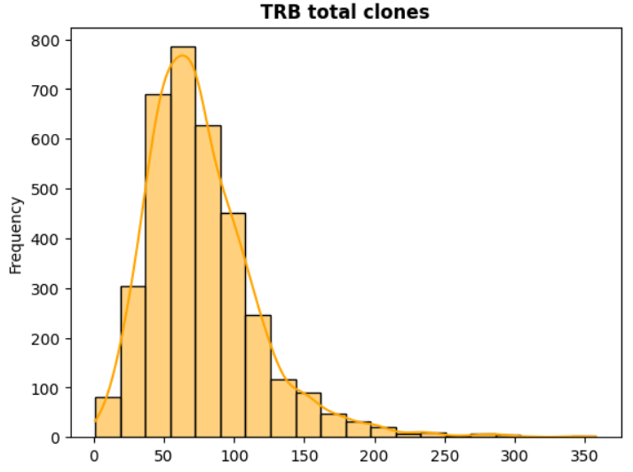
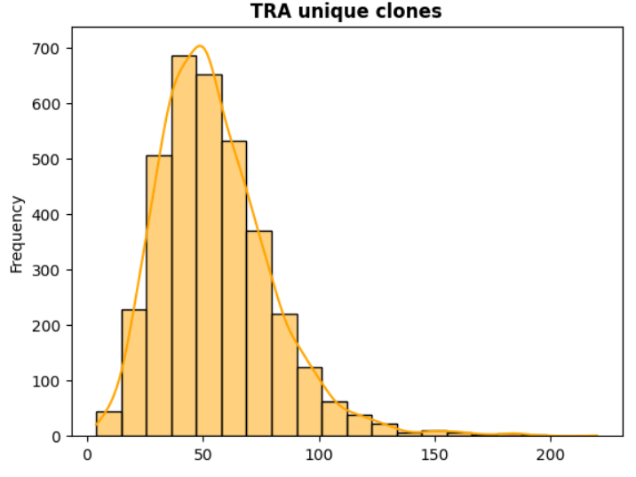
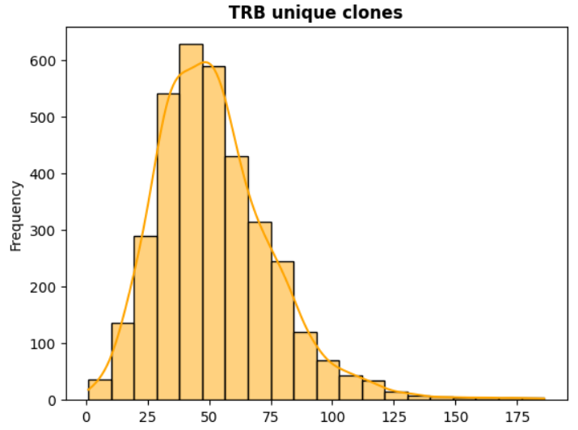
Combining metrics of TRA and TRB
Since the total number and diversity of TRA and TRB are highly correlated, combining them into a single feature called TRAB using Principal Component Analysis (PCA) [Explained Variance = 0.86]
This variable would act as the Bulk RNA-seq equivalent of alpha-beta chain pairing that can be obtained in single cell RNA-seq data.

Slide 24
CMV and T cell repertoire
Main Analysis

Slide 25
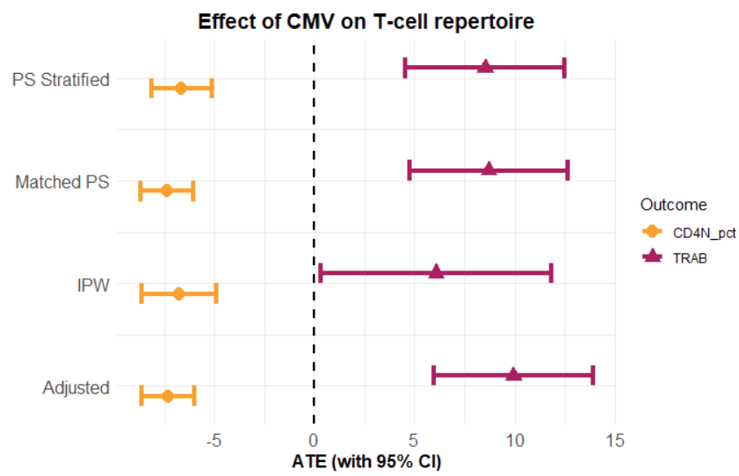
1. Evaluating the impact of CMV
Propensity Score was created using: CMV_status ~ age + sex + race + educ + smoking status + comorb index + INFLAM_5 After stratifying PS into quintiles and considering 100 bootstrap samples with replacement,
CMV positive individuals had
higher TRAB (ATE: 8.5 [4.5 to 12.5])
lower CD4N (ATE: -6.6 [-8.1 to -5.2])
than CMV negative individuals
Paradox: CMV drives expansion of T cell clones (TRAB) but has detrimental effect on CD4N despite all of these being protective of all-cause mortality

Slide 26
2. Genes in the pathways
To investigate the paradox, we examined gene expression pathways that mediate the relationship between CMV infection and T cell repertoire.
Also evaluated which of these pathways contribute to reduced mortality risk.
Public Health Implication:
This paradox is a sign of “beneficial exhaustion” where expanded memory/effector clones (if they are functional) are strong enough to handle most threats encountered during aging.
Identifying the pathways underlying this beneficial exhaustion could offer promising targets for future immunological interventions

Slide 27
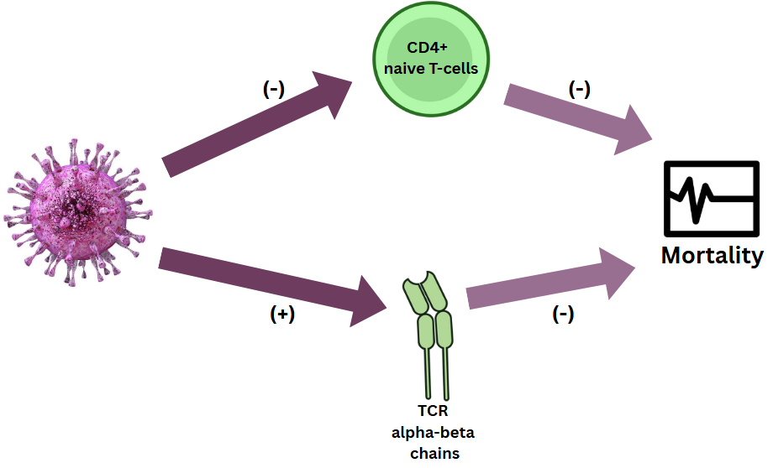
Analysis Flow:
CMV
DESeq2 +
WGCNA
(modules)
. . .
(+/-)

Slide 28
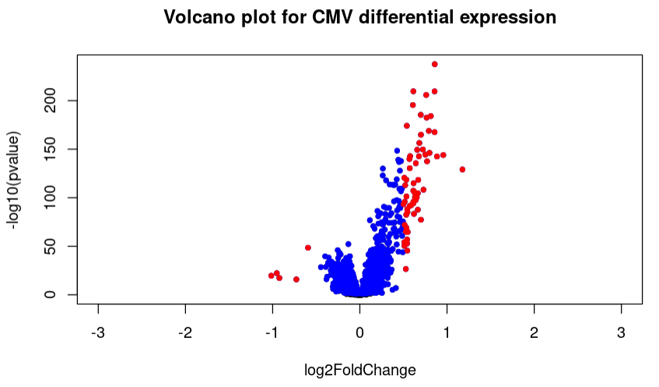
Genes Expressed in CMV Seropositive
We have the HRS sample of 3523 participants with valid values in CMV serostatus and TCR chains.
Out of 58,219 gene transcripts, only 12,800 had mean(expression) > 3cpm
From which only 6,202 genes are differentially expressed between CMV positive and negative groups upon adjustment for age, sex, race , educ, smoking status, lymphocytes, BMI, comorbidity index, and inflammation.

Slide 29
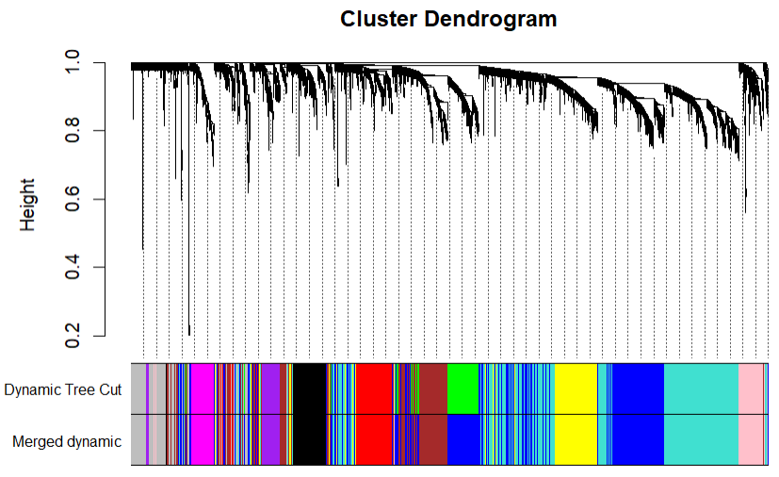
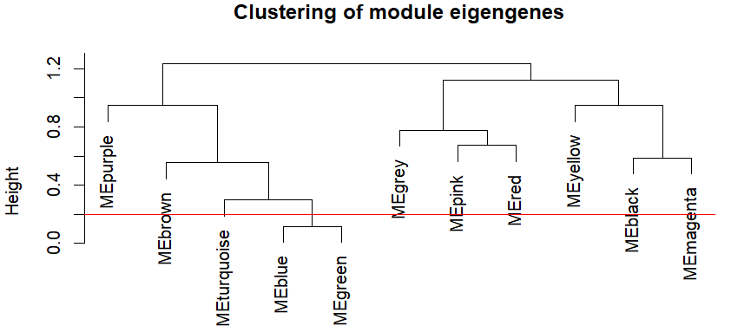
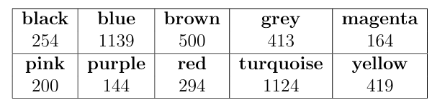
Co-expression Modules
Used hclust to exclude outlier participants (N=3,435)
From the significantly expressed gene set of 6,202 genes, we retained only those with higher variance (4,651) and then performed WGCNA.
Resulted in 10 co-expression modules after merging those with very less dissimilarity.
Module Sizes:

Slide 30
Modules associated with TRAB and CD4N
We then evaluated the genes in these 10 modules while accounting for the modularity against TRAB and CD4N.
Sparse Group Lasso models with only group regularization were used.
The optimal regularization parameter (λ) was selected based on the highest R^2 achieved via five-fold cross-validation.
Number of modules associated with TRAB: 6
Number of modules associated with CD4N: 7
Common modules:
Blue (1139) | Brown (500) | Black (254) | Pink (200)

Slide 31
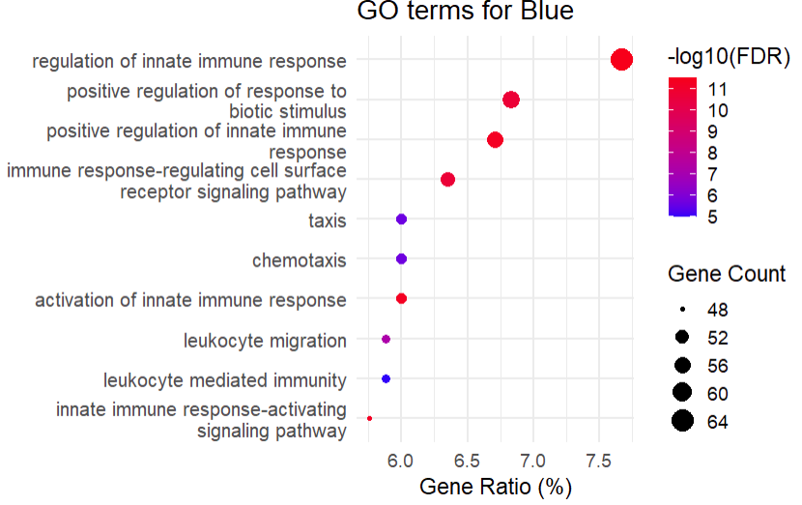
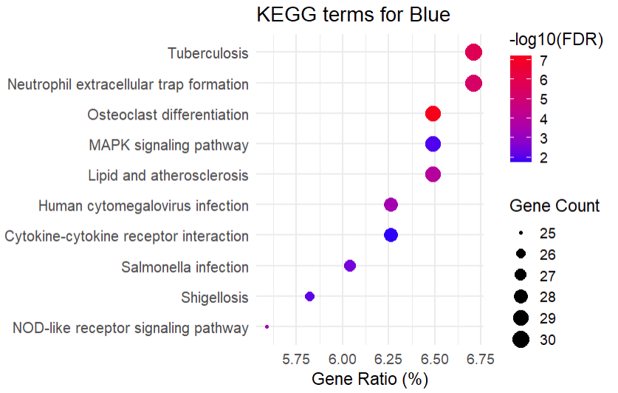
Modular Pathways
Blue: Cell trafficking through CMV infection and cytokine interactions

Slide 32
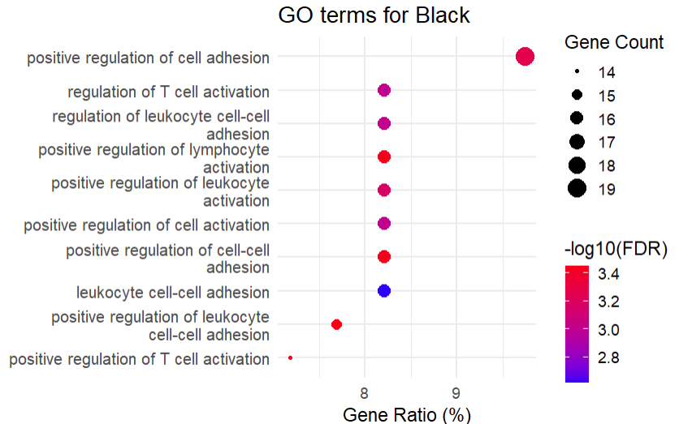
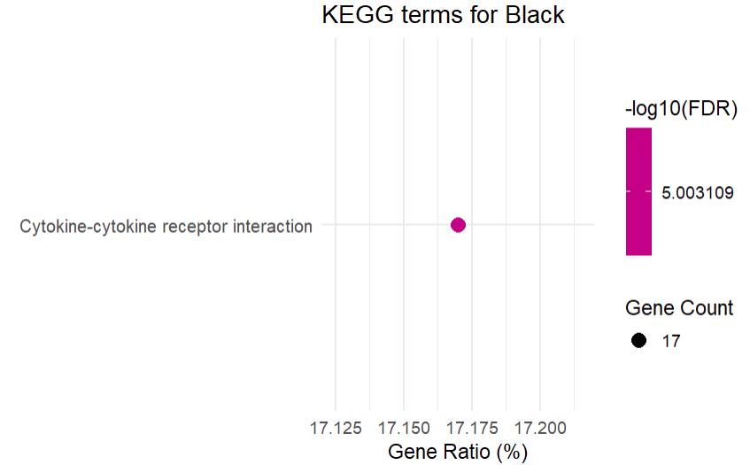
Modular Pathways
Black: immune cell adhesion and activation through cytokine interactions.

Slide 33
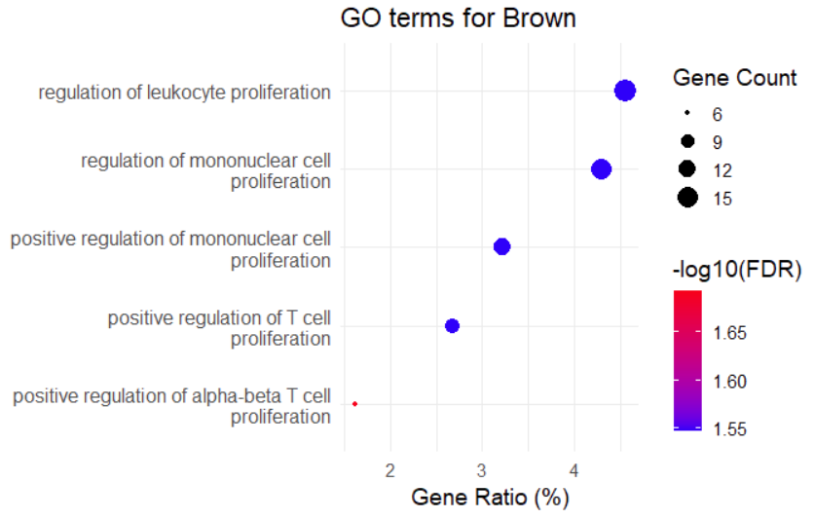
Modular Pathways
Brown: positive regulation T-cell proliferation. No KEGG pathways

Slide 34
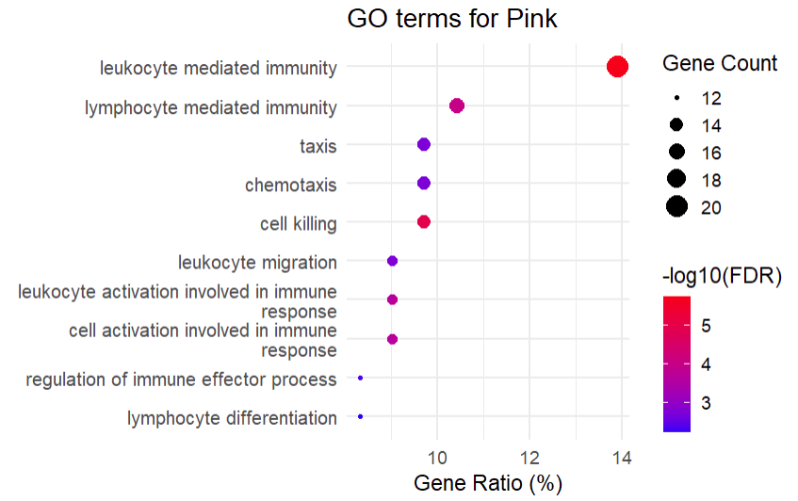
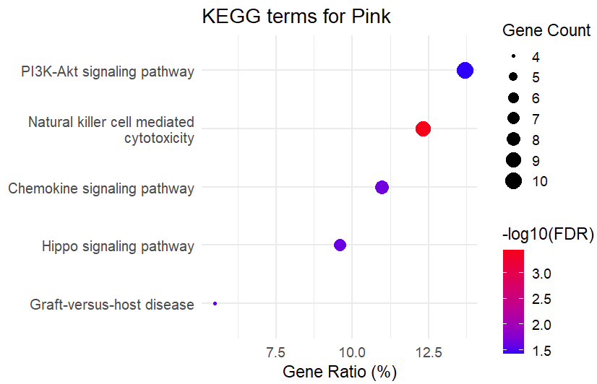
Modular Pathways
Pink: cell trafficking and other processes, through signaling pathways

Slide 35
Finding influential pathway for mortality-risk
Main Analysis

Slide 36
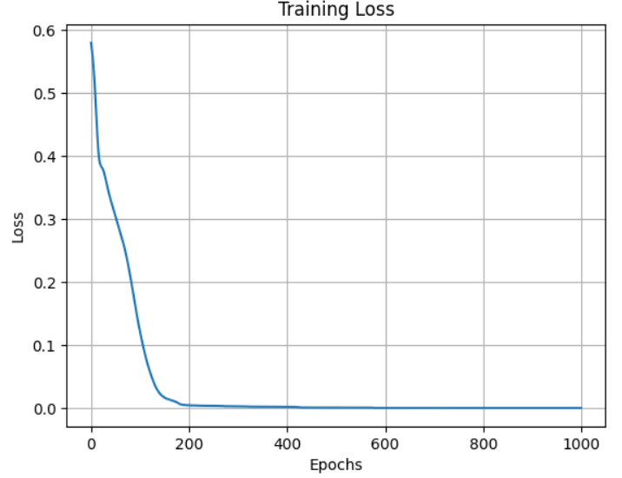
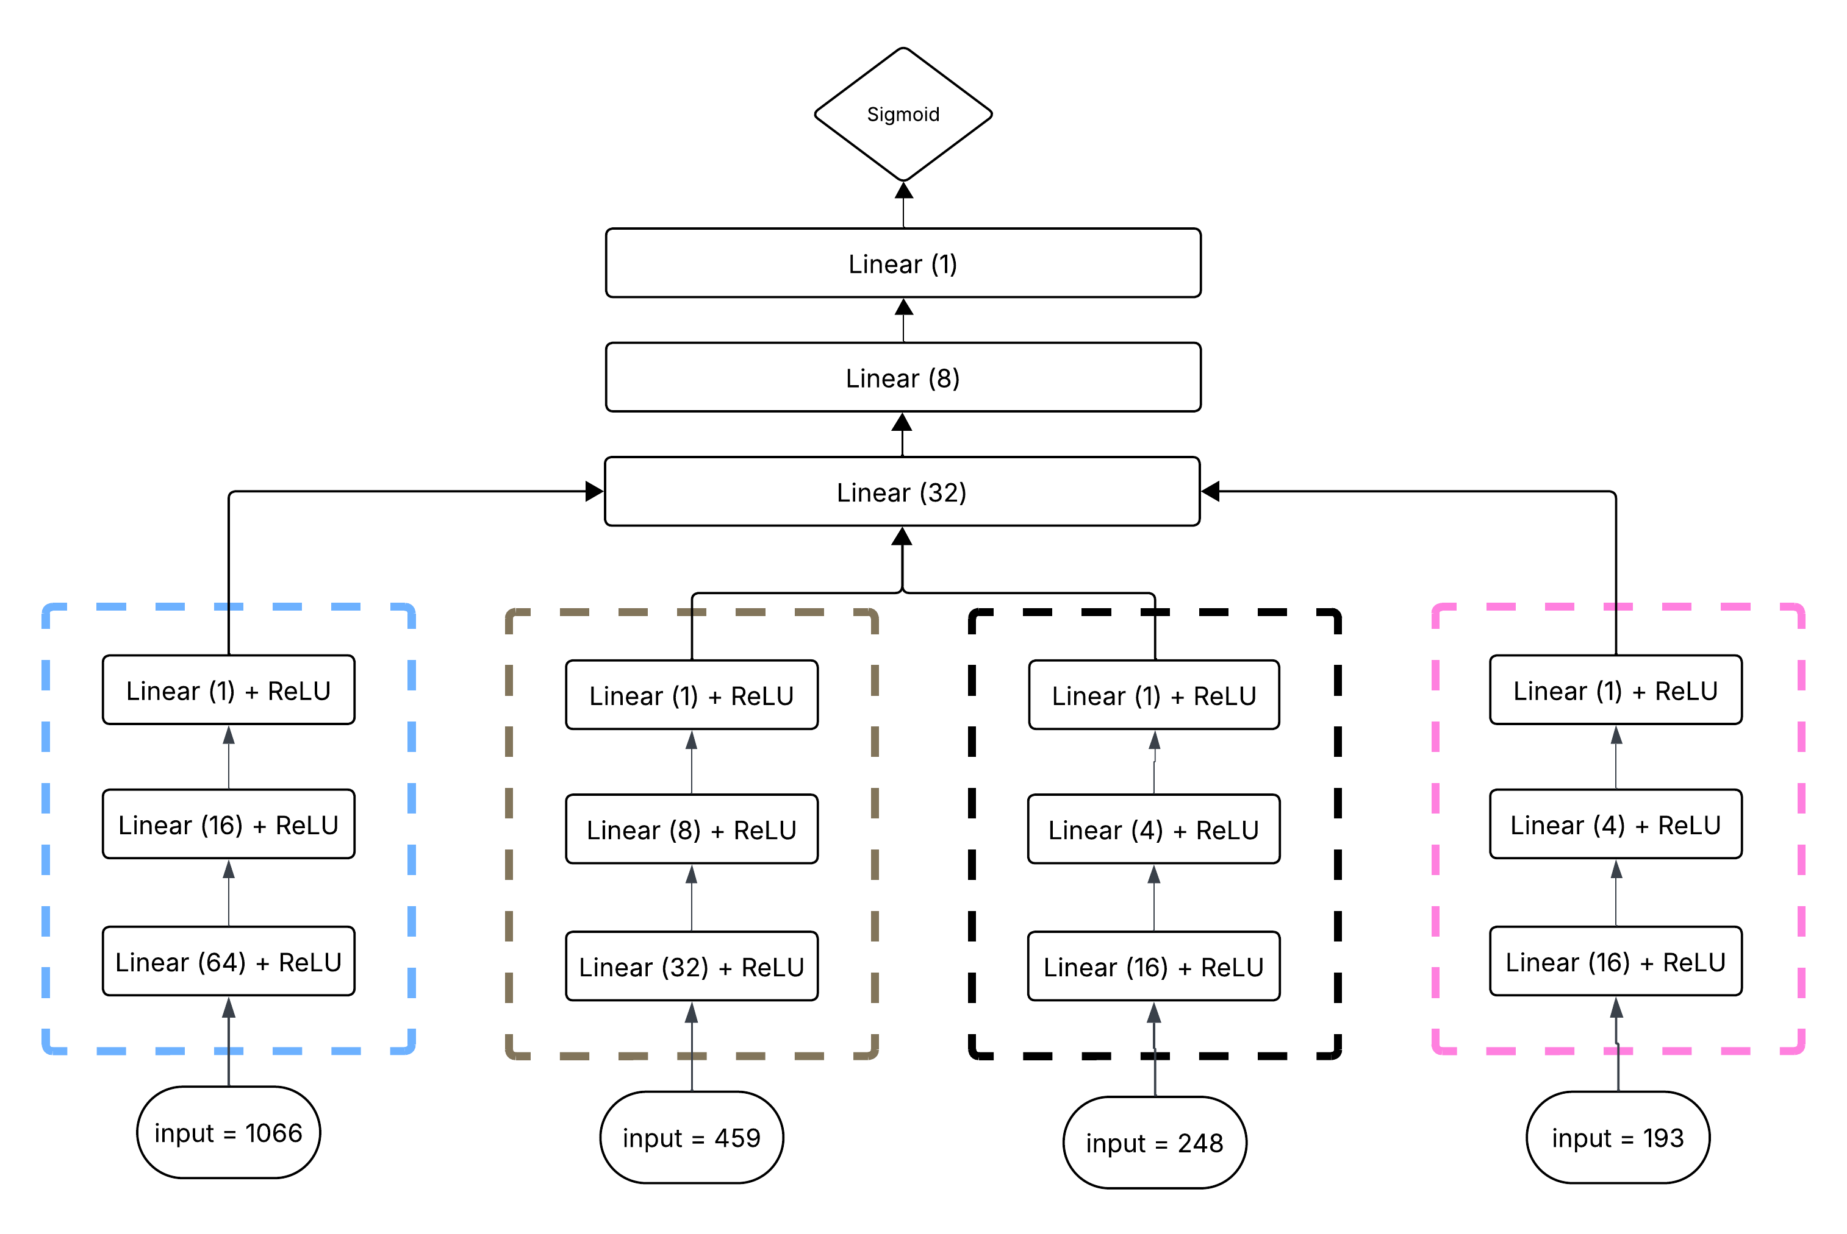
1. Latent Modeling
Our goal of this step is to encode the contribution of Blue, Brown, Black, and Pink modules towards all-cause mortality.
A deep-neural-network with four sub-networks (one for each module) is trained against mortality in the training set (N=2061).
BinaryCrossEntropy loss function and Adam Optimizer was used a learning rate of 0.001
DNN architecture
For each of the four modules, we selected only those genes that overlapped with the Long-Life Family Study (LLFS) dataset

Slide 37
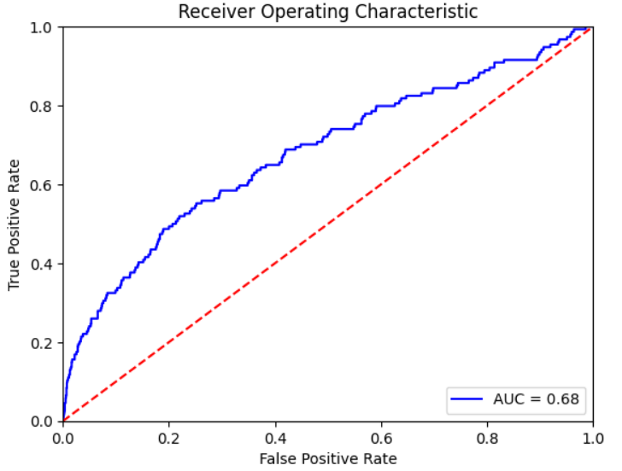
2. Evaluation in the HRS test set
When evaluated in the 40% test dataset from the HRS (n = 1302), we got an AUC score of 0.69.
Upon evaluating the encoded outputs from the three subnetworks, we could infer that Blue and Pink modules (Cell Trafficking) plays a stronger role towards reduced mortality odds.
Evaluating latent representations:
In the test set, after adjustment for age, sex, race, CMV, education, and BMI. The following were the module associations with mortality
Predictors | OR | Lower CI | Upper CI | P val
Blue | 0.66 | 0.53 | 0.82 | 0.0002
Brown | 1.45 | 1.2 | 1.73 | 0.0001
Black | 0.82 | 0.65 | 1.04 | 0.097
Pink | 0.75 | 0.61 | 0.91 | 0.0048
Test Set ROC Curve

Slide 38
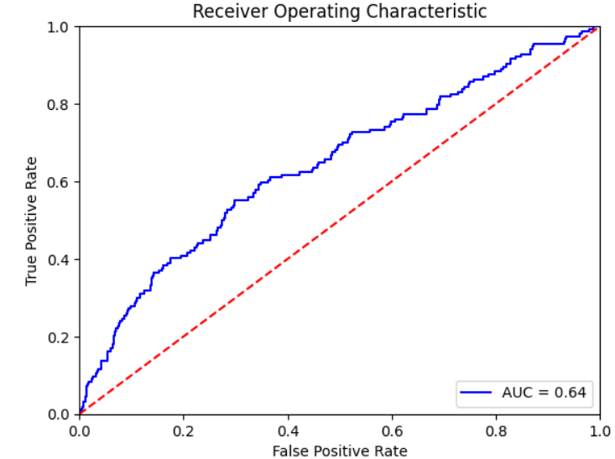
Comparison with module-eigen genes
Upon using the same neural network, but with WGCNA module eigen-genes as inputs (instead of sub-networks), we got a performance of 0.64 AUC in the test set.
This indicates that our latent-model is a better way to capture module representations than module Eigen-genes.
Evaluating Eigen-genes:
In the test set, after adjustment for age, sex, race, CMV, education, and BMI. The following were the module associations with mortality
Predictors | OR | Lower CI | Upper CI | P val
MEblue | 0.94 | 0.72 | 1.21 | 0.63
MEbrown | 1.07 | 0.81 | 1.41 | 0.62
MEblack | 0.72 | 0.54 | 0.95 | 0.02
MEpink | 0.83 | 0.63 | 1.09 | 0.17

Slide 39
Modules as surrogate for TRAB/CD4N
The following were the T-cell repertoire associations with mortality after adjustment for age, sex, race, CMV, education, BMI, and co-expression modules.
 | Feature | + Blue | + Brown | + Black | + Pink | + all modules
CD4N | 0.93 [0.77 – 1.12] p = 0.46
TRAB | 0.77 [0.62 - 0.95] p = 0.016

Slide 40
Modules as surrogate for TRAB/CD4N
The following were the T-cell repertoire associations with mortality after adjustment for age, sex, race, CMV, education, BMI, and co-expression modules.
 | Feature | + Blue (taxis) | + Brown (regulation) | + Black (adhesion & activation) | + Pink (taxis +) | + all modules
CD4N | 0.93 [0.77 – 1.12] p = 0.46 | 0.96 [0.79 – 1.16] p = 0.65 | 0.97 [0.8 – 1.17] p = 0.75 | 0.95 [0.78 – 1.15] p = 0.62 | 0.88 [0.72 – 1.07] p = 0.21
TRAB | 0.77 [0.62 - 0.95] p = 0.016 | 0.78 [0.63 - 0.97] p = 0.026 | 0.80 [0.65 - 0.98] p = 0.014 | 0.77 [0.62 - 0.96] p = 0.02 | 0.78 [0.63 - 0.97] p = 0.025

Slide 41
Modules as surrogate for TRAB/CD4N
The following were the T-cell repertoire associations with mortality after adjustment for age, sex, race, CMV, education, BMI, and co-expression modules.
 | Feature | + Blue (taxis) | + Brown (regulation) | + Black (adhesion & activation) | + Pink (taxis +) | + all modules
CD4N | 0.93 [0.77 – 1.12] p = 0.46 | 0.96 [0.79 – 1.16] p = 0.65 | 0.97 [0.8 – 1.17] p = 0.75 | 0.95 [0.78 – 1.15] p = 0.62 | 0.88 [0.72 – 1.07] p = 0.21 | 0. 99 [0.81 – 1.22] p = 0.99
TRAB | 0.77 [0.62 - 0.95] p = 0.016 | 0.78 [0.63 - 0.97] p = 0.026 | 0.80 [0.65 - 0.98] p = 0.014 | 0.77 [0.62 - 0.96] p = 0.02 | 0.78 [0.63 - 0.97] p = 0.025 | 0.88 [0.71 - 1.09] p = 0.26

Slide 42
Validation in an independent cohort
Main Analysis

Slide 43
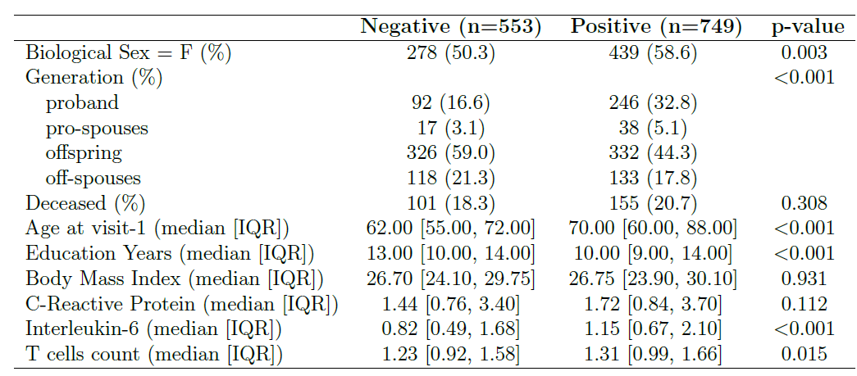
Long-Life Family Study (LLFS)
LLFS is a longitudinal study comprising of participants with ancestral longevity and their spouses.
Upon combining gene expression data from the visit 1 with other clinical datasets, we arrived at a sample of 1302 participants.
CMV Status

Slide 44
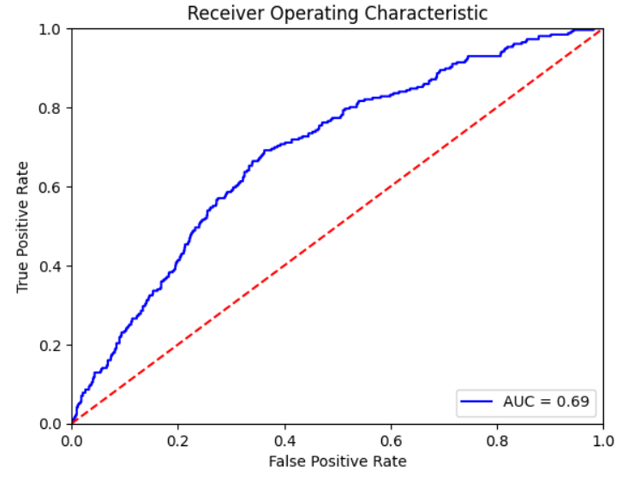
Evaluation in the LLFS dataset
LLFS participants are very different from normal population, so if our results could be replicated in LLFS, it indicates that our findings applies to even special populations.
We evaluated the model trained in HRS in the LLFS dataset.
Evaluating latent representations:
In the LLFS, after adjustment for age, sex, fc, CMV, education, and BMI. The following were the module associations with mortality
Predictors | OR | Lower CI | Upper CI | P val
Blue | 0.79 | 0.63 | 0.99 | 0.043
Brown | 1.3 | 1.06 | 1.59 | 0.01
Black | 0.83 | 0.62 | 1.11 | 0.22
Pink | 0.78 | 0.61 | 0.96 | 0.016
LLFS ROC Curve
Notes:
LLFS is a population of individuals with ancestral longevity and they are different from normal population, if I could replicate the findings in LLFS, it is an indication that our findings applies to even special populations.

Slide 45
Conclusion
Our findings,
CMV results in the clonal expansion of TCR alpha and beta chains and a reduction in CD4 naïve T cells percentage, both of which are independently associated with reduced mortality odds.
The pathways involved are cell trafficking, immune cell activation and adhesion, and response regulation.
Among this, cell trafficking (taxis) pathway drives the association between CMV-induced immune changes and mortality.
These results suggest that targeting the cell trafficking pathway may be a promising strategy to mitigate mortality risk, particularly in the context of chronic viral infections such as CMV.

Slide 46

Acknowledgements
Dr. Bharat Thyagarajan, for providing access to the datasets and for his guidance throughout the project.
Dr. Ryan Martinez, for sharing his immunological expertise.
Faculty members of ARDL, for their ideas and support in refining this work.
Committee members: Dr. Adam Rothman, Dr. Bharat Thyagarajan, Dr. Weihua Guan, Dr. Aaron Molstad, and Dr. Erich Kummerfeld, for their support and valuable feedback.
Minnesota Supercomputing Institute (MSI), for providing their computing resources.
The participants and data collectors of the HRS and LLFS studies, for their invaluable contributions.
My family, for their endless support during turbulent times.
This work is supported and funded by National Institutes of Health grants: R01-AG060110, U01-AG009740, U01‐AG023746, U01‐AG023712, U01‐AG023749, U01‐AG023755, U01‐AG023744, and U19-AG063893

Slide 47

Thank you!!!

Slide 48


