Slide 1
The Impact of CMV on T Cell Repertoire: Insights from Transcriptomic Data Analysis
Gokul Seshadri
03/25/2025
Advisors: Bharat Thyagarajan and Adam Rothman

Slide 2
Our Goals
Extract T-cell receptor (TCR) clones using MiXCR
Evaluate demographic differences in the clonal properties and their associations with mortality
Investigate whether CMV impacts T-cell repertoire, and find the pathways involved.
Identify the most influential pathway for mortality-risk.

Slide 3
Synopsis
Preliminary:
Background
Extracting immune cell clones (MiXCR)
Dataset and EDA
Main:
What is T-cell repertoire?
CMV and T-cell repertoire
Genes in the Pathway
Latent Modeling
Conclusion

Slide 4
Preliminary Analysis

Slide 5
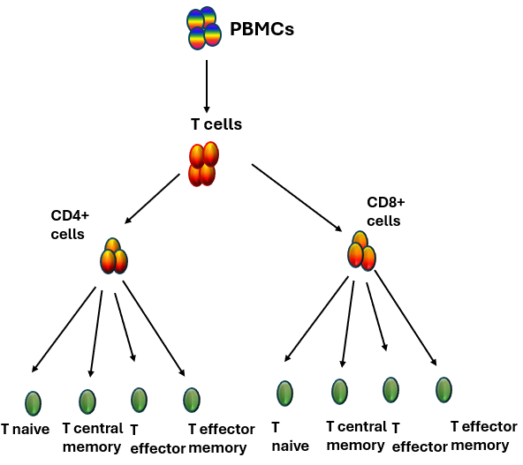
1. Background
The Health and Retirement Study (HRS) has performed extensive immunophenotyping of T cell subsets.
These subsets have been associated with age related diseases, biological aging and mortality
While the immunophenotyping data provides information on cell distribution it does not provide information on functionality or quality of the adaptive immune system.

Slide 6
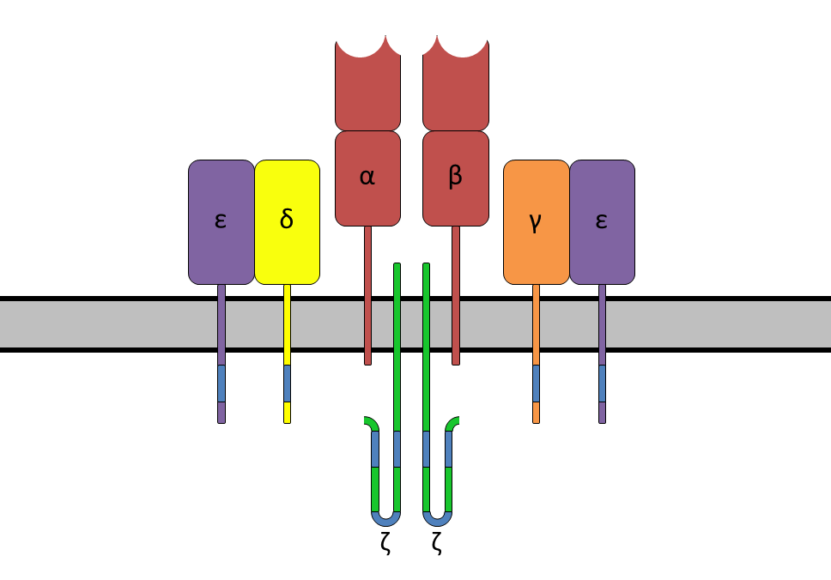
T cell receptors
T cell receptors (TCRs) are protein complexes on the surface of T cells that identify and bind to foreign substances, helping the body fight infection.
A T cell clone represents a collection of T cells with the same TCR sequence.
T cell receptors (TCRs) consists of
a combination of α and β chains (95%)
a combination of γ and δ chains (5%)

Slide 7
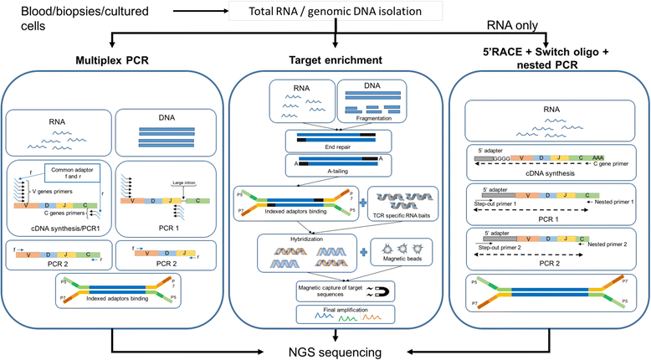
TCRs in HRS
The sum of all TCRs in an individual is generally termed as TCR repertoire.
With RNA as starting material, HRS used a whole transcriptome approach (no target enrichment)
Performed bulk RNA-Seq with 500 ng of RNA and a minimum of 20M reads.
Rosati, E., Dowds, C.M., Liaskou, E. et al. Overview of methodologies for T-cell receptor repertoire analysis. BMC Biotechnol 17, 61 (2017).

Slide 8
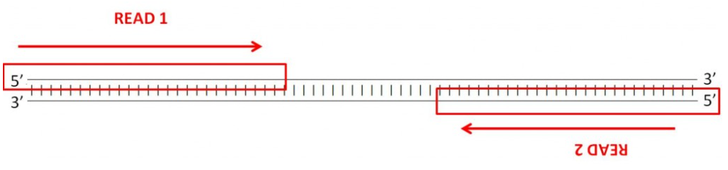
2. Extracting TCR sequences
MiXCR provides a seamless analytical pipeline for immune profiling with Next-Generation sequencing (NGS) data.
We chose MiXCR due to ability to handle a variety of data inputs and faster processing speed.
We have used rna-seq preset to extract the clonotypes from paired-end fastq files: mixcr analyze rna-seq --species hsa {R1_file} {R2_file} {output_file}
For a paired-end run, one R1 and one Read 2 (R2) FASTQ file is created for each sample for each flow cell lane.

Slide 9
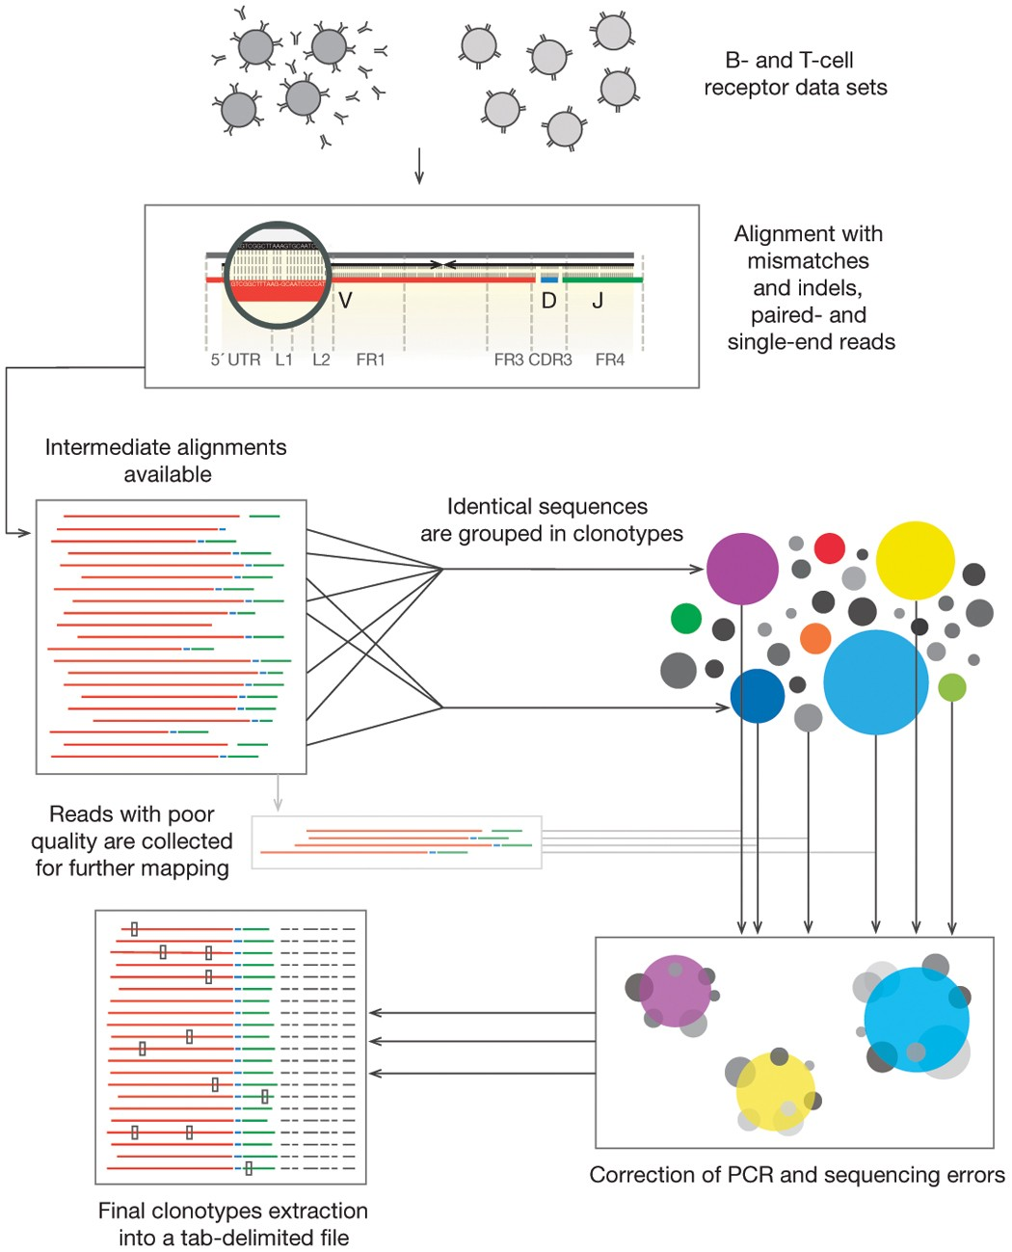
Overview of MiXCR pipeline
The below are the steps involved in the mixcr rna-seq preset,
align: map against V-, D-, J- and C- gene segments
assemblePartial: assembles alignments that only partially cover CDR3 region.
extend: Imputes missing nucleotides
assemble: assembles into clonotypes and applies errors correction.
export: Exports into tsv files
Flow Diagram
Bolotin, D., Poslavsky, S., Mitrophanov, I. et al. MiXCR: software for comprehensive adaptive immunity profiling. Nat Methods 12, 380–381 (2015).

Slide 10
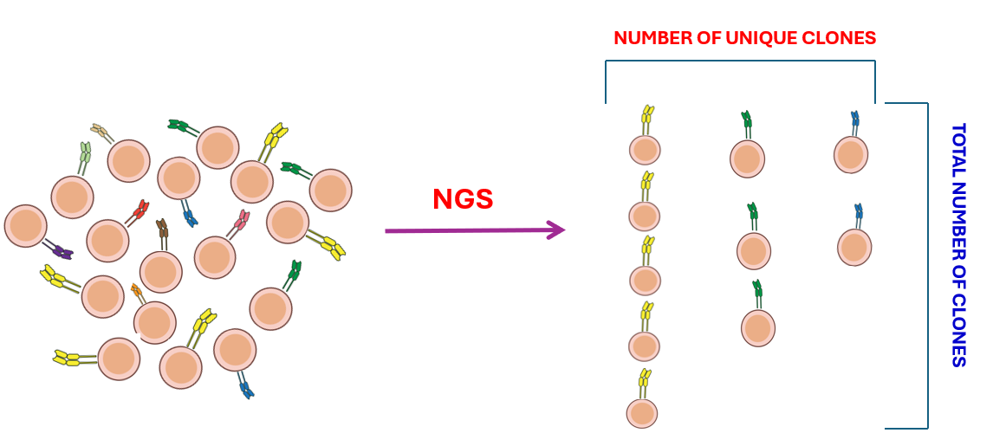
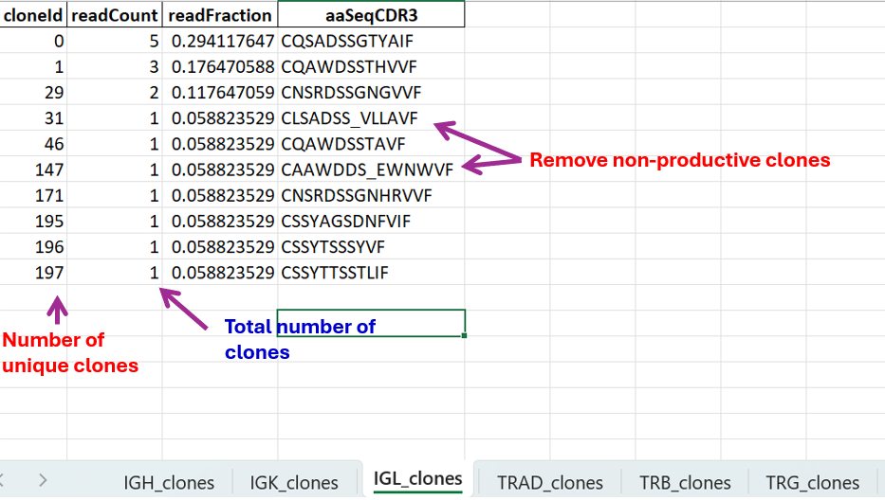
MiXCR Output
Metrics for evaluating clones
Paired end FASTQ files for 4388 samples in the HRS
On average, each sample has approximately 30-40M reads
We ran MiXCR pipeline for all these FASTQ files using slurm in the MSI
Then we extracted clonal metrics (# of unique clones and total # of clones) for each sample

Slide 11
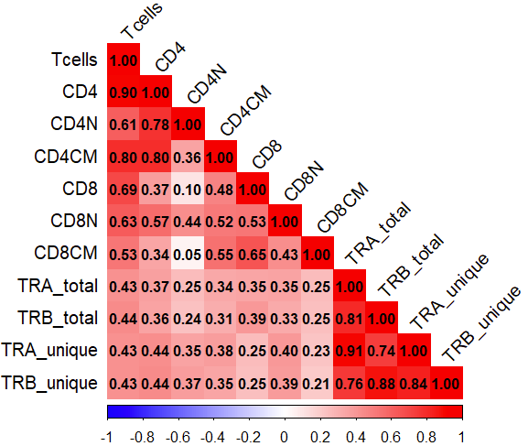
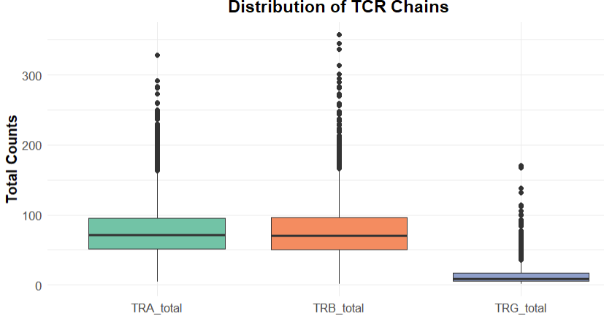
3. Dataset and EDA
Among the 9,934 HRS participants who were included in the 2016 Venous Blood Study (VBS) - whole transcriptome RNA sequences was available in 3748 HRS participants.
From MiXCR output, we have the clonal properties (total clones and unique clones) for TRA (alpha), TRB (beta), and TRG (gamma) chains.

Slide 12
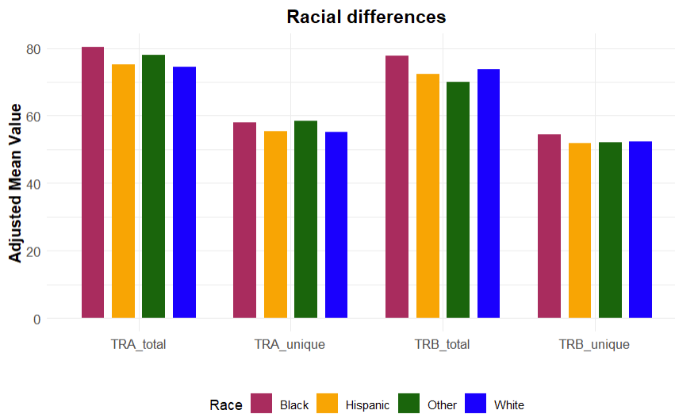
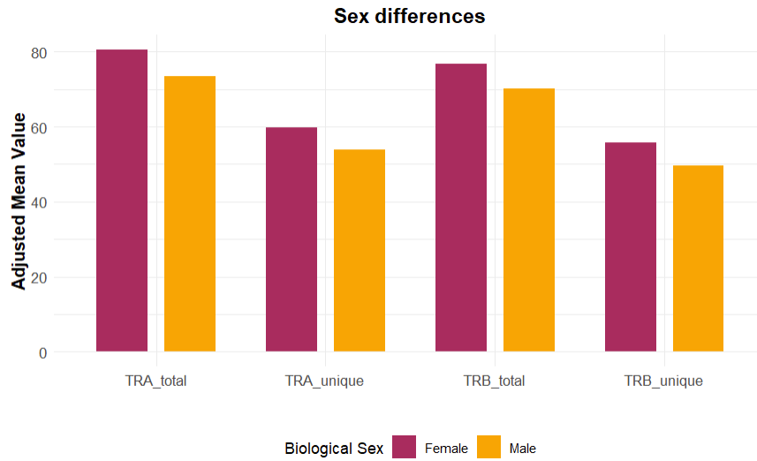
Clones and Participant Characteristics
*
*
*
*
*
*

Slide 13
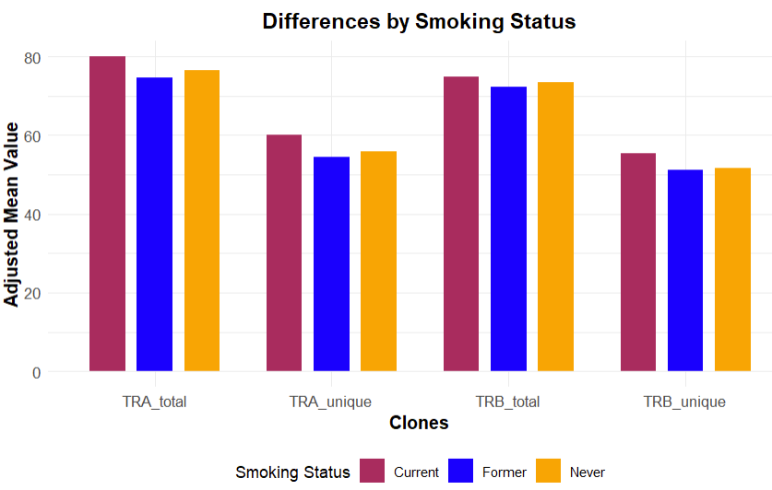
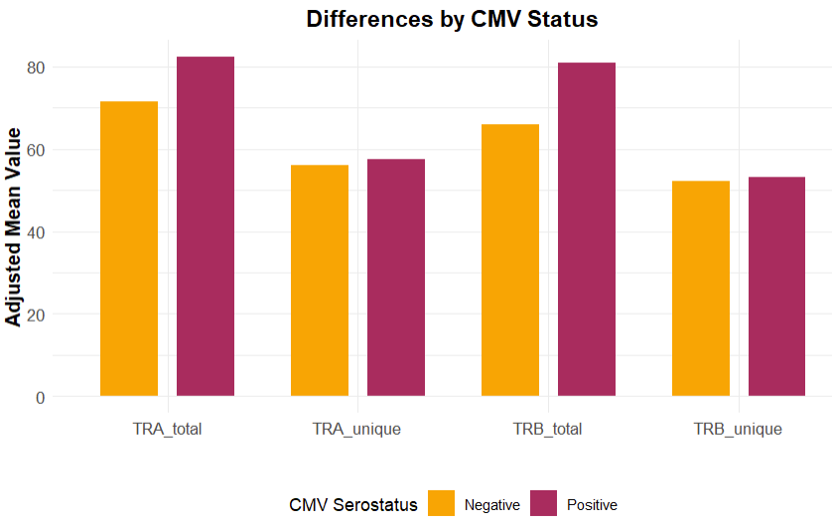
Clones and Participant Characteristics
*
*
*
*
*

Slide 14
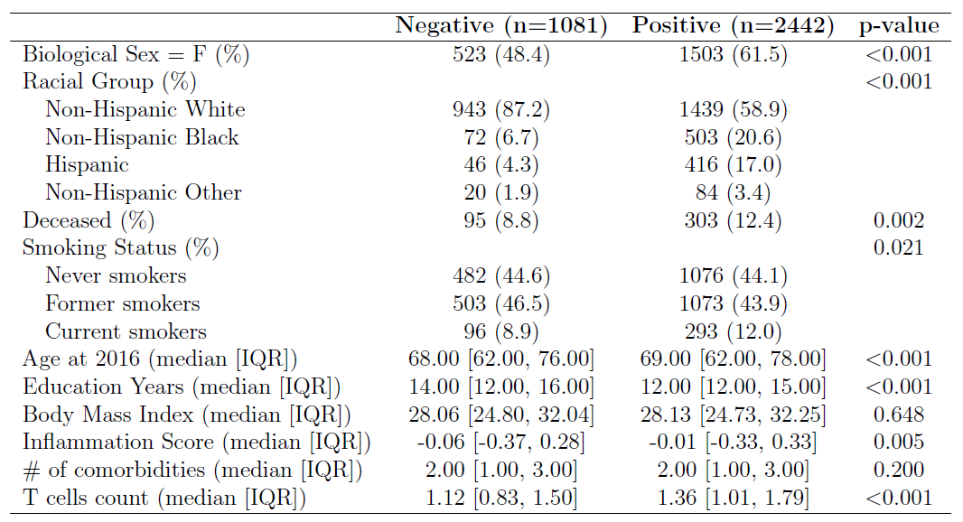
HRS participant characteristics grouped by CMV status

Slide 15
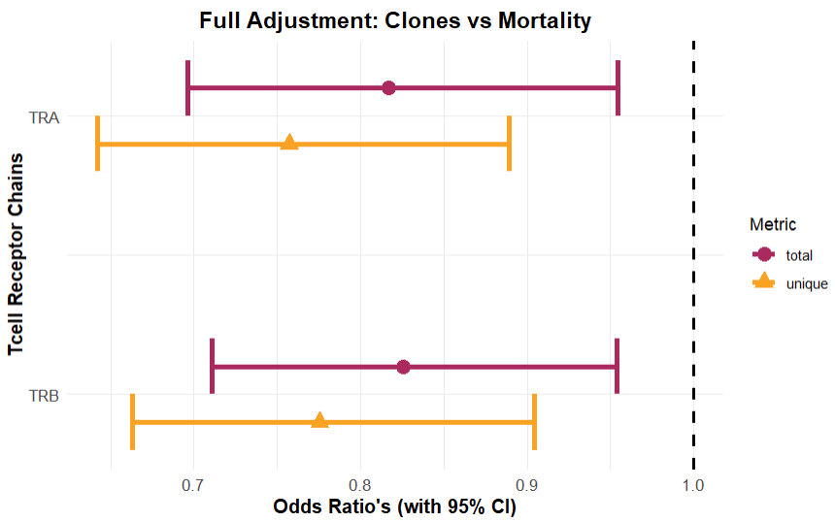
Clones and Mortality
Full model:
Mortality (2020) ~ clones (2016) + age + sex + race + education + smoking status + CMV status + total(read count) + BMI + inflammation+ comorbidity index
Cohort Size: 3523 participants with valid demographic and mortality information, CMV status, and TCR chain metrics

Slide 16
Preliminary Analysis Summary
We are interested in TRA (alpha) and TRB (beta) chains as they are more abundant and have significant negative associations with mortality.
TRA and TRB are highly correlated with each other (r^2 = 0.81) and are positively correlated with T-cell subsets.
Total and unique count of TRA and TRB clones are higher in the following groups (results not shown)
Females
Non-Hispanic Blacks
CMV positive individuals
Current smokers

Slide 17
Main Analysis

Slide 18
1. What is T cell repertoire?
Typically, a collection of all T-cell receptors (TCRs) in a person
The TCRs are made up of a pair of α (TRA) and β (TRB) chains
A normal range of total TCRs suggests a healthy immune system with sufficient diversity to recognize a variety of antigens.
In our preliminary analysis, we have shown that total number and diversity of alpha chains (TRA) and Beta chains (TRB) are associated with decreased odds of mortality.
Another T cell phenotype that is widely shown to be associated with decreased mortality odds is percentage of CD4+ naïve T cells (CD4N), and it reflects the adaptability of T cells in responding to antigens.
Alpha and Beta chains, CD4N make up T cell repertoire in this study.

Slide 19
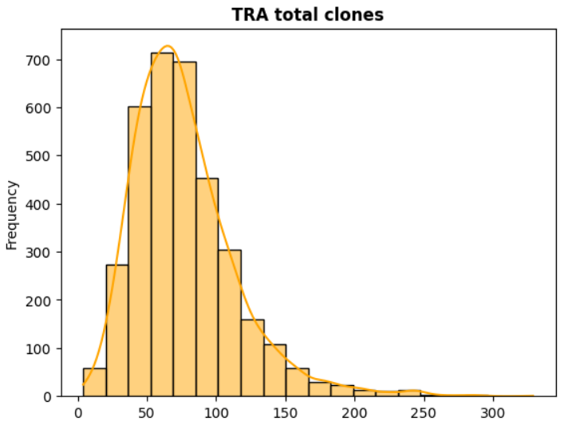
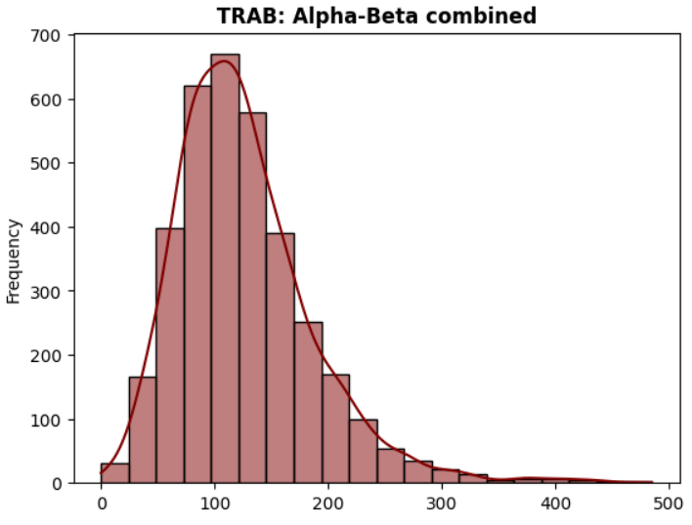
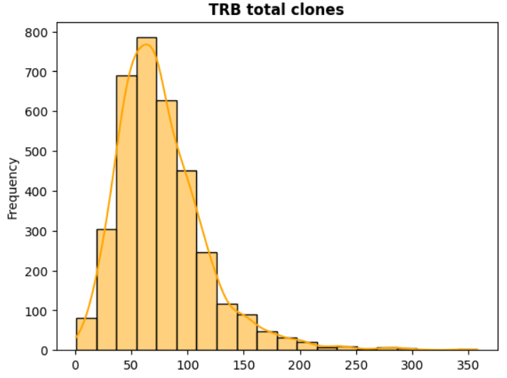
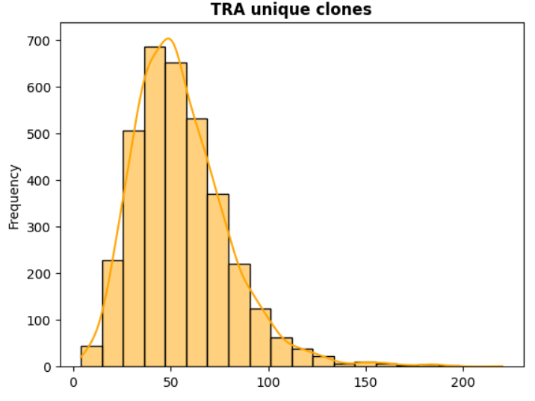
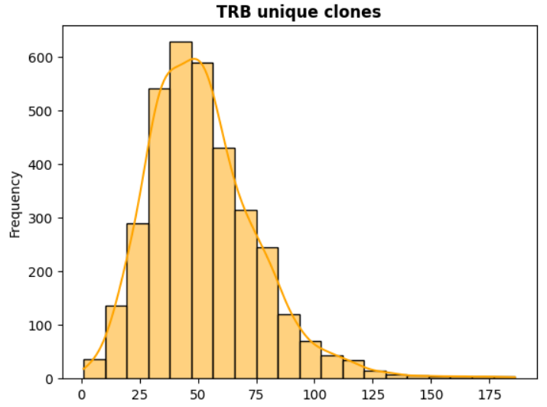
Combining metrics of TRA and TRB
Since the total number and diversity of TRA and TRB are highly correlated, combining them into a single feature called TRAB using Principal Component Analysis (PCA) [Explained Variance = 0.86]

Slide 20
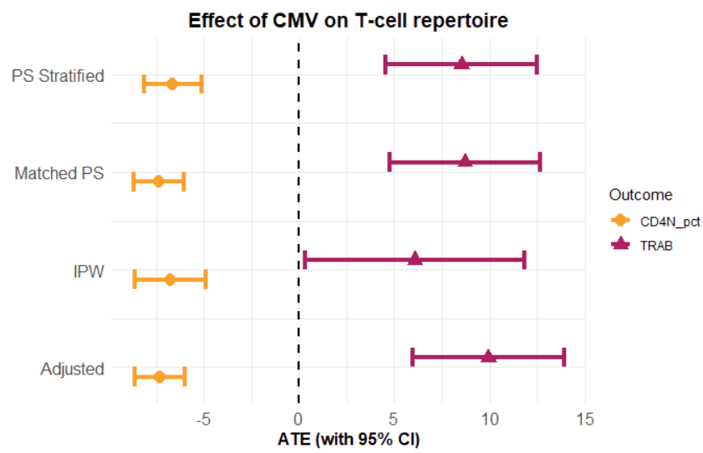
2. CMV and T cell repertoire
Propensity Score was created using: CMV_status ~ age + sex + race + educ + smoking status + comorb index + INFLAM_5 After stratifying PS into quintiles and considering 100 bootstrap samples with replacement,
CMV positive individuals had
higher TRAB (ATE: 8.5 [4.5 to 12.5])
lower CD4N (ATE: -6.6 [-8.1 to -5.2])
than CMV negative individuals
Paradox: CMV drives expansion of T cell clones (TRAB) but has detrimental effect on CD4N despite all of these being protective of all-cause mortality

Slide 21
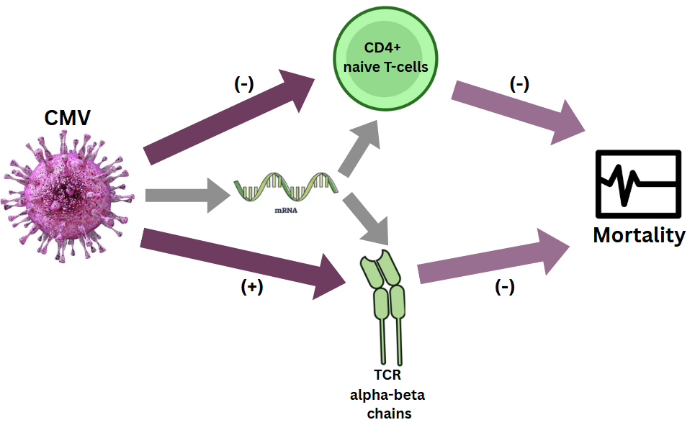
3. Genes in the pathways
To investigate the paradox, we examined gene expression pathways that mediate the relationship between CMV infection and T cell repertoire.
Also evaluated which of these pathways contribute to reduced mortality risk.

Slide 22
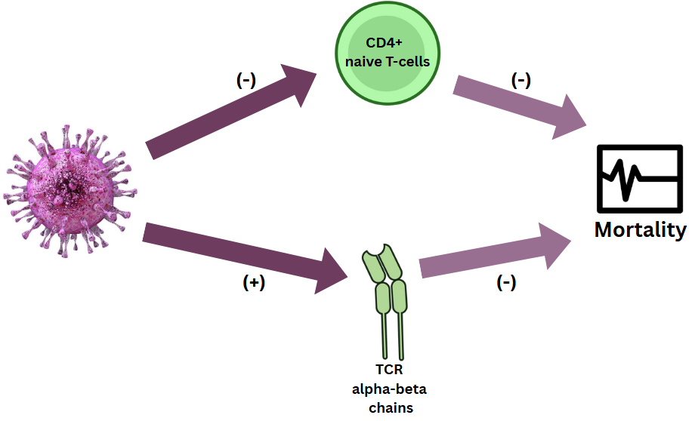
Elaborate Analysis Flow:
DESeq2 +
WGCNA
(modules)
. . .
(+/-)

Slide 23
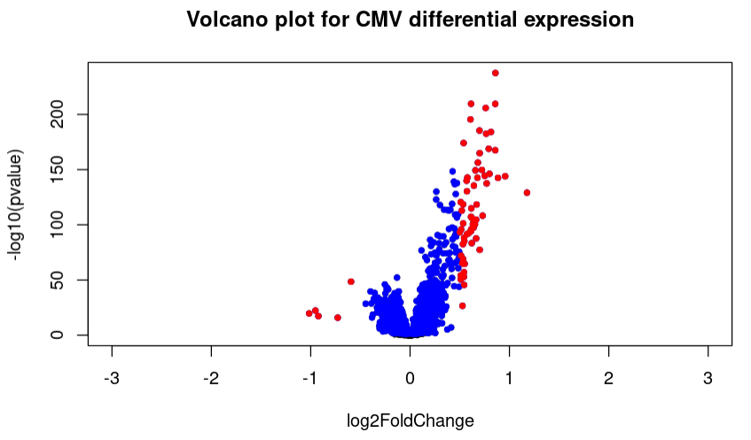
Genes Expressed in CMV Seropositive
We have the HRS sample of 3523 participants with valid values in CMV serostatus and TCR chains.
Out of 58,219 gene transcripts, only 12,800 had mean(expression) > 3cpm
From which only 6,202 genes are differentially expressed between CMV positive and negative groups upon adjustment for age, sex, race , educ, smoking status, lymphocytes, BMI, comorbidity index, and inflammation.

Slide 24
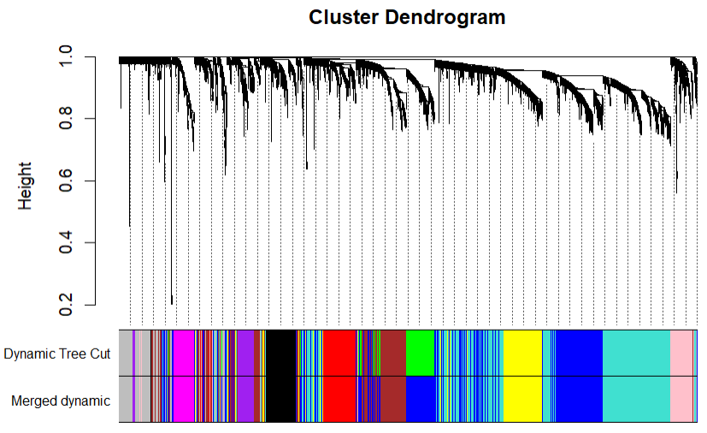
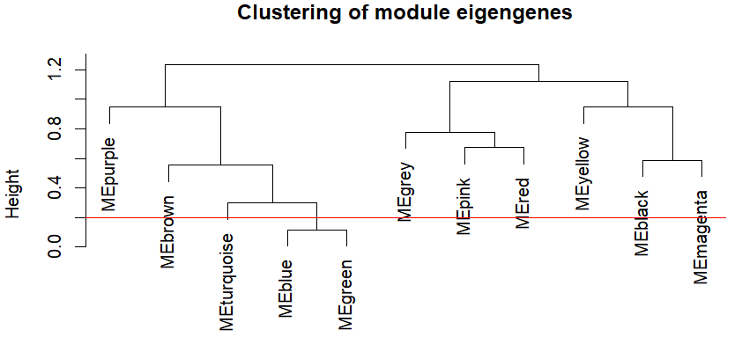
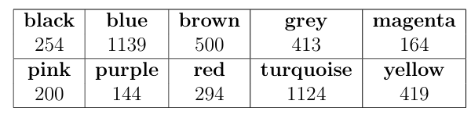
Co-expression Modules
Used hclust to exclude outlier participants (N=3,435)
From the significantly expressed gene set of 6,202 genes, we retained only those with higher variance (4,651) and then performed WGCNA.
Resulted in 10 co-expression modules after merging those with very less dissimilarity.
Module Sizes:

Slide 25
Modules associated with TRAB and CD4N
We then evaluated the genes in these 10 modules while accounting for the modularity against TRAB and CD4N.
Sparse Group Lasso models with only group regularization were used.
The optimal regularization parameter (λ) was selected based on the highest R^2 achieved via five-fold cross-validation.
Number of modules associated with TRAB: 6
Number of modules associated with CD4N: 7
Common modules:
Blue (1139) | Brown (500) | Black (254) | Pink (200)

Slide 26
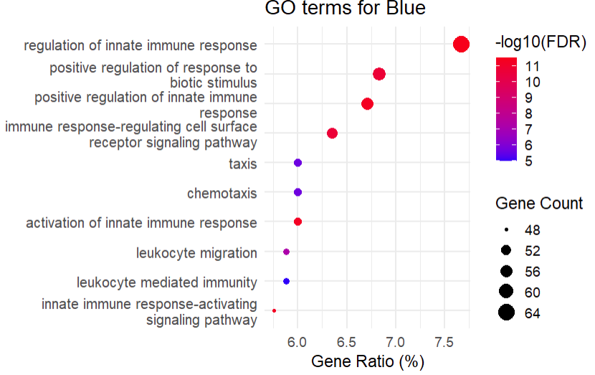
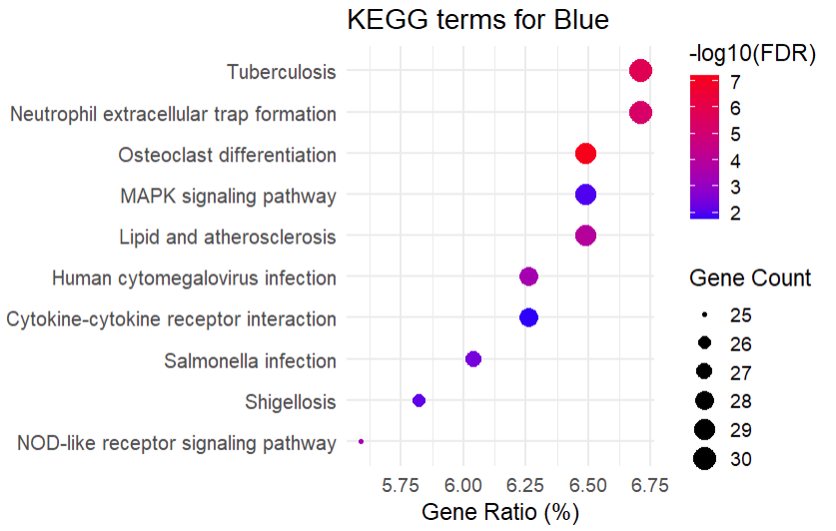
Modular Pathways
Blue: Cell trafficking through CMV infection and cytokine interactions

Slide 27
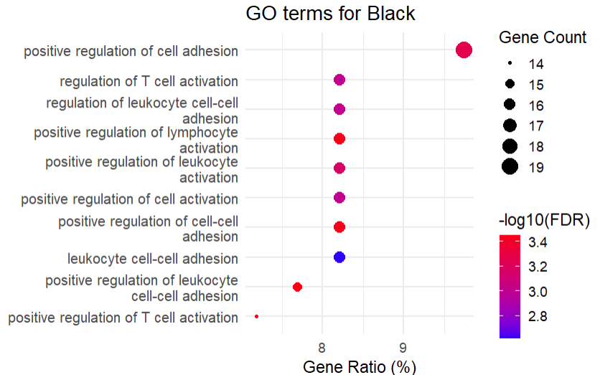
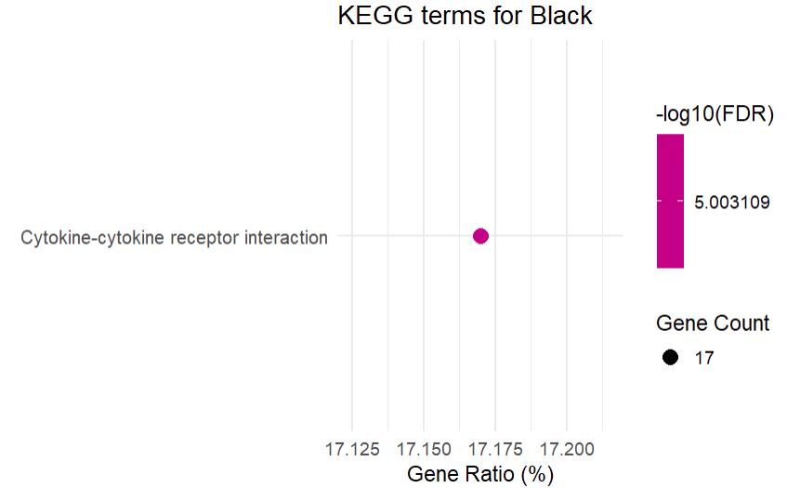
Modular Pathways
Black: immune cell adhesion and activation through cytokine interactions.

Slide 28
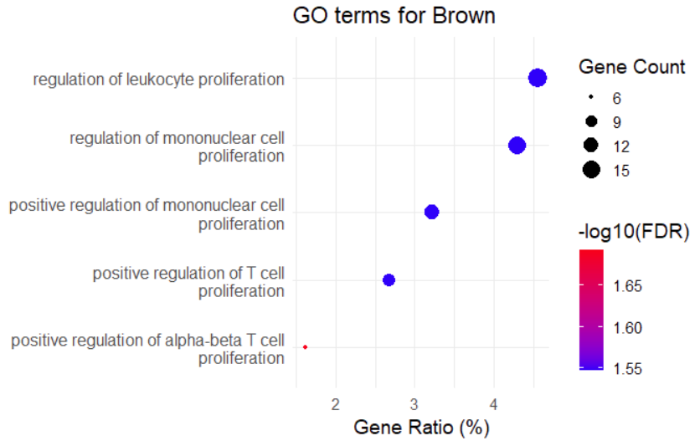
Modular Pathways
Brown: positive regulation T-cell proliferation. No KEGG pathways

Slide 29
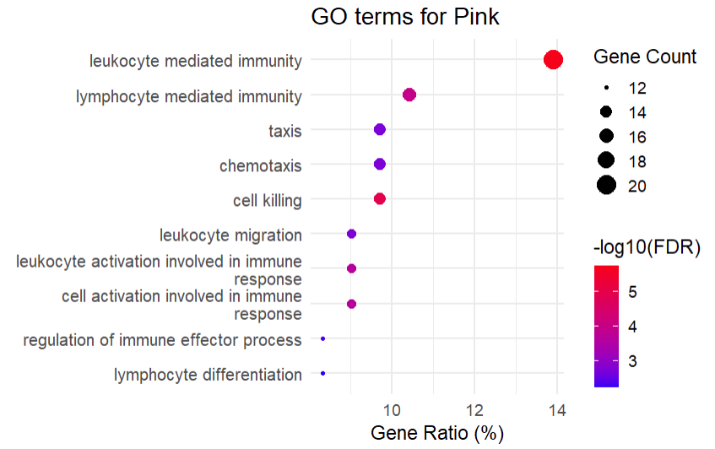
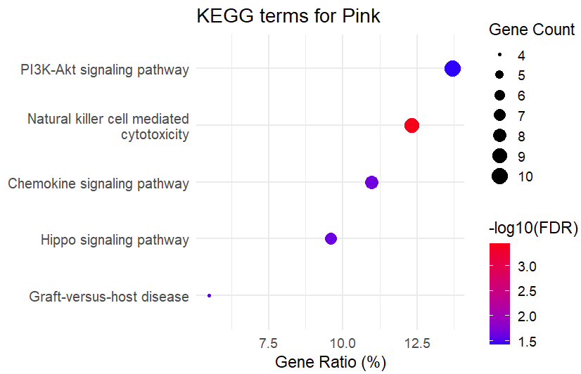
Modular Pathways
Pink: cell trafficking and other processes, through signaling pathways

Slide 30
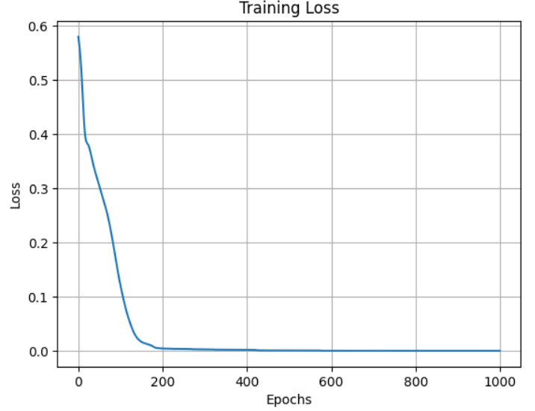
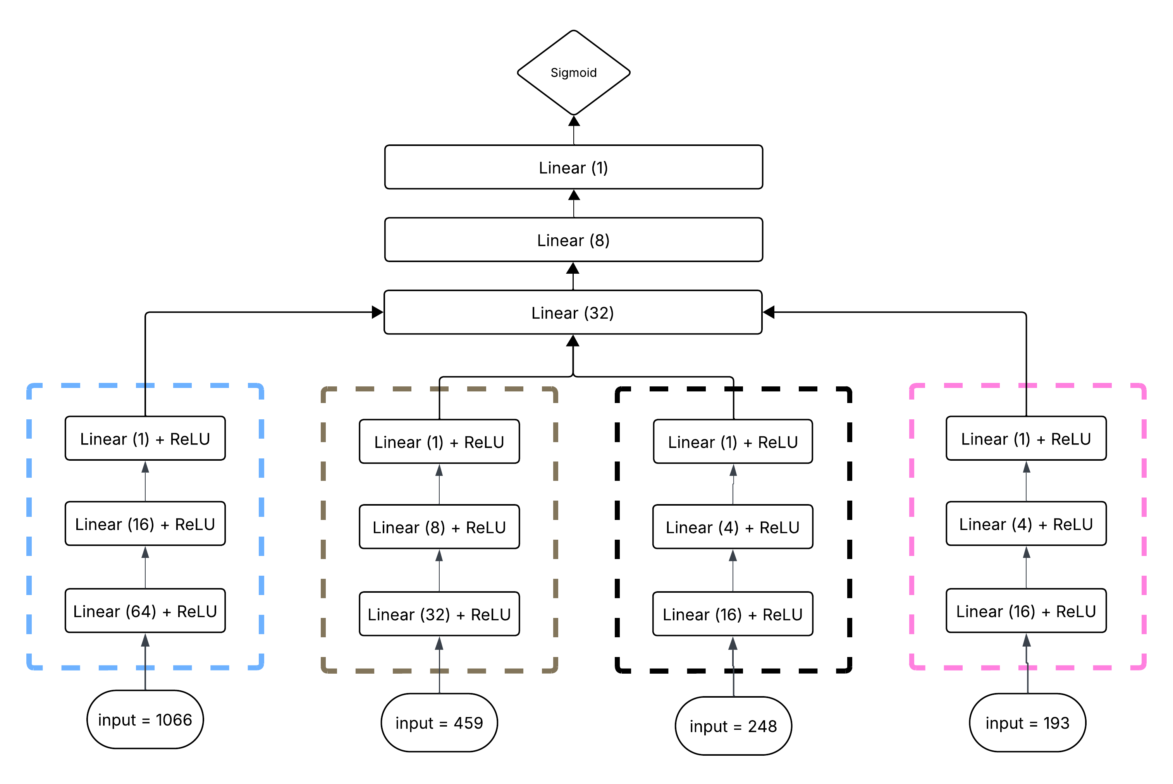
4. Latent Modeling
Our goal of this step is to encode the contribution of Blue, Brown, Black, and Pink modules towards all-cause mortality.
A deep-neural-network with four sub-networks (one for each module) is trained against mortality in the training set (N=2061).
BinaryCrossEntropy loss function and Adam Optimizer was used a learning rate of 0.001
DNN architecture
For each of the four modules, we selected only those genes that overlapped with the Long-Life Family Study (LLFS) dataset

Slide 31
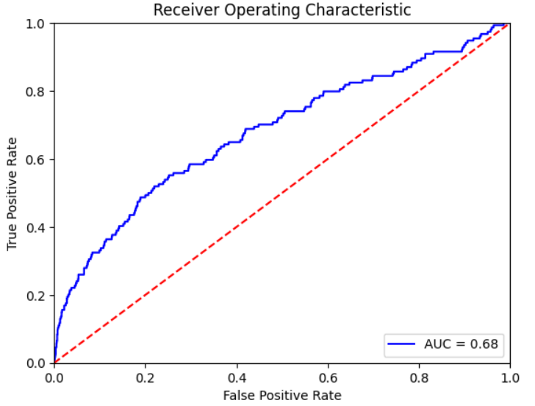
Evaluation in test set
When evaluated in the 40% test dataset from the HRS (n = 1302), we got an AUC score of 0.69.
Upon evaluating the encoded outputs from the three subnetworks, we could infer that Blue and Pink modules (Cell Trafficking) plays a stronger role towards reduced mortality odds.
Evaluating latent representations:
In the test set, after adjustment for age, sex, race, CMV, education, and BMI. The following were the module associations with mortality
Predictors | OR | Lower CI | Upper CI | P val
Blue | 0.66 | 0.53 | 0.82 | 0.0002
Brown | 1.45 | 1.2 | 1.73 | 0.0001
Black | 0.82 | 0.65 | 1.04 | 0.097
Pink | 0.75 | 0.61 | 0.91 | 0.0048
Test Set ROC Curve

Slide 32
Modules as surrogate for TRAB/CD4N
The following were the T-cell repertoire associations with mortality after adjustment for age, sex, race, CMV, education, BMI, and co-expression modules.
 | Feature | + Blue | + Brown | + Black | + Pink | + all modules
CD4N | 0.93 [0.77 – 1.12] p = 0.46
TRAB | 0.77 [0.62 - 0.95] p = 0.016

Slide 33
Modules as surrogate for TRAB/CD4N
The following were the T-cell repertoire associations with mortality after adjustment for age, sex, race, CMV, education, BMI, and co-expression modules.
 | Feature | + Blue | + Brown | + Black | + Pink | + all modules
CD4N | 0.93 [0.77 – 1.12] p = 0.46 | 0.96 [0.79 – 1.16] p = 0.65 | 0.97 [0.8 – 1.17] p = 0.75 | 0.95 [0.78 – 1.15] p = 0.62 | 0.88 [0.72 – 1.07] p = 0.21
TRAB | 0.77 [0.62 - 0.95] p = 0.016 | 0.78 [0.63 - 0.97] p = 0.026 | 0.80 [0.65 - 0.98] p = 0.014 | 0.77 [0.62 - 0.96] p = 0.02 | 0.78 [0.63 - 0.97] p = 0.025

Slide 34
Modules as surrogate for TRAB/CD4N
The following were the T-cell repertoire associations with mortality after adjustment for age, sex, race, CMV, education, BMI, and co-expression modules.
 | Feature | + Blue | + Brown | + Black | + Pink | + all modules
CD4N | 0.93 [0.77 – 1.12] p = 0.46 | 0.96 [0.79 – 1.16] p = 0.65 | 0.97 [0.8 – 1.17] p = 0.75 | 0.95 [0.78 – 1.15] p = 0.62 | 0.88 [0.72 – 1.07] p = 0.21 | 0. 99 [0.81 – 1.22] p = 0.99
TRAB | 0.77 [0.62 - 0.95] p = 0.016 | 0.78 [0.63 - 0.97] p = 0.026 | 0.80 [0.65 - 0.98] p = 0.014 | 0.77 [0.62 - 0.96] p = 0.02 | 0.78 [0.63 - 0.97] p = 0.025 | 0.88 [0.71 - 1.09] p = 0.26

Slide 35
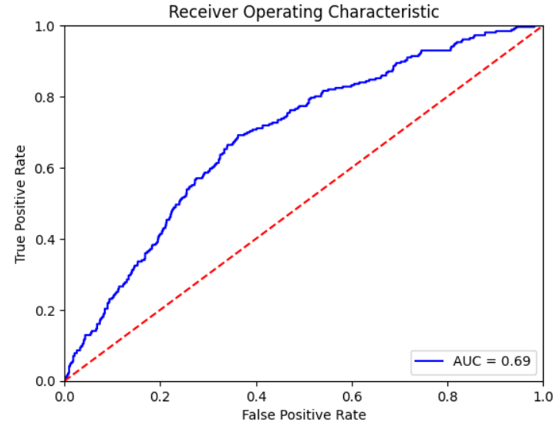
Evaluation in the LLFS dataset
The Long-Life Family Study (LLFS) is a longitudinal study comprising of participants with ancestral longevity and their spouses.
Upon combining gene expression data from the visit 1 with other clinical datasets, we arrived at a sample of 1302 participants.
We evaluated the model trained in HRS in the LLFS dataset.
Evaluating latent representations:
In the LLFS, after adjustment for age, sex, fc, CMV, education, and BMI. The following were the module associations with mortality
Predictors | OR | Lower CI | Upper CI | P val
Blue | 0.79 | 0.63 | 0.99 | 0.043
Brown | 1.3 | 1.06 | 1.59 | 0.01
Black | 0.83 | 0.62 | 1.11 | 0.22
Pink | 0.78 | 0.61 | 0.96 | 0.016
LLFS ROC Curve

Slide 36
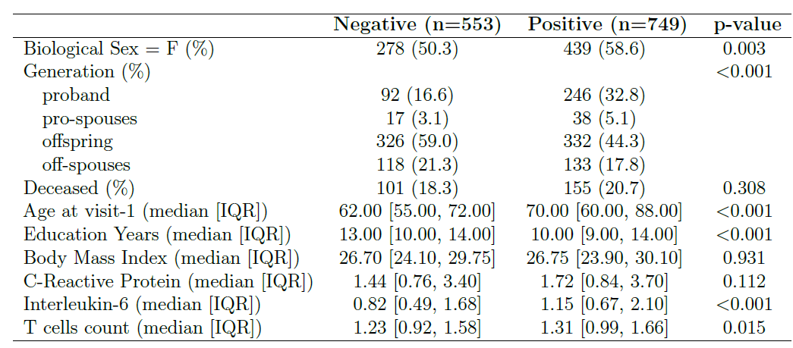
LLFS participant characteristics grouped by CMV status

Slide 37
5. Conclusion
Our findings,
CMV results in the clonal expansion of TCR alpha and beta chains and a reduction in CD4 naïve T cells percentage, both of which are independently associated with reduced mortality odds.
CMV impacts the T-cell repertoire (TCR clones and CD4 naïve) through pathways involving cell trafficking, immune cell activation and adhesion, and response regulation.
Among this, cell trafficking (taxis) pathway drives the association between CMV-induced immune changes and mortality.
These results suggest that targeting the cell trafficking pathway may be a promising strategy to mitigate mortality risk, particularly in the context of chronic viral infections such as CMV.

Slide 38

Thank you!!!

Slide 39


