Slide 1
Gokul M
Final Project

Slide 2
GANs Text to Image
- Generative Adversarial Networks

Slide 3


Agenda
Problem Statement
Project Overview
End users
My Solution and it's Value Propositions
The Wow in My Solution
Modeling
Result
3/21/2024 Annual Review

Slide 4

Problem Statement
Develop a GAN model to generate realistic images from textual descriptions. Given a dataset of paired descriptions and images, train the model to translate text inputs into corresponding visual representations. Evaluate the model's performance in producing high-quality images that accurately reﬂect the provided textual input.

Slide 5
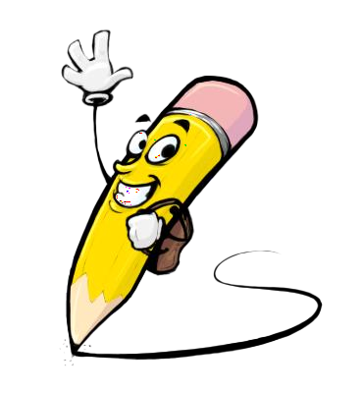
Problem Overview
This project aims to develop a text-to-image generation system using Generative Adversarial Networks (GANs). Leveraging a dataset of paired textual descriptions and images, the GAN model will be trained to generate realistic images based on input text. The system will undergo evaluation to ensure the fidelity and quality of generated images. The ultimate goal is to create a robust and efficient tool capable of translating textual descriptions into visually accurate representations.

Slide 6

End Users
Content Creators:
Authors, journalists, and storytellers can utilize the text-to-image generation system to visualize their narratives, articles, or stories, enhancing their engagement and impact.
Designers and Artists:
Graphic designers, illustrators, and artists can benefit from the system to quickly generate visual concepts and prototypes based on textual descriptions, aiding in their creative process.
Educators:
Teachers and educators can employ the system to create visual aids and illustrations for educational materials, improving the effectiveness of teaching and learning through multimedia content.

Slide 7

My Solution and its Value Propositions
Solution: is a state-of-the-art text-to-image generation system powered by advanced Generative Adversarial Networks (GANs). Leveraging cutting-edge neural network and deep learning techniques, our system translates textual descriptions into highly realistic and visually accurate images.
Value: Efficiency of our system streamlines the process of generating images from textual descriptions, saving users valuable time and resources compared to traditional manual image creation methods.

Slide 8
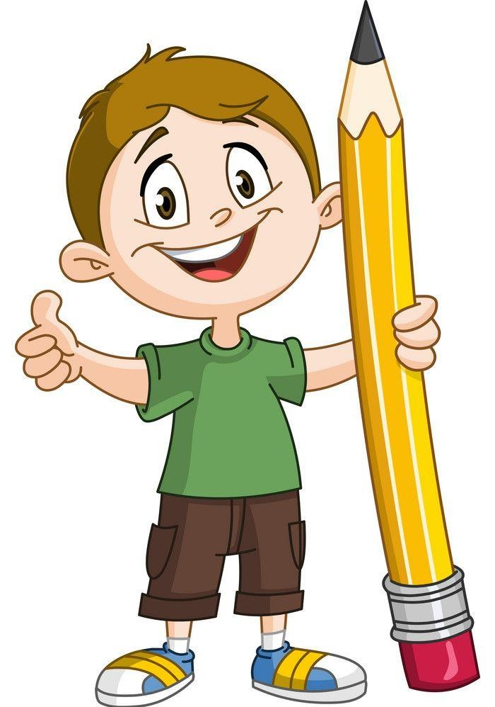
The Wow in My Solution
Harnessing cutting-edge AI, our solution transforms text into stunning, lifelike images, transcending traditional boundaries of image generation. With seamless integration and intuitive user experience, it empowers users to effortlessly create captivating visuals from mere words. Its ability to capture intricate details and nuances astonishes users, revolutionizing their creative workﬂows and unleashing endless possibilities.
3/21/2024 Annual Review

Slide 9
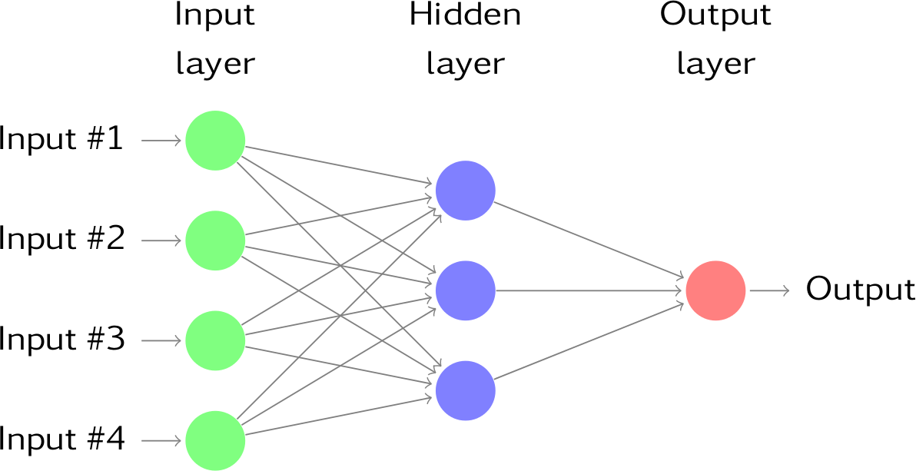
MODELING
Deep Neural Network Model

Slide 10
Application
Entertainment Industry:
Support filmmakers, game developers, and virtual reality creators in generating visual assets and scenes based on script descriptions, enhancing storytelling experiences.
Interior Design:
Facilitate interior designers and architects in visualizing design concepts by generating images based on textual descriptions of desired aesthetics, layouts, and furniture arrangements.

Slide 11

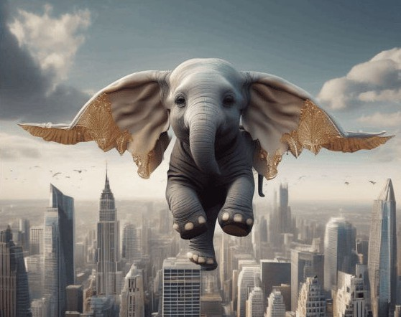
Result
prompt = "Real little elephant with wings, ﬂying over the city with fantastic design"

Slide 12
Thank You!

