Slide 1
Vehicle Loan Default Prediction
Team Details
GROUP MEMBERS:
Gokul Mahendran
Krishna Raj P
Nantha Kumar S
Rishi Kumar Raman
Vivekananth
MENTOR:
Mr. Romil Gupta

Slide 2
Introduction
Vehicle loans are the new front in asset quality problems for banks. To be more precise, Financial institutions incur significant losses due to the default of vehicle loans.
This warrants a study to estimate the determinants of vehicle loan default. The problem here is to accurately predict the probability of loanee/borrower defaulting on a vehicle loan in the first EMI (Equated Monthly Instalments) on the due date.
The dataset represents Vehicle Loan Default of L&T financial institution.

Slide 3
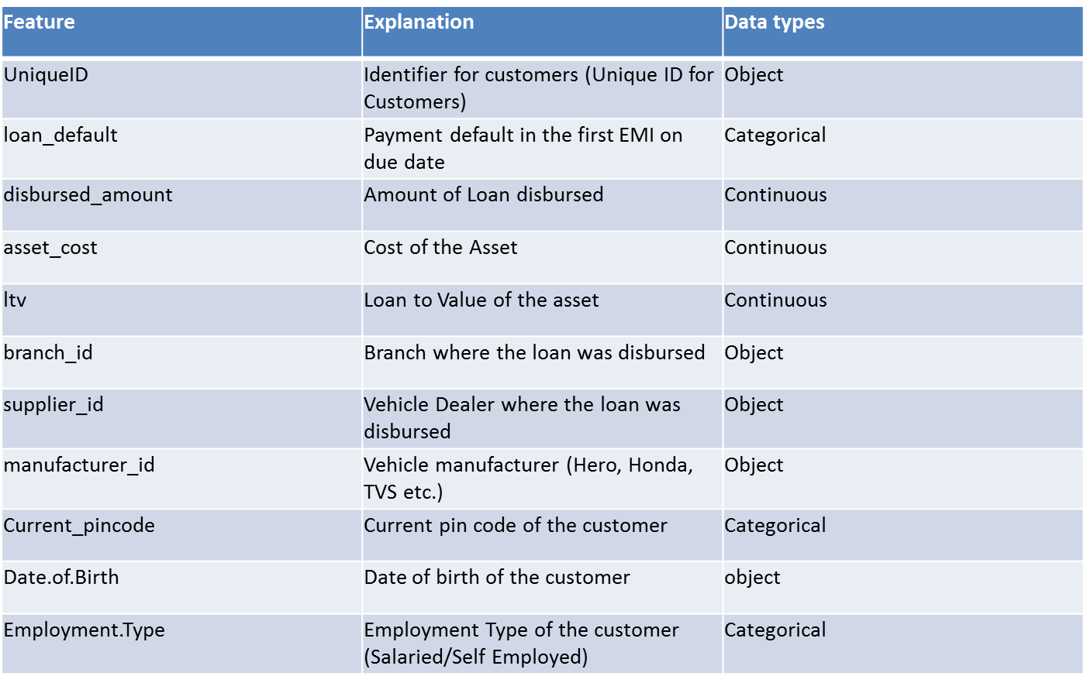
Data Description

Slide 4
Feature | Explanation | Data types
DisbursalDate | Date of disbursement | object
State_ID | State of disbursement | Categorical
Employee_code_ID | Employee of the organization who logged the disbursement | object
MobileNo_Avl_Flag | if Mobile no. was shared by the customer then flagged as 1 | Categorical
Aadhar_flag | if Aadhar was shared by the customer then flagged as 1 | Categorical
PAN_flag | if pan was shared by the customer then flagged as 1 | Categorical
VoterID_flag | if voter was shared by the customer then flagged as 1 | Categorical
Driving_flag | if DL was shared by the customer then flagged as 1 | Categorical
Passport_flag | if passport was shared by then 1 | Categorical
PERFORM_CNS.SCORE | Bureau Score | Categorical
PERFORM_CNS.SCORE.DESCRIPTION | Bureau score description | Categorical
PRI.NO.OF.ACCTS | count of total loans taken by the customer at the time of disbursement | Categorical
PRI.ACTIVE.ACCTS | count of active loans taken by the customer at the time of disbursement | Categorical

Slide 5
Feature | Explanation | Data types
PRI.OVERDUE.ACCTS | count of default accounts at the time of disbursement | Categorical
PRI.CURRENT.BALANCE | total Principal outstanding amount of the active loans at the time of disbursement | Continuous
PRI.SANCTIONED.AMOUNT | total amount that was sanctioned for all the loans at the time of disbursement | Continuous
PRI.DISBURSED.AMOUNT | total amount that was disbursed for all the loans at the time of disbursement | Continuous
SEC.NO.OF.ACCTS | count of total loans taken by the customer at the time of disbursement | Categorical
SEC.ACTIVE.ACCTS | count of active loans taken by the customer at the time of disbursement | Categorical
SEC.OVERDUE.ACCTS | count of default accounts at the time of disbursement | Categorical
SEC.CURRENT.BALANCE | total Principal outstanding amount of the active loans at the time of disbursement | Continuous
SEC.SANCTIONED.AMOUNT | total amount that was sanctioned for all the loans at the time of disbursement | Continuous
SEC.DISBURSED.AMOUNT | total amount that was disbursed for all the loans at the time of disbursement | Continuous
PRIMARY.INSTAL.AMT | EMI Amount of the primary loan | Continuous

Slide 6
Feature | Explanation | Data types
SEC.INSTAL.AMT | EMI Amount of the secondary loan | Continuous
NEW.ACCTS.IN.LAST.SIX.MONTHS | New loans taken by the customer in last 6 months before the disbursement | Categorical
DELINQUENT.ACCTS.IN.LAST.SIX.MONTHS | Loans defaulted in the last 6 months | Categorical
AVERAGE.ACCT.AGE | Average loan tenure | Categorical
CREDIT.HISTORY.LENGTH | Time since first loan | Categorical
NO.OF_INQUIRIES | Enquires done by the customer for loans | Categorical
SEC.INSTAL.AMT | EMI Amount of the secondary loan | Continuous
NEW.ACCTS.IN.LAST.SIX.MONTHS | New loans taken by the customer in last 6 months before the disbursement | Categorical

Slide 7
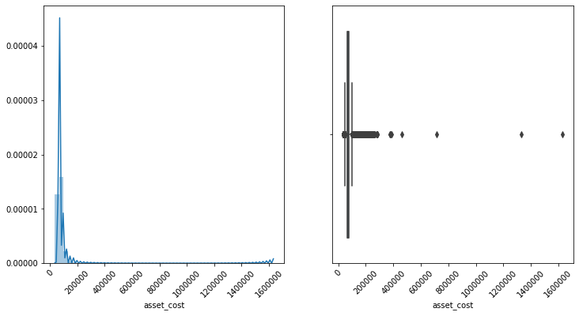
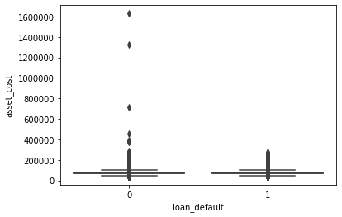
EXPLORATORY DATA ANALYSIS
Numerical Columns
Asset Cost

Slide 8
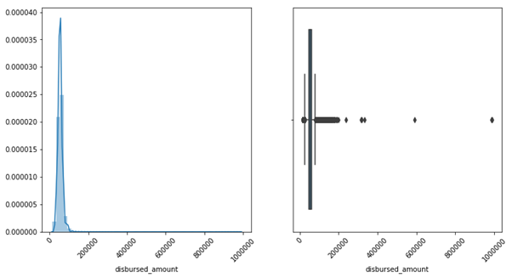
Disbursed Amount

Slide 9
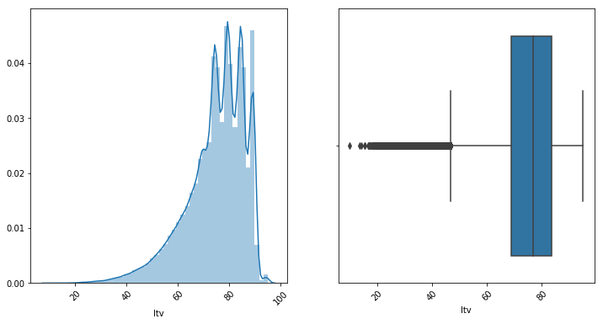
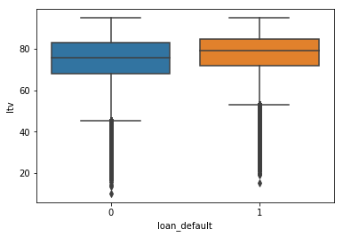
LTV

Slide 10
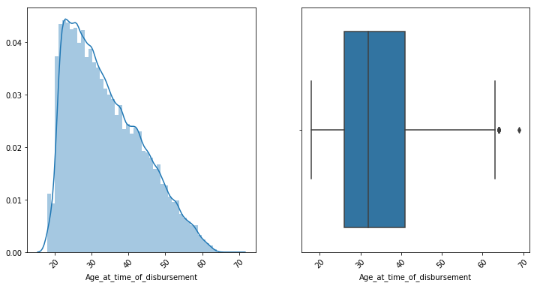
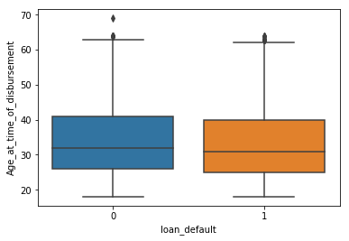
Age at time of disbursement

Slide 11
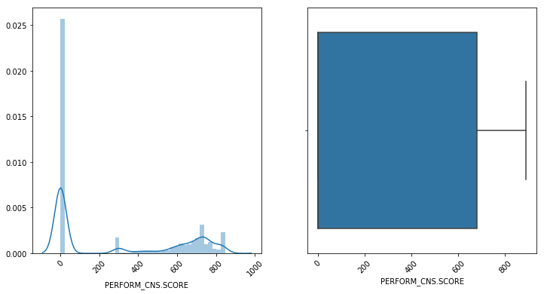
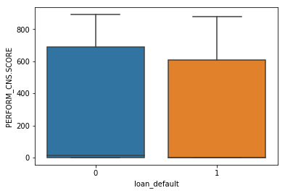
PERFORM CNS SCORE

Slide 12
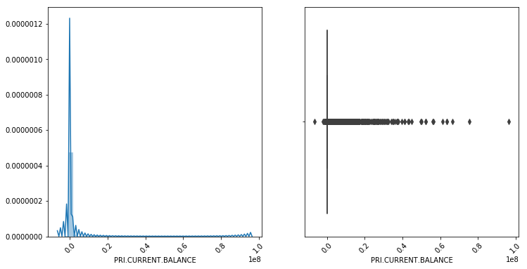
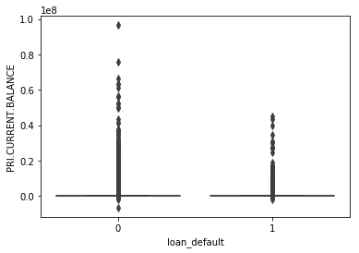
PRI CURRENT BALANCE

Slide 13
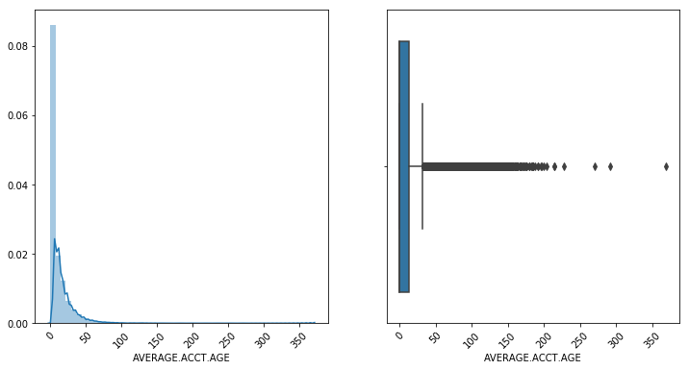
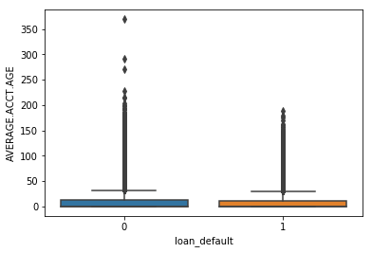
AVERAGE ACCT AGE

Slide 14
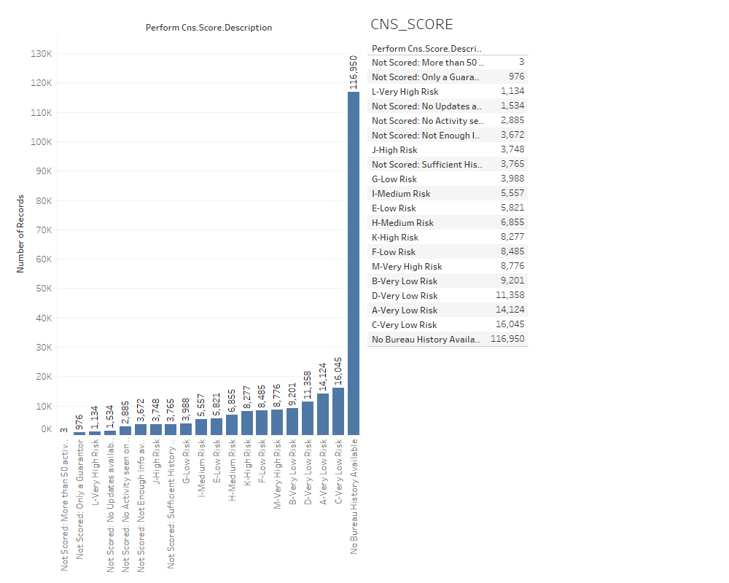
Categorical Columns
PERFORM CNS SCORE DESCRIPTION

Slide 15
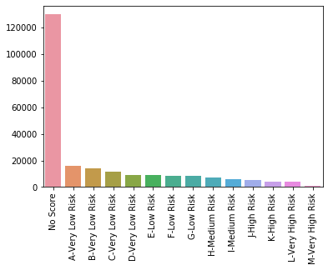
After Feature Extraction
PERFORM CNS SCORE DESCRIPTION

Slide 16
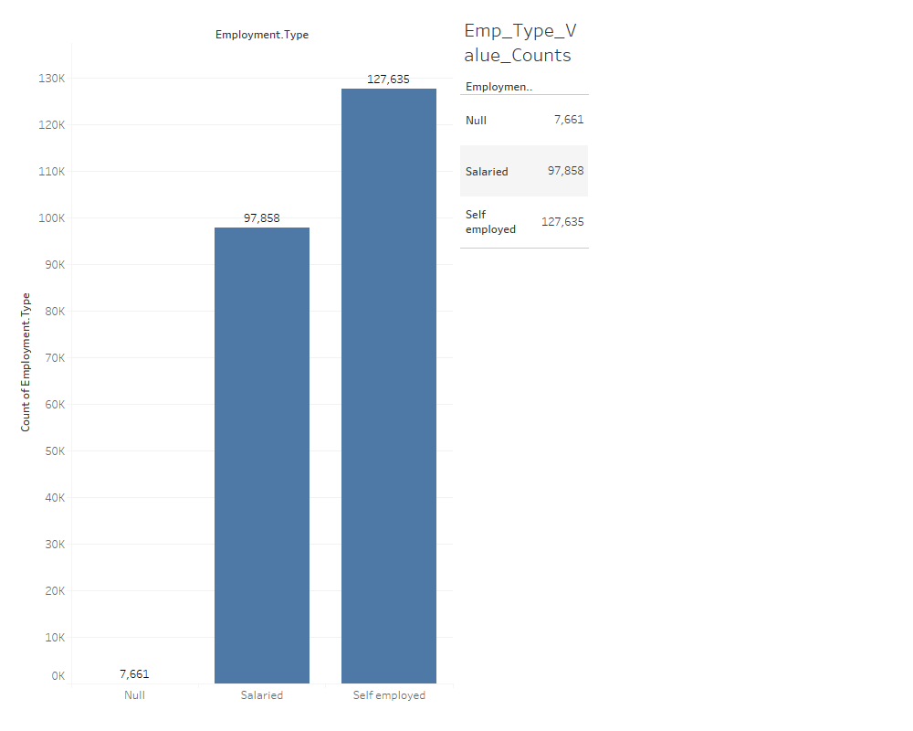
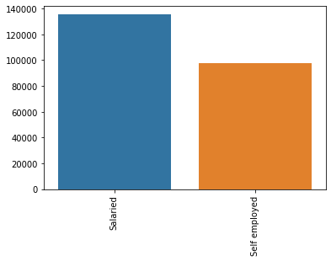
Employment Type

Slide 17
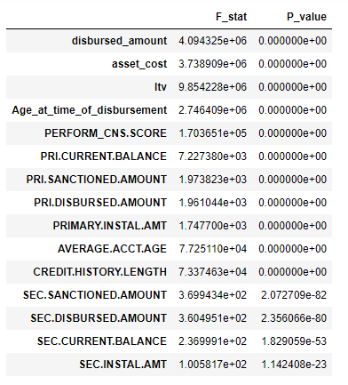
STATISTICAL DATA ANALYSIS
Numerical Columns
OneWay-Anova Test

Slide 18
Analysis from OneWay-Anova Test
All our variables have rejected the null hypothesis and the hypothesis is in favor of alternate hypothesis which states that the mean of two groups are not equal which will help in splitting our target variable.
These test does explain significance but not strength of the variable associated with the target variable. So, we perform point biserial test to explain the strength.
The point biserial correlation coefficient is a special case of Pearson’s correlation coefficient. It measures the relationship between two variables

Slide 19
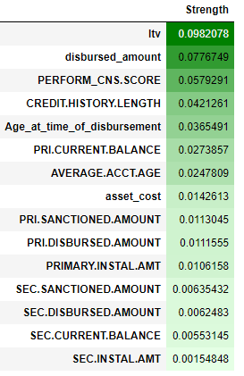
Point Biserial R Test for Numerical Variables
It is clear that ltv, disbursed amount and CNS.SCORE are most important variable, while Secondary loan associated variable seems to be less important.

Slide 20
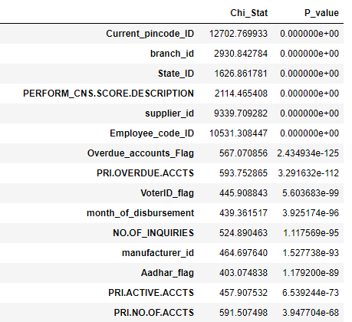
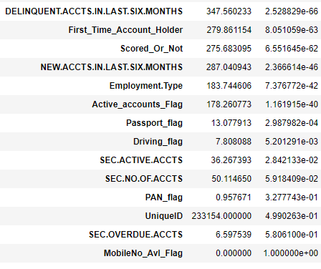
STATISTICAL DATA ANALYSIS
Categorical Columns
Chi-Square Test

Slide 21
Analysis from Categorical Columns
The Chi-Square test of independence is used to determine if there is a significant relationship between two nominal (categorical) variables.
The frequency of each category for one nominal variable is compared across the categories of the second nominal variable.
The data can be displayed in a contingency table where each row represents a category for one variable and each column represents a category for the other variable.
From the test, we can see Pan flag, Unique_id, mobileflag and Sec.Overdue.Accts have failed the test and so they are insignificant variables to the target variable.
The strength of categorical variables can be explained with Cramer’s test.

Slide 22
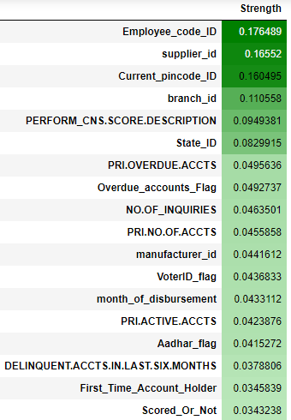
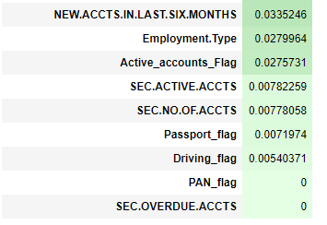
Cramer’s test for Categorical Variables

Slide 23
Analysis from Cramer’s test for Categorical Variables
We can see that employee_code_id, supplier_id, pincode and branch seems to be strong with target.
But these variables have huge unique values in them. Using them effectively in the model is highly difficult as it can increase no of columns which can cause curse of dimensionality.
Hence, PERFORM.CNS.SCORE.DESC is the most important variable in our case.

Slide 24
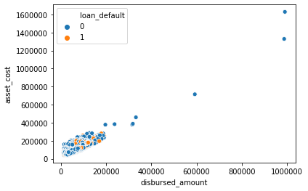
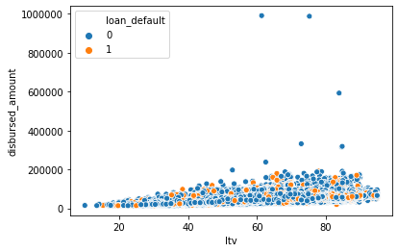
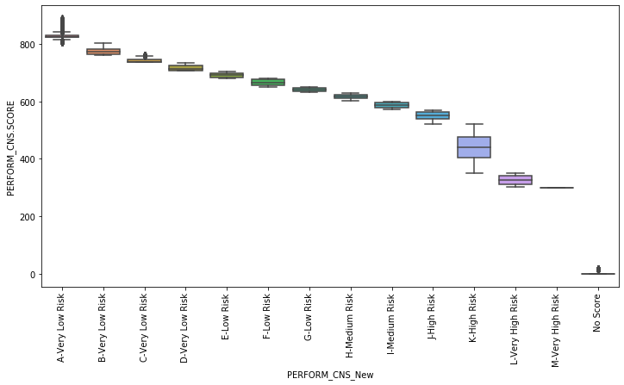
Bivariate analysis and Multivariate analysis

Slide 25
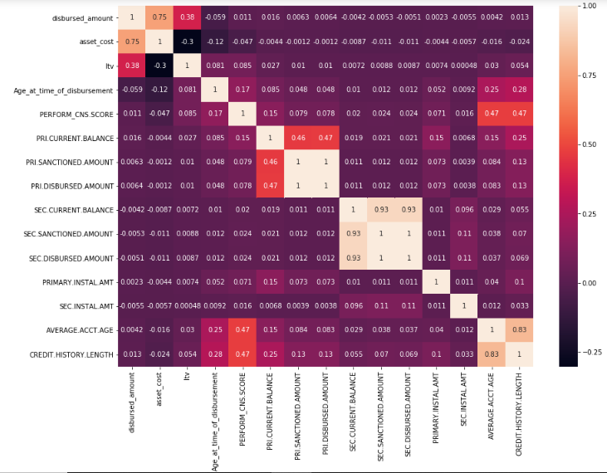
Correlation for Numerical and Categorical Columns

Slide 26
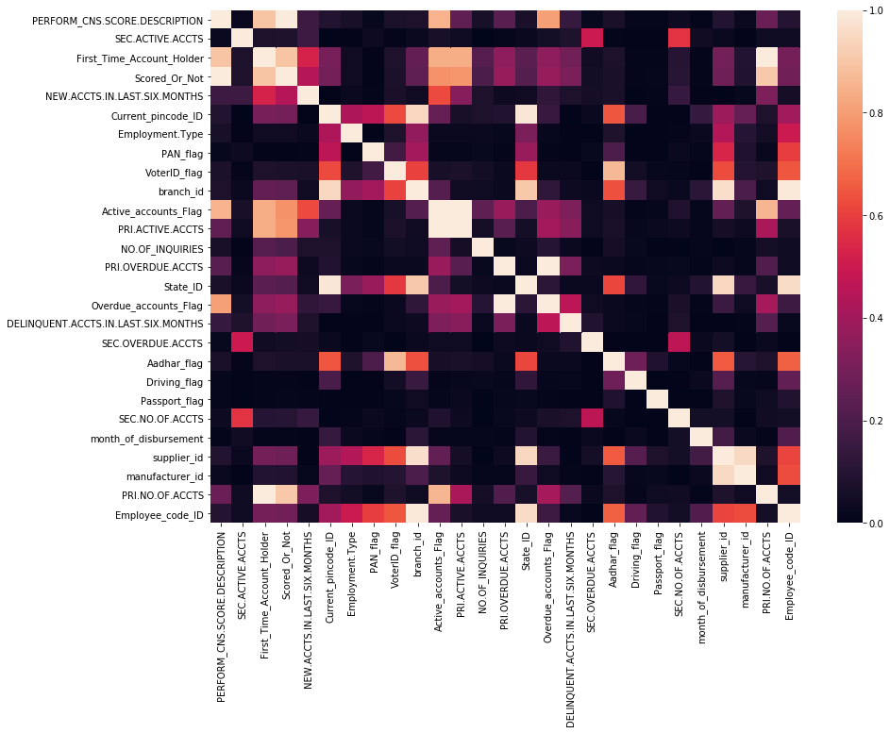
Correlation for Numerical and Categorical Columns

Slide 27
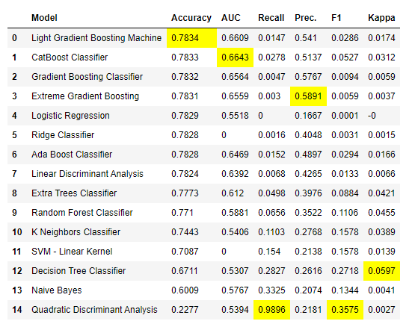
Base Model of Different Estimators

Slide 28
Conclusion
Since tree based perform better, we could tune the models using hyper parameters techniques like Random Search CV, Grid Search CV and stacking of various tree models could give a better AUC score.
As the scope of Feature engineering is low, we can try out multiplying numerical columns, frequency encoding of categorical columns and binning of numerical columns.

Slide 29
Thanks!

