Slide 1


SMART INDIA HACKATHON 2024
TITLE PAGE
Problem Statement ID – SIH1555
Problem Statement Title- Create a Virtual Herbal Garden that provides an interactive,educational, and immersive experience to users, showcasing the diverse range of medical plants used in AYUSH(Ayurveda,Yoga & Naturopathy,Unani,Siddha and Hemeopathy)
Theme- MedTech/BioTech/HealthTech.
PS Category- Software
Team ID-166
Team Name – Verdant Coders

Slide 2
PLANT -O- PEDIA
Verdant Coders
Virtual Herbal Garden Overview: The Virtual Herbal Garden is a digital platform designed to educate and engage users about medicinal plants used in AYUSH (Ayurveda, Yoga & Naturopathy, Unani, Siddha, and Homeopathy). This platform includes interactive 3D models of plants, detailed plant information, multimedia integration, and user-friendly features like search and filter options. The aim is to create an immersive, educational experience that makes learning about these plants accessible to everyone, regardless of their location.
Key Features:
Interactive 3D Models: Users can explore realistic 3D models of medicinal plants, rotating and zooming to view from different angles.
Comprehensive Plant Information: Each plant includes details like botanical names, common names, habitat, medicinal uses, and cultivation methods.
Multimedia Integration: The platform incorporates high-quality images, videos, and audio descriptions to cater to various learning styles.
Search and Filter Options: Advanced search and filter functionalities help users easily find specific plants based on medicinal uses, region, or type.
User Interaction: Features like bookmarking, note-taking, and social media sharing allow for a personalized and engaging user experience.
Engagement and Retention: Utilizes interactive 3D models and multimedia to make learning more engaging and improve information retention compared to traditional text-based resources.
Scalable and Adaptable: Easily expandable to include more plants, multimedia content, and features, ensuring the platform evolves with technology and user feedback.

Slide 3
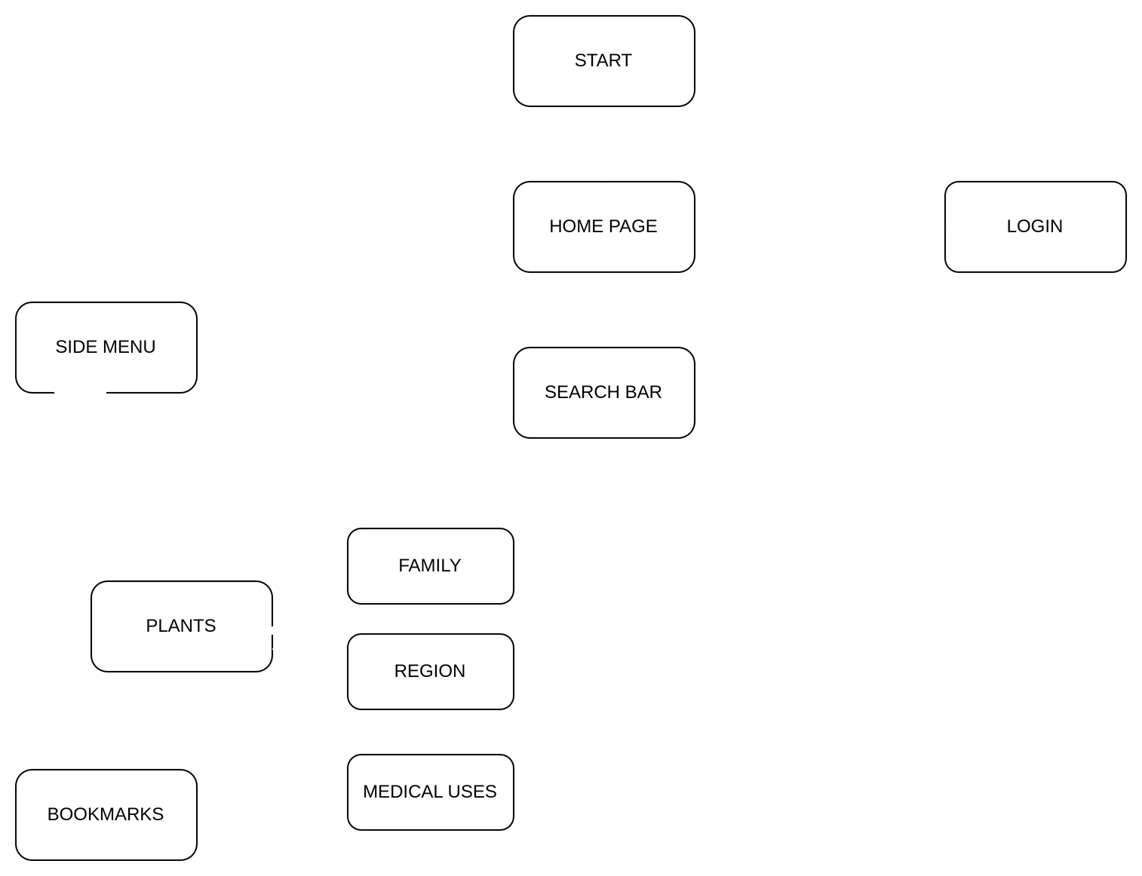
TECHNOLOGICAL APPROACH
Verdant Coders
Programming Languages:
HTML, CSS, JavaScript, Python.
Frameworks & Libraries:
React.js , Three.js, Vite, MongoDB, Django, GLTFLoader/OBJLoader, Whoosh, OAuth with Django Social Auth

Slide 4
FEASIBILITY AND VIABILITY
Verdant Coders
Technological Feasibility: The selected technologies (HTML, CSS, JavaScript, React, Three.js, Django, MongoDB, Whoosh, OAuth) are well-established and capable of supporting the project’s requirements. React and Three.js will enable interactive 3D visualizations, while Django and MongoDB will efficiently manage backend operations and data.
Performance Optimization and Data Handling:
Challenge : The application must handle potentially large datasets and provide a smooth
user experience, which could strain resources and affect performance.
Solution : Implement performance optimization techniques, such as lazy loading
Whoosh Integration optimize search and indexing settings to ensure performance and
efficient data handling, to ensure smooth operation.
Cost Management
Challenge : The primary costs will include development time, hosting, and possibly purchasing 3D models or licenses.
Solution : Open-source tools and libraries can reduce costs, and the use of free or low-cost hosting solutions can help manage expenses.

Slide 5
IMPACT AND BENEFITS
Verdant Coders
Enhanced Learning Experience:
Interactive 3D models of medicinal plants allow users to explore and understand the plants' physical characteristics and significance from various angles.
Detailed data on botanical names, medicinal uses, and cultivation methods supports in-depth learning and enhances appreciation of AYUSH practices.
Cultural Awareness and Preservation:
By showcasing plants used in Ayurveda, Yoga & Naturopathy, Unani, Siddha, and Homeopathy, the platform promotes awareness of traditional medicinal practices. This helps preserve and spread knowledge of these practices, contributing to cultural heritage and traditional medicine.
Global Accessibility:
The virtual nature of the garden makes it accessible to a global audience, overcoming geographical barriers that limit access to physical herbal gardens. Users from different regions can explore and learn about medicinal plants without needing to visit physical locations.

Slide 6
RESEARCH AND REFERENCES
Verdant Coder
E. Freeman and E. Robson, Head First HTML and CSS, O'Reilly Media, 2012.
Addy Osmani, Learning JavaScript Design Patterns, O'Reilly Media, 2012
React Documentation
M. H. Stonebraker and D. J. Abadi, "The End of an Architectural Era: (It's Time for a Complete Rewrite)," Proceedings of the 2008 ACM SIGMOD International Conference on Management of Data, Vancouver, Canada.
MongoDB Documentation.
D. Beazley and B. Jones, Python Cookbook, O'Reilly Media, 2013.
Django Documentation:
M. H. Forney, Whoosh: A Fast and Flexible Search Engine Library, 2016.
Whoosh Documentation.
D. Beazley, "OAuth 2.0: Getting Started," O'Reilly Media, 2014.
Django Social Auth Documentation.
Plants for the Future Website.
Sketchfab Official Website

