Slide 1
SLAM

Slide 2
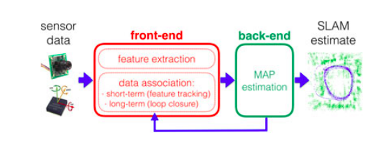
SLAM components
SLAM system
Frontend
Converts sensor data to abstract data, better for the required estimations
Backend
Inference on the abstract data to provide the required estimations
Frontend
Backend

