Slide 1

ANNA UNIVERSITY REGIONAL CAMPUS COIMBATORE
IBM NAAN MUDHALVAN PHASE 1
CLOUD COMPUTING
EFFECTIVE NOISE MONITORING SYSTEM
SUBMITTED BY
GOKULAKRISHNAN V
710021106009
Dept. of Electronics and communication engineering

Slide 2
ABSTRACT
Advancing Urban Quality of Life through Effective Noise Monitoring: A Comprehensive System for Real-time Data Collection and Analysis. Advancing Urban Quality of Life . This presentation discusses a comprehensive system for real time noise monitoring to improve urban quality of life. The system includes data collection and analysis for effective noise

Slide 3
Noise pollution impacts
Noise pollution is a serious issue that affects urban residents' health and well-being. Noise pollution, the excessive or disturbing noise that interferes with normal activities, can have various impacts on individuals, communities, and the environment. Here are some key effects of noise pollution
Hearing Loss
Stress and Anxiety
Sleep Disturbances
Cardiovascular Effects
Communication Interference
Impact on Learning and Performance
Workplace Productivity
Quality of Life
Social and Recreational Disruptions
Effects on Wildlife

Slide 4
Components of the comprehensive system
The comprehensive system includes hardware, software, and data analytics tools for real-time noise monitoring. The hardware includes sensors, microphones, and data loggers. The software includes data visualization and analysis tools.

Slide 5
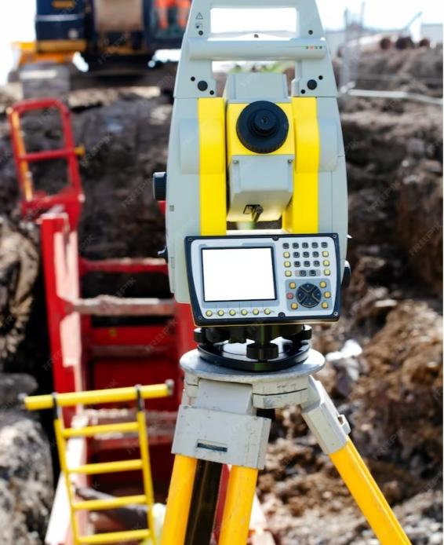
Real-time Data Collection and Analysis
The system collects real-time noise data from different locations in the city. The data is analyzed to identify noise hotspots, trends, and patterns. The results can be used to develop effective noise management strategies.

Slide 6
Benefits of the Comprehensive System
The comprehensive system provides several benefits, including improved noise management, enhanced urban quality of life, and better decision-making for urban planners and policy makers

Slide 7
Conclusion
Noise in cities has increased in the past decades, due to a growing urban development. In the last century, population movement to the greater cities, disorder planned city development and increase of the motor vehicle in the traffic have been produced noise pollution and other environmental problems. Management and reduction or urban noise has been called for in urban development plans. Noise community ordinances have been approved at national and local levels in various countries of the world. The comprehensive system for real-time noise monitoring is an effective tool for advancing urban quality of life. Its benefits include improved noise management, enhanced health and well-being, and better decision-making for urban planners and policy maker

Slide 8
THANK YOU

