Slide 1

ANNA UNIVERSITY REGIONAL CAMPUS COIMBATORE
IBM NAAN MUDHALVAN PHASE 2
CLOUD COMPUTING
EFFECTIVE NOISE MONITORING SYSTEM
SUBMITTED BY
GOKULA KRISHNAN. V 710021106009
Dept. of Electronics and communication engineering

Slide 2
ABSTRACT
Noise in cities has increased in the past decades, due to a growing urban development. In the last century, population movement to the greater cities, disorder planned city development and increase of the motor vehicle in the traffic have been produced noise pollution and other environmental problems. Noise community ordinances have been approved at national and local levels in various countries of the world. They usually establish noise limits for various activities and zones, according to the land uses, and define the basis of noise management strategies. It is required to draw noise maps, as a noise management tool, to be integrated in the land use plans and to be used as a basis for noise reduction plans where the noise levels exceed maximum prescribed levels. In the project we have implemented a mapping with noise levels which is helping for reducing noise in the environment.

Slide 3
SOURCES OF NOISE DISTURBANCES
CONSTRUCTION WORKS
EMERGENY VEHICLES SIRENS
ROAD AND RAIL TRAFFIC
AIRCRAFT
LOUD MUSIC
EVENTS AND CROWDS

Slide 4
Effects Of Noise
Stress and Anxiety
Hearing loss
Sleep Disturbances
Cardiovascular Effects
Communication Interference
Impact on Learning and Performance
Workplace Productivity
Quality of Life
Social and Recreational Disruptions
Effects on Wildlife

Slide 5
Components Requirements
Microphones
Pre-amplifiers
Analog to digital converters
Data acquisition system
Global positioning system
Mapping software
Data storage

Slide 6
Components required
To create an urban noise monitoring system project, you'll need the following components:
1. Microphones/Sensors: Quality microphones or noise sensors to capture ambient sound levels.
2. Microcontroller/Processor: A microcontroller (e.g., Arduino, Raspberry Pi) to process data from the sensors.
3. Power Supply: Depending on the deployment location, consider a reliable power source or battery.
4. Data Logger/Storage:For storing the recorded noise data, you might need an SD card or other data storage solutions.
5. Communication Module: A module for data transmission, such as Wi-Fi, GSM, or LoRa, to send the collected data to a central system.
6. GPS Module: If you want to include location information in your monitoring, a GPS module is useful.
7. Weatherproof Enclosure: Protect the components from environmental factors like rain, dust, etc.

Slide 7
Cont…
8. User Interface: A display or a web-based interface for users to visualize and interpret the noise data.
9. Power Management: Efficient power management system to optimize battery usage if applicable.
10. Centralized Database/Server: A centralized system to collect and store data from multiple monitoring points.
11. Software/Algorithm: Develop algorithms for analyzing noise data and identifying patterns or trends.
12. Alert System: If needed, implement an alert system to notify relevant authorities or users based on predefined thresholds.
13. Security Measures: Implement security protocols to protect the system from unauthorized access.
14. Maintenance Plan: Plan for regular maintenance to ensure the system's continued functionality.

Slide 8
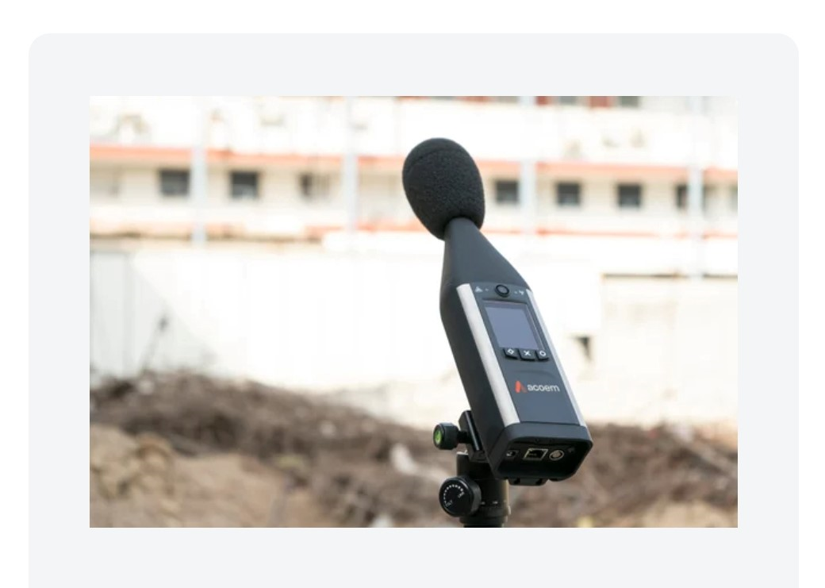
Sound level meter
Fusion™ by Acoem is the only IEC 61672 Class 1 sound level meter/analyser on the market with a built-in 4G modem and your choice of trigger, advanced indicators, aircraft indicators and push data options.
With Fusion 4G, conduct all your measurements — environmental, buildings and/or monitoring with one compact and reliable device.

Slide 9
Flow chat
start
Noise
if i>=75
db
no
yes
Alarm not triggered
Mapping
stop

Slide 10
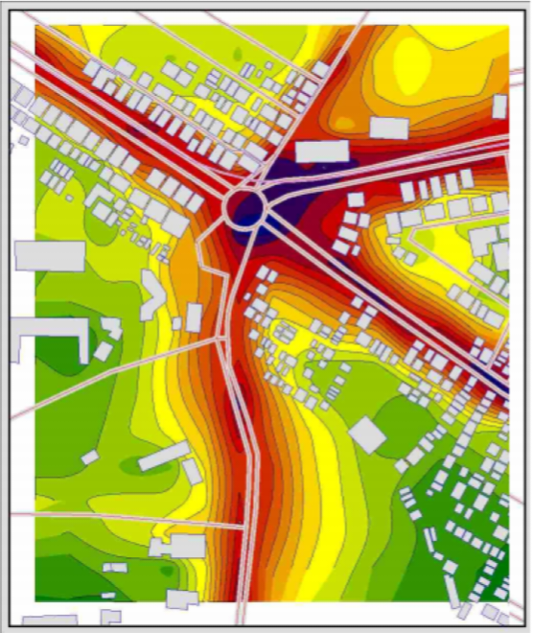
Noise mapping in india
In Noise mapping procedure, Sound Sensors play very important role. Noise level monitoring Sensors are placed in strategic locations in the study area. Data is collected periodically from noise sensors and it is used to create detailed noise map which shows distribution of noise levels in study area.

Slide 11
Conclusion
Noise in cities has increased in the past decades, due to a growing urban development. In the last century, population movement to the greater cities, disorder planned city development and increase of the motor vehicle in the traffic have been produced noise pollution and other environmental problems. Management and reduction or urban noise has been called for in urban development plans. Noise community ordinances have been approved at national and local levels in various countries of the world. The comprehensive system for real-time noise monitoring is an effective tool for advancing urban quality of life.

Slide 12
THANK YOU

