Slide 1


AI-Based Intrusion Detection System Gokul Athikavil Shaji Saathvika Prasad

Slide 2
Introduction
Problem Statement
Traditional Intrusion Detection Systems (IDS) struggle with high false positives and low recall, making them ineffective against evolving cyber threats. This study proposes a multi-stage IDS framework using machine learning to improve anomaly detection, attack classification, and zero-day threat identification, enhancing accuracy and reducing false positives.
Problem Statement:
Traditional Intrusion Detection Systems (IDS) struggle with high false positives and low recall, making them ineffective against evolving cyber threats. This study proposes a multi-stage IDS framework using machine learning to improve anomaly detection, attack classification, and zero-day threat identification, enhancing accuracy and reducing false positives. It aims to evaluate the effectiveness of different machine learning models and thresholding techniques to optimize IDS performance for real-world cybersecurity applications.

Slide 3
Intrusion Detection System
Layered Approach: Combines anomaly detection, known attack classification, and zero-day threat identification for robust intrusion detection.
WUSTL-IIOT-2021
CICIDS2017
CICIDS2018
IDS
Anomaly Detector
Attack Classifier
Zero-day attack classifier
Tailored for OT Environments: Designed to address the unique security challenges of OT systems, with training focused on Industrial Control Systems datasets for precise and reliable protection.

Slide 4



Intrusion Detection System
Attack
No Attack
How it Works ?
Network Data
Model Selector
IDS
The captured network traffic data is analyzed by a model selector.
The model selector identifies the appropriate models and thresholds based on traffic characteristics.
The IDS applies the selected models and thresholds to determine if the traffic is benign or an attack.

Slide 5
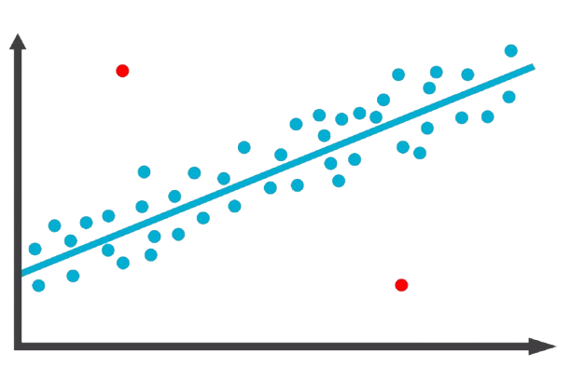
Intrusion Detection System
Stage 1 of IDS: Anomaly Detector
Focuses on detecting any traffic that deviates from normal behavior to ensure no attacks are missed.
A Benign Threshold is selected that ensures:
Most attacks are detected.
Balance between high detection rates and manageable false alarms for better security.
< Benign Threshold
Label it as Benign
Anomaly Detector
Send to Stage 2
Network Data
> Benign Threshold

Slide 6
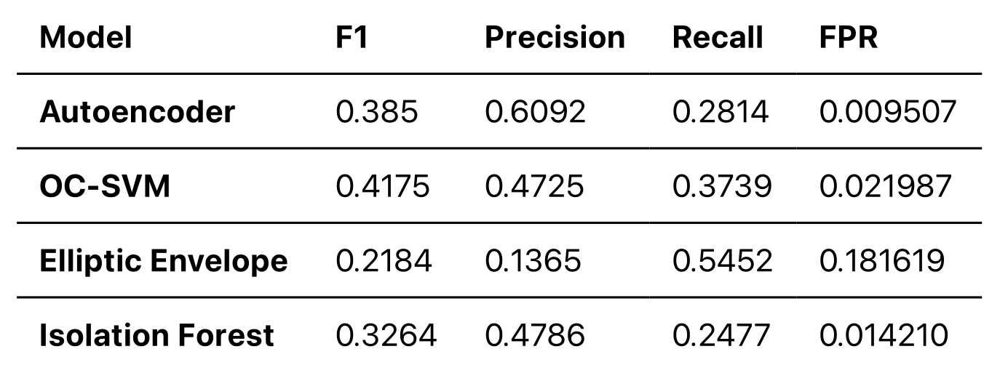
Intrusion Detection System
Stage 1 of IDS: Anomaly Detector
Models for each datasets are chosen considering following metrics:
Recall - How well they detect attacks
Precision - Accuracy of predictions
False Positive Rate - False alarms
F1 Score - Overall performance, combining precision and recall.
For e.g., For the CICIDS-2017 and CICIDS-2018 datasets, OC-SVM gave the best balance of recall, precision, and low false alarms, making it the top choice for anomaly detection.
Performance Overview for different models

Slide 7
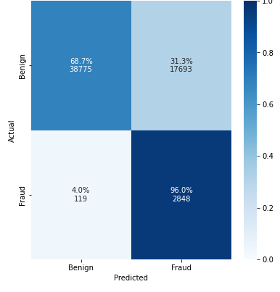
Intrusion Detection System
Stage 1 of IDS: Anomaly Detector
The benign threshold is selected by evaluating different values and choosing the one that provides the best balance between detecting attacks and minimizing false alarms based on metrics like F1 score and recall for the model selected.
The confusion matrix using the benign threshold shows:
Most of the fraud traffic (attacks) was correctly identified.
However, about one-third of the benign data was wrongly flagged as an attack.
We will observe how this issue is addressed in the subsequent stages.

Slide 8
Intrusion Detection System
Stage 2 of IDS: Attack Classifier
Stage 2 of the Intrusion Detection System (IDS) focuses on identifying the type of attack from the anomalies detected in Stage 1.
A confidence threshold is set to determine the certainty needed to classify a sample into a specific attack type.
> Confidence Threshold
Classify as an Attack
Stage 1
Attack Classifier
Send to Stage 3
Network Data
< Confidence Threshold

Slide 9
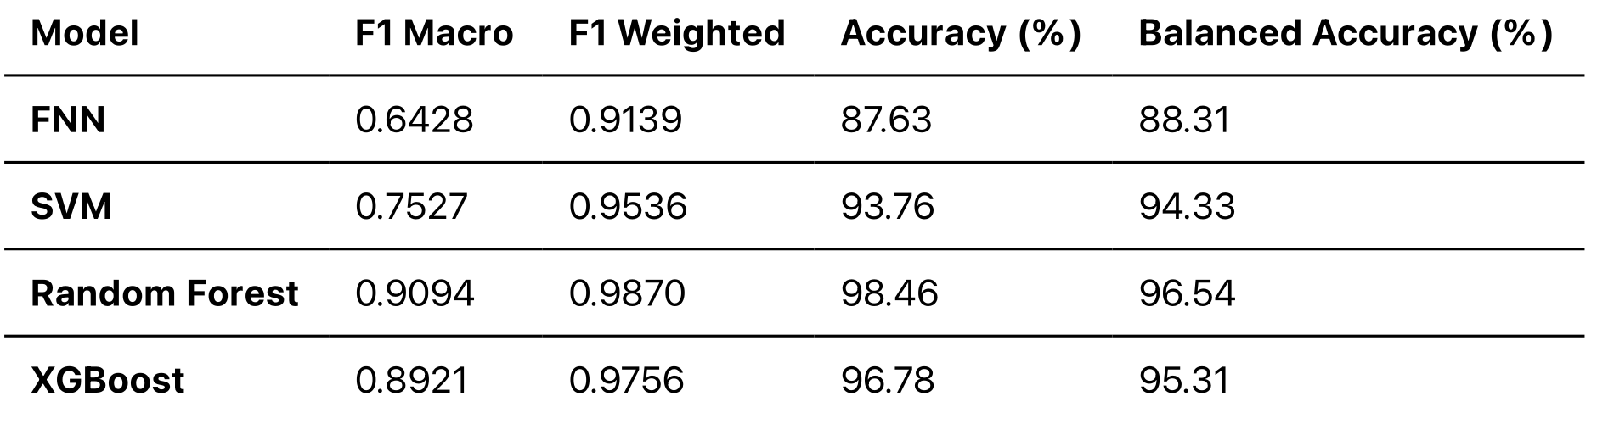
Intrusion Detection System
Stage 2 of IDS: Attack Classifier
Uses supervised machine learning models to identify the best attack classifier.
Hyperparameter Tuning and Evaluation :
The main goal is to adjust the model to work better with imbalanced data, where some attack types are much more common than others.
The F1 weighted score is used to make sure the model is good at detecting both common and rare attacks.
For example, in the case of the CICIDS-2017 and CICIDS-2018 datasets, we discovered that the Random Forest Classifier outperformed other classifiers in terms of accuracy and detection capabilities, providing better results for classifying attack types

Slide 10
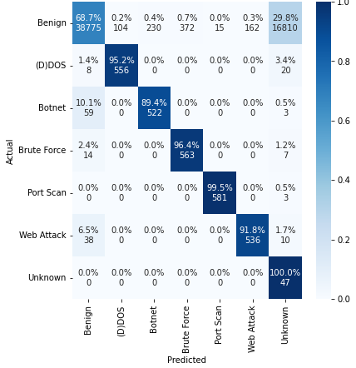
Intrusion Detection System
Stage 2 of IDS: Attack Classifier
Confusion Matrix with Confidence Threshold in Stage 2:
Most attack traffic was correctly identified as attacks.
Traffic that didn’t meet the confidence threshold was labeled as "Unknown."
Some benign traffic was also mistakenly labeled as "Unknown”, which will be rectified in stage 3
The confidence threshold is chosen by testing different values. The best threshold is the one that gives the highest F1 score, balancing correct attack detection and minimizing errors.

Slide 11
Intrusion Detection System
Stage 3 of IDS: Zero Day Attack Classifier
This stage focuses on refining the classification of "Unknown" samples from Stage 2.
A new threshold, called the Zero Day Threshold, is introduced to classify potential zero-day attacks.
> Zero Day Threshold
Label as Zero Day Attack
Zero Day Attack Classifier
Stage 1 & 2
Label as Benign
Network Data
< Zero Day Threshold

Slide 12
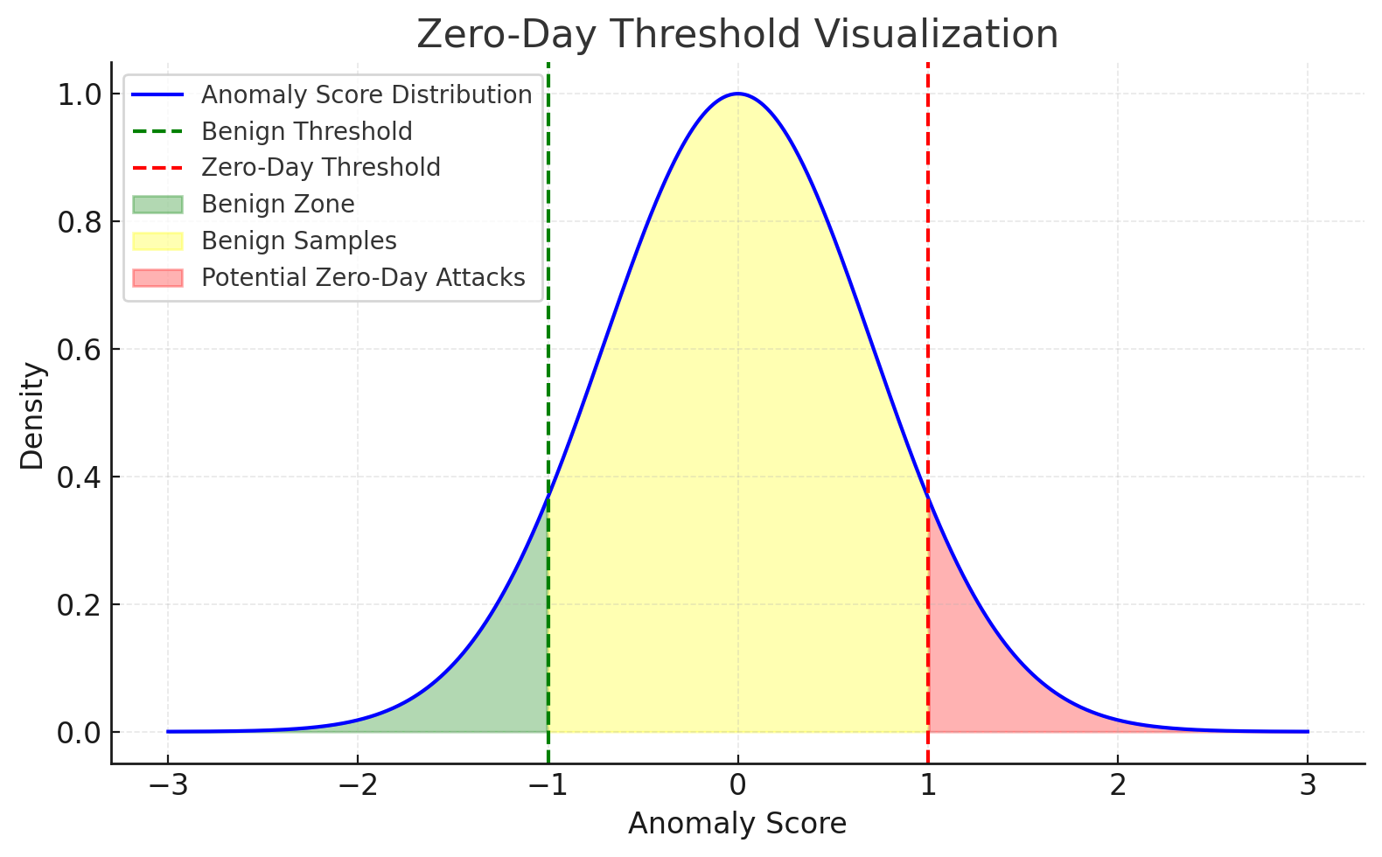
Intrusion Detection System
Stage 3 of IDS: Zero Day Attack Classifier
The anomaly score generated by the Stage 1 anomaly detector is reused in Stage 3 to evaluate samples against the Zero-Day Threshold.
The Zero-Day Threshold helps identify new, unseen attacks (zero-day attacks) based on anomaly scores.
Samples with scores above the threshold are flagged as potential zero-day attacks.
This threshold balances detecting novel threats while minimizing false positives
Samples between the Benign Threshold and the Zero-day Threshold are considered benign.

Slide 13
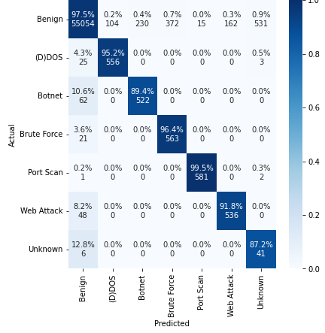
Intrusion Detection System
Stage 3 of IDS: Zero Day Attack Classifier
Finding the Optimal Zero-day Threshold:
During training, various quantiles of benign data are tested to identify the optimal Zero-Day Threshold. Quantiles divide data into equal portions; for instance, the 0.99 quantile represents the value below which 99% of the data points lie.
The quantile that provides the highest accuracy in distinguishing between known and unknown data is selected as the Zero-Day Threshold
Confusion Matrix with Zero Day Threshold in Stage 3:
All benign data misclassified in Stage 1 is accurately identified and corrected in Stage 3

