Slide 1
POC- Infrastruture as Code
May 2024

Slide 2
Objectives-
Showcase Infrastructure automation using Terraform.
Single touch cloud provisioning capability using Terraform.
Showcase how an entire environment can be provisioned using Terraform.
Provision Environment based on software application language.
Create templates specific to Java, Dotnet etc
Provision prerequisites on top on provisioned Cloud service.
Tools Used-
Cloud platform – AWS
CICD- Jenkins
IAC- Terraform
Source code Repo- GitHub

Slide 3
Task-
Create a branch in GitHub for IaC source code.
Create Terraform script to provision commonly used AWS services.
Create reusable Terraform script to destroy the services in AWS.
Create Terraform script to provision services in two different regions.
Create Terraform modules for Java and Dotnet Environment specific Infra.
Store the Statefile in S3 bucket.
Orchestrate TF scripts using Jenkins.

Slide 4



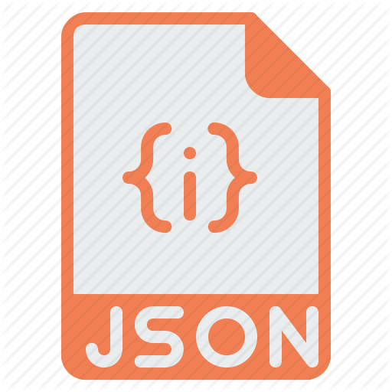

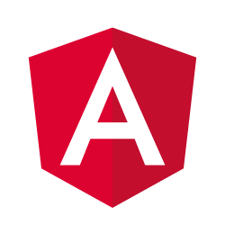

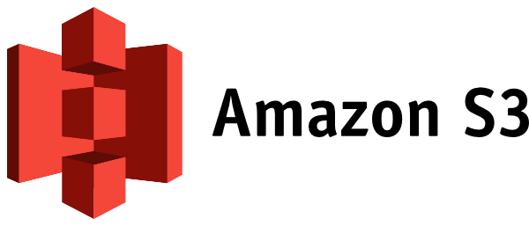


Design Diagram-
AWS Cloud
Orchestration and Provisioning Jobs
CI
Commit Detected
Commit
TEST
UAT
StateFile storage
Continuous Provisioning
Infrastructure as Code
PROD

