Slide 1

Prometheus

Slide 2
Prometheus
Prometheus is an open-source monitoring and alerting toolkit.
Developed originally at SoundCloud and now a part of the Cloud Native
Prometheus is widely used for system and service monitoring.
Licenced under apache 2.0 licence
Very active developer and user community around the globe
Written in GO lang

Slide 3
Features
Data Collection: Prometheus scrapes metrics from instrumented jobs and stores them in a time-series database.
Time-Series Database: Prometheus uses a custom, highly efficient time-series database to store all scraped samples.
PromQL: users to select and aggregate time-series data in real-time.
Alerting: It includes an Alertmanager that handles alerts generated by Prometheus' monitoring and allows for complex alerting rules to be configured.
Visualization: Prometheus can be integrated with various visualization tools like Grafana to create dashboards that visualize the metrics data.
Service Discovery: Prometheus can dynamically discover targets to monitor.
Multi-dimensional Data Model: Prometheus uses labels (key-value pairs) to identify and organize data.

Slide 4
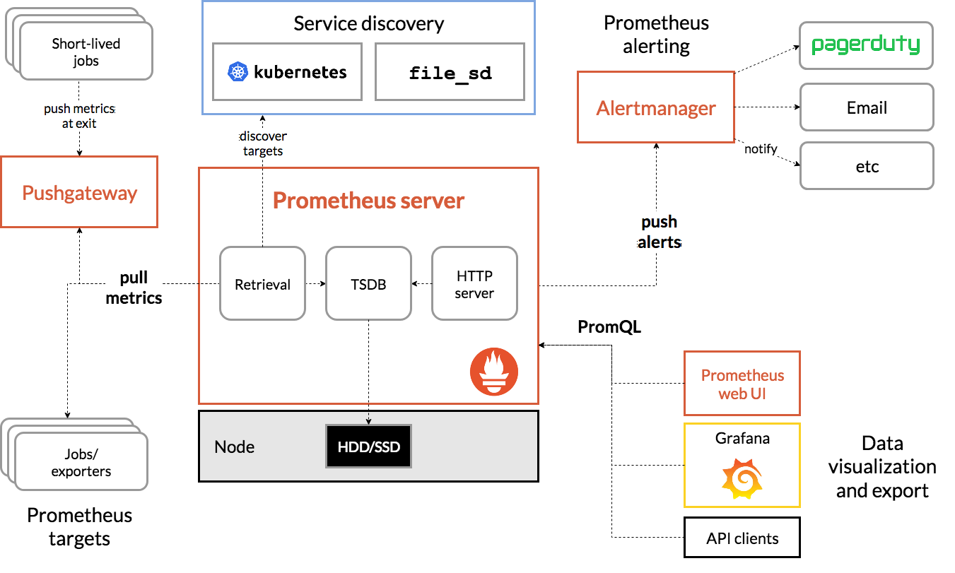
Architecture

Slide 5
Prometheus Workflow
MONITORING: It is a Systematic process of collecting and recording the activities taking place in target project, programme or service and then using that recorded values to check if the targets are reaching their objectives or not.
ALERT/ALERTING: Alerting rules in Prometheus servers send alerts to an Alertmanager.
ALERT MANAGER: The Alertmanager manages those alerts, including silencing, inhibition, aggregation and sending out notifications via methods such as email, on-call notification systems, and chat platforms.

Slide 6
Alternate Monitoring Tools
Nagios
Graphite
AppDynamics
Splunk
InfluxDB
New Relic
Datadog
OpenTSDB

Slide 7
SSO and SSL
SSO | SSL
Single Sign-On | Secure Socket Layer
Manages user authentication across multiple applications with a single login. | Encrypts data transmission between a client and a server to protect it.
Focuses on user identity and access management. | Focuses on data encryption and securing communication channels.
Involves authentication tokens, identity providers, and service providers. | Involves encryption protocols, SSL certificates, and certificate authorities.
Simplifies user login processes and centralized authentication for multiple applications. | Secures the data in transit and ensures that it is not intercepted or altered.
Examples: Google Workspace (G Suite) Microsoft Azure Active Directory Okta | Examples: HTTPS Secure email protocols (SMTPS, IMAPS)

Slide 8
Thank You

