Slide 1
ABSTRACT
• Real-Time Threat Monitoring: Wazuh functions as a robust SIEM platform, collecting and analyzing security data across endpoints, networks and cloud environments to detect anomalies and breaches.
• Automated Incident Response: Shuffle complements Wazuh by executing customizable playbooks that automate responses to detected threats, minimizing manual effort and accelerating remediation.
• Proactive Security Operations: The integration empowers SOC teams to transition from reactive to proactive defense, enhancing visibility, operational efficiency and threat resilience.
• Scalable Cybersecurity Solution: This system offers a flexible, intelligent architecture capable of addressing modern threats like phishing and DoS attacks while supporting compliance and growth.

Slide 2
OBJECTIVE
1. Develop a Real-Time Cybersecurity Framework
Integrate Wazuh (SIEM) and Shuffle (SOAR) to provide continuous monitoring, threat detection and automated response in real-time.
2. Enable Intelligent Threat Detection and Correlation
Utilize Wazuh to analyze logs, system activity and network traffic, identifying threats through rule-based and behavioral analysis.
3. Automate Incident Response
Leverage Shuffle to build customizable workflows that automatically respond to incidents, reducing human intervention and response time.
4. Enhance Security Operations Center (SOC) Efficiency
Support SOCs with a centralized, scalable and automated solution that transitions operations from reactive to proactive defense.

Slide 3
INTRODUCTION
This project integrates Wazuh and Shuffle to deliver a proactive cybersecurity solution. Wazuh provides real-time threat detection across endpoints, networks and cloud environments, while Shuffle automates incident response through customizable playbooks. Together, they reduce manual effort, accelerate response times and enhance visibility into system behavior. By combining intelligent automation with continuous monitoring, this platform empowers Security Operations Centers to shift from reactive defense to strategic resilience—addressing threats like phishing and DoS with speed, precision and adaptability.

Slide 4
EXISTING SYSTEM
1. Wazuh serves as the core threat detection engine, analyzing logs, monitoring file integrity and identifying vulnerabilities across endpoints and servers.
2. Shuffle enables automated incident response by executing playbooks triggered by Wazuh alerts, reducing manual intervention and accelerating mitigation.
3. The system provides a centralized dashboard for real-time visibility, allowing security teams to monitor threats, prioritize alerts and respond efficiently.
4. Integration between Wazuh and Shuffle supports compliance, streamlines operations and enhances overall security posture by ensuring consistent, scalable and rapid threat response.

Slide 5
PROPOSED SYSTEM
1. Enhanced Threat Detection: Deploy Wazuh agents across endpoints and cloud infrastructure to improve log collection, anomaly detection and vulnerability scanning.
2. Automated Response Workflows: Integrate Shuffle to build dynamic playbooks that automatically respond to Wazuh alerts—quarantine hosts, notify teams, or escalate incidents.
3. Unified Security Dashboard: Create a centralized interface for monitoring alerts, tracking response actions and visualizing threat trends in real time.
4. Scalable & Compliant Architecture: Design the system to support enterprise growth while ensuring alignment with regulatory standards like ISO 27001, HIPAA and GDPR.

Slide 6
Flow Chart:
Internet
Incoming
Wazuh manager
Router
PC
Shuffle
Events
Send Response Action
SOC Analyst

Slide 7
Problem Statement:
Cyber threats like phishing, DoS and privilege escalation are growing in complexity and frequency.
Traditional SOC operations rely heavily on manual detection and response, leading to delays and inefficiencies.
Lack of centralized visibility across endpoints, networks and cloud environments.
Organizations struggle to meet compliance standards due to fragmented security workflows.
There is a critical need for an integrated, automated and scalable cybersecurity framework.

Slide 8
Use Case Scenario:
Enterprise SOC Automation: Detect and respond to privilege escalation attempts across multiple endpoints.
Healthcare Compliance: Monitor patient data access and automate alerts for HIPAA violations.
E-Commerce Security: Block phishing domains and notify users of suspicious login attempts.
Cloud Infrastructure Monitoring: Identify unauthorized access and quarantine affected cloud nodes.
Educational Institutions: Track student device activity and respond to malware infections in real time.

Slide 9
System Architecture:
Endpoints: Windows/Linux/macOS systems with Wazuh agents installed.
Wazuh Manager: Central server for log collection, rule-based analysis and alert generation.
Shuffle SOAR: Docker-based automation engine executing playbooks triggered by Wazuh alerts.
Dashboard: OpenSearch for real-time visualization and alert tracking.
SOC Analyst: Monitors dashboard, validates alerts and oversees automated responses.

Slide 10
MODULE 1:
AGENT DEPLOYMENT
Install Wazuh agents on endpoints (Windows/Linux/macOS) to collect logs and monitor system activity.
Configure agents to communicate with Wazuh Manager securely.
Ensure coverage across critical infrastructure: servers, user systems, cloud nodes

Slide 11
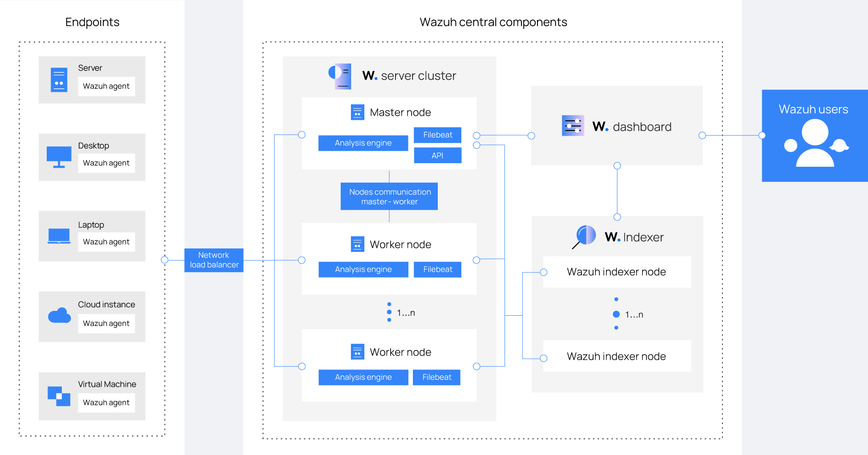

Slide 12
MODULE 2:
WAZUH MANAGER CONFIGURATION
Set up Wazuh Manager on a Linux server (Ubuntu recommended).
Enable modules for log analysis, file integrity monitoring, vulnerability detection.
Configure rules and decoders to detect phishing, DoS and privilege escalation attempts.

Slide 13
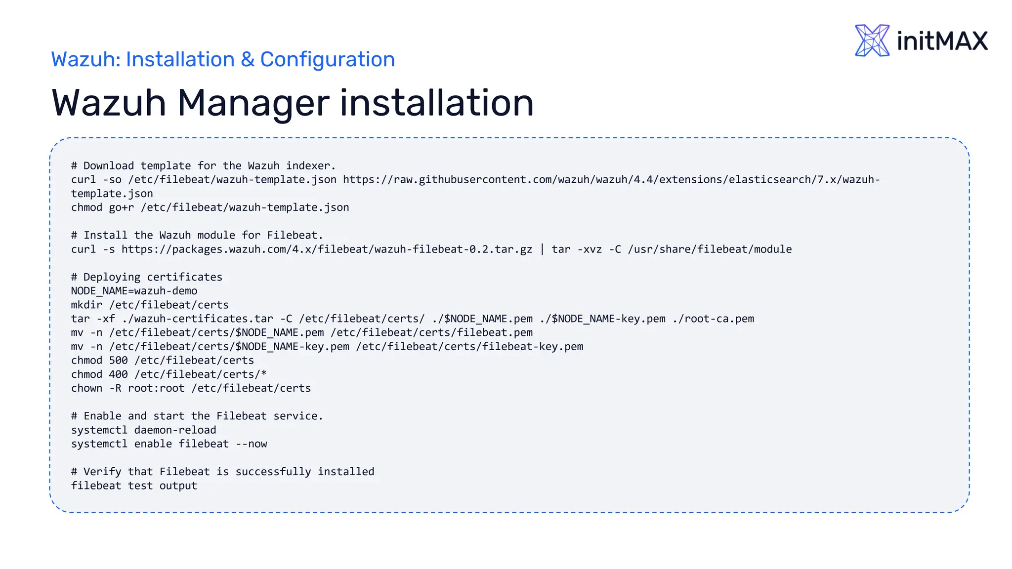



Slide 14
MODULE 3:
SHUFFLE SOAR INTEGRATION
Deploy Shuffle using Docker and connect it to Wazuh via API.
Create playbooks that automate responses: isolate host, send alerts, escalate tickets.
Test workflows with simulated threat alerts to validate automation.

Slide 15
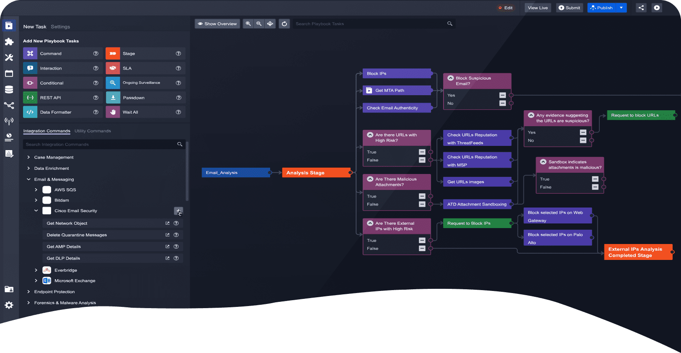

Slide 16
MODULE 4:
CENTRALIZED DASHBOARD & ALERTING
Integrate Wazuh with Kibana or OpenSearch for real-time visualization.
Display threat trends, alert severity and response actions on a unified dashboard.
Enable email/SMS notifications for critical alerts.

Slide 17
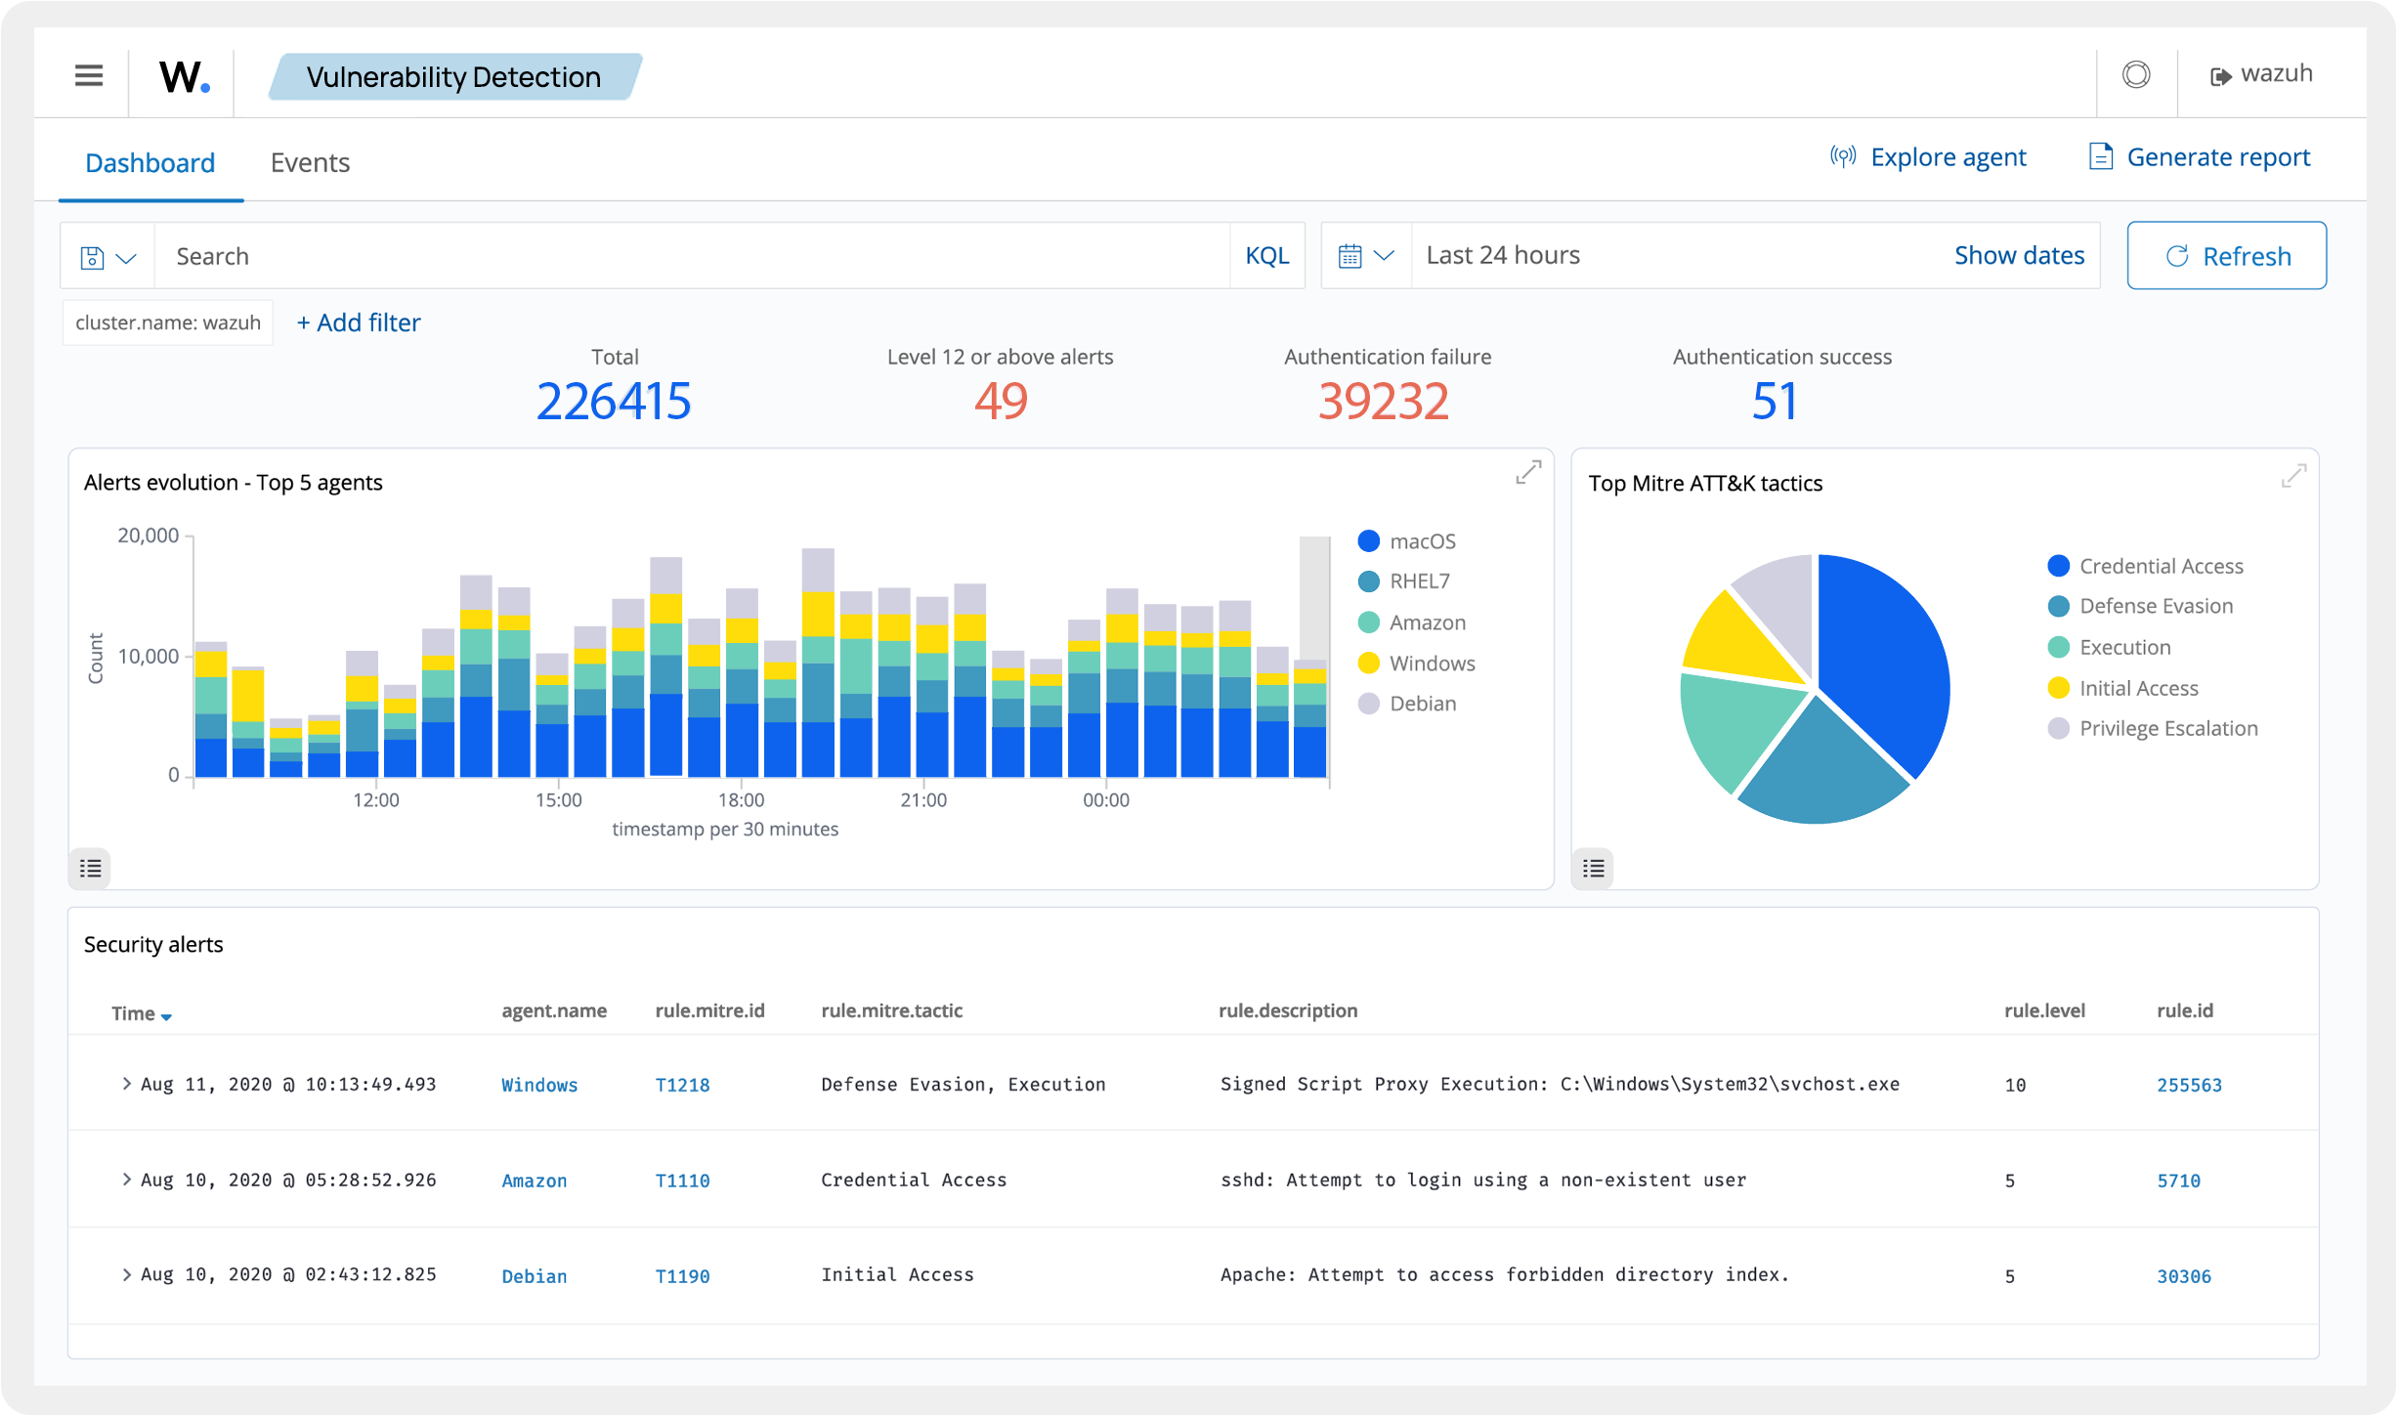

Slide 18
MODULE 5:
INCIDENT RESPONSE WORKFLOWS
Design Shuffle playbooks for specific threats:
Phishing: Notify user, block domain, log incident.
DoS: Quarantine IP, alert SOC, update firewall rules.
Use conditional logic and branching to handle complex scenarios.

Slide 19
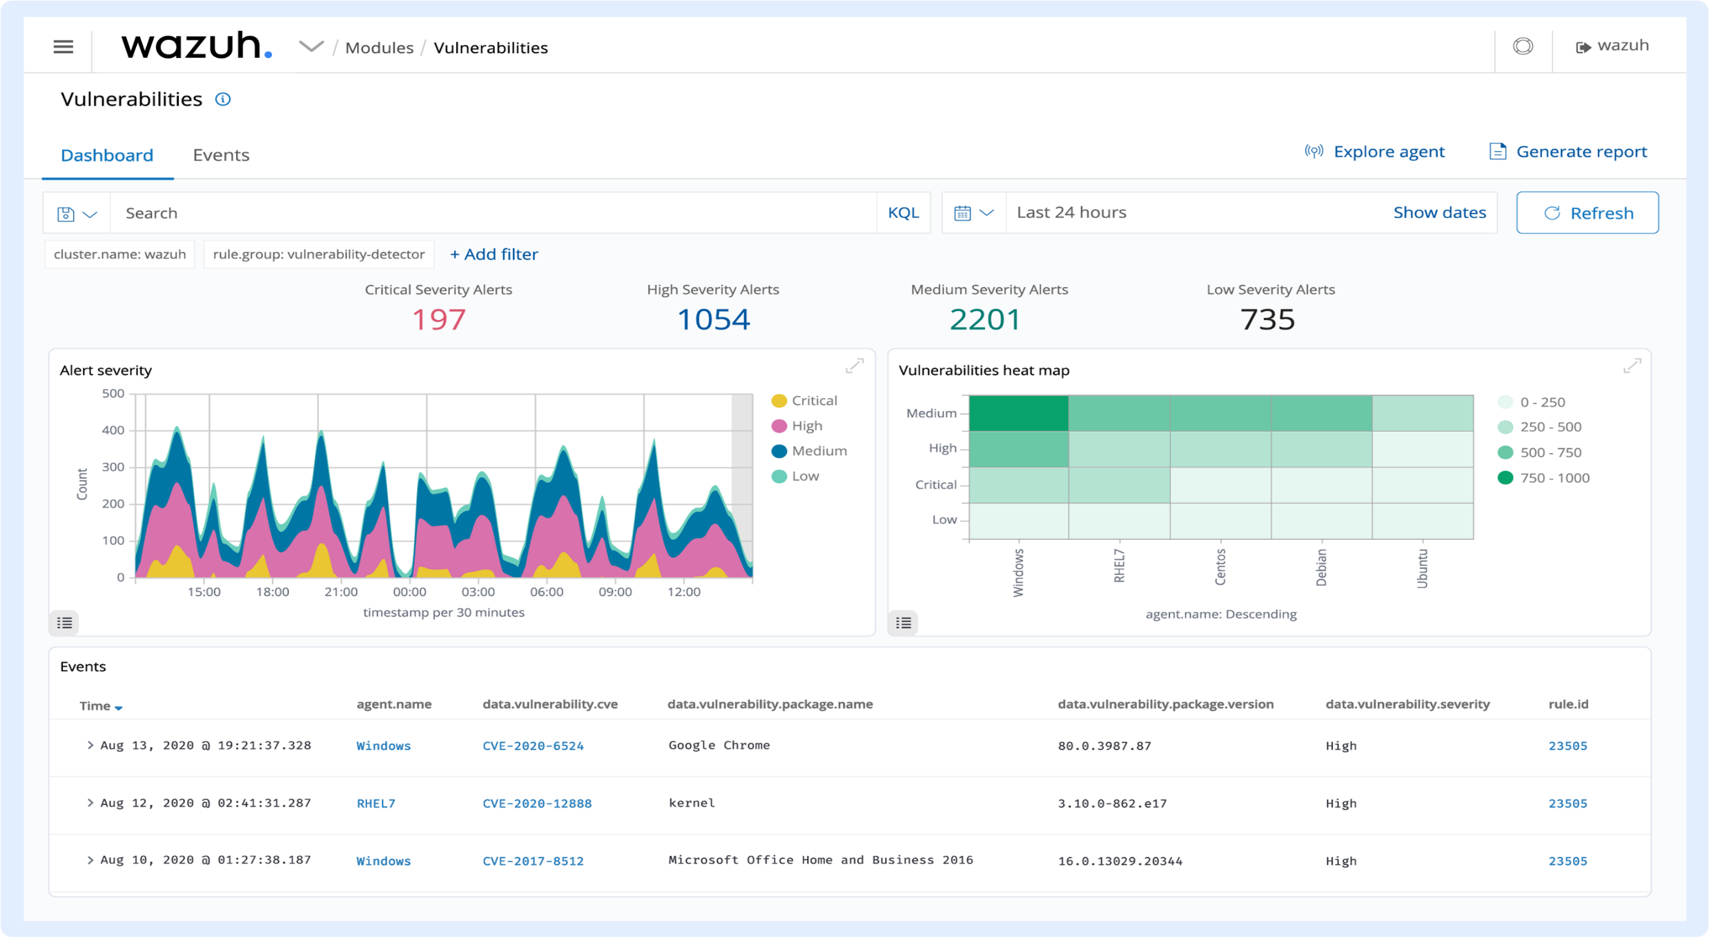

Slide 20
MODULE 6:
COMPLIANCE & SCALABILITY
Align system with standards like ISO 27001, HIPAA, GDPR.
Ensure log retention policies and access controls are enforced.
Design architecture to scale with enterprise growth and agent expansion.

Slide 21
Performance Evaluation:
Detection Speed: Threats identified within 2–5 seconds of log ingestion.
Response Time: Automated playbooks execute within 3 seconds of alert trigger.
Manual Effort Reduction: 60–70% decrease in analyst workload.
Alert Accuracy: 90%+ precision in rule-based threat detection.
Scalability: Supports 1000+ endpoints with consistent performance

Slide 22
Challenges & Solutions:
Challenge: Initial API integration between Wazuh and Shuffle.
Solution: Used RESTful API with token-based authentication and tested with simulated alerts.
Challenge: False positives in phishing detection.
Solution: Refined Wazuh rules and added domain reputation checks.
Challenge: Resource constraints on Shuffle server.
Solution: Optimized Docker deployment and scaled RAM to 16 GB.
Challenge: Alert overload in dashboard.
Solution: Implemented alert prioritization and severity filters.

Slide 23
Future Enhancements:
Integrate machine learning models for predictive threat detection.
Add support for mobile device monitoring and response.
Enable multi-cloud compatibility (AWS, Azure, GCP).
Develop role-based access control for dashboard users.
Expand playbook library to cover insider threats and ransomware.

Slide 24
Components:
Softeware Requirements
• Wazuh Manager (Linux-based server: Ubuntu, CentOS, Debian)
• Wazuh Agents (Windows, Linux, macOS endpoints)
• Shuffle SOAR Platform (Docker-based deployment)

Slide 25
Hardware Requirements:
Wazuh Manager Server
• CPU: 4–8 cores (Intel Xeon or AMD EPYC recommended)
• RAM: 16–32 GB (depending on log volume and agent count)
• Storage: SSD with 500 GB+ (expandable based on retention policy)
• Network: Gigabit Ethernet for fast log ingestion
Shuffle Server
CPU: 4 cores
RAM: 8–16 GB
Storage: 100 GB SSD
Network: Reliable internet for API integrations

Slide 26
CONCLUSION
The integration of Wazuh and Shuffle offers a powerful, scalable cybersecurity framework.
Real-time monitoring and automated response reduce manual effort and improve SOC efficiency.
This modular approach ensures adaptability, compliance and resilience against evolving threats.

