Slide 1
PawFam
24CS635 – Full Stack Development

Slide 2

PawFam Slogan : Short Stay, Big Love
https://github.com/PROFESSOR-DJ/Full-Stack-Project
Review-1

Slide 3
Collaborators
Collaborator Name
Organization
URL of Organization

Slide 4



GROUP MEMBERS
Roll No | Name | Official Email id | Contribution | Photo
CB.SC.P2CSE25009 | DHIRAAJ K V | Cb.sc.p2cse25009@cb.students.amrita.edu | Created Login/SignUp/Forgot Forms, Home Page, User Postings, and the About section
CB.SC.P2CSE25035 | SUDHARSHAN | Cb.sc.p2cse25035@cb.students.amrita.edu | Created Listing of price and services, User Postings and Cart/Check Out
CB.SC.P2CSE25010 | GOKUL KANNAN | Cb.sc.p2cse25010@cb.students.amrita.edu | Listing of Grooming and Pet Food Products, User Postings

Slide 5
Abstract
PawFam is a connecting platform for premier short-term pet shelter and care centers and pet owners who are out to take a break for themselves.
Additionally, we link a wide range of pet food and accessory retailers with customers and pet adoption centers with prospective owners.
Many of the existing services like Charlies Animal Rescue Centre (who provide timely medical aid to injured and ill animals), Petsy (Pet Food and accessories), PetPlace (Pet Adoption) only focus on a single aspect of pet care and services. We are a one-stop solution for pet adoption and all your pet care and needs.
Our USP is that we bridge short-term pet shelter and care centers with pet owners who want to spend some time for themselves (be it a vacation, a family function etc.)
List of reports – Pet Accessories and Pet Food (Daily Sales Report across all vendors), Pet Shelter (Daily Intake report, Daily Pet Churn report across all vendors), Pet Adoption (New Pet owners report across all vendors – on a daily basis)

Slide 6
List of similar products and features
Product Name | URL | Features | What features are missing in the product (Can also include responsiveness, Technology aspect)
Juspets | https://www.juspets.in/ | Listing about pet care and real-time postings | The website is not very responsive (user posting)
IAdopt | https://iadopt.in/ | Adoption services, Donation and large community | They offer a Google form as the application form for adopting new pets
Charlies Animal Rescue Centre | https://charlies-care.com/ | Animal Shelter which provides timely medical aid to injured and ill animals | They do not offer short term pet care and shelter services.

Slide 7
Uniqueness of product???
PawFam is the first of its kind to bridge short term pet shelter and care centers with pet owners.
PawFam is also a one stop solution for all your pet food and accessory requirements.
Additionally, PawFam offers pet adoption services by connecting adoption centers with prospective pet owners.

Slide 8
Full Stack AI product
AI Chatbot/Virtual Assistant – Helps pet owners with booking, FAQs, emergency guidance, and personalized care recommendations.
Personalized Recommendations – Suggests best pet accessories, diet plans, based on pet breed, age, and past choices.

Slide 9
Users/Roles
User Name | Role | Type of functions expected by the user
Customer | Utilize the provided service | Login, Utilize the services offered
Temporary pet shelter providers | Update their services to the users | Update the availability of services and prices
Pet Food and Accessory retailers | Update their product portfolio to the users | Update the availability of products and prices
Pet adoption centers | Update their list of pets to the user | Update the availability of pets
Admin | Administrator | Monitor logs and update bug fixes

Slide 10



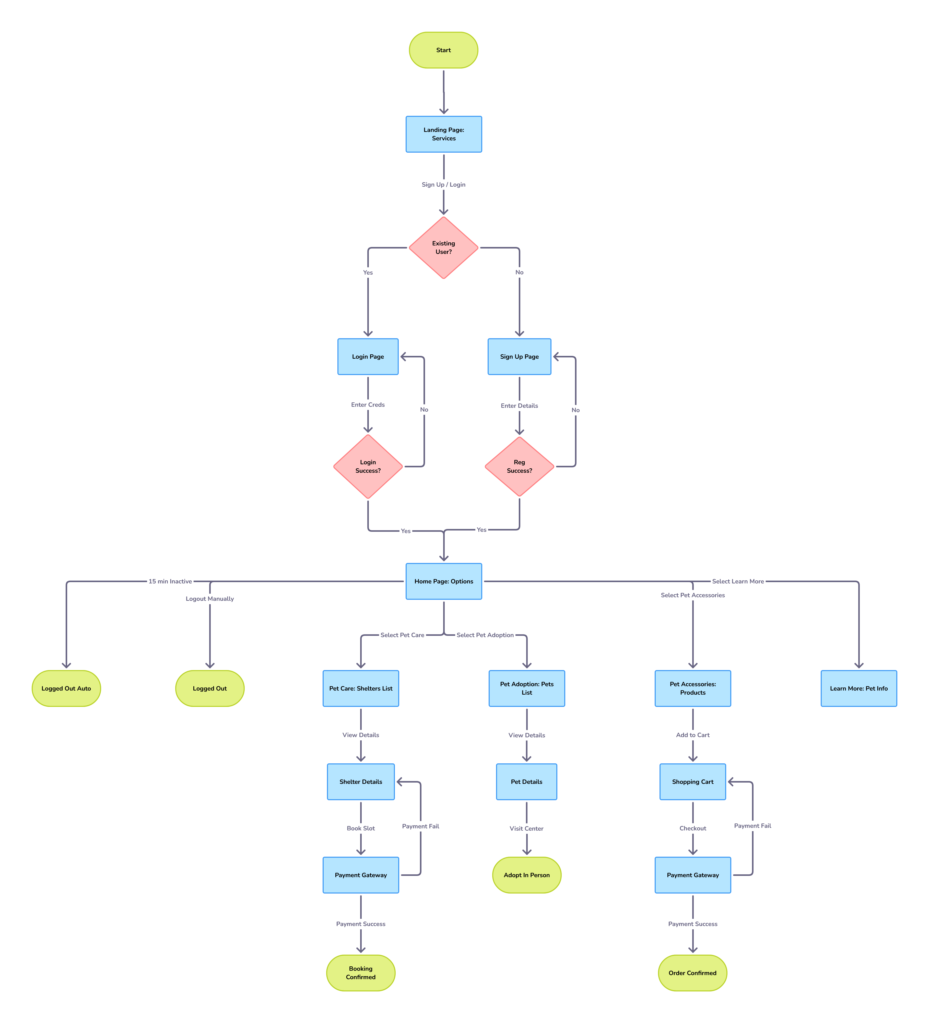


Block Diagram
(User Journey)

Slide 11
Module Details
Module Name | Sub Module | Functions
User Dashboard/ Home Page | Login/SignUp/Forgot Password Forms, Service Listing, Cart/Checkout, Home Page navigation components. | Register/Login to the portal, View the features and services offered, Look for unchecked products
Pet Shelter Page | Centers Listing, Price Listing and Service availability | Listing of different pet care centers with their service and availability
Pet Adoption | User Postings | Users upload their interests to adopt a pet

Slide 12
Module Details
Module Name | Sub Module | Functions
Learn About Pets | Information of different pets | Users can learn about the different pets, their behaviour, types etc
Pet Care | Listing of Pet Food and Accessories | Users can purchase pet food or accessories

Slide 13
Technology Stack
Front End - React JS
Back End - Python
Scripting language - JavaScript
Editor – Visual Studio Code Insiders
Backend - MongoDB
Language – Python, JavaScript
Server – Amrita Hosting
Testing Tool – Selenium & Postman

Slide 14
Reference
Juspets: https://www.juspets.in/
IAdopt: https://iadopt.in/
Charlies Animal Rescue Centre: https://charlies-care.com/
Petsy: https://petsy.online/

