Slide 1
Subject code- Subject Name

Slide 2
Title of project Slogan : Refer: https://www.webfx.com/blog/marketing/brand-slogan-examples/
Product Logo
Github URL
URL of the git link/server where it is posted
Review-1

Slide 3
Collaborators
Collaborator Name
Organization
URL of Organization

Slide 4
GROUP MEMBERS
Roll No | Name | Official Email id | Contribution | Photo
CB.SC.P2AIE23021 |  |  | Text Preprocessing, Noise removal, Lasso, Ridge regression, Kmeans with SVM, Fuzzy C-means with KNN, Multinomial Naive Bayes, Kmeans with CNN, RNN-LSTM
CB.SC.P2AIE23022 |  |  | Descriptive Statistics, Smote algorithm, Linear, Logistic regression, Kmeans with KNN, Gaussian Naive Bayes, Decision Tree, AdaBoost Classifier, RNN-GRU

Slide 5
Abstract
---Write as a paragraph
About the product
Features of the product
How it is resembling to existing products
How is the product Responsive?
List of reports that will be provided the product
Can indicate how the testing will be done for the product

Slide 6
List of similar products and features
Product Name | URL | Features | What features are missing in the product? (Can also include responsiveness, Technology aspects)

Slide 7
Uniqueness of product???
Justify referring to sources why this product is essential
Can also indicate the features and jusify?
Functions planned can also be thought.
Demographic analysis can also be provided on how the product will be used
* The slide should justify why this product is required when there are existing products , Provide your thoughts in different dimensions

Slide 8
Full Stack AI product
Write in your own words what features can be added to this product so that it can be called as a full stack AI product
Can also provide aspects of computer vision/camera integration,IoT ,Security aspects to the product
Kindly refer
https://medium.com/@smith.emily2584/full-stack-web-development-with-ai-a-comprehensive-guide-d84c02f6ea54

Slide 9
Users/Roles
User Name | Role | Type of functions expected by user
In Hotel Billing system For ex: Front Office Manager | They take care of the approval of room booking in the Hotel | View room availability Cancel booking done by Customer Payment approval Payment concession

Slide 10
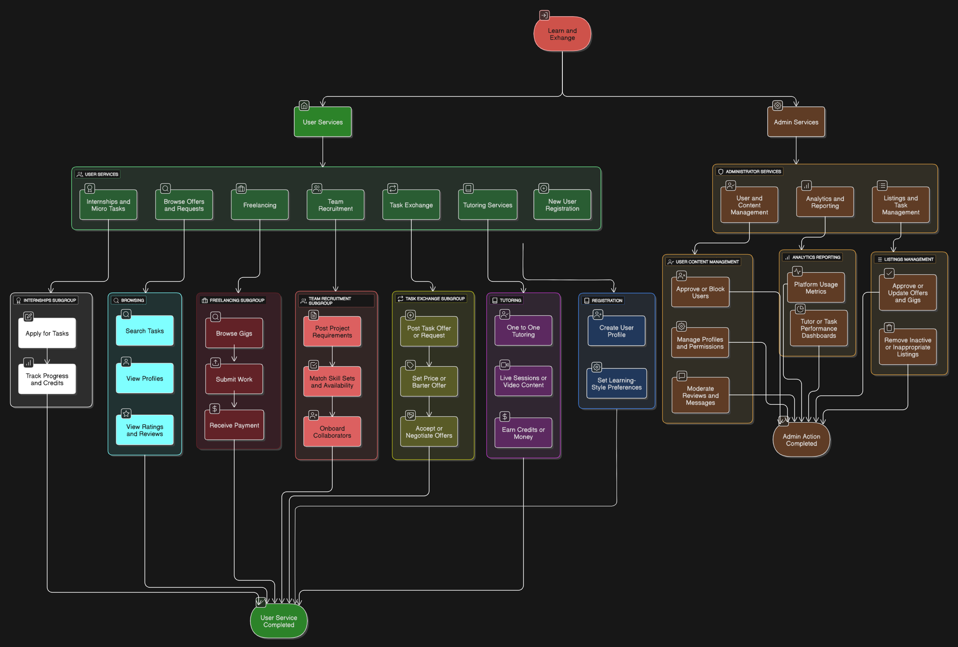
Block Diagram
Consider the product flow and draw the block diagram

Slide 11
Module Details
Module Name | Sub Module | Functions
For Ex: Hotel Booking | Room Availability | Search for Room Book a Room Cancel a Room View Discounts for Rooms
 | Group Booking | View Room Availability Discount offers based on group count

Slide 12
What kind of responsiveness is planned to provided in the product?
How quickly can the product engage in the business model of the user?
How will users be more engaged in your product?
How will you make sure that your product comes as a first one while searching for a requirement ?
What concepts/technologies are available that are used in the product?
For ex: if I am searching for food order I may get zomato as users accessing is high???
A demographic analysis can also be provided

Slide 13
Technology Stack
Front End -
Back End
Scripting language
Editor
Backend
Language
Server
Testing Tool
Framework Details

Slide 14
Reference
URL’s referred for the product

