Slide 1
Employee Performance Analysis using Excel
STUDENT NAME : GOKULAKRISHNAN J
REGISTER NO : 122201074 NM:E7F4B1A03902A5D96EB4FAAC6C6F460A
DEPARTMENT : B.COM. Corporate Secretaryship
COLLEGE : Apollo Arts & Science College

Slide 2
PROJECT TITLE
Employee Performance Analysis using Excel

Slide 3


AGENDA
Problem Statement
Project Overview
End Users
Our Solution and Proposition
Dataset Description
Modelling Approach
Results and Discussion
Conclusion
3/21/2024 Annual Review

Slide 4

PROBLEM STATEMENT
Employee performance analysis is conducted to evaluate how well employees are meeting job expectations and contributing to organizational goals. It helps identify strengths and areas for improvement, guiding decisions on promotions, training, and rewards. This analysis also ensures alignment between employee efforts and the company’s objectives, ultimately enhancing overall productivity and efficiency.

Slide 5

PROJECT OVERVIEW
This project utilizes a dataset containing key attributes related to employee performance, extracted from the Edunet Dashboard. The dataset comprises 10 selected features, including employee identifiers (ID, First Name, Last Name), business details (Business Unit Code, Employee Status), and performance metrics (Performance Score, Current Employee Rating, Performance Level). The primary objective of this analysis is to evaluate employee performance levels (ranging from Very High to Low) and to explore how various factors such as employee classification, type, and gender influence these performance outcomes. Insights from this analysis will guide the organization in optimizing employee management strategies, improving performance, and aligning workforce capabilities with business goals.

Slide 6
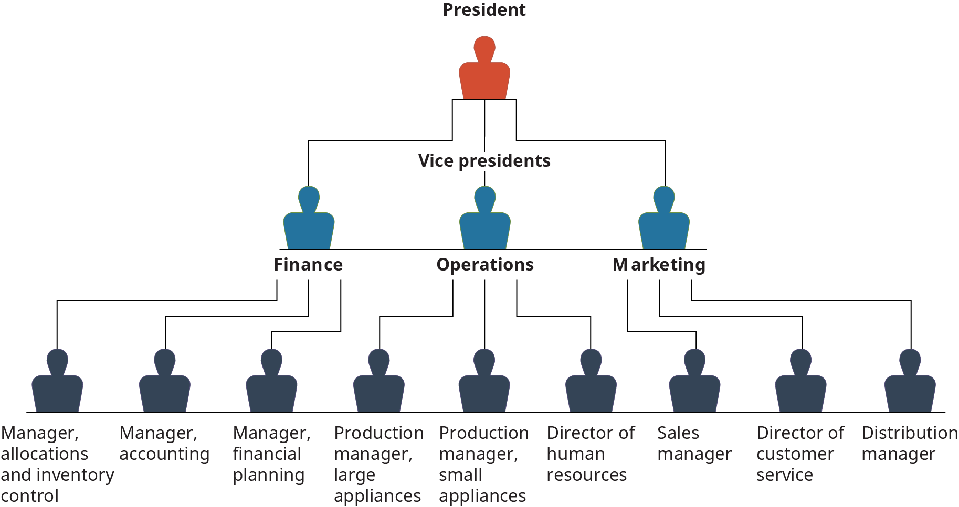

WHO ARE THE END USERS?

Slide 7

OUR SOLUTION AND ITS VALUE PROPOSITION
Conditional Formatting- Used to highlight the blank spaces.
Filter- Used to remove those blank spaces.
Formula - Used to categorize the performance of the employees.
Pivot table - Summary of the employee performance.
Bar chart – Visualization of the data in the pivot table.
Pie chart – Representation of high performance of the employees.

Slide 8
Dataset Description
Employee Data – Edunet Dashboard.
10 features ( From 26 features).
Employee ID- Number.
First Name – Text.
Last Name- Text.
Business Unit- Code.
Employee Status- Text.
Employee Type- Text.
Employee Classification Type- Text.
Gender Code- Male or Female.
Performance Score- Text.
Current Employee Rating- Number.
Performance Level – (Very High/High/Med/Low).

Slide 9

THE "WOW" IN OUR SOLUTION
Performance Level =IF(J8>=5,"VERYHIGH",IF(J8=4,"HIGH",IF(J8=3,"MED","LOW")))
3/21/2024 Annual Review
9

Slide 10
MODELLING
Data Collection :
Employee Data from Edunet Dashboard.
Ten selected features from 26 available features .
Data includes personal, business unit, and performance details.
Feature Collection :
1. Employee ID, Name, and Business Unit Code.
2. Employee Status, Type, and Classification Type .
3. Performance Score, Current Employee Rating, Performance Level.
Data Cleaning :
1. Handle missing or inconsistent data (e.g., incomplete records) .
2. Used Conditional Formatting to highlight blank spaces and Filter to remove those blank spaces.
Performance Level :
1. Used formula to Categorize performance levels: Very High, High, Medium, Low.
2. To Evaluate Employes Performance.
10

Slide 11
Visualization:
1. Bar Chart (Pivot Table): - Show distribution of employees across performance levels - Compare performance by business units or classification types.
2. Pie Chart: - Visualize the high performed employees.
Summary:
1. Identified key features influencing employee performance .
2. Established a model for categorizing employees by performance levels .
3. Used pivot tables and charts to visualize and interpret performance data .
4. Provided actionable insights for HR and management decisions.

Slide 12
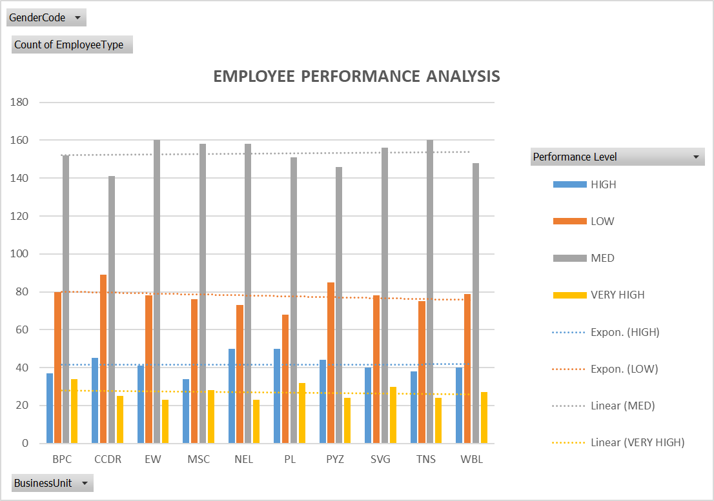
RESULTS
12

Slide 13
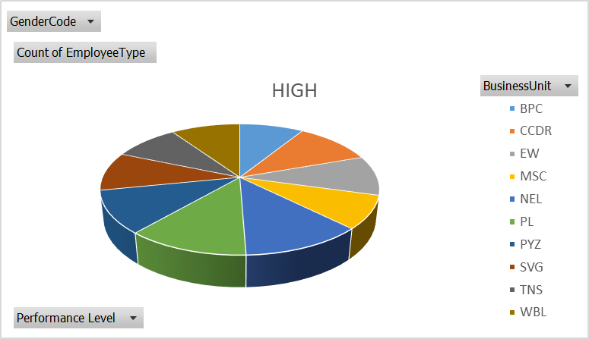
RESULTS

Slide 14
Conclusion
The performance analysis across different business units shows that:
Medium performers, are the largest group across business units.
Low performers follow, indicating areas needing improvement.
High performers are fewer, showing growth potential.
Very high performers are the smallest group, highlighting top talent.
The focus should be on elevating low and medium performers while nurturing high performers to boost overall organizational success.

