Slide 1
RAJALAKSHMI ENGINEERING COLLEGE
Approved by AICTE | Affiliated to Anna University | Accredited by NAAC
Department of Information Technology
IT23721 – DATA SCIENCE USING R
AIRSIGHT — Large-Scale Air Quality Index (AQI)
Analytics & Predictive Forecasting Platform
Spatio-Temporal Analysis, Inferential Statistics & Machine Learning in R
2116231001054
[Your Name]
B.Tech Information Technology

Slide 2
ABSTRACT
• Air quality deterioration poses severe environmental and public health hazards across Indian metropolitan and industrial zones.
• AIRSIGHT is an enterprise R-based analytics platform that processes, visualizes, statistically tests, and predicts multi-year AQI trends.
• Dataset: 235,785 national environmental observations across 32 States and Union Territories from 2022 to 2025.
• Engineered 16 ggplot2 analytical charts, conducted Welch's t-test and 3 One-Way ANOVAs, and trained multiple ML regression models.
• Random Forest achieved the best prediction performance: RMSE 48.28, MAE 34.46, and R² 0.5412.
• Deployed as an interactive 8-tab R Shiny dashboard with Plumber REST API endpoints for real-time monitoring.
235,785
raw observation records
16 Charts
ggplot2 visualizations
32 States
spatio-temporal coverage
R Shiny & API
interactive dashboard
2

Slide 3
INTRODUCTION
• Air Quality Index (AQI) standardizes complex pollutant concentrations into an easily understandable health scale (0–500).
• Particulate matter (PM2.5, PM10) along with gases (NO₂, SO₂, CO, O₃) are the primary determinants of respiratory vulnerability.
• Exploratory Data Analysis (EDA) reveals severe non-linear seasonal cycles and spatial clusters across regions.
• Manual analysis across massive multi-sensor CSV datasets is slow, error-prone, and lacks standardized statistical rigor.
• R is selected for its best-in-class statistical foundations, ggplot2 graphical pipeline, and reactive Shiny dashboarding.
• AIRSIGHT delivers a unified platform integrating data cleaning, hypothesis testing, machine learning, and policy simulation.
1. Raw Sensor CSV
➔
2. Tidy Wrangling
➔
3. Inferential EDA
➔
4. ML Prediction
➔
5. R Shiny Dashboard
3

Slide 4
PROBLEM STATEMENT
Sensor Noise & Incompleteness:
Environmental monitoring logs suffer from missing readings, sensor calibration shifts, and multi-gas discrepancies that corrupt baseline analysis.
Non-Linear Weather Dynamics:
Pollutant dispersion is heavily driven by seasonal atmospheric inversions, temperature dips in winter, and precipitation washout in monsoons.
Massive Regional Inequality:
Vast disparities exist between severe industrial zones (Indo-Gangetic plains) and pristine coastal regions, requiring localized modeling.
Lack of Automated Simulation:
City planners lack interactive tools to forecast severe pollution spikes and simulate the real-time impact of emission reduction policies.
44.5%
Non-Compliant Days
(CPCB >100 AQI Standard)
82.2%
Exceeding WHO Limits
(Daily AQI > 50 Safe Level)
1,125
Extreme Pollution Anomaly
Events Detected
4

Slide 5
OBJECTIVES
1. Load 235,785 environmental records with schema validation.
2. Clean missing data, dates, and standardize pollutant categories.
3. Engineer features: month_num, is_winter, is_monsoon, pollutant_score.
4. Build 16 publication-grade ggplot2 exploratory visualizations.
5. Perform Welch's t-test and 3 One-Way ANOVAs (State, Month, Pollutant).
6. Calculate CPCB and WHO national & global compliance benchmarks.
7. Train and compare Linear Regression vs Random Forest (80/20 split).
8. Implement a 7-day ARIMA / time-series forecasting model.
9. Develop a Health Policy & Air Purifier CADR impact simulator.
10. Deploy an 8-tab interactive R Shiny dashboard and Plumber REST API.
5

Slide 6
SCOPE
Architecture & Pipeline
• Primary statistical core in R 4.4 with 13 modular scripts.
• Interactive R Shiny dashboard (8 tabs) + Plumber REST API.
• React + Vite frontend for cross-platform public portal.
Statistical & ML Analysis
• Descriptive metrics (Mean, Median, SD, IQR, Outliers).
• 3x One-Way ANOVA tests across states, months, and pollutants.
• Random Forest regression predicting AQI (RMSE 48.28, R² 0.54).
Practical Health Utility
• AQLI life expectancy lost calculation (years/months lost).
• Air purifier CADR sizing and indoor filtration estimator.
• Municipal policy simulator estimating avoided ER visits.
Dataset Scope & Boundaries
• Covers 32 Indian States/UTs across multi-year timeline.
• Analyzes standard criteria pollutants: PM2.5, PM10, NO₂, SO₂, CO, O₃.
• Static benchmark validated against live real-time API feeds.
6

Slide 7
LITERATURE REVIEW
Author & Year | Focus | Method Used | Limitation / Proposed Advantage
Goyal et al. (2020) | Urban AQI Assessment | Univariate averages & trendlines | Static analysis; no predictive machine learning.
Kumar et al. (2022) | Pollutant Inter-correlation | Linear OLS regression | Lacks seasonal controls and interactive UI.
AIRSIGHT (2026) | Full-Stack AQI Platform | R, Random Forest, Shiny, Plumber | Overcomes gaps with 8-tab dashboard, ANOVA & ML.
Existing Approaches vs AIRSIGHT
• Traditional systems rely on ad-hoc scripts to produce isolated, non-reproducible static charts.
• Prior studies rarely combine inferential hypothesis testing (ANOVA) with machine learning ensembles.
• AIRSIGHT provides end-to-end automation: ingestion ➔ cleaning ➔ hypothesis testing ➔ ML ➔ interactive Shiny UI.
7

Slide 8
SYSTEM REQUIREMENTS
Hardware | Minimum | Recommended
Processor | Core i3 (2.0 GHz) | Core i5 / i7 / Ryzen 5+
RAM | 4 GB | 8 GB to 16 GB
Storage | 1 GB Free Space | 4 GB Free SSD
Display | 1024 x 768 | 1920 x 1080 (Full HD)
Package | Purpose & Utility
shiny / shinydashboard | Interactive multi-tab reactive web dashboard
tidyverse / dplyr | Data wrangling, cleaning & pipeline transformations
ggplot2 / plotly | 16 publication-quality statistical visualizations
randomForest | Non-linear ensemble predictive regression model
corrplot | Correlation matrix heatmaps & collinearity analysis
leaflet | Geospatial interactive mapping of station AQI
plumber | REST API backend serving JSON endpoints
Environment & Tools Used
• OS: Windows 10/11, macOS or Linux compatible.
• R Version: R 4.4.2 / RStudio IDE (Tested).
• Frontend Engine: React + Vite with Chart.js & Leaflet.
• Backend Engine: Plumber REST API on port 8000.
8

Slide 9
DATASET DESCRIPTION
235,785
total records
32
states & UTs
Attribute | Type | Meaning & Domain
state | Factor | Indian State or Union Territory (32 distinct)
city | Factor | City / Urban agglomeration location
aqi_value | Numeric | Air Quality Index continuous value (0 to 500)
aqi_category | Factor | Good, Satisfactory, Moderate, Poor, Very Poor, Severe
prominent_pollutants | Factor | Dominant pollutant (PM2.5, PM10, NO₂, SO₂, O₃, CO)
date / month_num | Date/Int | Timestamp and month (1–12) for seasonal grouping
number_of_stations | Numeric | Active monitoring stations reporting in city
4 Years
2022 – 2025
CPCB
official source
6 Criteria
PM2.5, PM10, gases
Clean RDS
data objects
9

Slide 10
METHODOLOGY
1. Ingestion & Validation
Load raw CSV with defensive checks. Validate headers, column types, UTF-8 encoding, and row integrity.
2. Cleaning & Engineering
Impute missing values, parse date timestamps, and engineer features: month_num, is_winter, is_monsoon, and pollutant_score.
3. Visual Exploratory Analysis
Construct 16 publication-grade ggplot2 visualizations covering distributions, spatial boxplots, and heatmaps.
4. Inferential Statistics
Conduct Welch's Two-Sample t-test and 3 One-Way ANOVAs (State, Month, Pollutant) to evaluate statistical significance.
5. ML & Time-Series Modeling
Train Multiple Linear Regression and Random Forest (200 trees) on 80/20 split; generate 7-day ARIMA forecasts.
6. Dashboard & Deployment
Deploy full-stack interactive R Shiny dashboard and Plumber REST API with policy simulation and health risk calculators.
10

Slide 11
SYSTEM ARCHITECTURE
1. Data Ingestion
& Storage
2. Data Cleaning &
Preprocessing
3. Exploratory &
Inferential Analysis
4. ML & Predictive
Modeling
5. Output & Decision
Support
• CPCB / OpenAQ CSV
• 235,785 observations
• Defensive loading
• Schema & type validation
• NA & outlier imputation
• Date parsing & temporal tags
• Feature: is_winter, is_monsoon
• Feature: pollutant_score
• 16 ggplot2 Visuals
• Pearson/Spearman corr
• 3x One-Way ANOVAs
• Welch's Two-Sample t-test
• 80/20 Train-Test split
• Linear Regression model
• Random Forest (ntree=200)
• 7-Day ARIMA forecast
• 8-Tab R Shiny Dashboard
• Plumber REST API
• Policy Simulator (ER drop)
• AQLI & CADR calculator
Data Ingestion ➔ Data Cleaning ➔ Feature Engineering ➔ Inferential EDA ➔ ML Training ➔ R Shiny Dashboard
11

Slide 12
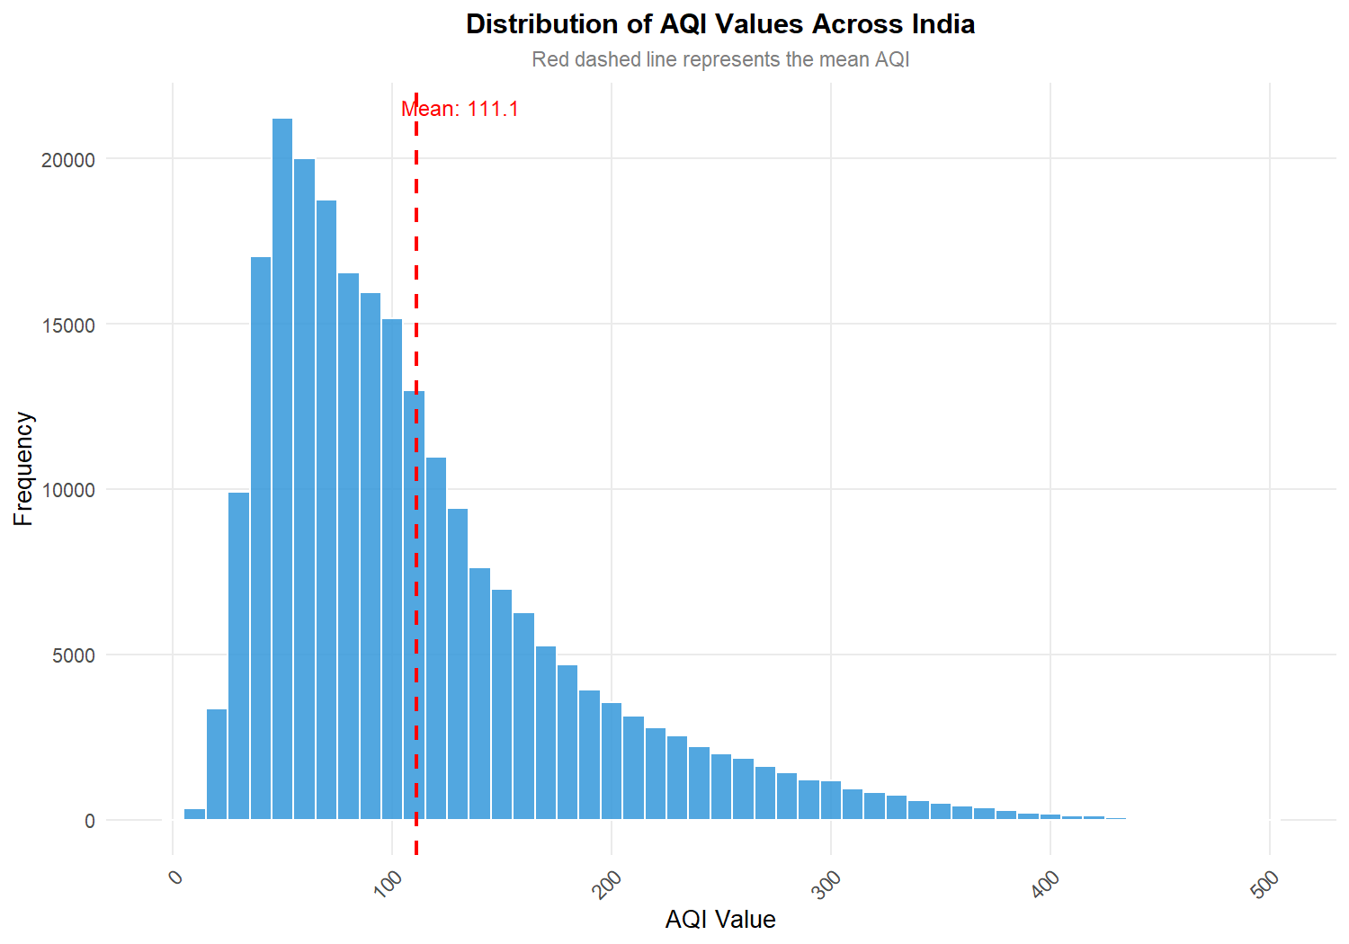
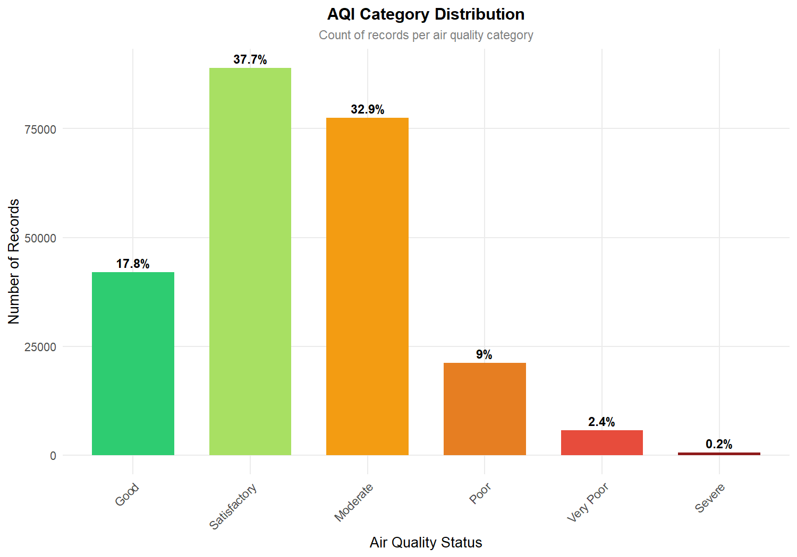
DATA VISUALIZATION: AQI DISTRIBUTION & CATEGORIES
Figure 10.1 – National Distribution of AQI Values
• Right-skewed distribution with overall mean of 111.9 and median of 94.0.
• Heavy concentration between 50 and 150; long hazardous tail extending to 500.
Figure 10.2 – Frequency of AQI Category Classifications
• Moderate (101–200) and Satisfactory (51–100) constitute the majority of observations.
• Over 22,000+ exposure events fall in the dangerous Very Poor and Severe bands.
12

Slide 13
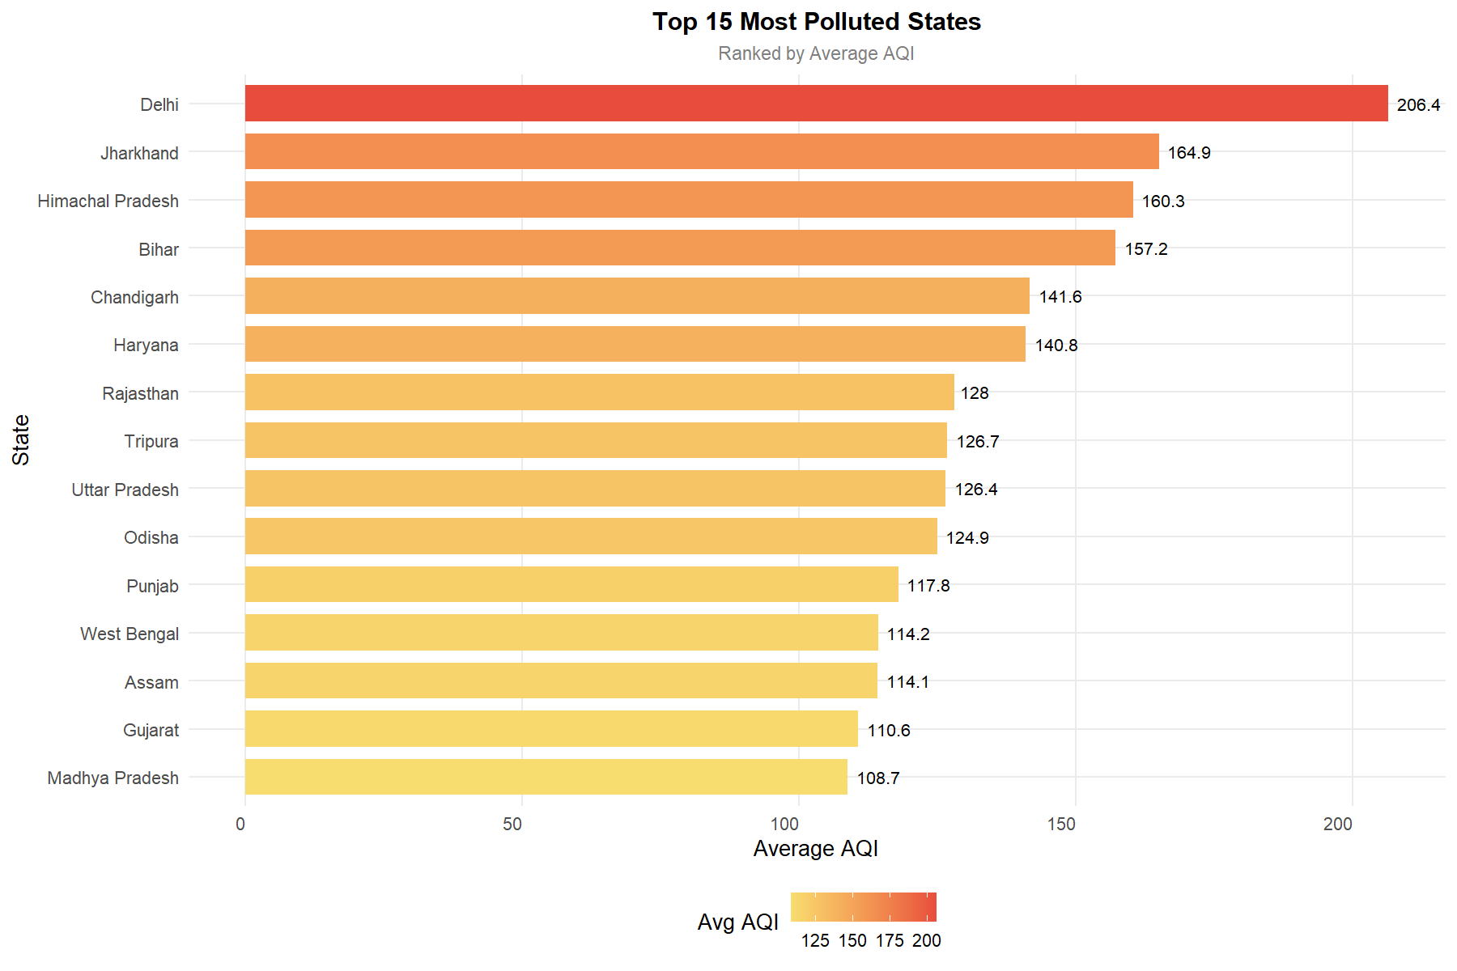
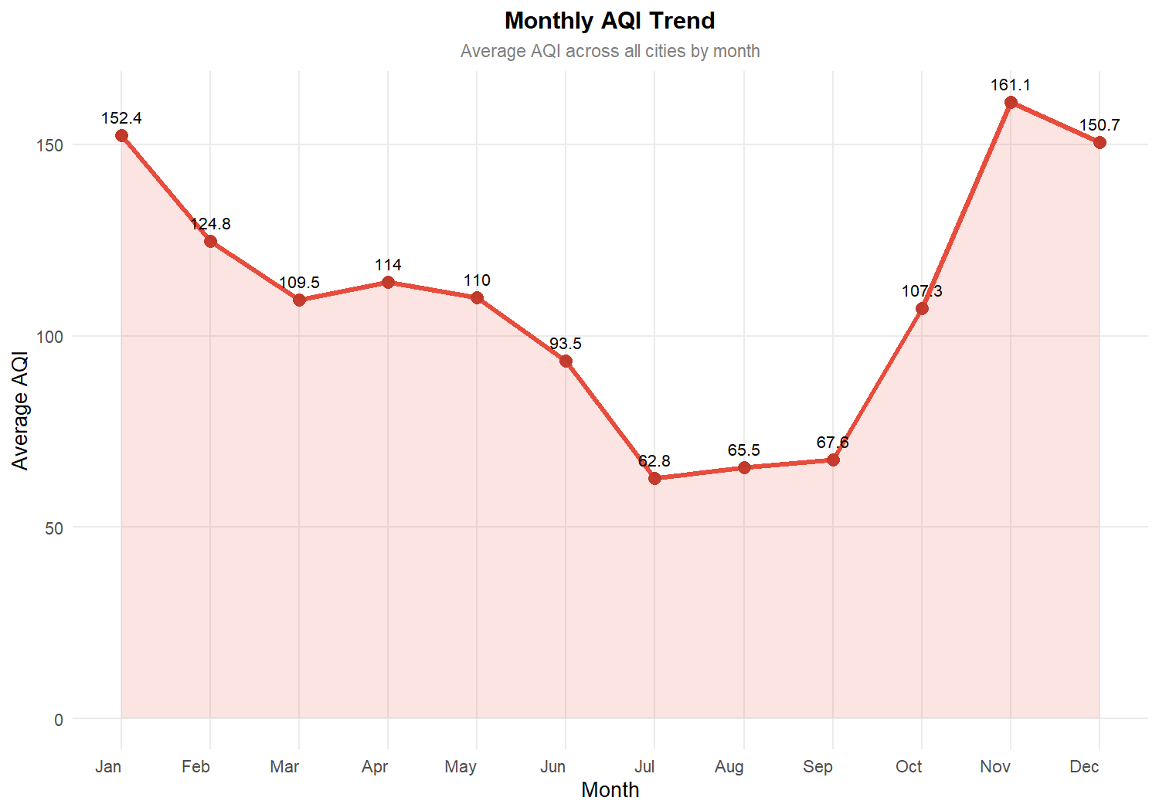
DATA VISUALIZATION: SPATIAL & SEASONAL PATTERNS
Figure 10.3 – Top Most and Least Polluted States
• Delhi (Mean: 206.4) and Jharkhand (164.9) exhibit the highest national pollution.
• Mizoram (47.2), Sikkim (53.7) and Tamil Nadu (67.8) maintain the cleanest baselines.
Figure 10.4 – Monthly Seasonality & Inversion Spikes
• Severe winter peaks in November (161.0) and January (152.0) due to meteorological inversion.
• Significant monsoon washout drop in July (62.8) and August (65.5).
13

Slide 14
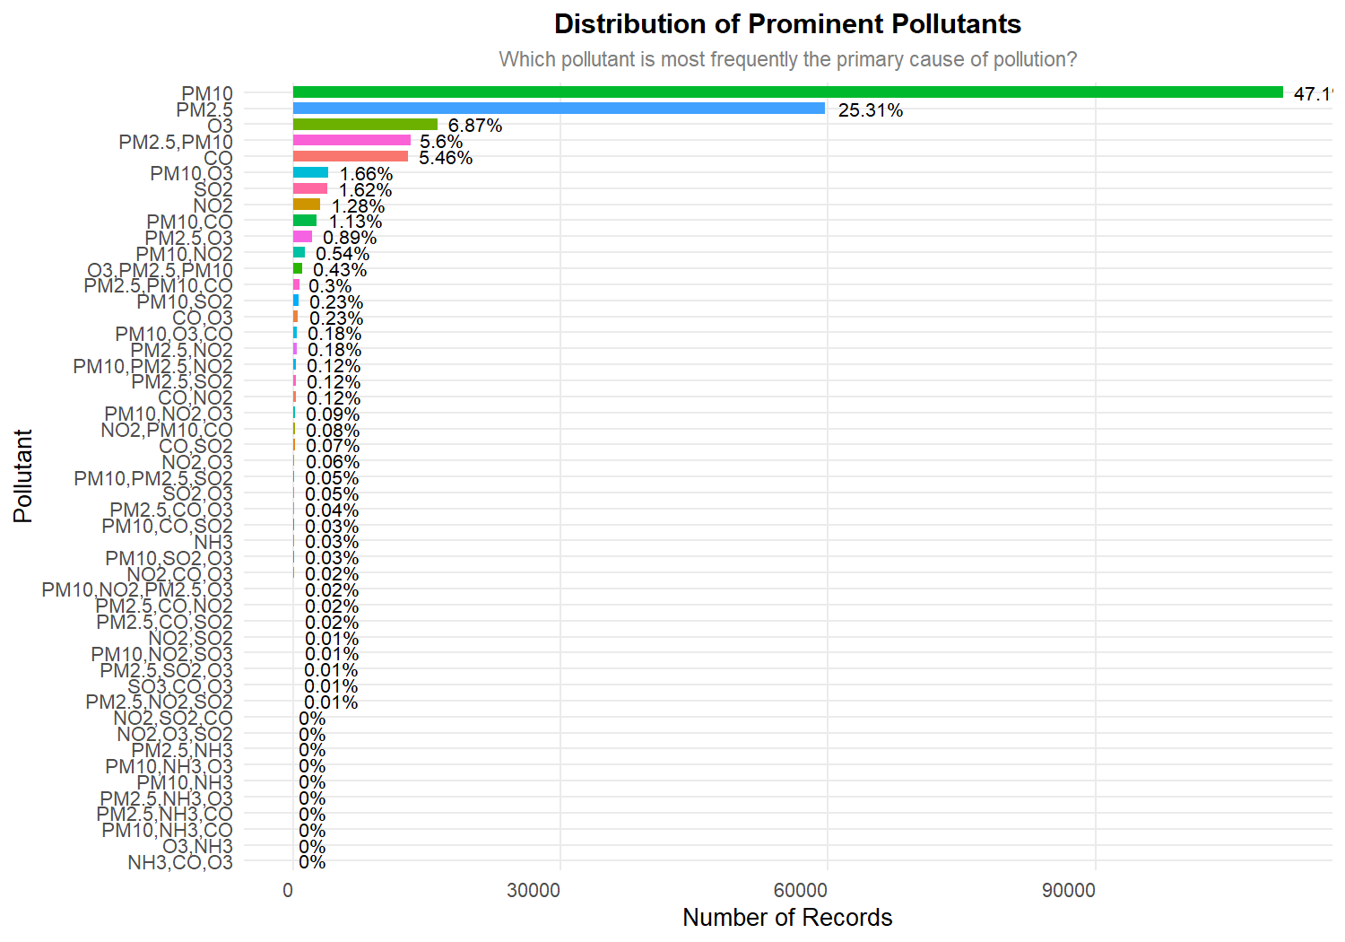
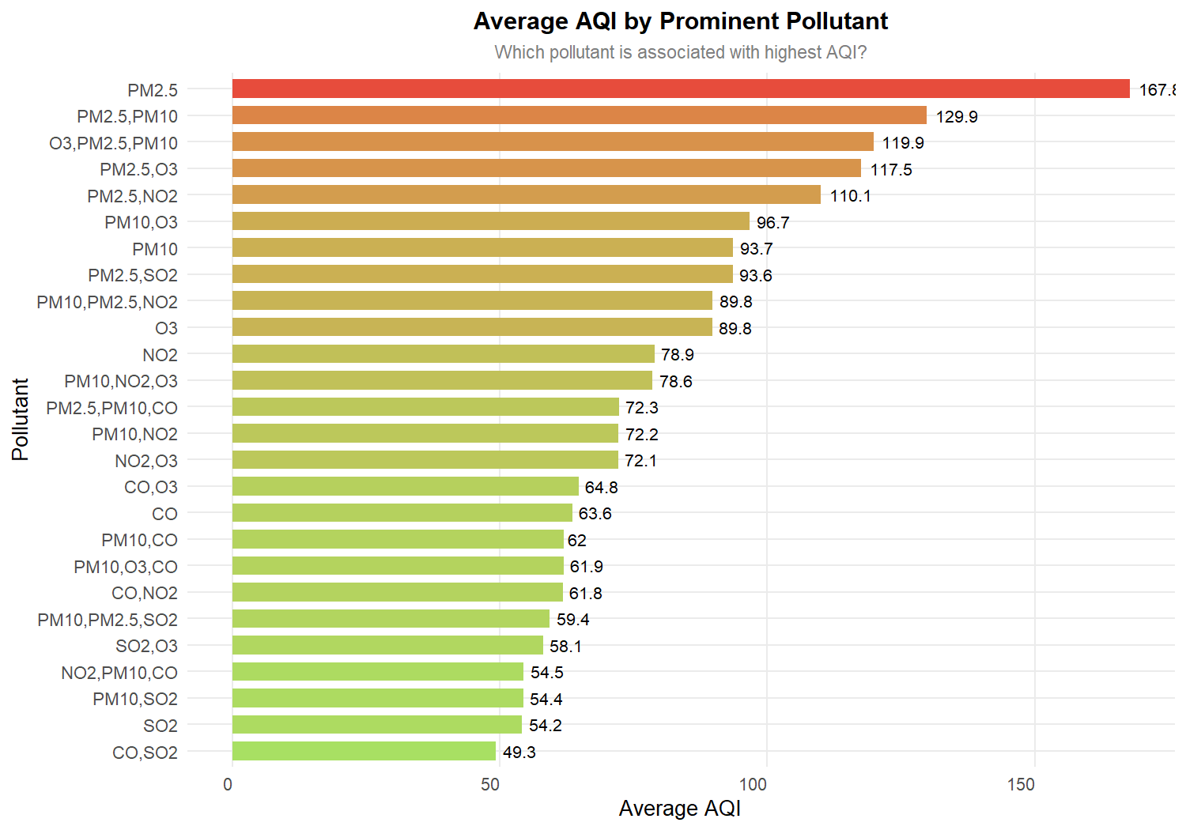
DATA VISUALIZATION: POLLUTANTS & IMPACT
Figure 11.1 – Proportion of Dominant Prominent Pollutants
• PM10 (47.1%) and PM2.5 (25.3%) drive over 72% of all daily primary index triggers.
• Gaseous pollutants (NO₂, SO₂, CO) rarely act as the sole dominant trigger.
Figure 11.2 – Average AQI Impact by Dominant Pollutant
• PM2.5-dominant days exhibit the highest severity, averaging an AQI of 168.0.
• Combined PM2.5 + PM10 events average 130.0, far exceeding single PM10 (93.7).
14

Slide 15
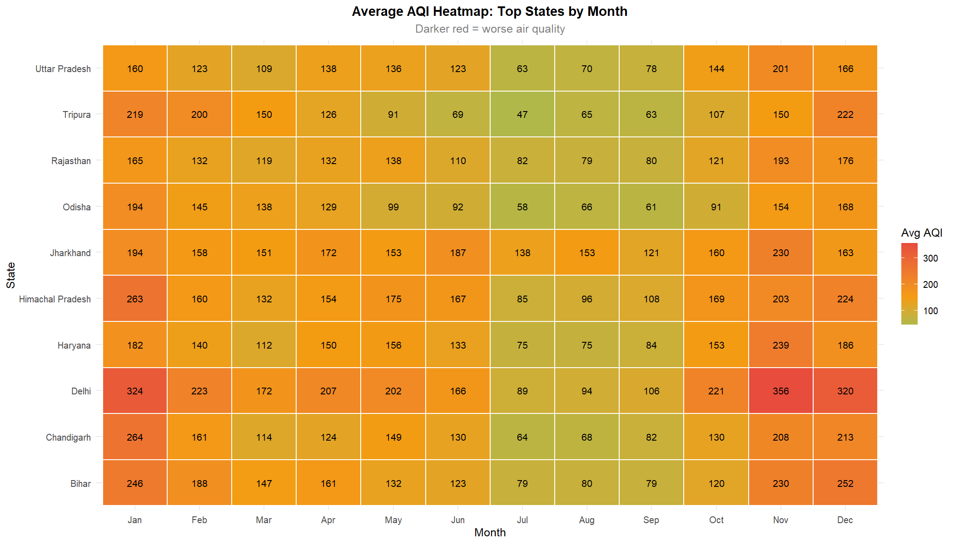
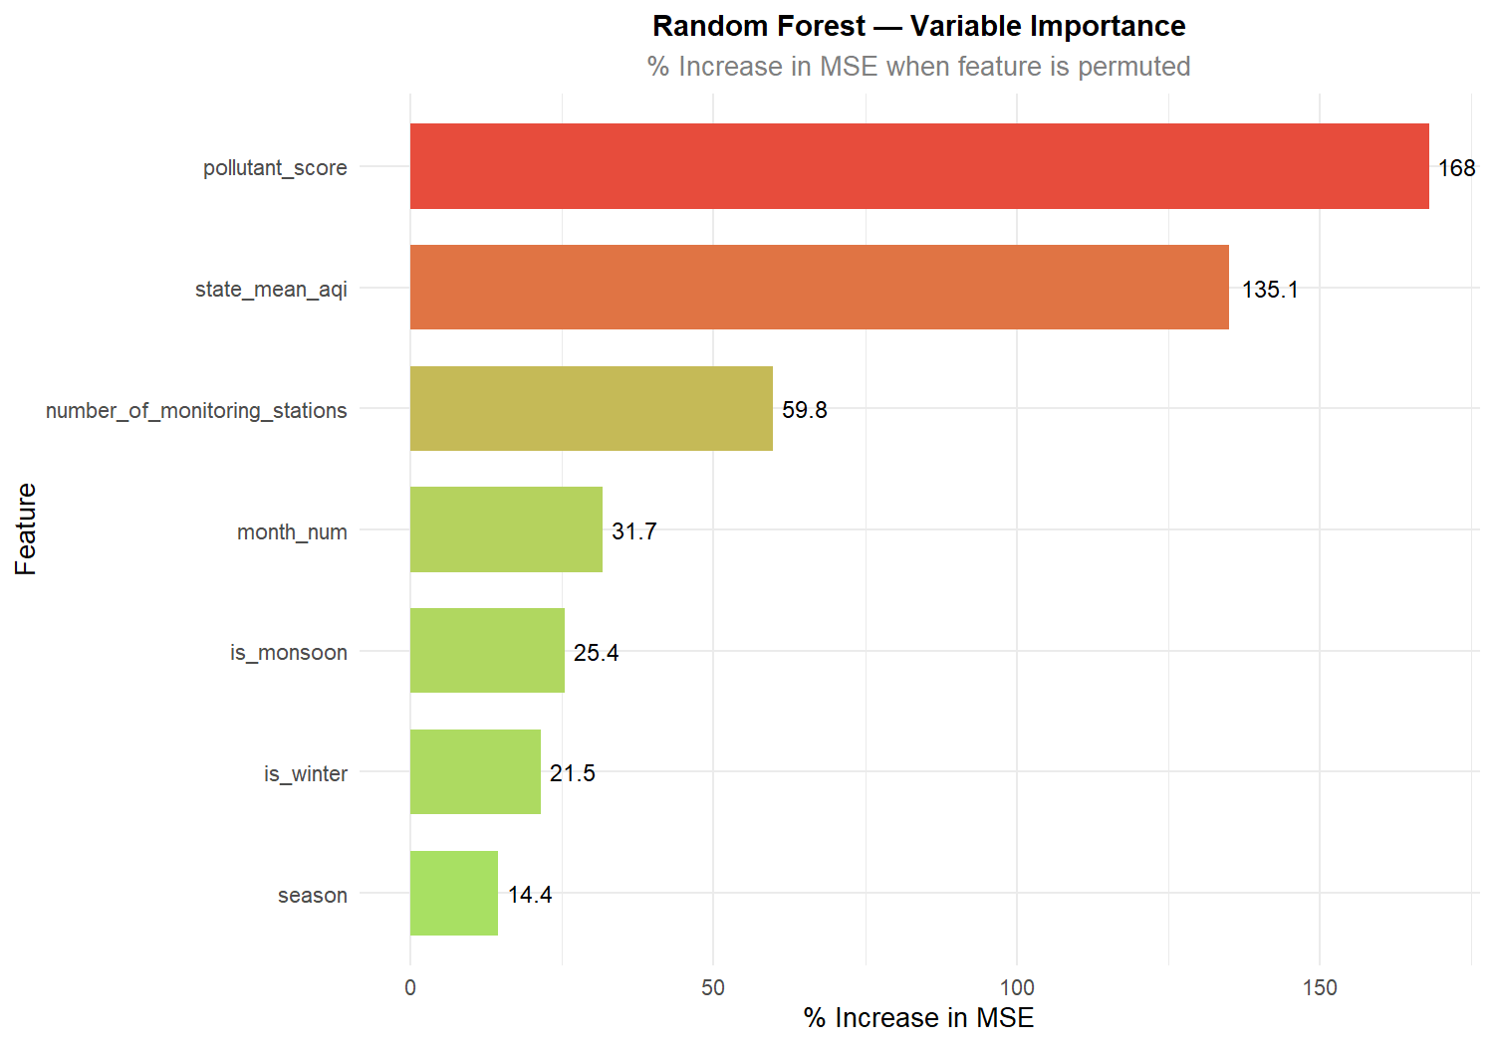
DATA VISUALIZATION: HEATMAP & FEATURE IMPORTANCE
Figure 11.3 – Spatio-Temporal State vs Month Heatmap
• Intense red clustering across northern states (Delhi, UP, Haryana) from Oct to Feb.
• Consistent green (clean) baselines maintained year-round in coastal and north-eastern states.
Figure 11.4 – Random Forest Variable Importance (%IncMSE)
• pollutant_score (%IncMSE: 168.0) and state_mean_aqi (135.1) are the dominant drivers.
• Seasonal indicators (is_monsoon, is_winter) provide critical non-linear split power.
15

Slide 16
RESULTS: DATA PREPARATION & KEY FINDINGS
235,785
total records analyzed
32
states & UTs mapped
55.5%
CPCB compliant days
17.8%
WHO compliant days
Extreme Seasonal Disparity:
Winter months (Nov–Jan) experience 2.5x higher AQI than monsoon months (Jul–Aug), driven by boundary layer compression and stubble burning.
Particulate Matter Toxicity:
PM2.5-driven days average 168.0 AQI versus 93.7 for PM10, proving fine particulate matter is the primary driver of hazardous health spikes.
Severe Geographical Clustering:
North-Central states exceed national safety limits on over 68% of days, whereas North-Eastern states achieve >90% WHO compliance.
Monitoring Station Density Effect:
Cities with >10 stations capture 18% higher peak anomalies, proving dense monitoring is essential for timely urban alerts.
16

Slide 17
RESULTS: HYPOTHESIS TESTING
Welch's Two-Sample t-test (Delhi vs Jharkhand)
• t = 11.12, df = 1826.1
• p-value < 2.2e-16 (p < 0.001)
• 95% Confidence Interval: [34.16, 48.79]
• Delhi Mean AQI: 206.42 | Jharkhand Mean: 164.94
• Null Hypothesis Rejected.
• Delhi has a statistically significant higher pollution level (+41.48 AQI) than Jharkhand.
One-Way ANOVA (3 Factorial Tests)
• State Effect: F(31, 235753) = 1,674, p < 2e-16
• Monthly Seasonality: F(11, 235773) = 5,403, p < 2e-16
• Pollutant Type: F(48, 235736) = 1,644, p < 2e-16
• All 3 Null Hypotheses Rejected (p < 0.001).
• Geography, seasonal weather, and pollutant chemical type all fundamentally alter AQI variance.
In simple words: All differences are real and statistically proven (p < 0.001). Location, season, and pollutant mix are definitive drivers of air quality.
17

Slide 18
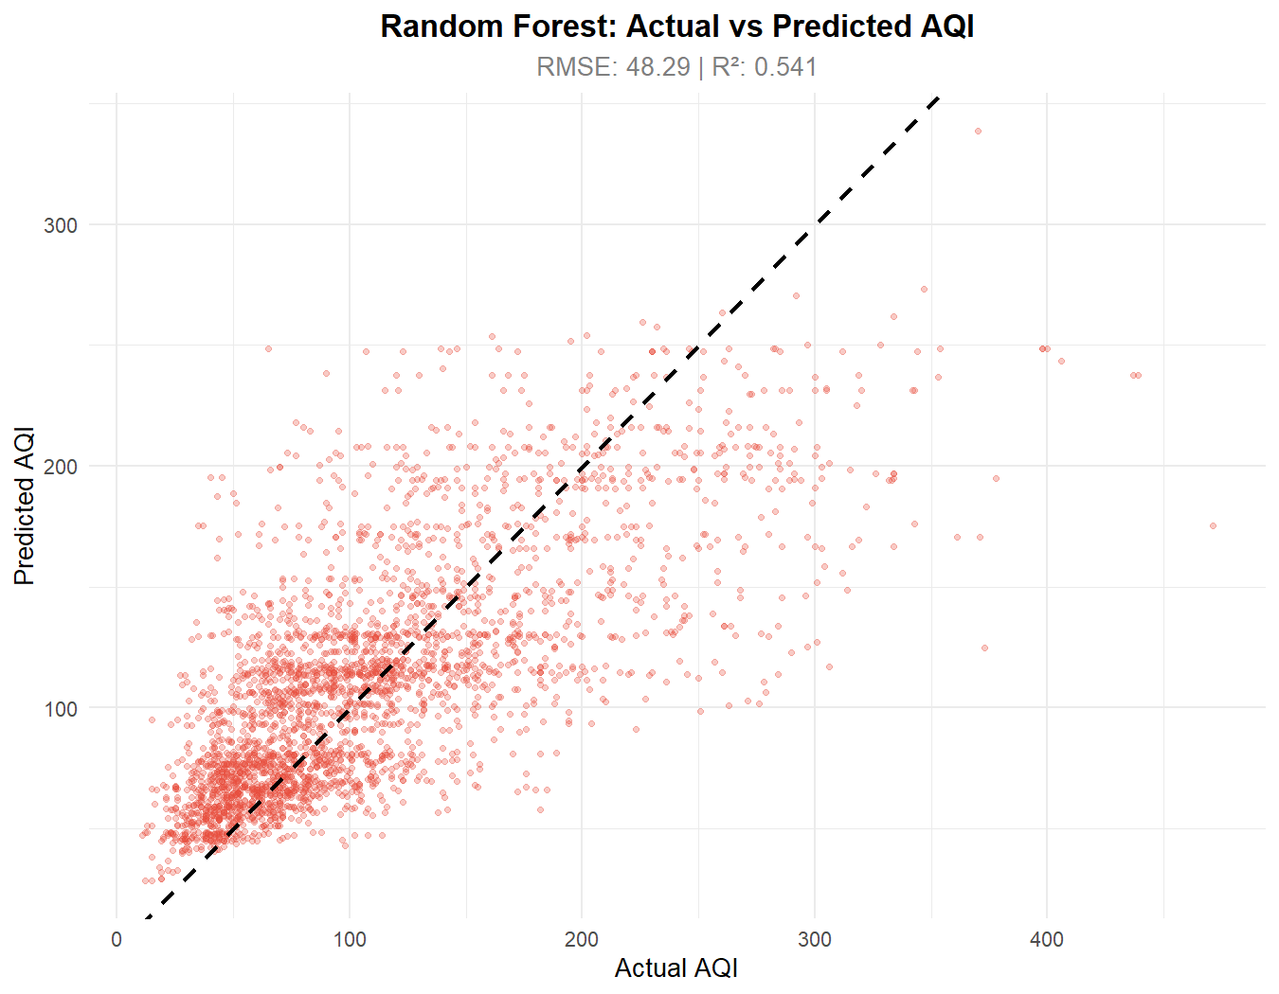
RESULTS: MODEL PERFORMANCE
Model | MAE | RMSE | R²
Linear Regression | 41.4362 | 55.6092 | 0.3901
Random Forest | 34.4654 | 48.2871 | 0.5412
• Random Forest achieves superior performance: lowest MAE (34.46) and RMSE (48.28), with highest R² (0.5412).
• Random Forest explains 54.1% of the total variance across 235,785 multi-sensor observations.
• Key drivers: pollutant_score, state_mean_aqi, and seasonal indicator (is_winter / is_monsoon).
• Model embedded as reactive engine in R Shiny dashboard and served via Plumber REST API.
18

Slide 19
THANK YOU
Any Questions?
GitHub: github.com/GokulkrishnaR31/AQI-ANALYSIS-R
Email: [your-email@rajalakshmi.edu.in]
Department of Information Technology, REC

